Slide 1
E T L Day-3 – Extraction
Cyrus Lentin

Slide 2
What Is Required?
Crucial To Know How To Extract The Data From The Source System
Each Source Has Distinctive Characteristics And Need To Be Managed Accordingly
Integration With Different Systems
Database Management System
Operating Systems
Hardware
Communication Protocols
It Is Important To Logically Map The Data From The Source Defining Different Fields

Slide 3
Extracting Data – Considerations
Understanding Data - Logical Data Map
Extracting Data From Disparate Platforms
Extracting Changed Data

Slide 4
Understanding Data – Logical Data Map
Logical Data Plan Before Physical Activity
Ensure The Following Steps Are Achieved Before You Start Any Physical ETL Development:
Have A Plan
Identify Data Source Candidates
Analyze Source Systems With A Data-profiling Tool
Receive Walk-though Of Data Lineage And Business Rules
Receive Walk-through Of Data Warehouse Data Model
Validate Calculations And Formulas

Slide 5
Components Of Logical Data Map
Table Name
Column Name
Table Type (Fact, Dimension, Sub Dimension, Supporting Etc)
Slow Changing Dimension Type (Applicable For Dimension Tables)
Source Database To Get This Information From
Source Table
Source Column Name
Transformation Required (If Any)

Slide 6
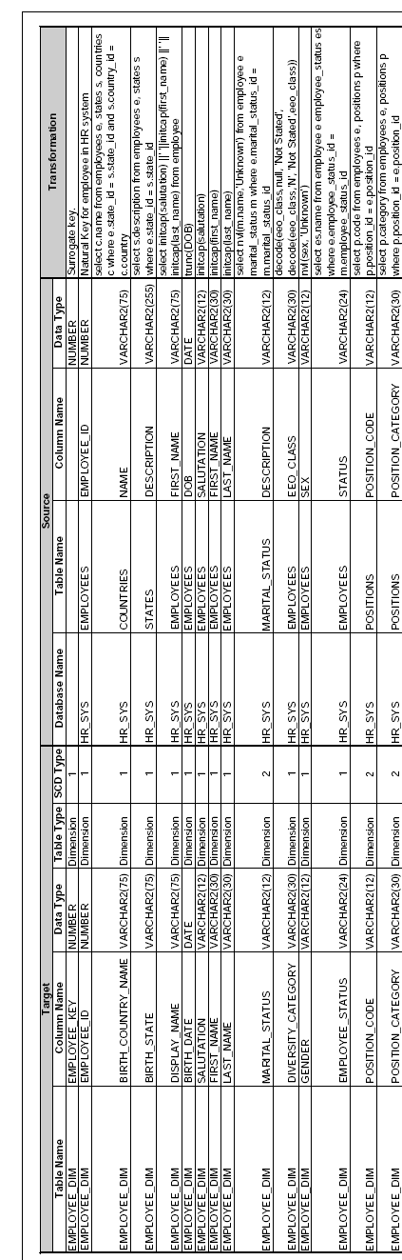
Logical Data Map Report

Slide 7
Important Factors Of Loading
Important Factor To Be Considered When Loading The Dimension Tables
Structure Of The Dimension Table Cannot Tell What The Strategy Is
Columns Have Historic Relevance And The Strategy Required For Capturing This History Should Be Known In Advance
Changing The SCD After The Design Should Be Managed Well Through A Change Management Process
SCDs Data Changes Slowly, Rather Than Changing On Regular Schedule
Example:
City
Country

Slide 8
Slowly Changing Data (SCD)
Type 0 Passive Values remain same for ever
Type 1 Allows new data to overwrite old data So not required to track the history
Type 2 Tracks historical data by creating multiple records for a given natural key in the dimensional tables with separate surrogate keys and/or different version numbers
Type 3 Tracks changes using separate columns and preserves limited history
Type 4 Maintains older data in separate history tables
Type 5 Also called hybrid It is a combination of 2 or more of the above methods

Slide 9
Building Logical Data Map
Logical Data Mapping Not Possible Until The Source Systems Have Been Identified And Analyzed
The Analysis Of The Source System Is Usually Broken Into Two Major Phases:
Data Discovery Phase
Collecting and Documenting Source Systems – Entity Relationship Diagram
Keeping Track of the Source Systems – Source System Tracking Report
Anomaly Detection Phase
Data Content Analysis
Collecting Business Rules
Collecting Heterogenous Data

Slide 10
Entity Relationship Diagram
Unique Identifiers And Natural Keys
Data Types
Relationships Between Tables
Discrete Relationships
Cardinality Of Relationships And Columns
One-to-one
One-to-many
Many-to-many
Important
Referential Key Integrity
Data Type Issues Between Source & ETL

Slide 11
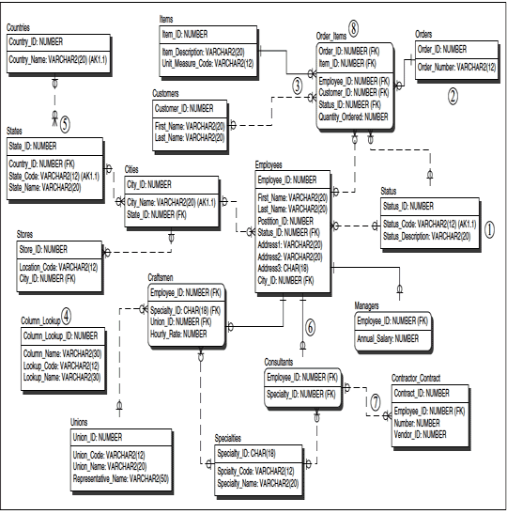
Entity Relationship Diagram

Slide 12
Source System Tracking Report
Subject Area
Interface Name
Business Name
Priority
Department / Business Use
Business Owner
Technical Owner
DBMS
Platform
Daily Users Count
Db Size
Transactions Per Day
Comments

Slide 13
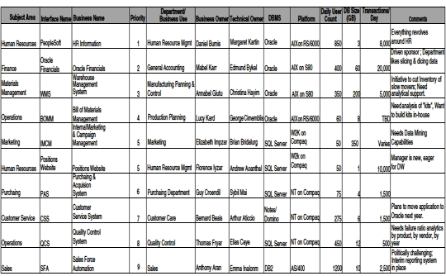
Source System Tracking Report

Slide 14
Data Content Analysis
Referential Key Integrity
Data Type Issues Between Source & ETL
NULL Values
Date Values

Slide 15
Business Rules
Status
Flags
Labels
Classification
Important
Undocumented

Slide 16
Integrating Heterogeneous Data Sources
Identify the source systems
Understand the source systems (data profiling)
Create record matching logic
Establish survivorship rules
Establish non-key attribute business rules
Load conformed dimension

Slide 17
Extracting Data from Disparate Platforms
ODBC
Mainframe
Flat Files
XML
Web Logs
ERP Systems

Slide 18
O D B C
Open Database Connectivity (ODBC)
Was created to enable users to access databases from their applications retrospective of the OS
The original intention for ODBC was to make applications portable, meaning that if an application’s underlying database changed—say from DB2 to Oracle—the application layer did not need to be recoded and compiled to accommodate the change
Instead, you simply change the ODBC driver, which is transparent to the application You can obtain ODBC drivers for practically every DBMS in existence on virtually any platform You can also use ODBC to access flat files
Advantage
Flexibility
Interoperability
Drawback
Performance
DBMS Based Commands

Slide 19
Mainframe
In Many Large Companies, Much Of The Day-to-day Business Data Is Processed And Stored On Mainframe Systems (And Certain Minicomputer Systems, Such As The IBM AS/400) And Integrating Data From These Systems Into The Data Warehouse Involves Some Unique Challenges
Mainframes Have A Special Architecture Emphasizing Peripheral Channels That Process All Input/Output, Leaving The CPU Dedicated To Processing Only Data, Such As Calculating Formulas And Balances
There Are Several Characteristics Of Mainframe Systems That The ETL Team Must Be Familiar With And Develop Techniques To Handle:
COBOL Datasets
EBCDIC Character Sets
Numeric Data
Packed Decimal Fields
Multiple Record Types
Variable Record Lengths

Slide 20
Flat Files
Flat files are the mainstay of any data-staging application
Flat files are utilized by the ETL process for at least three reasons:
Delivery Of Source Data
Working / Staging Tables
Preparation For Bulk Load
Flat files essentially come in two flavors:
Fixed length
Delimited

Slide 21
Flat Files – Pre Validation
Fixed Length Flat Files – Pre Validation
Validate That The Positions Of The Data In The File Are Accurate
Check For The Positions Is To Test Any Date (Or Time) Field To Make Sure It Is A Valid Date
If The Positions Are Shifted, The Date Field Most Likely Contains Alpha Characters Or Illogical Numbers
Other Class / Category / Status / Flags Fields With Can Be Tested In The Same Way
Positional Flat Files Are Often Indicated On The File System By A TXT Extension
Positional Flat Files Can Have Virtually Any File Extension—or None At All
Delimited Files – Pre Validation
Validate That The Delimiters In The File Are In Order
Check For The Delimiters To Test Any Date (Or Time) Field To Make Sure It Is A Valid Date
If The Delimiters Are Shifted, The Date Field Most Likely Contains Alpha Characters Or Illogical Numbers
Other Class / Category / Status / Flags Fields With Can Be Tested In The Same Way
Delimited Files Are Often Indicated On The File System By A CSV Extension
Delimited Files Also Can Have Virtually Any File Extension—or None At All
Must Have Explicit Validation Tests Written By The ETL Team And Embedded In The ETL Routines

Slide 22
X M L
Extensible Markup Language (XML) Is Slowly But Surely Becoming The Standard For Sharing Data
XML Has Emerged To Become A Universal Language For Exchanging Data Between Enterprises
If Your Data Warehouse Includes Data That Comes From External Sources—those From Outside Of Your Enterprise—odds Are That Those Sources Will Be Provided In XML
XML Has Two Important Elements:
Metadata
Data
Xml Considerations
Character Sets
Character Sets Are Groups Of Unique Symbols Used For Displaying And Printing Output
Default Character Set For Most Relational Database Management Systems Is Iso8859-15 (Latin 9)
XML Supports The Utf-8 Character Set UTF-8 Supports Most Of The Languages And Alphabets
XML Meta Data
XML Schema
Namespace
Always Use XML Reader Ensure ETL Tool Can Natively Process XML And XML Schemas

Slide 23
Web Logs
Web logs are line records of every request to & response from the Web server
Web logs are important because they reveal the user traffic & many other details on the Web site
Fortunately, the format of the text-based log is standardized by W3C
W3C Common Format
Date
client-ip
server-ip
method
url
query
protocol
sc-status
user-agent
referrer
W3C Extended Formats
log-server
username
server-port
time-taken

Slide 24
ERP Systems
ERP systems were created to solve one of the issues that data warehouses face today—integration of heterogeneous data
ERP systems are designed to be an integrated enterprise solution that enables every major entity of the enterprise, such as sales, accounting, human resources, inventory, and production control, to be on the same platform, database, and application framework
ERP systems are extremely complex and not easily implemented They take months or years to customize so they contain the exact functionality to meet all of the requirements to run a particular business
ERP systems are notoriously large, and because they are really a framework and not an application, their data models are comprehensive, often containing thousands of tables
Moreover, because of their flexibility, the data models that support ERP processing are incredibly difficult to navigate
Inspite of the effort to be an all-inclusive solution, it’s very rare to see an entire enterprise use only an ERP system to run a company
The more popular ERP systems are SAP, PeopleSoft, Oracle, Baan, and JDEdwards
Many of the major ETL vendors now offer ERP adapters to communicate with the popular ERP systems

Slide 25
Extracting Changed Data
The initial load of ETL is easy
Once that load is complete, the ability to capture data changes in the source system becomes priority
Capturing data changes is very complicated task
You must plan your strategy to capture incremental changes to the source data at the onset
Steps Involved
Detecting Changes
Extraction Tips
Detecting Deleted or Overwritten Fact Records at the Source

Slide 26
Detecting Changes
Using Audit Columns
Database Log Scraping Or Sniffing
Timed Extracts
Process Of Elimination
Initial And Incremental Loads

Slide 27
Header
Bullets

Slide 28
Extraction Tips
Use DISTINCT Sparingly
Use SET Operators Sparingly
Use HINT / EXPLAIN As Necessary
Avoid Not
Avoid Functions In Your Where Clause

Slide 29
Detecting Deleted Or Overwritten Fact Records At The Source
Measurement (fact) records deleted or overwritten from source systems can pose a very difficult challenge for the data warehouse if no notification of the deletion or overwrite occurs.
Since it is usually infeasible to repeatedly re-extract old transaction records, looking for these omissions and alterations, the best we can offer are the following procedures:
Negotiate with the source system owners, if possible, explicit notification of all deleted or overwritten measurement records.
In cases of deleted or modified fact records, rather than just performing a deletion or update in the data warehouse, a new record is inserted that implements the change in the fact by canceling or negating the originally posted value. In many applications, this will sum the reported fact to the correct quantity (if it is additive) as well as provide a kind of audit trail that the correction occurred.
Periodically check historical totals of measurements from the source system to alert the ETL staff that something has changed. When a change is detected, drill down as far as possible to isolate the change.
In these cases, it may also be convenient to carry an extra administrative time stamp that identifies when the database actions took place.

