Slide 1
E T L Day-4 – Cleaning & Conforming
Cyrus Lentin

Slide 2
Cleaning & Conforming
Cleaning And Conforming Are The Main Steps Where The ETL System Adds Value
The Other Steps Of Extracting And Delivering Only Move And Reformat Data
Cleaning And Conforming Actually Changes Data
This Provides Guidance Whether Data Can Be Used For Its Intended Purposes
Cleaning & Conforming Process:
Design Objectives
Cleaning Deliverables
Checks and Their Measurements
Conforming Deliverables
Three Deliverables:
Data Profiling Report
Error Report
Audit Report
A Powerful Cleaning And Conforming System Is Built Around These Three Tangible Deliverables

Slide 3
Design Objectives
Understand Stake-Holders
Data Warehouse Manager
Business Owner
Technical Owner
Dimension Manager (Master Record Department)
Fact Table Provider (Transaction Record Department)
Design Objectives
Thorough
Fast
Corrective
Transparent
Balancing Conflicting Priorities
Completeness v/s Speed
Corrective v/s Transparent
Data Quality

Slide 4
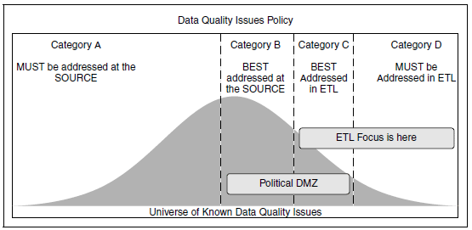
Defining Data Quality
Data Must Be Accurate
Correct
Unambiguous
Consistent
Complete
All Fields Defined
All Records Present
Data Quality Policy
Category A Missing Info Of Customer / Vendor
Category B Missing Info Of Customer / Vendor
Category C Missing Or Incomplete Information From Independent Third-party Data Suppliers
Category D Missing Or Incomplete Information From Independent Third-party Data Suppliers

Slide 5
Cleaning Deliverables
Cleaning Deliverables Sub-system Should Offer The Following Data-quality Insights:
Is Data Quality Getting Better Or Worse?
Which Source Systems Generate The Most/Least Data-quality Issues?
Are There Interesting Patterns Or Trends Revealed In Scrutinizing The Data-quality Issues Over Time?
Is There Any Correlation Observable Between Data-quality Levels And The Performance Of The Organization As A Whole?
Also Should Be Able To Answer:
Which Of My Data-Quality Checks Consume The Most/Least Time In My ETL Window?
Are There Data Quality Checks That Can Be Retired Because The Types Of Issues That They Uncover No Longer Appear In Our Data?
Deliverables
Data Profiling Report
Error Report
Audit Report

Slide 6
Checks and Their Measurements
Detailed Design Stage
Contains A Set Of Fundamental Checks And Tests At The Core Of Most Data-cleaning Engines
It Describes What These Functions Do, How They Do It
It Describes How They Build Upon One Another To Deliver Cleaned Data
Anomaly Detection
A Data Anomaly Is A Piece Of Data That Does Not Pass The Data Quality Test
Finding Data Anomalies May Be Perceived By Some Outside The ETL Scope
Detecting Data Anomalies Will Be The Responsibility Of The ETL Team
Anomaly Detection
All Records
Data Sampling

Slide 7
Checks and Their Measurements
Types Of Checks
Column Property Checks
Structure Checks
Data Checks
Value Checks
Based On The Findings Of These Checks, The ETL Job Stream Can Choose To:
Pass The Record With No Errors
Pass The Record, Flagging Offending Column Values
Reject The Record
Stop The ETL Job Stream

Slide 8
Conforming Deliverables
Incoming Data Needs To
Be Made Structurally Identical
Filtered Of Invalid Records
Standardized In Terms Of Its Content
De-duplicated
Converted Into The New Conformed Image
Process For Building Conformed Data
Standardizing
Deduplication
Surviving

Slide 9
Standardizing
Descriptive Attributes Vary Across Multiple Data Sources
These Are Not Errors But Variations Of Good Data
Standardizing Is Capturing & Correcting These Variations
The Corrections Should Be Based On The Requirements Of The Target System
Data Validation & Correction As Require By The Target System

Slide 10
Matching & Deduplication
Matching, or deduplication, involves the elimination of duplicate standardized records
Duplicate can be easily detected through the appearance of identical values in some key column—like social security number, telephone number, or charge card number
In other cases, no such definitive match is found, and the only clues available for deduplication are the similarity of several columns that almost match
Specialized data integration matching tools are now mature and in widespread use and deal with these very specialized data-cleansing issues
The matching software must compare the set of records in the data stream to the universe of conformed dimension records and return:
A numeric score that quantifies the likelihood of a match
A set of match keys that link the input records to conformed dimension instances
Organizations with a need for very robust deduplication capabilities can choose also to maintain a persistent library of previously matched data & use this consolidated library to improve their results

Slide 11
Surviving
Survivorship Refers To The Process Of Creating / Filtering A Set Of Standardized & Deduplicated Records
Surviving Data Is Filtered Into A Separate Table That Combines The Column Values From Each Of The Records To Build Conformed Target Records For Fact Or Dimension Tables
This Entails Establishing Business Rules That Must Applied When Writing Out For Survived Records
Source-To-Target Mapping (eg Validation Of State Names, Categories, Class, Etc)
Survivorship Block Of Records (for master-detail type of transaction, ensure record(s) present)

Slide 12
Data Profiling Report
Good Data Profiling Analysis Takes The Form Of A Specific Metadata Repository Describing:
Schema Definitions
Business Objects
Domains
Data Sources
Table Definitions
Synonyms
Data Rules
Value Rules
Issues That Need To Be Addressed

Slide 13
Error Report
Each Data-quality Error Or Issue Surfaced By The Data-cleaning Subsystem Is Captured As A Row In The Error Report
The Attributes Of The Error Report Are As Follows:
Error Date / Time
ETL Stage
Processing Order Number
Severity Score
Exception Action
Error
SQL Statement

Slide 14
Audit Report
To Associate Data-quality Indicators With The Final Tables As Per The Target System, We Need To Build A Table Wise Audit Report.
The Audit Report Is Prepared For Each Table In The Target System
The Audit Report Captures Important ETL Processing Milestone Like
Timestamps
Outcomes
Significant Errors
Correction
Frequency Of Error Occurrence
Overall Data-quality Score
Audit Reports Are Created As The Final Step Of The Processing For Cleaned And Conformed Tables And Must Contain A Description Of The Fixes And Changes That Have Been Applied
Audit Report Must Be Prepared For Each ETL Job
Audit Report Must Be Circulated To Business Owners & Technical Owners Of Source & Target System

Slide 15
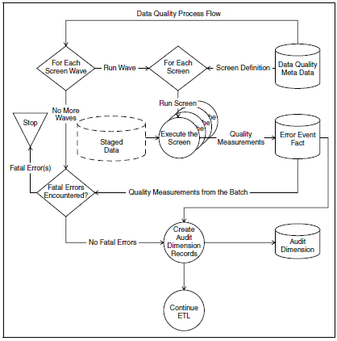
Data Quality Process Flow

