Slide 1
E T L Day-5 – Delivery / Loading
Cyrus Lentin

Slide 2
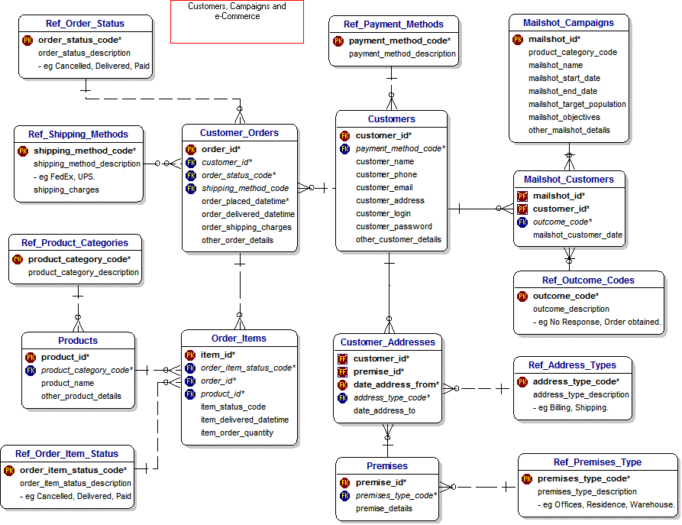
Snowflake Schema – Typical RDBMS Architecture

Slide 3
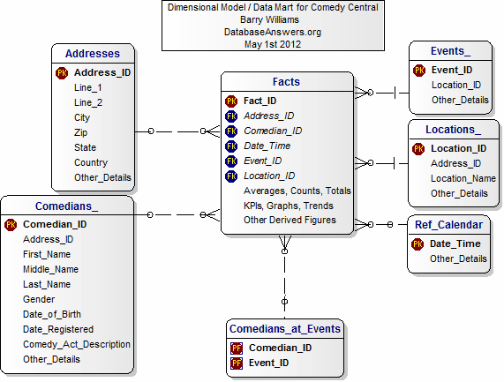
Star Schema – Typical BI-Tool Architecture

Slide 4
Star Schema – Typical BI-Tool Architecture
 | Star Schema | Snowflake Schema
Ease of maintenance | Has redundant data and hence difficult to maintain / change | No redundancy, so snowflake schemas are easier to maintain and change
Ease of Use | Less query complexity and easy to understand | More complex queries and hence difficult to understand
Query Performance | Less number of foreign keys and hence shorter query execution time (faster) | More foreign keys and hence longer query execution time (slower)
Type of Data Warehouse | Good for DataMart’s with simple relationships (1:1 or 1:many) | Good to use for data warehouse with complex relationships (many:many)
Joins | Less Joins | Higher number of Joins
Normalization / DeNormalization | Both Dimension and Fact Tables are in De-Normalized form | Dimension Tables are in Normalized Fact Tables Are De-Normalized

Slide 5
Measures / Fact Tables
Fields Which Contain Numeric Values
Reside In Fact Tables
Calculations Made Over Number Of Records In A Data Set
Measures Get Aggregated … Sum, Count, Min, Max, Etc
Measure Alone Cannot Provide Insight With Point Of Reference Or Contextual Reference
A Measure Is A Property On Which Calculations & Aggregations (Sum, Count, Average, Minimum, Maximum) Can Be Made
For Example If Retail Store Sold A Specific Product, The Quantity And Prices Of Each Item Sold Could Be Added Or Averaged To Find The Total Number Of Items Sold And Total Or Average Price Of The Goods Sold

Slide 6
Dimensions
Categories / Classification Of Data
Reside In Dimension Tables
Dimensions Provide Structured Labeling Information To Otherwise Unordered Numeric Measures
A Dimension Is A Structure That Categorizes Measures To Enable Users To Answer Business Questions
A Dimension Is A Dataset Composed Of Individual, Non-overlapping Data Elements
The Primary Functions Of Dimensions Are Threefold:
Labelling
Filtering
Grouping
Commonly Used Dimensions Are People, Products, Place, Time, Category or Classification
Contains Textual Description To Provide Context To The Measures
Quantity Sold By Department X
Revenue By Product A
Measures Can Aggregated For Each Dimension
Quantity Sold By Each Department
Revenue By Each Product

Slide 7
Dimension Tables
Dimension Tables Provide The Context For Fact Tables
Dimension Tables Are Usually Much Smaller Than Fact Tables
Dimension Tables Are Crux Of The Data Warehouse
They Provide Entry Points To Listing / Filtering / Grouping Data
A Data Warehouse Is Only As Good As Its Dimensions

Slide 8
Star Scheme Compatibility
Dimension tables should be denormalized flat tables.
All hierarchies & normalized structures that may be present in earlier staging tables should be flattened
All attributes in a dimension must take on a single value in the presence of the dimension’s primary key.
If all the proper data relationships have been enforced in the data-cleaning step, these relationships are preserved perfectly in the flattened dimension table.

Slide 9
Dimension Considerations
Date / Time
Big Dimensions
Small Dimensions
One Dimension or Two
Dimensional Roles
Degenerate Dimensions
Slowly Changing Dimensions
All data structures in the ETL, including flat files, XML data sets, and entity-relation schemas, we transform the structures into dimensional schemas to prepare for the final data-presentation step

Slide 10
Fact Tables
Every Fact Table Is Defined By The Measures
The Fact Table Must State How The Measurement Is Taken In The Physical World
All Fact Tables Possess A Set Of Foreign Keys Connected To The Dimensions That Provide The Context Of The Fact Table Measurements
Most Fact Tables Also Possess One Or More Numerical Measurement Fields, Which We Call Facts
Fact Tables Almost Always Have At Least Three Dimensions, But Most Fact Tables Have More
Virtually Every Fact Table Has A Primary Key Defined By A Subset Of The Fields In The Table

Slide 11
Basic Structure
Every Fact Table Is Defined By The Grain (Functionality) Of The Table
The Grain Of The Fact Table Is The Definition Of The Measurement Event
The Grain Of The Fact Table Shows How The Measurement Is Taken In The Physical World.
This Grain Can Be Expressed As Dimension Foreign Keys And Possibly Other Fields In The Fact Table
All Fact Tables Possess A Set Of Foreign Keys Connected To The Dimensions That Provide The Context Of The Fact Table Measurements
Most Fact Tables Also Possess One Or More Numerical Measurement Fields, Which We Call Facts
Some Fact Tables Possess One Or More Special Dimension Like Fields Known As Degenerate Dimensions. Degenerate Dimensions Exist In The Fact Table, But They Are Not Foreign Keys
Types Of Fact Tables
Transactional
Snapshot

Slide 12
Guaranteeing Referential Integrity
No Fact Table Record Should Contains Corrupt Or Unknown Foreign Key References
There Are Only Two Ways To Violate Referential Integrity In A Dimensional Schema:
Load A Fact Record With One Or More Bad Foreign Keys
Delete A Dimension Record Whose Primary Key Is Being Used In The Fact Table
Areas Where Referential Integrity Can Be Enforced:
Just Before Loading The Fact Table Records Into The Final Tables, Coupled With Deleting Any Dimension Records
Enforcement Of Referential Integrity In The Database Itself At The Moment Of Every Fact Table Insertion And Every Dimension Table Deletion
Discovery And Correction Of Referential Integrity Violations After Loading Has Occurred By Regularly Scanning The Fact Table, Looking For Bad Foreign Keys

Slide 13
Loading Data
Preparation For Loading Fact Tables
Managing Indexes
Managing Partitions
Rollback Log
Loading the Data
Inserting Facts
Updating and Correcting Facts
Negating Facts
Updating Facts
Deleting Facts
Incremental Loading

Slide 14
Structural Modifications
Structural Modifications:
Adding A Fact To An Existing Fact Table
Adding A Dimension To An Existing Fact Table
Adding An Attribute To An Existing Dimension
Increasing The Granularity Of Existing Fact Tables

Slide 15
Aggregations
The single most dramatic way to affect performance in a large data warehouse is to provide a proper set of aggregate (summary) records that coexist with the primary base records.
Aggregates can have a very significant effect on performance, in some cases speeding queries by a factor of a hundred or even a thousand.
No other means exist to harvest such spectacular gains.
IT owners of a data warehouse should exhaust the potential for performance gains with aggregates before investing in major new hardware purchases.
The benefits of a comprehensive aggregate-building program can be realized with almost every data warehouse
Design Requirements
Aggregates Must Be Stored In Their Own Fact Tables, Separate From Base-level Data. Each Distinct Aggregation Level Must Occupy Its Own Unique Fact Table
Aggregate Fact Tables Must Be Same Or Shrunken (Less Columns) Versions Of The Base Fact Table Some Dimensions Should Be Removed. Definitely No New Dimensions Added
The Base Fact Table And All Its Related Aggregate Fact Tables Can Be Associated Together As A Family Generally Done Using A Common Prefix To The Base Fact & Aggregated Fact Tables
End User Applications Must Refer Exclusively To The Base Fact Table Never The Aggregated Fact Tables

