Slide 1
E T L Day-6 – Talend Install Guide
Cyrus Lentin

Slide 2
Talend Download
Link https://www1.talend.com/download/talend-open-studio#t4-gs
Select The Latest Stable Version TOS_DI-Win32-20161216_1026-V6.3.1.exe
Download from US / Europe link on the right most column.
https://www.talendbyexample.com/installing-talend.html

Slide 3
Talend Installation
Installation
Run As Admin The Latest Stable Version Downloaded
Use Default Options
On Windows, install in a directory C:\Talend
Note: does not work well with directory paths that contain spaces, so avoid Program Files
Starting Talend
If 32-bit H/W & 32-bit OS TOS_DI-win32-x86.exe
If 64-bit H/W & 32-bit OS TOS_DI-win32-x86.exe
If 64-bit H/W & 64-bit OS TOS_DI-win-x86_64.exe
Source: https://www.talendbyexample.com/installing-talend.html

Slide 4
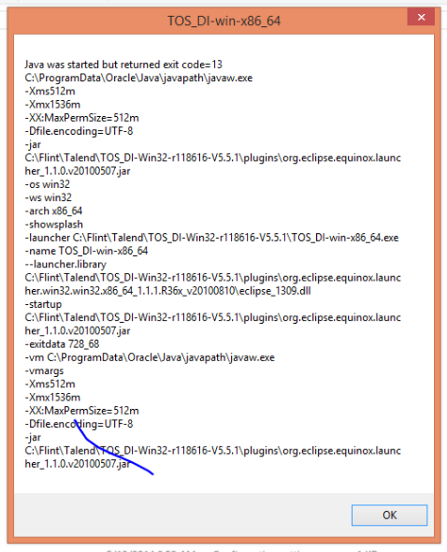
Talend Error
Errors
Java Has Started But Returned Exit Code = 1
Java Has Started But Returned Exit Code = 13
Probable Reasons
Java Installation Is Not Proper
Java Version Is Not Proper
Path To Java Not Available
In short, Java Related Issues
Solution – Install Java
If 32-bit H/W & 32-bit OS 32-bit Java
If 64-bit H/W & 32-bit OS 32-bit Java
If 64-bit H/W & 64-bit OS 64-bit Java
Talend v6.x.x requires Java 1.8.xx
Source: http://www.oracle.com/technetwork/java/javase/downloads/index.html

