Slide 1
E T L Day-7 – Talend Fundamentals
Cyrus Lentin

Slide 2
Talend
Visual Programming IDE For ETL Applications
Java Code Generator
600+ Connectors For Open And Proprietary Data Systems
Easily Embeddable In Custom Applications
Cross-platform
Central Metadata Repository
Available In Both Open Source And Premium Flavors

Slide 3
Talend Open Studio
IT’s The Open Source, Free To Use, Community-supported Version Of Talend For Data Integration
Often Abbreviated In “TOS”, To Differ From The Premium Version (“TIS”)
Features-lite, But Still Completely Usable
Same Set Of Connectors And Components Of The Premium Version
It Misses Team Working And Enterprise Capabilities Like SVN, Scheduling, Process Orchestrations And Monitoring Console

Slide 4
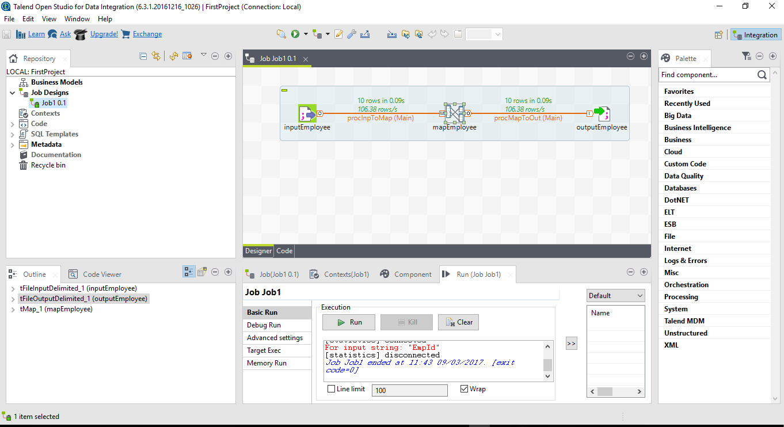
TOS – First Look

Slide 5
Designer
The Designer is the “canvas” where you’re “draw” your ETL job, connecting components to each others using different kinds of connectors.

Slide 6
Palette
The Palette pane hosts complete set of 600+ available components, both custom and built

Slide 7
Repository
The Repository pane hosts all the jobs and metadata info like DB connections credentials, external delimited file
schemas, parameters etc

Slide 8
Parameters
The Parameters pane hosts all the select-component settings, job settings and parameters, debug status and the diagnostic tab

Slide 9
Workspace
A Workspace Is A Container Of Projects Which Shares The Same TOS Version And The Same Components Palette
You Can Choose Which One To Use When The Program Starts
In TOS, It’s A Folder In The Local Drive

Slide 10
Business Diagrams
It stores diagrams used to conveniently describe business models and to embed them with ETL
It offers a small set of drawing capabilities in UML-fashion
It is not widely used, but it’s proven to be useful to quickly sketch-up transformation goals
It is also useful for auto documenting ETL

Slide 11
Repository
Repository Provides TOS With Preliminary Definition & Description Of Jobs & Metadata
There Are 8 Types Of Repositories
Important Repositories Are:
Business Models
Jobs
Contexts
Code
Metadata
SQL Templates

Slide 12
Projects
A Project Is A Set Of Jobs And Involved Metadata
It’s Defined Under A Subfolder Into The Workspace
All TOS Preferences Are Project-based
In Other Words, Different Projects In The Same Workspace Can Have Different Settings
Internally, It’s A Mix Of XML, .Items And .Properties Files

Slide 13
Jobs
It Is The Core Of TOS Repository
The Jobs Graphically Describes The Jobs
All Components Used In The Job Are Described Here Components – Connectors, Signals, Parameters, Colors And Presentation
Jobs Should Be Organized Properly For Better Clarity

Slide 14
My First Project – Problem Definition
Data File
Employee.csv
Extract
Read As Standard .CSV File
Transform
Rename Column Headers As Required In Target EmpId => EmpId Name => EmpName Dept => EmpDept Joined => JoinDate Salary => Salary
Convert EmpName & EmpDept Data To Upper Case
Load
Save As Standard .TDL File

Slide 15
My First Project – Steps / Procedure
Start Talend
Create New Project
Select / Open New Project
Copy Data In …/workspace/PROJECT/data folder
Create New Job
Select tFileInputDelimited
Select tMap
Select tFileOutputDelimited
Configure tFileInputDelimited
Edit Schema for tFileInputDelimited
Configure tFileOutputDelimited
Edit Schema for tFileOutputDelimited
Connect tFileInputDelimited & tMap
Connect tMap & tFileOutputDelimited
Map Individual Colums
Save Project & Run
Source: https://www.talendbyexample.com/my-first-talend-job.html

Slide 16
Assignment – Problem Definition
Data File
Catalog.csv | Catalog.dat | Catalog.json | Catalog.xml | Catalog.xls
Extract
Read as standard .csv file
Transform
Nil
Load
csv => dat / xml / xls / json
dat => csv / xml / xls / json
xml => csv / dat / xls / json
xls => csv / dat / xml / json
json => csv / dat / xml / xls

