Slide 1



Brand Name
Actionable insights from behavioural signals.

Slide 2


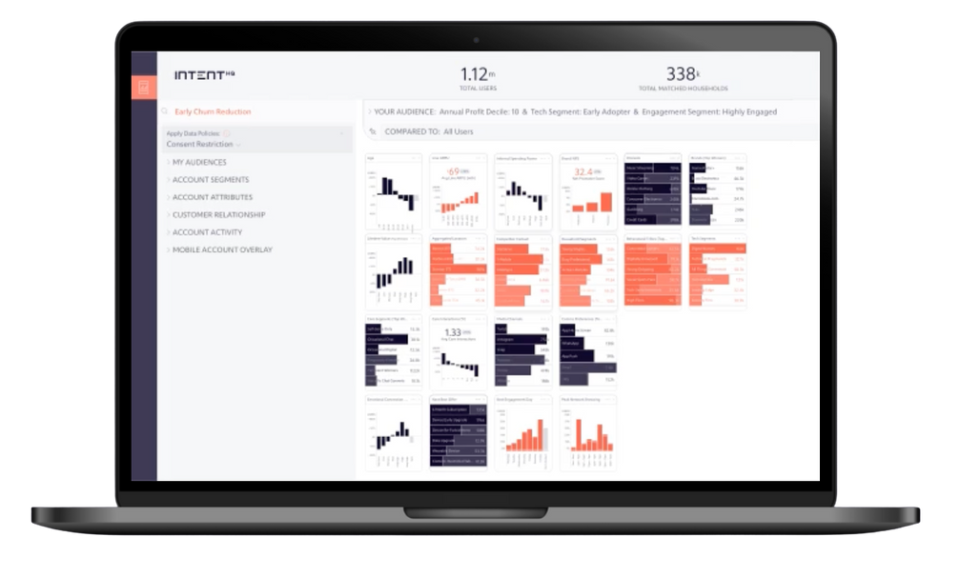
Agenda
The Shift
The Challenge
About IntentHQ
Platform Overview
The Solution
AoB & Next steps

Slide 3

The Shift
AI enables personalized experiences by tailoring products and services to individual needs and preferences. This creates a more relevant and engaging customer journey.AI enables personalized experiences by tailoring products and services to individual needs and preferences. This creates a more relevant and engaging customer journey.AI enables personalized experiences by tailoring products and services to individual needs and preferences. This creates a more relevant and engaging customer
AI algorithms analyze user data to provide personalized recommendations for products, content, and services. AI algorithms analyze user data to provide personalized recommendations for products, content, and services. AI algorithms analyze user data to provide personalized recommendations for products, content, and services. AI algorithms analyze user data to provide personalized
AI enables consumers to customize products based on their preferences, from color and size to features and functionality. AI algorithms analyze user data to provide personalized recommendations for products, content, and services. AI algorithms analyze user data to provide personalized recommendations for products, content, and services. AI algorithms analyze user data to provide personalized recommendations for products,
AI enables consumers to customize products based on their preferences, from color and size to features and functionality. AI algorithms analyze user data to provide personalized recommendations for products, content, and services. AI algorithms analyze user data to provide personalized recommendations for products, content, and services. AI algorithms analyze user data to provide personalized recommendations for products,

Slide 4
The Challenge
Pain Point 1 Pain Point 1 Pain Point 1 Pain Point 1
AI chatbots and virtual assistants provide personalized interactions, answering questions and resolving issues efficiently.AI chatbots and virtual assistants provide personalized interactions, answering questions and resolving issues efficiently.AI chatbots and virtual assistants provide personalized interactions,
AI can predict potential issues with products and services, enabling proactive support and minimizing downtime.AI chatbots and virtual assistants provide personalized interactions, answering questions and resolving issues efficiently.AI chatbots and virtual assistants provide personalized interactions, answering
AI analyzes customer feedback and sentiment, providing insights into customer satisfaction and areas for improvement.AI chatbots and virtual assistants provide personalized interactions, answering questions and resolving issues efficiently.AI chatbots and virtual assistants provide personalized interactions,

Slide 5
The Challenge
Pain Point 2 Pain Point 2 Pain Point 2 Pain Point 2
AI chatbots and virtual assistants provide personalized interactions, answering questions and resolving issues efficiently.AI chatbots and virtual assistants provide personalized interactions, answering questions and resolving issues efficiently.AI chatbots and virtual assistants provide personalized interactions,
AI can predict potential issues with products and services, enabling proactive support and minimizing downtime.AI chatbots and virtual assistants provide personalized interactions, answering questions and resolving issues efficiently.AI chatbots and virtual assistants provide personalized interactions, answering
AI analyzes customer feedback and sentiment, providing insights into customer satisfaction and areas for improvement.AI chatbots and virtual assistants provide personalized interactions, answering questions and resolving issues efficiently.AI chatbots and virtual assistants provide personalized interactions,

Slide 6
The Challenge
Pain Point 3 Pain Point 3 Pain Point 3 Pain Point 3
AI chatbots and virtual assistants provide personalized interactions, answering questions and resolving issues efficiently.AI chatbots and virtual assistants provide personalized interactions, answering questions and resolving issues efficiently.AI chatbots and virtual assistants provide personalized interactions,
AI can predict potential issues with products and services, enabling proactive support and minimizing downtime.AI chatbots and virtual assistants provide personalized interactions, answering questions and resolving issues efficiently.AI chatbots and virtual assistants provide personalized interactions, answering
AI analyzes customer feedback and sentiment, providing insights into customer satisfaction and areas for improvement.AI chatbots and virtual assistants provide personalized interactions, answering questions and resolving issues efficiently.AI chatbots and virtual assistants provide personalized interactions,

Slide 7




About IntentHQ
Privacy-Safe Signals
Intent HQ, is a visionary company redefining the landscape of AI and customer data analytics, firmly placing customer privacy at the heart of scalable, personalized marketing strategies and data monetisation.
Extract and enrich behavioural signals from first-party (and partner) data with privacy guaranteed.
Human-Like Insights
Turn those signals into productised, predictive “human-like” customer insights that teams can actually use.
In-the-Moment Engagement
Use on-device Edge AI to understand users beyond-the-app and trigger the best moment to engage, in real time.
Audiences at Scale
Operationalise insights into larger, smarter audiences and measurable outcomes across channels (connectors + activation).

Slide 8










About IntentHQ (contd.)
Research Chair in Consumer Behaviour
>$100M Technology Platform Investment
100+ Employees Across the World
120+ Customers Across Industries
37 Registered Patents
Trusted by Leading Global Organisations
Global Partnerships with Tech Leaders
Global Offices
United Kingdom
United States
Singapore
Spain
Portugal
United Arab Emirates

Slide 9

Platform Overview
INTENT LIFT
INTENT xCHANGE
INTENT EDGE
Intent Lift is an end-to-end solution that ingests internet-scale volumes of customer data. It identifies the signals in this data, turning them into productized customer insights that improve marketing and business outcomes, with privacy guaranteed.
Intent xChange is the world’s only global marketplace of privacy-safe insights. xChange provides a window onto the world’s data. You can safely monetize data to the xChange, access anonymized insights via Market Explorer, or enable your Insight Makers to create new insights.
Intent Edge helps marketers and data scientists personalize user experiences and offers based on an entirely new set of previously untapped behavioral insights from real users’ devices.

Slide 10
The Solution
Solution 1 Name Solution 1 Name Solution 1 Name
AI algorithms analyze user data to provide personalized recommendations for products, content, and services. AI algorithms analyze user data to provide personalized recommendations for products, content, and services. AI algorithms analyze user data to provide personalized recommendations for products, content, and services. AI algorithms analyze user data to provide personalized recommendations for
AI enables consumers to customize products based on their preferences, from color and size to features and functionality. AI algorithms analyze user data to provide personalized recommendations for products, content, and services. AI algorithms analyze user data to provide personalized recommendations for products, content, and services. AI algorithms analyze user data to provide personalized recommendations for products,
AI enables consumers to customize products based on their preferences, from color and size to features and functionality. AI algorithms analyze user data to provide personalized recommendations for products, content, and services. AI algorithms analyze user data to provide personalized recommendations for products, content, and services. AI algorithms analyze user data to provide personalized recommendations for products,

Slide 11
The Solution
Solution 2 Name Solution 2 Name Solution 2
AI algorithms analyze user data to provide personalized recommendations for products, content, and services. AI algorithms analyze user data to provide personalized recommendations for products, content, and services. AI algorithms analyze user data to provide personalized recommendations for products, content, and services. AI algorithms analyze user data to provide personalized recommendations for
AI enables consumers to customize products based on their preferences, from color and size to features and functionality. AI algorithms analyze user data to provide personalized recommendations for products, content, and services. AI algorithms analyze user data to provide personalized recommendations for products, content, and services. AI algorithms analyze user data to provide personalized recommendations for products,
AI enables consumers to customize products based on their preferences, from color and size to features and functionality. AI algorithms analyze user data to provide personalized recommendations for products, content, and services. AI algorithms analyze user data to provide personalized recommendations for products, content, and services. AI algorithms analyze user data to provide personalized recommendations for products,

Slide 12
AoB
&
Next Steps

