Slide 1


JIS College of Engineering (An Autonomous Institution) Final Year Project Abstract
“Novel approach of ear and face biometrics
in surveillance system and human motion”
Project Group Members: Debolina Das. Akash Pal. Avinandan Sau. Sukanta Sharma.
GUIDED BY:
Nilanjan Dey
Asst. Professor
CSE Dept

Slide 2
Introduction
Biometrics refers to methods for uniquely recognizing humans based upon one or more intrinsic physical or behavioral traits.
In information technology, in particular, biometrics is used as a form of identity access management and access control.
It is also used to identify individuals in groups that are under surveillance.

Slide 3
Biometric characteristics :
Active
Passive

Slide 4
Active Biometric characteristics
Fingerprint recognition
Iris recognition
Retina recognition
Face recognition
Ear recognition

Slide 5
Passive Biometric Characteristics
Voice recognition
Signature recognition

Slide 6
Biometric System:
Unimodal Biometric System: .
only one biometric sample is used to recognize a person
Multimodal Biometric System.:
uses two or more biometric samples from the same
person in order to identify the person

Slide 7
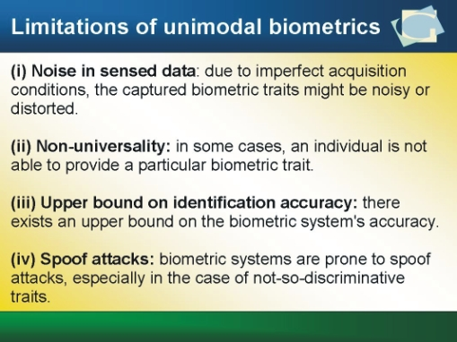

Slide 8
Multimodal Biometric System.
It is logical to try and combine multiple biometric samples to get the best results.
Some of the problems inherent in unimodal biometric systems can be overcome by using multiple sources of information.
Such systems are knows as multimodal biometric system, which uses two or more biometric samples from the same person in order to identify the person.

Slide 9
Advantages of Biometric
The person is the key so you need never remember your card or key again.
Each body part is unique and Biometrics uses your unique identity to enable a purchase activate something or unlock something.
Biometrics encompasses Voice, Vein, Eye, Fingerprint, Facial recognition and more
Logical access control e.g.: biometric signature.
Financial Security
Airports

Slide 10
Disadvantages
The Disadvantages are numerous however:
Criminals have been known to remove fingers to open biometric locks, Biometrics requires a lot of data to be kept on a person, these systems are not always reliable as human beings change over time if you are ill; eyes puffy, voice hoarse or your fingers are rough from laboring for example it maybe more difficult for the machinery to identify you accurately.
Every time you use Biometrics you are being tracked by a database bringing up a range of privacy issues.
The final disadvantage is the expense and technical complexity of such system.

Slide 11
Need of Biometrics
Biometric does solve problems and does appeal to the modern demands.
Regardless of the fact that some of the biometrics has high initial costs they do save money on the long run to the cooperation and institutes that choose to adopt them.
It is easy to use and offers almost immediate authentication without several steps.
Biometric devices can be used in hospitals to identify emergency patients who may not be in a position to communicate.

Slide 12
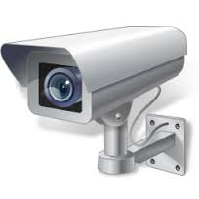
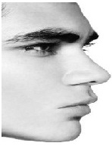

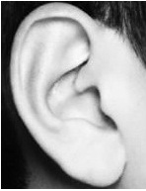
Acquisition & Extraction

Slide 13
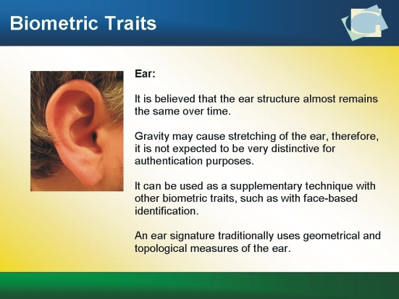

Slide 14

Image Fusion & Feature Extraction
Extracted Features
Fused Image

Slide 15
Introduction to Human Motion Detection
The ability to reliably detect and track human motion is a useful tool for higher-level appli­cations that rely on visual input.
Interacting with humans and understanding their activities are at the core of many problems in intelligent systems, such as human-computer interaction and robotics.
An algorithm for human motion detection digests high-bandwidth video into a compact description of the human presence in that scene.
This high-level description can then be put to use in other applications.

Slide 16
Some examples of applications that could be realized with reliable human motion detec­tion and tracking are:
Automated surveillance for security-conscious venues such as airports, casinos, muse­ums, and government installations: Intelligent software could monitor security cameras and detect suspicious behavior. Further more, human operators could search archived video for classes of activity that they specify without requiring manual viewing of each sequence. Having automated surveillance vastly increases the productivity of the human operator and increases coverage of the surveillance.
Human interaction for mobile robotics: Autonomous mobile robots in the workplace or home could interact more seamlessly with the humans in their environment if they could reliably detect their presence. For example, robots to assist the elderly would know when assistance is needed based on the motion of a person.
Safety devices for pedestrian detection on motor vehicles: Intelligent software on a camera-equipped car could detect pedestrians and warn the driver.
Automatic motion capture for ﬁlm and television: Producing computer-generated im­agery of realistic motion currently requires the use of a motion-capture system that stores the exact 2-D or 3-D motion of a human body using visual or radio markers at­tached to each limb of an actor. With accurate algorithms for human motion tracking,

Slide 17
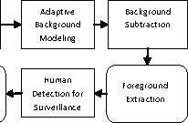
Image Acquisition from camera

Slide 18
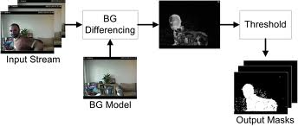

Slide 19
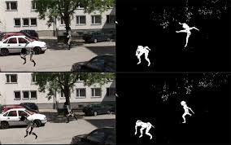
Background Subtraction
Detection of moving human in videos from static camera is widely performed by background subtraction method.
The origin in the approach is that of detecting the moving objects from the difference between the existing frame and a reference frame, frequently called the “background copy”, or “background replica”.
As a baric, the background image must be a representation of the scene with no moving objects and must be kept regularly updated so as to adapt to the varying luminance conditions and geometry settings.
More difficult models have extended the concept of “background subtraction” beyond its literal meaning. The background subtraction method is the common method of motion detection. It is a technology that uses the difference of the current image and the background image to
detect the motion region, and it is generally able to provide data included object information.

Slide 20
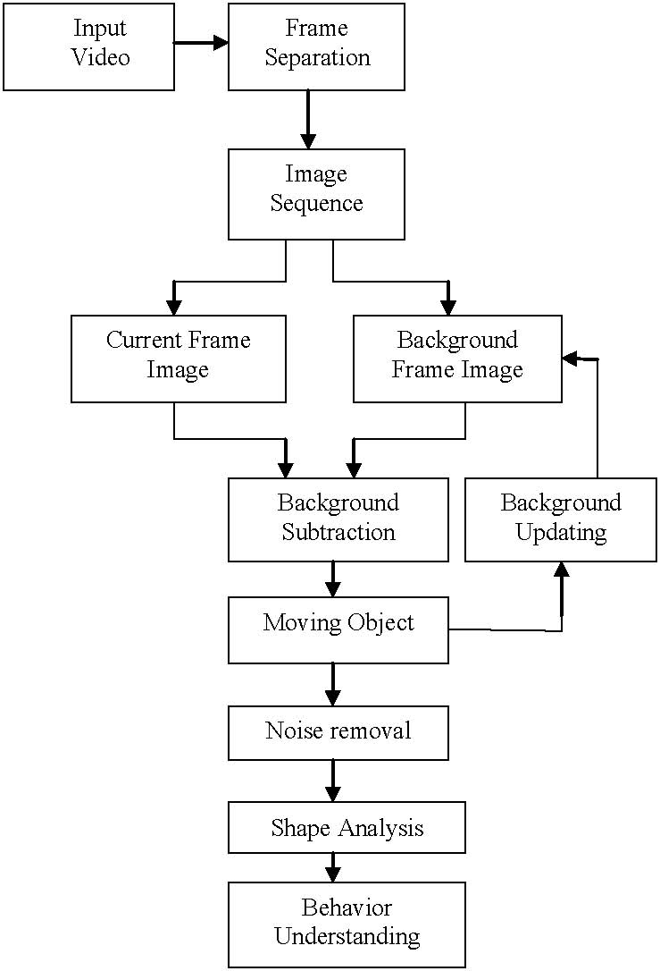
The system through Flow Chart

Slide 21

THANK YOU……..

