Slide 1
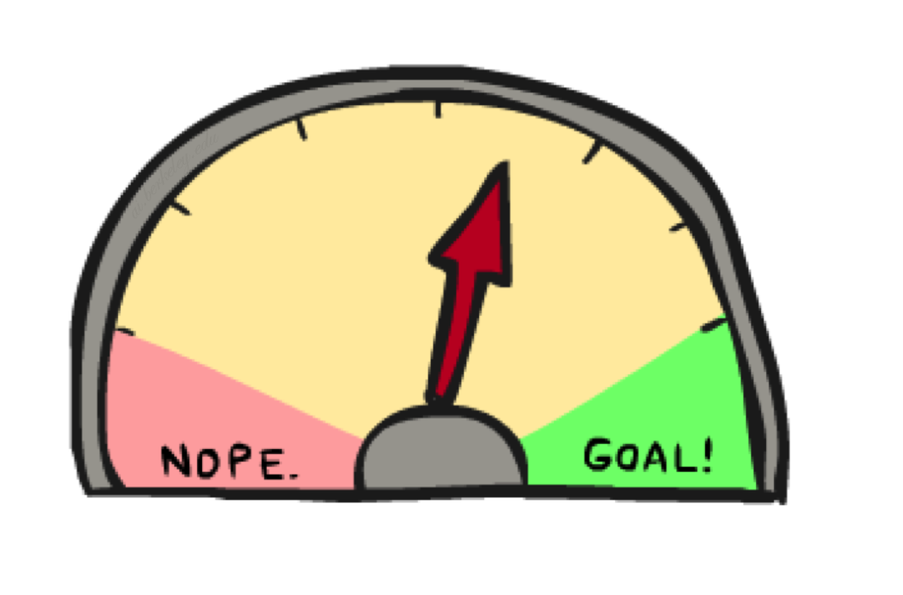
Informed Search

Slide 2
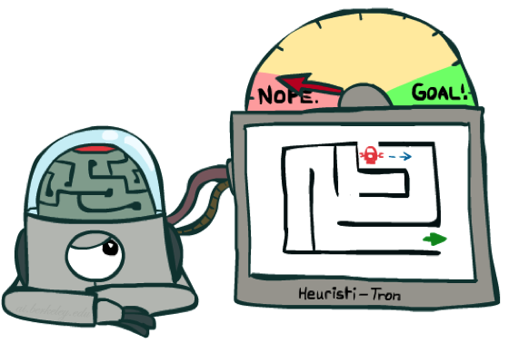
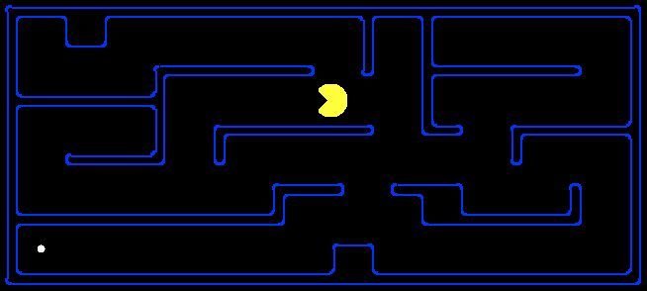
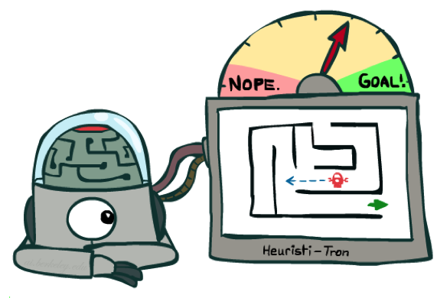
Search Heuristics
A heuristic is:
A function that estimates how close a state is to a goal
Designed for a particular search problem
Examples: Manhattan distance, Euclidean distance for pathing
10
5
11.2

Slide 3
Example: Heuristic Function
h(x)

Slide 4
Example: Heuristic Function
Heuristic: the number of the largest pancake that is still out of place
3
h(x)
4
3
4
3
0
4
4
3
4
4
2
3
Notes:
A* expanded 8100 ; Path cost = 33
UCS expanded 25263 . Path cost = 33
Greedy expanded 10 . Path cost = 41
[0, 7, 5, 3, 2, 1, 4, 6]
(7, 0, 5, 3, 2, 1, 4, 6)
(6, 4, 1, 2, 3, 5, 0, 7)
(3, 2, 1, 4, 6, 5, 0, 7)
(1, 2, 3, 4, 6, 5, 0, 7)
(5, 6, 4, 3, 2, 1, 0, 7)
(6, 5, 4, 3, 2, 1, 0, 7)
(0, 1, 2, 3, 4, 5, 6, 7)

Slide 5
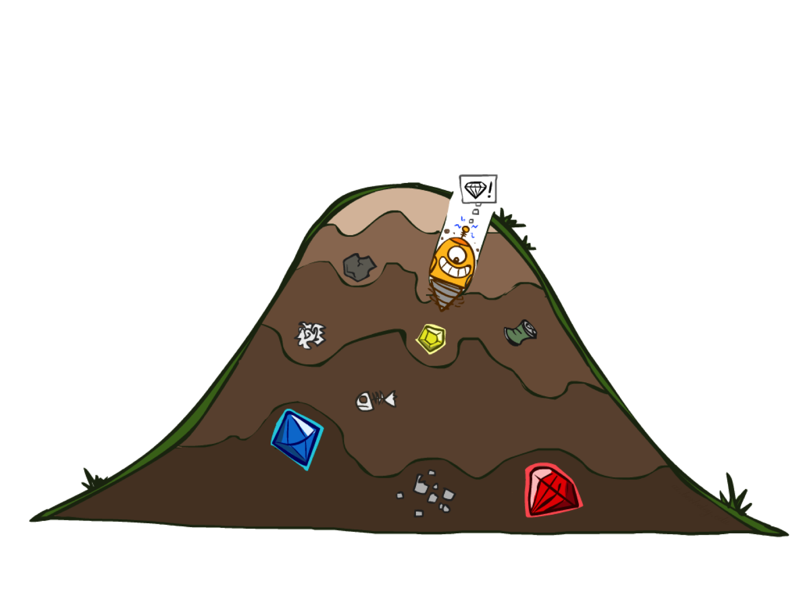
Greedy Search

Slide 6
Example: Heuristic Function
h(x)

Slide 7

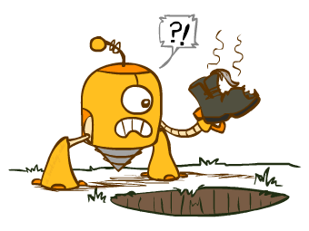
Greedy Search
Expand the node that seems closest…
What can go wrong?

Slide 8
Greedy Search
b
Strategy: expand a node that you think is closest to a goal state
Heuristic: estimate of distance to nearest goal for each state
A common case:
Best-first takes you straight to the (wrong) goal
Worst-case: like a badly-guided DFS
…
b
…
[Demo: contours greedy empty (L3D1)]
[Demo: contours greedy pacman small maze (L3D4)]
Notes:
For any search problem, you know the goal. Now, you have an idea of how far away you are from the goal.

Slide 9

Video of Demo Contours Greedy (Pacman Small Maze)

