Slide 1

Hospital Readmissions: Prediction and Management of Readmission Risk (30 days risk model) for Diabetic Patients
Nicholas Schettini & Niteen Kumar
Data 698 - Master Research Project
Professor Arthur O’Connor

Slide 2
Introduction
Hospital readmissions of diabetic patients are one of the most common problems that are found in healthcare today. Hospital readmission rates are also used as an indicator of the quality of health care services.
A readmission can be defined in multiple ways, including:
All-cause unplanned readmissions that happen within 30 days of discharge from the index (i.e., initial) admission.
Patients who are readmitted to the same hospital, or another applicable acute care hospital for any reason.
Readmissions to any applicable acute care hospital are counted, no matter what the principal diagnosis was.

Slide 3

Background
According to the national healthcare data, readmission is also one of the main reasons why our nation’s healthcare cost is so high.
In 2012¹, the Affordable Care Act (ACA) established the Hospital Readmission Reduction Program (HRRP) as a way to incentivize hospitals to develop policies and procedures to reduce the number of readmissions per year within a hospital institution.
Hospitals are penalized when patients are discharged and readmitted within 30 days. Readmissions are associated with negative patient and financial outcomes. ²

Slide 4
Data Source
The UCI Machine Learning Repository: Diabetes 130-US Hospitals for years 1999-2008 Data Set contains 100000 instances of data, with 55 attributes.
The dataset represents 10 years of clinical data at 130 US hospitals.
The data contains attributes such as: patient’s race, gender, age, time in hospital, number of lab tests performed, number of inpatient, outpatient, and emergency visits for prior year, etc. ³

Slide 5
Approach and Methodologies
Data Collection
Data Preparation and Data Wrangling
EDA (Exploratory Data Analysis)
Model building
Model evaluation and Model Selection
Data visualization and Dashboard

Slide 6
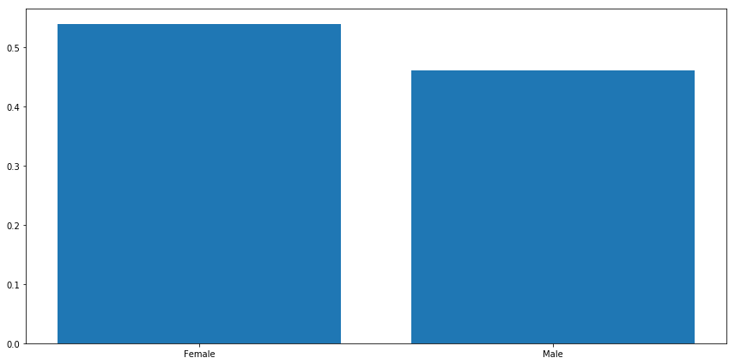
Exploratory Data Analysis (EDA)
Patient Demographics: The plot shows that number of female patients are more than male patients. Female population is 54% of the total population and male population is 46%. There are 3 patients for which gender information is unknown.

Slide 7
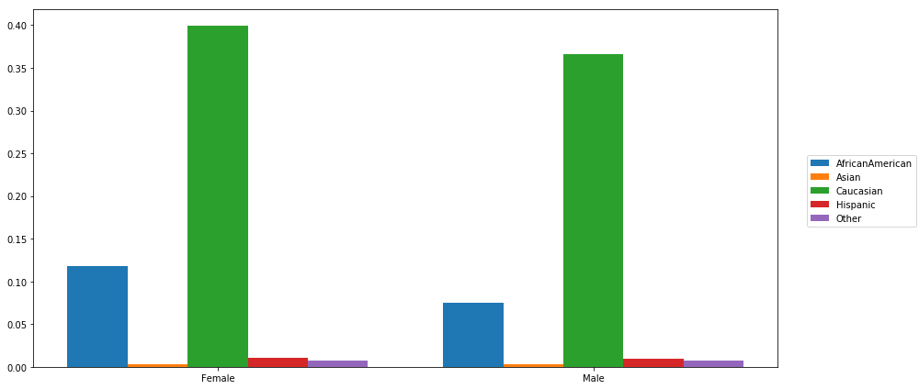
EDA
Race | Population %
Caucasian | 75 %
African American | 19%
Hispanic | 2%
Asian | < 1%
Other | 1.5%
The data distribution for race and gender features indicate that both male and female population for Caucasian patients are greater than 35%. The number of female patients appear to be high in all races.

Slide 8
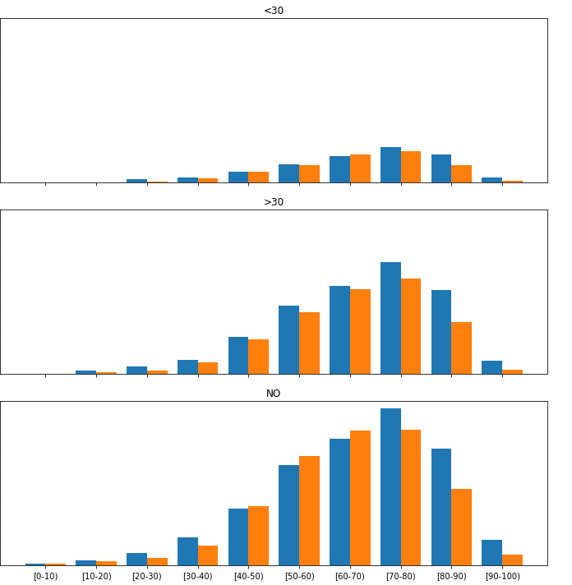

EDA
We also tried to find the correlation between race, gender, age and how these features relate to the response variable ‘readmitted’. It appears that number of patients are lowest who got readmitted in less than 30 days.
Readmission rate appears to be highest for both male and female for more than 30 days period. There are significant number of patients who do not return to the hospital.
The readmission data for the age group between 40 to 90 appears to have normal distribution and peaking for the age group 70-80 for both more than 30 days and less than 30 days period.

Slide 9
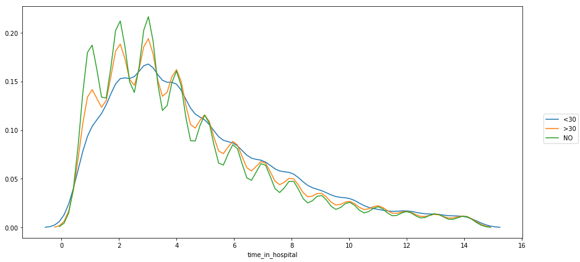
EDA
It also appears that patients who are discharged within 2 to 5 days are most likely to be readmitted.
The plot is right skewed and the number of patients who do not come back also appear to be released within 2 to 5 days.

Slide 10
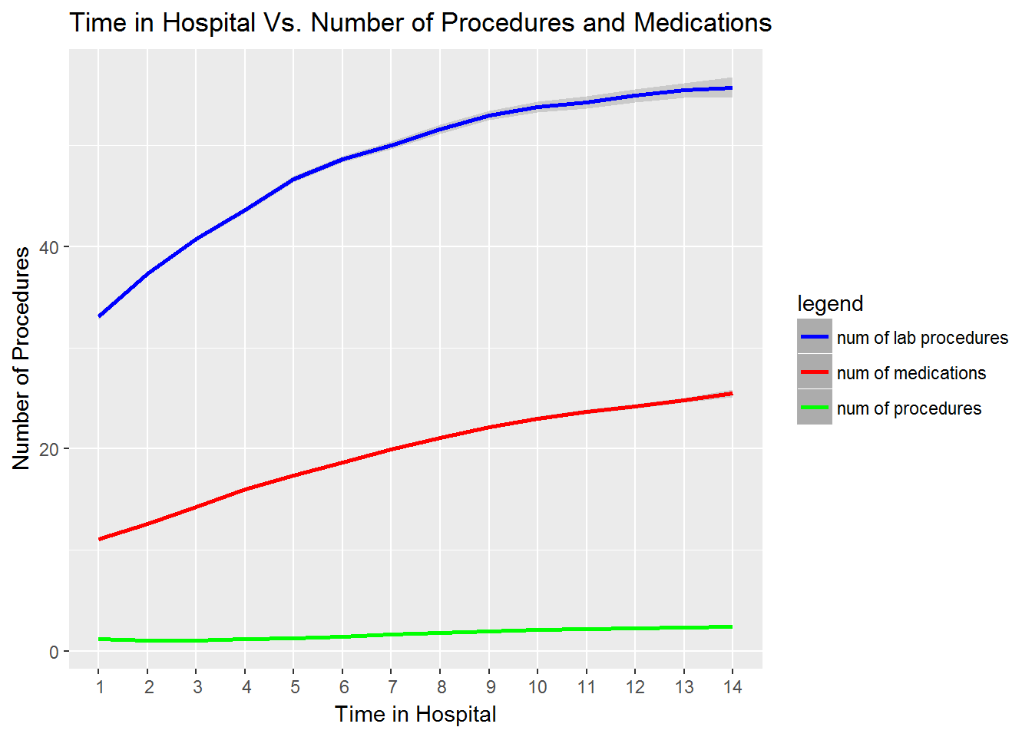
EDA
Both features number of lab procedures and number of medications have upward trend with regards to length of stay in the hospital.
The number of procedures remain low as the patient stays longer in hospital.
Both the number of lab procedures and number of medications can play significant role for readmission cases.

Slide 11

Model Building
Different modeling techniques will be used in our readmission predictions. Model results will be evaluated and compared to each other to select the most accurate technique.
Data Preprocessing: In order to apply machine learning algorithms, we need to preprocess the data so that it can properly fit into the model.

Slide 12
Modeling Techniques:
One of the main goals is to understand how a particular set of features perform with different models. The model accuracy is important, but we would also focus on interpretability of the model.
We randomized (to avoid any selection bias) and split the pre-processed clean data into Training and Test Data set, in an 80:20 ratio, which allowed us to train our models on 80% of the data and use the other 20% to assess the performance of our models.
Multiple fold cross-validation was used on our training data to ensure that our models were both scalable and robust and were not over-fitting on the training data

Slide 13
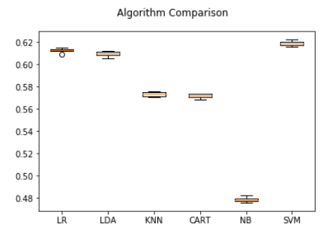
Models
After our data preprocessing our models were then compared to each other:

