Slide 1
Energy Data, Mining & Analyzing
Thriveni Enugu
Yuko Olsson Moriya
Sajjad Ahmed
Christoffer Brodin

Slide 2
Project idea
Project idea
Purpose
Accomplishment
Technology - Python, SQL, Database, Power Bi, Dash, Machine Learning, Linear Regression, ETL, Git, API
Sustainability
Dataset - World Energy Consumption from Kaggle

Slide 3
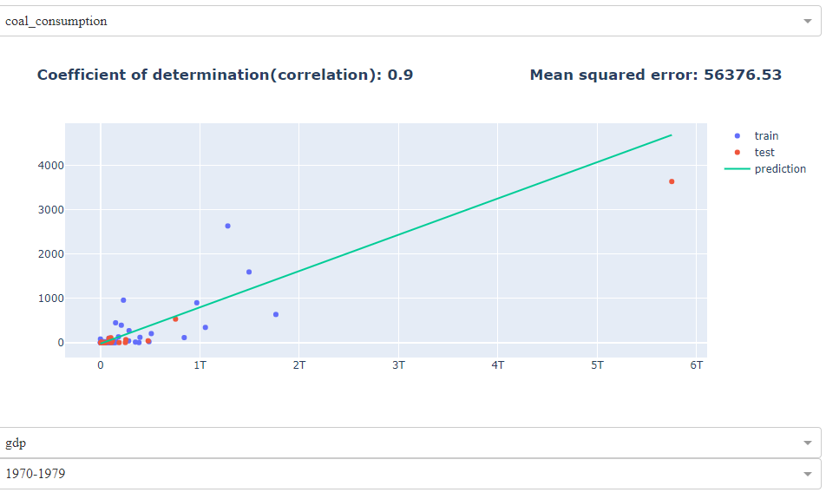
Demonstration: Dash / Code

Slide 4
Power Bi
Energy consumption analyzes
Electricity source distribution

Slide 5
Project group:
Thriveni, Group manager
Yuko, Scrum-master
Sajjad, Testing
Christoffer, Git-manager

Slide 6
Agile methodology:
Daily Scrum
Distribution of tasks
Setting up goals for the day
Make sure everyone is equally active and participating on developing an ongoing product
End of the day meeting

Slide 7
Challenges:
Dataset, find a good data set, what can we do with it?
What techniques should we use?
Machine Learning

Slide 8
Learnings :
Regression
Dash in combination with Machine learning
Power Bi, connecting to Database
Agile

Slide 9
Future & Potentials
Add another data set, to do further analysis
Create sustainability reports, climate changes
Use cloud
More machine learning, prediction analysis,
Classifications, clustering
Mobile applications

Slide 10

Thank You!
Questions?

