Slide 1
Energy Data, Mining & Analyzing
Thriveni Enugu
Yuko Olsson Moriya
Sajjad Ahmed
Christoffer Brodin

Slide 2
Project idea
Project idea
Dataset - World Energy Consumption from Kaggle
Purpose
Accomplishment
Technology - Python, SQL, Database, Power Bi, Dash, Machine Learning, Linear Regression, ETL, Git, API
Sustainability

Slide 3
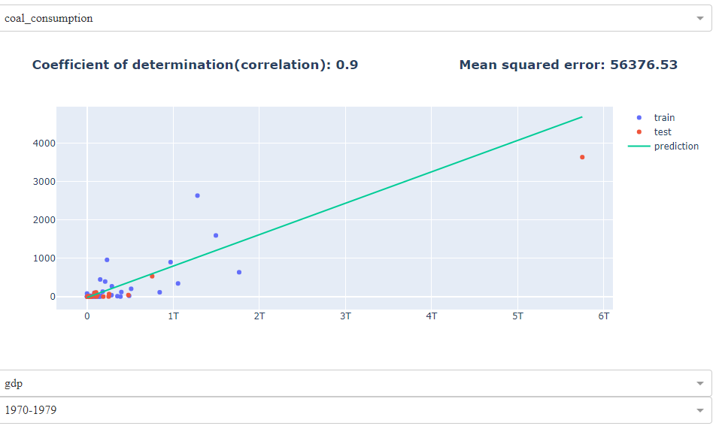
Demonstration: Dash / Code

Slide 4
Power Bi
Energy consumption analyzes
Electricity source distribution

Slide 5
Project group:
Who’s been doing what?
Thriveni Enugu, Group manager
Yuko Olsson Moriya, Scrum-master
Sajjad Ahmed, Testing
Christoffer Brodin, Git-manager

Slide 6
Agile methodology:
Daily Scrum
Distribution of tasks
Setting up goals for the day
Make sure everyone is equally active and participating on developing an ongoing product
End of the day meeting

Slide 7
Challenges:
Dataset, find a good data set, what can we do with it?
What techniques should we use?
Machine Learning
Learnings :
Regression, greater understanding
Dash in combination with Machine learning
Power Bi, connecting to Database
From dataset to the finish product
Agile

Slide 8
Future & Potentials
Add another data set, to do further analysis
Create sustainability reports, climate changes
Use cloud
More machine learning, prediction analysis,
Classifications, clustering
Mobile applications

Slide 9
Thank You!
Questions?

