Slide 1
Energy data, mining & analyzing
Thriveni Enugu
Yuko Olsson Moriya
Sajjad Ahmed
Christoffer Brodin

Slide 2
Project idea
Stor mängd data, visa tydligt vad datan, Electricity generation from, measured in terawatt-hours åller, consumption measured I terawtt-hours, per år,
Info
Python, SQL, Database, Power Bi, Dash, Machine Learning, Linear Regression, ETL, GiT, API
Sustainability: generate/produce energy from

Slide 3
Demonstration: Power Bi

Slide 4
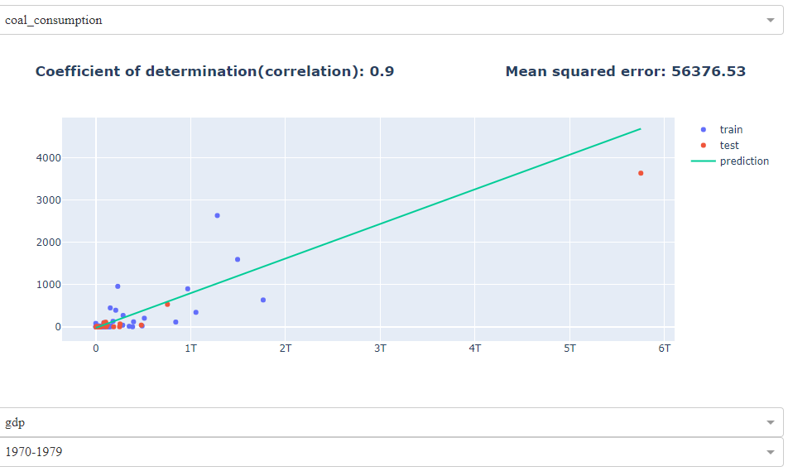
Demonstration: Dash Dash

Slide 5
Project group:
Who’s been doing what?
Thriveni Enugu, scrum, Power Bi, SQL
Yuko Olsson Moriya, Power Bi, documentation,
Sajjad Ahmed, Testing, Power Bi
Christoffer Brodin, Git, python,

Slide 6
Project group:
Agile methodology:
Välkomna förändrade krav, även sent under utvecklingen. Agila metoder utnyttjar förändring till kundens konkurrensfördel.
Verksamhetskunniga och utvecklare måste arbeta tillsammans dagligen under hela projektet.
Dagliga möten, på morgonen, vad alla skall göra, avlustande möte vid dagens slut, vad har vi åstakommit, vad har varit problematiskt, bra osv.

Slide 7
Project group:
Challenges
Dataset, find a good data set, what can we do with it?
What techniques should we use?
Machine Learning, hade inte så mycket kunskap,
Learnings:
Regression, greater understanding
Dash in combination with Machine learning
Power Bi, connecting to Database
From dataset to the finish product
Agile

Slide 8
Next step??
Future?
Add another data set, to do further analysis
Create sustainability reports
Use cloud
More machine learning, prediction analysis,
Classifications
Potentials for 2.0??
Mobile applications

