Slide 1
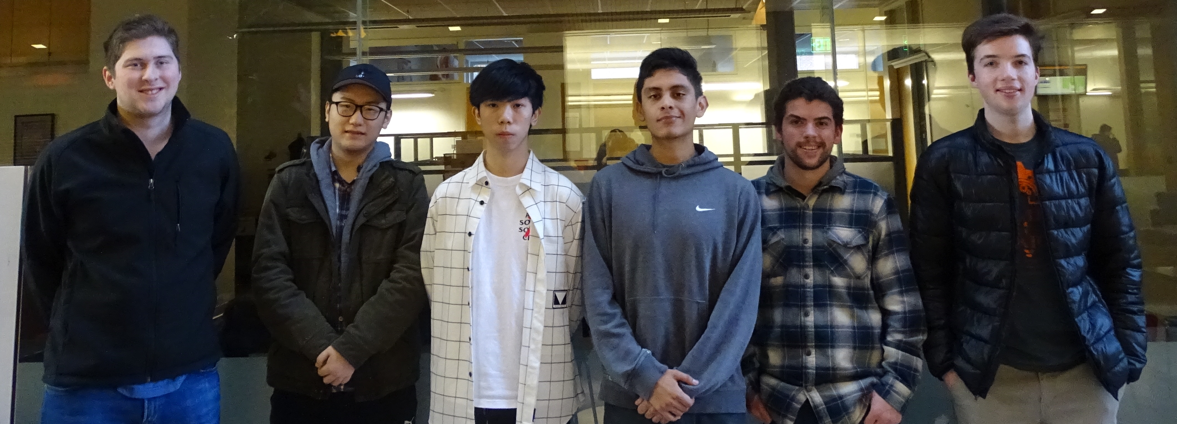
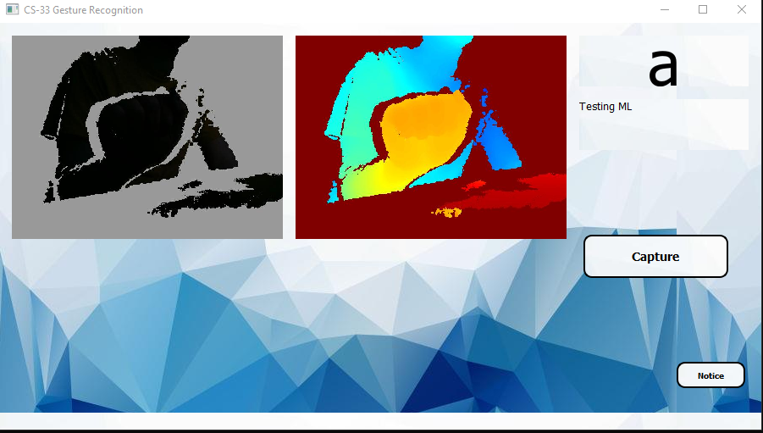
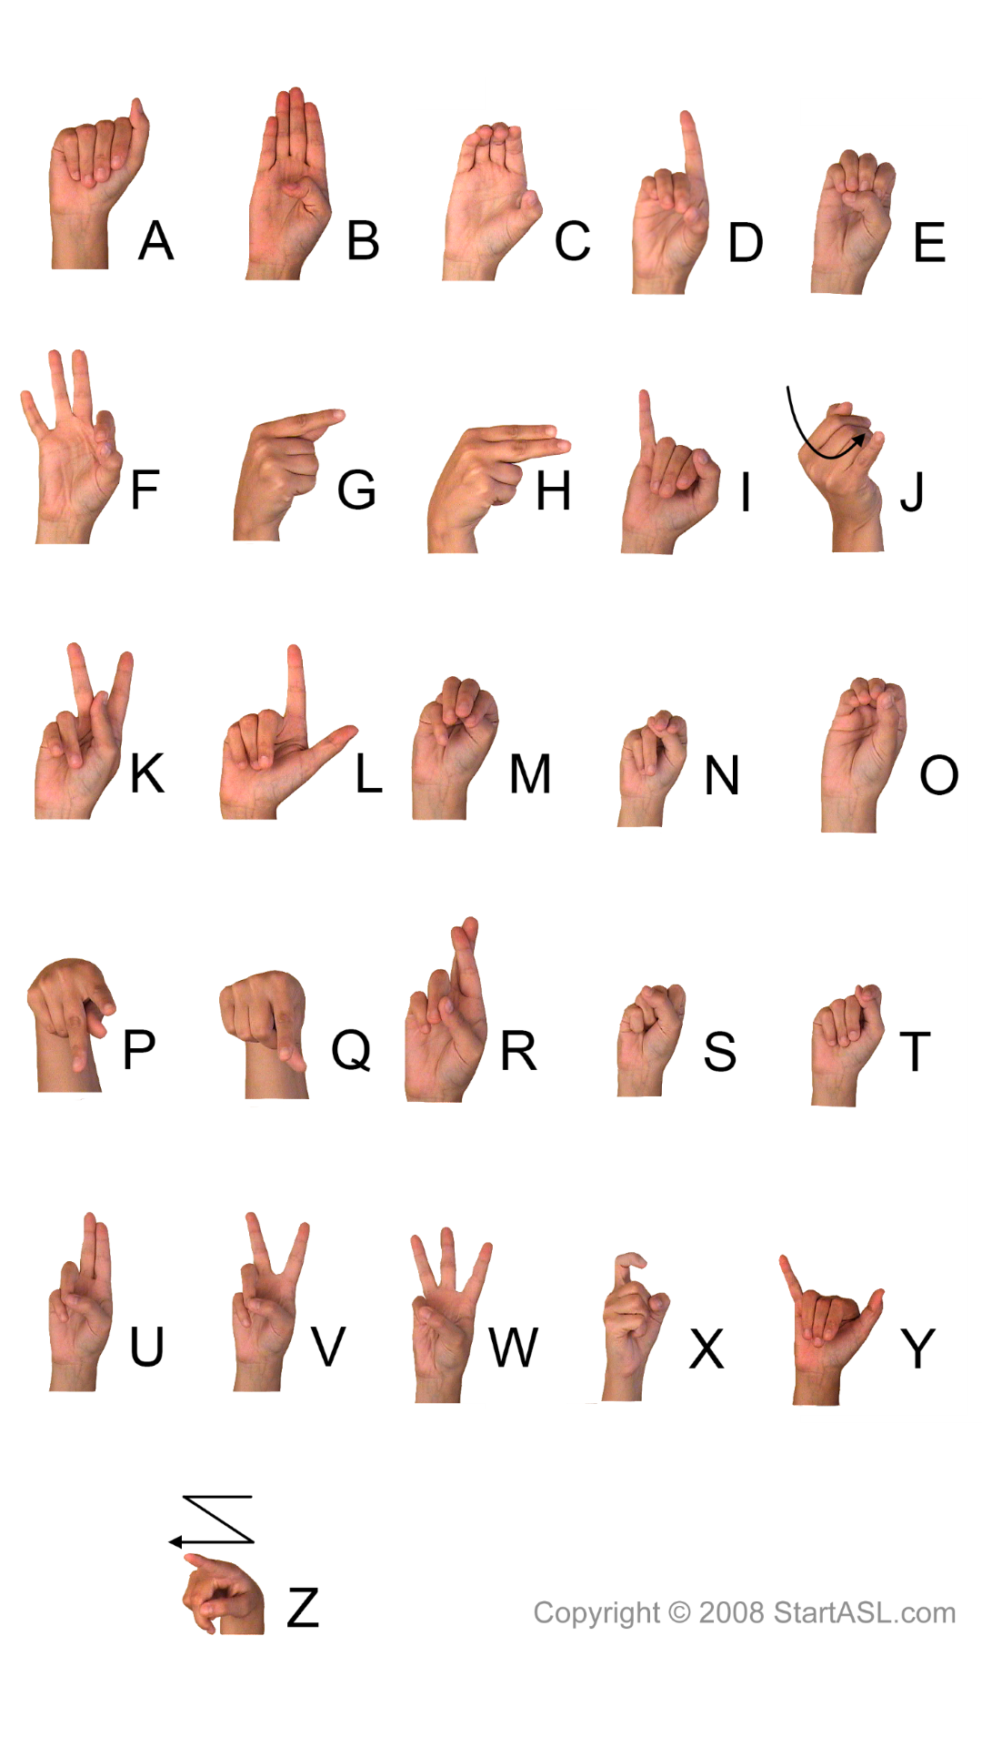
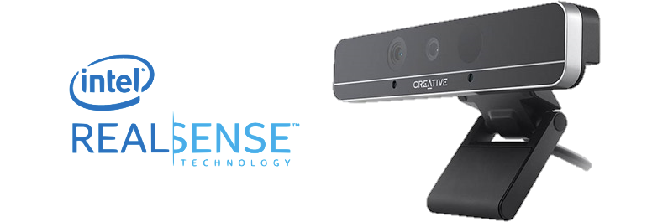
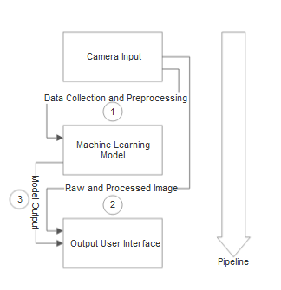

CS33
COST EFFECTIVE COMMUNICATION
GESTURE RECOGNITION
ABOUT THE TEAM
The goal of this project was to explore cost effective medium of communication that would be utilized by the deaf community
This project uses a trained Machine Learning model to identify ASL gestures coupled with a pre-trained database that classifies the gesture made.
Jonathan Hull: User Interface Team
Shihao Song: User Interface Team
Ulises Zaragoza: Machine Learning Team Zhidong Zhang: Machine Learning Team
Shane Clancy: Software Team
Nicholas Davies: Software Team
ASL Gesture Recognition using new Intel RealSense light-coded Camera
Figure 3: Team Photo (Photo Credits to Vishnupriya Nochikaduthekkedath Reghunathan)
ROLES
The User Interface Team created the GUI for the project. What was produced was a 2 windowed interface with a button on the right to capture the gesture, and the Machine Learning Model classification on the right side of the screen with an accuracy associated.
Software Team focused on data integration. This team managed data storage, image normalization, and communication between the UI and the ML model.
Machine Learning Team dealt with creating the machine model used to classify gestures. Specifically, they used a convolutional neural-network, with a transfer learning approach with a pre-trained on a ResNet-18 dataset.
Figure 1: Demonstration by Jonathan Hull for the ASL letter “A” in testing mode (Photo Credits to Jonathan Hull)
CLIENTS
PIPELINE
Figure 2: ASL Alphabet (Photo Credits to https://external-content.duckduckgo.com/iu/?u=https%3A%2F%2Fres.cloudinary.com%2Fstartasl%2Fimage%2Fupload%2Fwp-content%2Fuploads%2Fstartasl%2Fasl-alphabet_wallpaper_1080x1920.png&f=1&nofb=1)
The clientele for this project are Eduardo Alban, Satoshi Suzuki, and Po-Cheng Chen from Intel. Intel allowed the team to utilize their librealsense library as well as providing multiple Intel RealSense cameras. The clients have been able support the team with changes in direction and advice throughout the project. Weekly meetings has allowed the team to receive valuable feedback such as additional features for the UI which helped it to appear more user-friendly.
The software side of this project was essentially a pipeline to process and send data back and forth from the UI to the ML Model.
Once the capture button is clicked, the depth-per-pixel is extracted via the RealSense camera. If the training mode is not activated, then it is saved to the HDF5 file, otherwise it is then normalized.
Our normalization process inverts the pixels, rescales and re-centers the image, and then finally normalize the depth.
The normalized image is then sent to the ML Model, and a string is then outputted.
This classification then is presented to the user via UI. Figure 3 illustrates the pipeline process of the project.
Figure 3: Pipeline Diagram (Photo Credits to Design Document)

