Slide 1








NATIONAL SCIENCE DATA FABRIC
OCT 19–20, 2026
— NSDF SUMMIT 2026
Federated
Autonomous Science
A working meeting bringing together academia, industry, national labs, and cyberinfrastructure organizations to build the digital backbone for trustworthy autonomous scientific discovery.
● Mon–Tue, Oct 19–20, 2026
● Discovery Partners Institute · Chicago, IL
● Held with PACT 2026
PARTNER
INSTITUTIONS
NSF Award #2609465

Slide 2

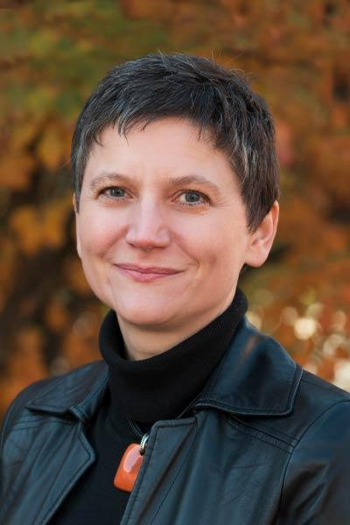
Michela Taufer
Summit Organizer
University of Tennessee, Knoxville
WELCOME · 15 MIN
Welcome: The Collaboration Challenge
NSDF Summit on Federated Autonomous Science
Monday, October 19, 2026 · 9:00–9:15 AM CT
Michela Taufer is a MathWorks Professor and ACM Distinguished Scientist specializing in high-performance and heterogeneous computing, cloud computing, and performance optimization of scientific applications. She is a leader in interdisciplinary computational research and has held prominent leadership roles in the ACM and IEEE high-performance computing communities.
PARTNER INSTITUTIONS
1
NSF Award #2609465
Notes:
Talk: Welcome: The Collaboration Challenge
Format: Welcome (15 min).
Session: NSDF Summit on Federated Autonomous Science (Monday, October 19, 2026 · 9:00–9:15 AM CT).
Individual talk times within a session are not listed on the program page; the time above is the session block.
Event: NSDF Summit on Federated Autonomous Science, Oct 19 (all day) and Oct 20 (morning), 2026. Discovery Partners Institute, 200 S Wacker, Chicago, IL 60606, 4th floor. Held in conjunction with PACT 2026. All times Central.
Also: Commitments and Close (with Valerio Pascucci), Mon 4:50–5:00 PM CT; PACT 2026 Welcome (with Jaejin Lee and Lawrence Rauchwerger), Tue 9:00–9:30 AM CT. Contact: mtaufer@utk.edu.
Not on the program page (left blank): headshot, organization logo, talk summary, speaker bio.
Source: https://nationalsciencedatafabric.org/news/event-nsdf-summit/#program

Slide 3
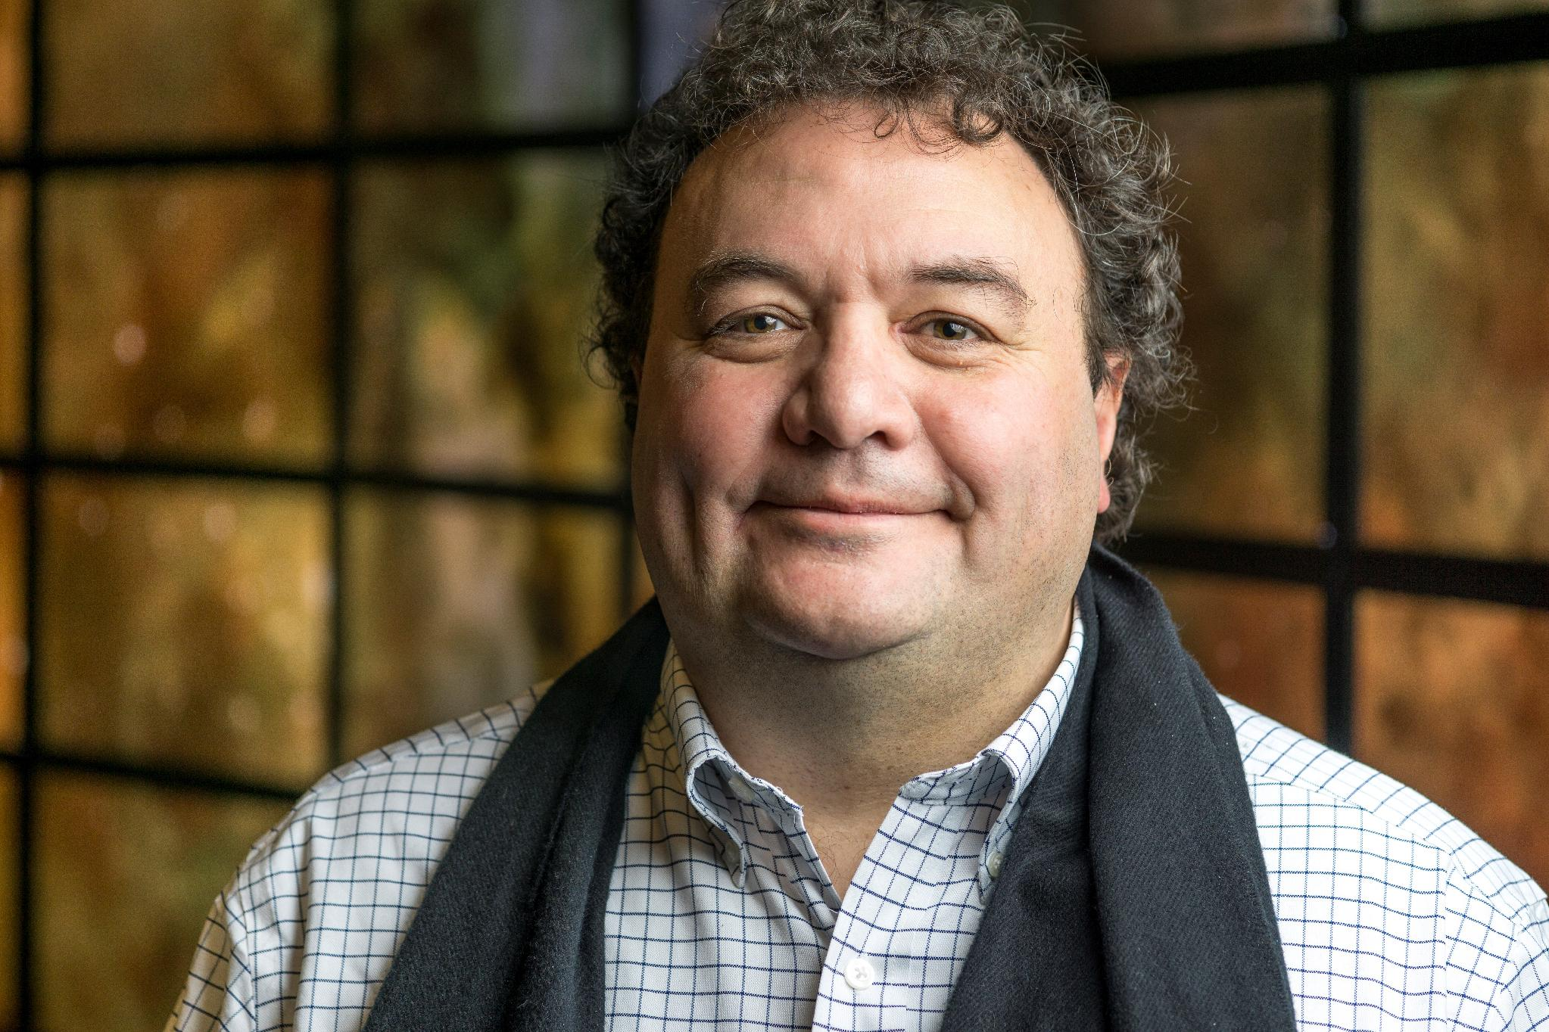
Valerio Pascucci is as research has advanced the analysis and visualization
Valerio Pascucci
Summit Organizer
University of Utah
WELCOME · 15 MIN
Welcome: The Collaboration Challenge
NSDF Summit on Federated Autonomous Science
Monday, October 19, 2026 · 9:00–9:15 AM CT
Valerio Pascucci is a distinguished Professor of Computer Science at the University of Utah and an internationally recognized leader in scientific visualization, computational topology, and large-scale data analytics. His research has advanced the analysis and visualization of massive scientific datasets, combining academic leadership with extensive experience at U.S. national laboratories.
PARTNER INSTITUTIONS
2
NSF Award #2609465
Notes:
Talk: Welcome: The Collaboration Challenge
Format: Welcome (15 min).
Session: NSDF Summit on Federated Autonomous Science (Monday, October 19, 2026 · 9:00–9:15 AM CT).
Individual talk times within a session are not listed on the program page; the time above is the session block.
Event: NSDF Summit on Federated Autonomous Science, Oct 19 (all day) and Oct 20 (morning), 2026. Discovery Partners Institute, 200 S Wacker, Chicago, IL 60606, 4th floor. Held in conjunction with PACT 2026. All times Central.
Also: Commitments and Close (with Michela Taufer), Mon 4:50–5:00 PM CT. Contact: pascucci.valerio@gmail.com.
Not on the program page (left blank): headshot, organization logo, talk summary, speaker bio.
Source: https://nationalsciencedatafabric.org/news/event-nsdf-summit/#program

Slide 4

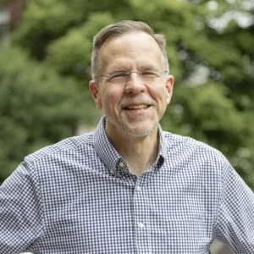
Todd Hufnagel
Johns Hopkins University
TALK · 15 MIN
Materials Science: Artificial Intelligence for Materials Design PCL Node AIMD-Net
Session: Foundations for Federated Autonomous Science
Monday, October 19, 2026 · 9:15–10:00 AM CT
Todd Hufnagel is a Professor of Materials Science and Engineering at Johns Hopkins University and an expert in structural materials, nanomaterials, X-ray scattering, 3D microstructures, and metals. He also serves as Associate Director of the Materials Science in Extreme Environments University Research Alliance, an 18-institution research collaboration focused on materials under extreme conditions.
PARTNER INSTITUTIONS
3
NSF Award #2609465
Notes:
Talk: Materials Science: Artificial Intelligence for Materials Design PCL Node AIMD-Net
Format: Talk (15 min).
Session: Foundations for Federated Autonomous Science (Monday, October 19, 2026 · 9:15–10:00 AM CT). Chair: TBA.
Individual talk times within a session are not listed on the program page; the time above is the session block.
Event: NSDF Summit on Federated Autonomous Science, Oct 19 (all day) and Oct 20 (morning), 2026. Discovery Partners Institute, 200 S Wacker, Chicago, IL 60606, 4th floor. Held in conjunction with PACT 2026. All times Central.
Not on the program page (left blank): title/role, headshot, organization logo, talk summary, speaker bio.
Source: https://nationalsciencedatafabric.org/news/event-nsdf-summit/#program

Slide 5
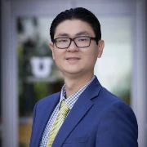
Vince Wang
Utah Nuclear Engineering Program
TALK · 15 MIN
Energy: Trustworthy Autonomous Control of Nuclear Reactors Through Federated Science
Session: Foundations for Federated Autonomous Science
Monday, October 19, 2026 · 9:15–10:00 AM CT
Meng-Jen “Vince” Wang is an Assistant Professor of Nuclear Engineering at the University of Utah specializing in computational particle transport, reactor physics, radiation shielding, and multiphysics simulation. His research combines high-performance computing and advanced numerical methods to develop predictive models and digital twins of nuclear reactors, complemented by industry experience in advanced reactor design and a U.S. NRC Senior Reactor Operator license.
PARTNER INSTITUTIONS
4
NSF Award #2609465
Notes:
Talk: Energy: Trustworthy Autonomous Control of Nuclear Reactors Through Federated Science
Format: Talk (15 min).
Session: Foundations for Federated Autonomous Science (Monday, October 19, 2026 · 9:15–10:00 AM CT). Chair: TBA.
Individual talk times within a session are not listed on the program page; the time above is the session block.
Event: NSDF Summit on Federated Autonomous Science, Oct 19 (all day) and Oct 20 (morning), 2026. Discovery Partners Institute, 200 S Wacker, Chicago, IL 60606, 4th floor. Held in conjunction with PACT 2026. All times Central.
The program page lists this affiliation as "Utah Nuclear Engineering Program..." (text appears truncated on the site).
Not on the program page (left blank): title/role, headshot, organization logo, talk summary, speaker bio.
Source: https://nationalsciencedatafabric.org/news/event-nsdf-summit/#program

Slide 6

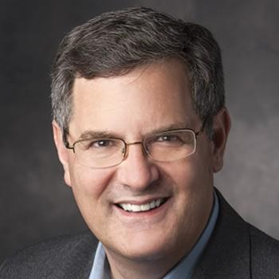
Mark A. Musen
Stanford University
TALK · 15 MIN
Health/Medical: The Need for Community Standards
Session: Foundations for Federated Autonomous Science
Monday, October 19, 2026 · 9:15–10:00 AM CT
Mark Musen is the Stanford Medicine Professor of Computational Medicine and Chief of Stanford’s Division of Computational Medicine, with internationally recognized expertise in biomedical informatics, AI, knowledge representation, and open science. He led the development of Protégé, a widely used platform for building biomedical ontologies, and is an elected member of the National Academy of Medicine.
PARTNER INSTITUTIONS
5
NSF Award #2609465
Notes:
Talk: Health/medical: The Need for Community Standards
Format: Talk (15 min).
Session: Foundations for Federated Autonomous Science (Monday, October 19, 2026 · 9:15–10:00 AM CT). Chair: TBA.
Individual talk times within a session are not listed on the program page; the time above is the session block.
Event: NSDF Summit on Federated Autonomous Science, Oct 19 (all day) and Oct 20 (morning), 2026. Discovery Partners Institute, 200 S Wacker, Chicago, IL 60606, 4th floor. Held in conjunction with PACT 2026. All times Central.
Not on the program page (left blank): title/role, headshot, organization logo, talk summary, speaker bio.
Source: https://nationalsciencedatafabric.org/news/event-nsdf-summit/#program

Slide 7

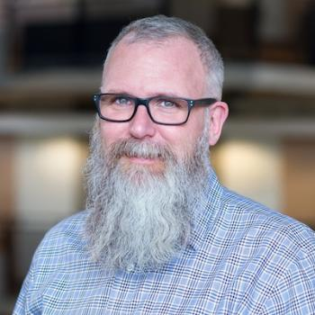
Mike Papka
Session Moderator
Argonne National Laboratory; University of Illinois Chicago
MODERATOR · 90 MIN
Science Domains and Trustworthy Autonomy
Monday, October 19, 2026 · 10:30 AM–12:00 PM CT
Michael Papka is a Senior Scientist and Distinguished Fellow at Argonne National Laboratory, Deputy Associate Laboratory Director for Computing, Environment and Life Sciences, and Director of the Argonne Leadership Computing Facility, one of the nation’s premier scientific supercomputing facilities. His research and leadership span high-performance computing, large-scale data analysis and visualization, and advanced research infrastructure, with nearly 30 years of experience applying computation to accelerate scientific discovery.
PARTNER INSTITUTIONS
6
NSF Award #2609465
Notes:
Talk: Science Domains and Trustworthy Autonomy
Format: Moderator (90 min).
Session: Science Domains and Trustworthy Autonomy (Monday, October 19, 2026 · 10:30 AM–12:00 PM CT). Moderator: Mike Papka, Argonne National Laboratory; University of Illinois Chicago.
Individual talk times within a session are not listed on the program page; the time above is the session block.
Event: NSDF Summit on Federated Autonomous Science, Oct 19 (all day) and Oct 20 (morning), 2026. Discovery Partners Institute, 200 S Wacker, Chicago, IL 60606, 4th floor. Held in conjunction with PACT 2026. All times Central.
Not on the program page (left blank): headshot, organization logo, talk summary, speaker bio.
Source: https://nationalsciencedatafabric.org/news/event-nsdf-summit/#program

Slide 8
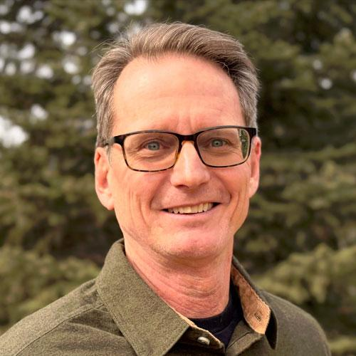
David Hart
Internet2
TALK · 10 MIN
Internet2 and the Future of Federated Autonomous Science
Session: Science Domains and Trustworthy Autonomy
Monday, October 19, 2026 · 10:30 AM–12:00 PM CT
David Hart is Director of Research Infrastructure Partnerships at Internet2, where he provides strategic leadership for national cyberinfrastructure and AI initiatives and builds partnerships across academia, government, and industry. He brings 30 years of research computing experience, including leadership roles with the NAIRR Pilot, NSF ACCESS, XSEDE, TeraGrid, NCAR, and the San Diego Supercomputer Center.
PARTNER INSTITUTIONS
7
NSF Award #2609465
Notes:
Talk: Internet2 and the Future of Federated Autonomous Science
Format: Talk (10 min).
Session: Science Domains and Trustworthy Autonomy (Monday, October 19, 2026 · 10:30 AM–12:00 PM CT). Moderator: Mike Papka, Argonne National Laboratory; University of Illinois Chicago.
Individual talk times within a session are not listed on the program page; the time above is the session block.
Event: NSDF Summit on Federated Autonomous Science, Oct 19 (all day) and Oct 20 (morning), 2026. Discovery Partners Institute, 200 S Wacker, Chicago, IL 60606, 4th floor. Held in conjunction with PACT 2026. All times Central.
Not on the program page (left blank): title/role, headshot, organization logo, talk summary, speaker bio.
Source: https://nationalsciencedatafabric.org/news/event-nsdf-summit/#program

Slide 9
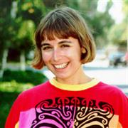
Orly Alter
University of Utah and Qalanit
TALK · 10 MIN
Quantum Mechanics-Based Multitensor AI/ML Uniquely Able to Discover, Validate and Interpret Predictors of Patient Outcomes and Drug Targets from Small-Cohort, Noisy and High-Dimensional Multiomic Data
Session: Science Domains and Trustworthy Autonomy
Monday, October 19, 2026 · 10:30 AM–12:00 PM CT
Orly Alter is a USTAR Associate Professor of Bioengineering and Human Genetics at the University of Utah and Chief Scientific Officer and Co-Founder of Qalanit. Her research combines AI/ML, genomics, and quantum-mechanics-inspired mathematical methods to develop predictive approaches for cancer, including glioblastoma outcomes and treatment response.
PARTNER INSTITUTIONS
8
NSF Award #2609465
Notes:
Talk: Quantum Mechanics-Based Multitensor AI/ML Uniquely Able to Discover, Validate and Interpret Predictors of Patient Outcomes and Drug Targets from Small-Cohort, Noisy and High-Dimensional Multiomic Data
Format: Talk (10 min).
Session: Science Domains and Trustworthy Autonomy (Monday, October 19, 2026 · 10:30 AM–12:00 PM CT). Moderator: Mike Papka, Argonne National Laboratory; University of Illinois Chicago.
Individual talk times within a session are not listed on the program page; the time above is the session block.
Event: NSDF Summit on Federated Autonomous Science, Oct 19 (all day) and Oct 20 (morning), 2026. Discovery Partners Institute, 200 S Wacker, Chicago, IL 60606, 4th floor. Held in conjunction with PACT 2026. All times Central.
Not on the program page (left blank): title/role, headshot, organization logo, talk summary, speaker bio.
Source: https://nationalsciencedatafabric.org/news/event-nsdf-summit/#program

Slide 10

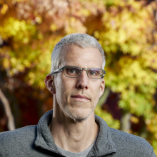
Timo Bremer
Lawrence Livermore National Laboratory and University of Utah
TALK · 10 MIN
Challenges for Distributed Digital Infrastructure at LLNL
Session: Science Domains and Trustworthy Autonomy
Monday, October 19, 2026 · 10:30 AM–12:00 PM CT
Peer-Timo Bremer is a computer scientist at Lawrence Livermore National Laboratory, where he leads the Machine Intelligence Group and serves as Associate Director of LLNL’s AI Innovation Incubator. His research spans scientific machine learning, large-scale data analysis, visualization, and interpretable AI, with applications across the physical and life sciences.
PARTNER INSTITUTIONS
9
NSF Award #2609465
Notes:
Talk: Challenges for Distributed Digital Infrastructure at LLNL
Format: Talk (10 min).
Session: Science Domains and Trustworthy Autonomy (Monday, October 19, 2026 · 10:30 AM–12:00 PM CT). Moderator: Mike Papka, Argonne National Laboratory; University of Illinois Chicago.
Individual talk times within a session are not listed on the program page; the time above is the session block.
Event: NSDF Summit on Federated Autonomous Science, Oct 19 (all day) and Oct 20 (morning), 2026. Discovery Partners Institute, 200 S Wacker, Chicago, IL 60606, 4th floor. Held in conjunction with PACT 2026. All times Central.
Also moderating: From Position Papers to Collaborative Pilots, Mon 3:30–4:10 PM CT.
Not on the program page (left blank): title/role, headshot, organization logo, talk summary, speaker bio.
Source: https://nationalsciencedatafabric.org/news/event-nsdf-summit/#program

Slide 11

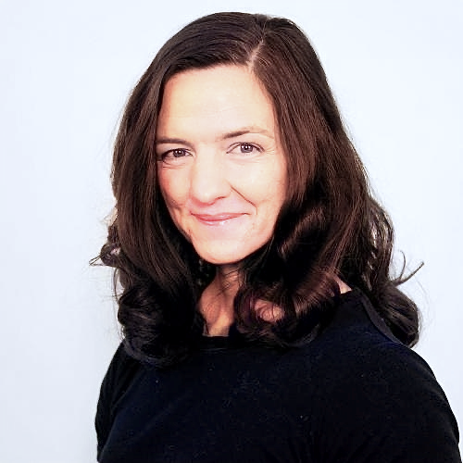
Anita Nikolich
University of Illinois Urbana-Champaign
TALK · 10 MIN
Trust but Verify: Secure and Trustworthy AI in Science
Session: Science Domains and Trustworthy Autonomy
Monday, October 19, 2026 · 10:30 AM–12:00 PM CT
Anita Nikolich is Director of Research and Technology Innovation and a Research Scientist at the University of Illinois Urbana-Champaign’s School of Information Sciences. Her work focuses on cybersecurity, privacy and trust, advanced network infrastructure, and resilience to online deception, with leadership roles in major NSF-supported initiatives including FABRIC and research on securing scientific AI and computing infrastructure.
PARTNER INSTITUTIONS
10
NSF Award #2609465
Notes:
Talk: Trust but Verify: Secure and Trustworthy AI in Science
Format: Talk (10 min).
Session: Science Domains and Trustworthy Autonomy (Monday, October 19, 2026 · 10:30 AM–12:00 PM CT). Moderator: Mike Papka, Argonne National Laboratory; University of Illinois Chicago.
Individual talk times within a session are not listed on the program page; the time above is the session block.
Event: NSDF Summit on Federated Autonomous Science, Oct 19 (all day) and Oct 20 (morning), 2026. Discovery Partners Institute, 200 S Wacker, Chicago, IL 60606, 4th floor. Held in conjunction with PACT 2026. All times Central.
Not on the program page (left blank): title/role, headshot, organization logo, talk summary, speaker bio.
Source: https://nationalsciencedatafabric.org/news/event-nsdf-summit/#program

Slide 12

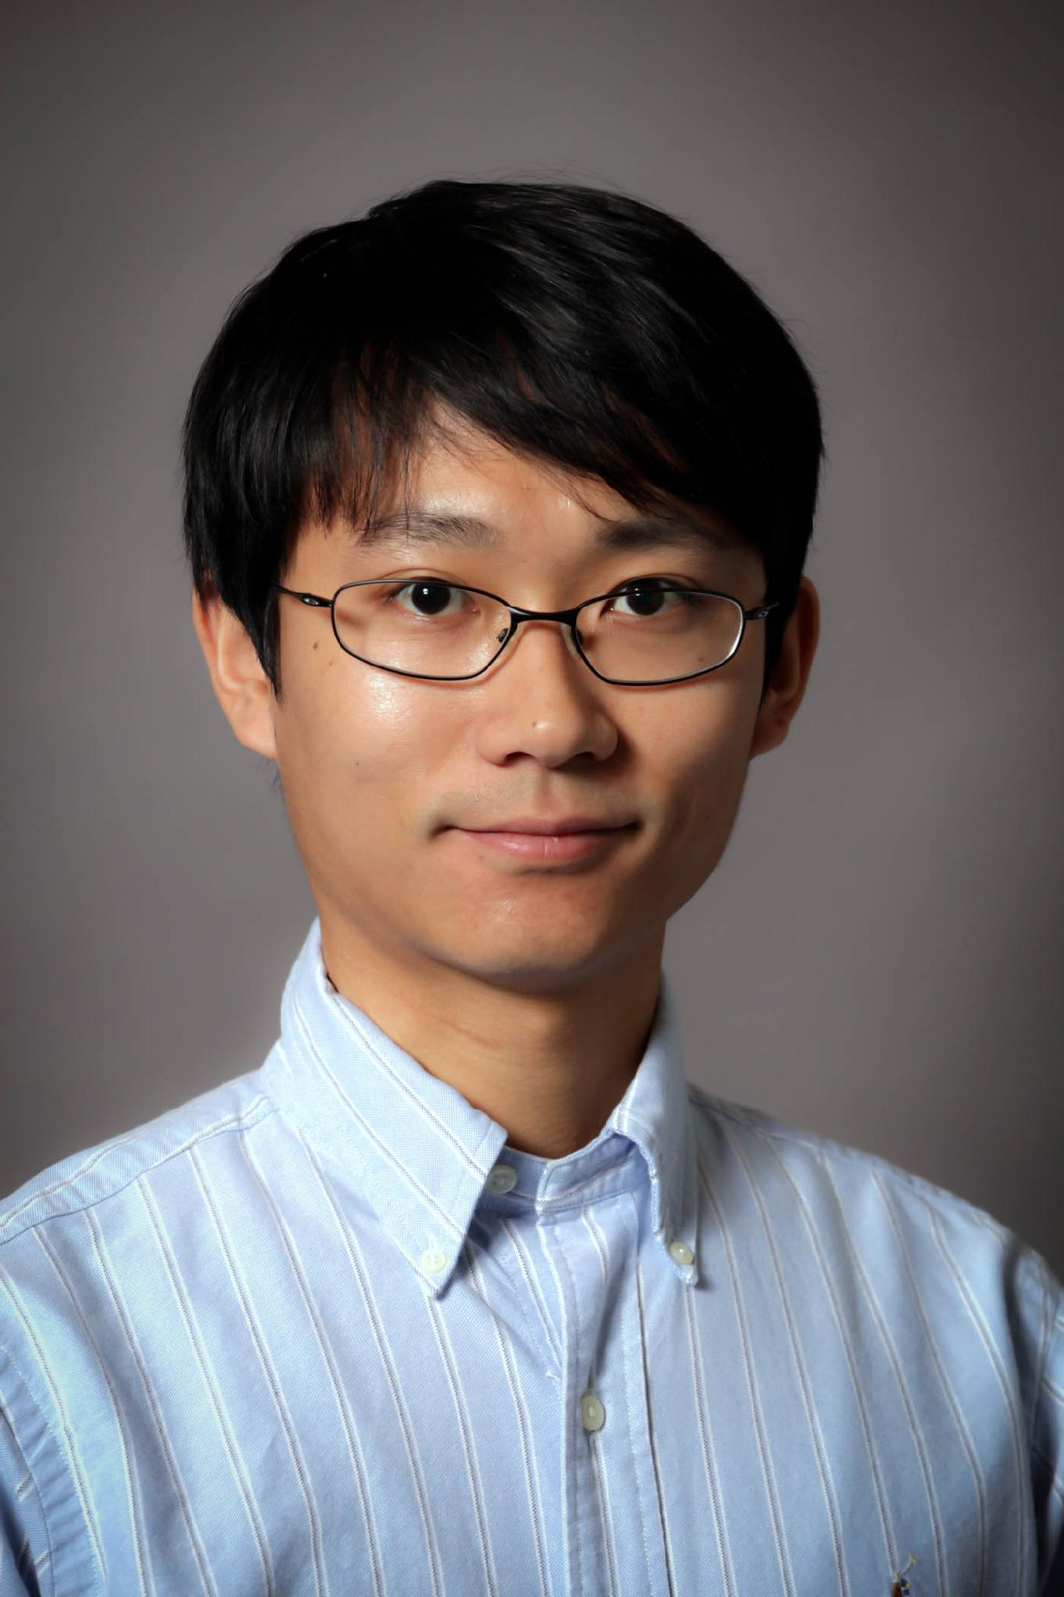
Ziyue Xu
NVIDIA
TALK · 10 MIN
FedReady: Bounded Agents for Federation Formation
Session: Science Domains and Trustworthy Autonomy
Monday, October 19, 2026 · 10:30 AM–12:00 PM CT
Ziyue Xu is a Senior Scientist at NVIDIA Research specializing in artificial intelligence, computer vision, and medical imaging. His work applies machine learning, shape modeling, and graph-based methods to biomedical and clinical imaging, building on prior research leadership at the National Institutes of Health.
PARTNER INSTITUTIONS
11
NSF Award #2609465
Notes:
Talk: FedReady: Bounded Agents for Federation Formation
Format: Talk (10 min).
Session: Science Domains and Trustworthy Autonomy (Monday, October 19, 2026 · 10:30 AM–12:00 PM CT). Moderator: Mike Papka, Argonne National Laboratory; University of Illinois Chicago.
Individual talk times within a session are not listed on the program page; the time above is the session block.
Event: NSDF Summit on Federated Autonomous Science, Oct 19 (all day) and Oct 20 (morning), 2026. Discovery Partners Institute, 200 S Wacker, Chicago, IL 60606, 4th floor. Held in conjunction with PACT 2026. All times Central.
Not on the program page (left blank): title/role, headshot, organization logo, talk summary, speaker bio.
Source: https://nationalsciencedatafabric.org/news/event-nsdf-summit/#program

Slide 13


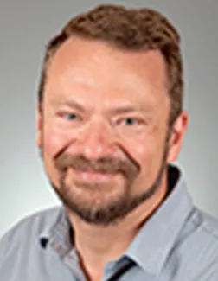
Rudolph Pienaar
Boston Children’s Hospital and Harvard Medical School
TALK · 10 MIN
Computing Infrastructure for Clinical AI — Needs and Challenges
Session: Science Domains and Trustworthy Autonomy
Monday, October 19, 2026 · 10:30 AM–12:00 PM CT
Rudolph Pienaar is a Staff Scientist at Boston Children’s Hospital and Assistant Professor of Radiology at Harvard Medical School, specializing in medical imaging, AI, and computational approaches to medicine. He leads development of ChRIS, an open-source platform that brings advanced AI and image-processing workflows into research and clinical environments, with a broader focus on bridging computational innovation and patient care.
PARTNER INSTITUTIONS
12
NSF Award #2609465
Notes:
Talk: Computing Infrastructure for Clinical AI — Needs and Challenges
Format: Talk (10 min).
Session: Science Domains and Trustworthy Autonomy (Monday, October 19, 2026 · 10:30 AM–12:00 PM CT). Moderator: Mike Papka, Argonne National Laboratory; University of Illinois Chicago.
Individual talk times within a session are not listed on the program page; the time above is the session block.
Event: NSDF Summit on Federated Autonomous Science, Oct 19 (all day) and Oct 20 (morning), 2026. Discovery Partners Institute, 200 S Wacker, Chicago, IL 60606, 4th floor. Held in conjunction with PACT 2026. All times Central.
Not on the program page (left blank): title/role, headshot, organization logo, talk summary, speaker bio.
Source: https://nationalsciencedatafabric.org/news/event-nsdf-summit/#program

Slide 14
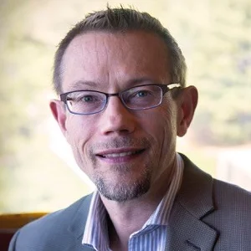
Mike Kirby
University of Utah
TALK · 10 MIN
Introducing AURORA: A Utah Programmable Cloud Laboratory (PCL) Node for Quantum Materials and Beyond
Session: Science Domains and Trustworthy Autonomy
Monday, October 19, 2026 · 10:30 AM–12:00 PM CT
Mike Kirby is a Professor of Computing and Acting Director of the Scientific Computing and Imaging Institute at the University of Utah, as well as founding Executive Director of the Utah Informatics Initiative. His research spans scientific and data computing, visualization, uncertainty quantification, high-performance computing, and computational science and engineering.
PARTNER INSTITUTIONS
13
NSF Award #2609465
Notes:
Talk: Introducing AURORA: A Utah Programmable Cloud Laboratory (PCL) Node for Quantum Materials and Beyond
Format: Talk (10 min).
Session: Science Domains and Trustworthy Autonomy (Monday, October 19, 2026 · 10:30 AM–12:00 PM CT). Moderator: Mike Papka, Argonne National Laboratory; University of Illinois Chicago.
Individual talk times within a session are not listed on the program page; the time above is the session block.
Event: NSDF Summit on Federated Autonomous Science, Oct 19 (all day) and Oct 20 (morning), 2026. Discovery Partners Institute, 200 S Wacker, Chicago, IL 60606, 4th floor. Held in conjunction with PACT 2026. All times Central.
Not on the program page (left blank): title/role, headshot, organization logo, talk summary, speaker bio.
Source: https://nationalsciencedatafabric.org/news/event-nsdf-summit/#program

Slide 15
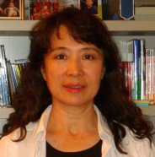
Carol Song
Session Moderator
Purdue University
MODERATOR · 45 MIN
Cross-Cutting Perspectives: Data, AI, and Federation
Monday, October 19, 2026 · 1:30–2:15 PM CT
Xiaohui “Carol” Song is Chief Scientist at Purdue University’s Rosen Center for Advanced Computing, with more than 20 years of experience in high-performance and distributed computing, research software engineering, and scientific cyberinfrastructure. She leads major national computing and data initiatives, including the NSF-funded Anvil supercomputer, and has served as PI or Co-PI on more than 30 projects representing over $90 million in research funding.
PARTNER INSTITUTIONS
14
NSF Award #2609465
Notes:
Talk: Cross-Cutting Perspectives: Data, AI, and Federation
Format: Moderator (45 min).
Session: Cross-Cutting Perspectives: Data, AI, and Federation (Monday, October 19, 2026 · 1:30–2:15 PM CT). Moderator: Carol Song, Purdue University.
Individual talk times within a session are not listed on the program page; the time above is the session block.
Event: NSDF Summit on Federated Autonomous Science, Oct 19 (all day) and Oct 20 (morning), 2026. Discovery Partners Institute, 200 S Wacker, Chicago, IL 60606, 4th floor. Held in conjunction with PACT 2026. All times Central.
Not on the program page (left blank): headshot, organization logo, talk summary, speaker bio.
Source: https://nationalsciencedatafabric.org/news/event-nsdf-summit/#program

Slide 16

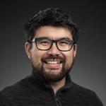
Cogan Shimizu
Wright State University
POSITION STATEMENT · 5 MIN
Knowledge Representation & Semantics in AI Science
Session: Cross-Cutting Perspectives: Data, AI, and Federation
Monday, October 19, 2026 · 1:30–2:15 PM CT
Cogan Shimizu is an Associate Professor of Computer Science and Engineering at Wright State University specializing in knowledge engineering, knowledge graphs, and neurosymbolic AI. His research develops methods for constructing and applying knowledge graphs and explores the intersection of neural and symbolic representations, including human-in-the-loop approaches to AI.
PARTNER INSTITUTIONS
15
NSF Award #2609465
Notes:
Talk: Knowledge Representation & Semantics in AI Science
Format: Position Statement (5 min).
Session: Cross-Cutting Perspectives: Data, AI, and Federation (Monday, October 19, 2026 · 1:30–2:15 PM CT). Moderator: Carol Song, Purdue University.
Individual talk times within a session are not listed on the program page; the time above is the session block.
Event: NSDF Summit on Federated Autonomous Science, Oct 19 (all day) and Oct 20 (morning), 2026. Discovery Partners Institute, 200 S Wacker, Chicago, IL 60606, 4th floor. Held in conjunction with PACT 2026. All times Central.
Not on the program page (left blank): title/role, headshot, organization logo, talk summary, speaker bio.
Source: https://nationalsciencedatafabric.org/news/event-nsdf-summit/#program

Slide 17


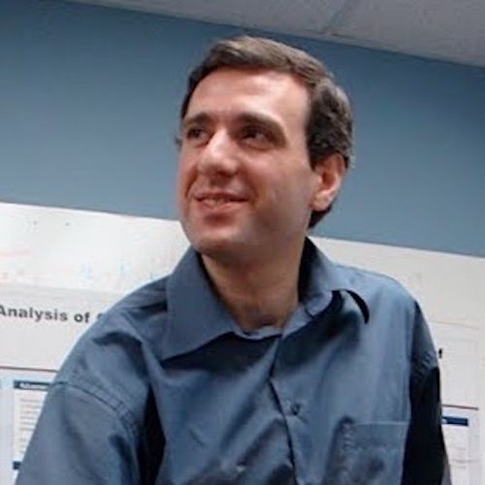
Russell Schwartz
DARPA Biological Technologies Office and Carnegie Mellon University
POSITION STATEMENT · 5 MIN
AI-Driven Autonomous Data Factories for Scientific Applications
Session: Cross-Cutting Perspectives: Data, AI, and Federation
Monday, October 19, 2026 · 1:30–2:15 PM CT
Russell Schwartz is Professor and Head of the Computational Biology Department at Carnegie Mellon University, specializing in algorithms, machine learning, computational genetics, genomics, and biophysics. His research has a major focus on cancer evolution, including tumor phylogenetics, single-cell and spatial genomics, liquid biopsy, and machine-learning methods for predicting cancer progression.
PARTNER INSTITUTIONS
16
NSF Award #2609465
Notes:
Talk: AI-Driven Autonomous Data Factories for Scientific Applications
Format: Position Statement (5 min).
Session: Cross-Cutting Perspectives: Data, AI, and Federation (Monday, October 19, 2026 · 1:30–2:15 PM CT). Moderator: Carol Song, Purdue University.
Individual talk times within a session are not listed on the program page; the time above is the session block.
Event: NSDF Summit on Federated Autonomous Science, Oct 19 (all day) and Oct 20 (morning), 2026. Discovery Partners Institute, 200 S Wacker, Chicago, IL 60606, 4th floor. Held in conjunction with PACT 2026. All times Central.
Not on the program page (left blank): title/role, headshot, organization logo, talk summary, speaker bio.
Source: https://nationalsciencedatafabric.org/news/event-nsdf-summit/#program

Slide 18

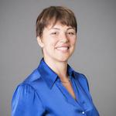
Jelena Mirkovic
USC Information Sciences Institute
POSITION STATEMENT · 5 MIN
Federating Research Infrastructure for Portable, Flexible Scientific Workflows
Session: Cross-Cutting Perspectives: Data, AI, and Federation
Monday, October 19, 2026 · 1:30–2:15 PM CT
Jelena Mirkovic is a Research Associate Professor of Computer Science at USC and a Project Leader at the USC Information Sciences Institute, specializing in computer networks and cybersecurity. Her research focuses on critical network-security challenges including botnets, denial-of-service attacks, IP spoofing, and experimental methods and infrastructure for cybersecurity research.
PARTNER INSTITUTIONS
17
NSF Award #2609465
Notes:
Talk: Federating Research Infrastructure for Portable, Flexible Scientific Workflows
Format: Position Statement (5 min).
Session: Cross-Cutting Perspectives: Data, AI, and Federation (Monday, October 19, 2026 · 1:30–2:15 PM CT). Moderator: Carol Song, Purdue University.
Individual talk times within a session are not listed on the program page; the time above is the session block.
Event: NSDF Summit on Federated Autonomous Science, Oct 19 (all day) and Oct 20 (morning), 2026. Discovery Partners Institute, 200 S Wacker, Chicago, IL 60606, 4th floor. Held in conjunction with PACT 2026. All times Central.
Not on the program page (left blank): title/role, headshot, organization logo, talk summary, speaker bio.
Source: https://nationalsciencedatafabric.org/news/event-nsdf-summit/#program

Slide 19

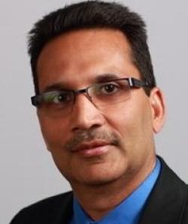
Vipin Chaudhary
Case Western Reserve University
POSITION STATEMENT · 5 MIN
Learning from Private Data Repositories
Session: Cross-Cutting Perspectives: Data, AI, and Federation
Monday, October 19, 2026 · 1:30–2:15 PM CT
Vipin Chaudhary is the Kevin J. Kranzusch Professor and Chair of Computer and Data Sciences at Case Western Reserve University, with expertise spanning high-performance computing, AI and machine learning, quantum computing, and computational medicine. His research has attracted more than $80 million in external funding, and his career spans academic leadership, technology entrepreneurship, and prior service as a Program Director at the National Science Foundation.
PARTNER INSTITUTIONS
18
NSF Award #2609465
Notes:
Talk: Learning from Private Data Repositories
Format: Position Statement (5 min).
Session: Cross-Cutting Perspectives: Data, AI, and Federation (Monday, October 19, 2026 · 1:30–2:15 PM CT). Moderator: Carol Song, Purdue University.
Individual talk times within a session are not listed on the program page; the time above is the session block.
Event: NSDF Summit on Federated Autonomous Science, Oct 19 (all day) and Oct 20 (morning), 2026. Discovery Partners Institute, 200 S Wacker, Chicago, IL 60606, 4th floor. Held in conjunction with PACT 2026. All times Central.
Not on the program page (left blank): title/role, headshot, organization logo, talk summary, speaker bio.
Source: https://nationalsciencedatafabric.org/news/event-nsdf-summit/#program

Slide 20
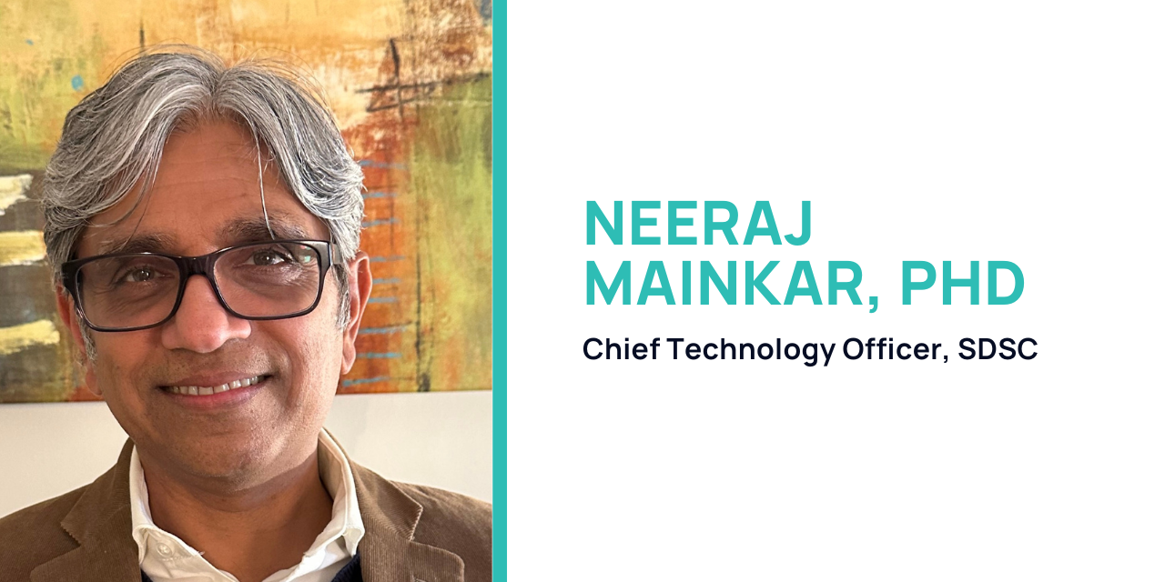
Neeraj Mainkar
Surgical Data Science Collective
POSITION STATEMENT · 5 MIN
Federated Surgical Intelligence: Toward a Distributed Measurement Infrastructure for Surgery
Session: Cross-Cutting Perspectives: Data, AI, and Federation
Monday, October 19, 2026 · 1:30–2:15 PM CT
Neeraj Mainkar is Chief Technology Officer of the Surgical Data Science Collective, where he leads the development of AI infrastructure and platforms for large-scale surgical video and multimodal data analysis. A physicist by training, he brings nearly three decades of technology leadership across defense and healthcare, including medical devices, surgical robotics, and AI-powered surgical navigation.
PARTNER INSTITUTIONS
19
NSF Award #2609465
Notes:
Talk: Federated Surgical Intelligence: Toward a Distributed Measurement Infrastructure for Surgery
Format: Position Statement (5 min).
Session: Cross-Cutting Perspectives: Data, AI, and Federation (Monday, October 19, 2026 · 1:30–2:15 PM CT). Moderator: Carol Song, Purdue University.
Individual talk times within a session are not listed on the program page; the time above is the session block.
Event: NSDF Summit on Federated Autonomous Science, Oct 19 (all day) and Oct 20 (morning), 2026. Discovery Partners Institute, 200 S Wacker, Chicago, IL 60606, 4th floor. Held in conjunction with PACT 2026. All times Central.
Not on the program page (left blank): title/role, headshot, organization logo, talk summary, speaker bio.
Source: https://nationalsciencedatafabric.org/news/event-nsdf-summit/#program

Slide 21

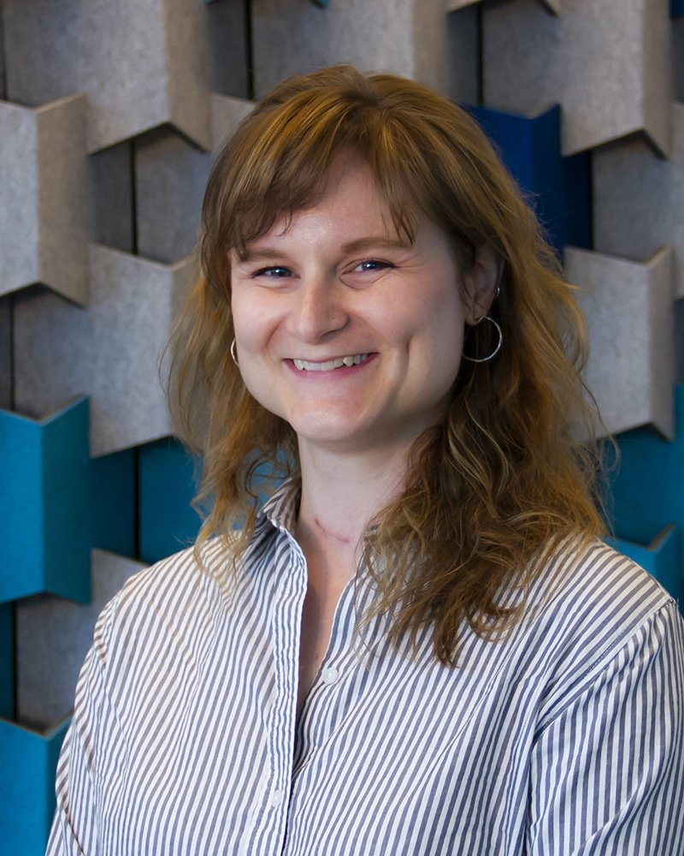
Virginia Trueheart
Session Moderator
TACC
MODERATOR · 45 MIN
Shared Requirements for Federated Autonomous Science
Monday, October 19, 2026 · 2:15–3:00 PM CT
Virginia Trueheart is Director of User Services at the Texas Advanced Computing Center (TACC), where she leads support and training services for researchers using some of the nation’s most advanced computing systems. Her work focuses on improving the HPC user experience, research support operations, job monitoring and profiling, resource-usage analysis, and the development of scalable training and support programs.
PARTNER INSTITUTIONS
20
NSF Award #2609465
Notes:
Talk: Shared Requirements for Federated Autonomous Science
Format: Moderator (45 min).
Session: Shared Requirements for Federated Autonomous Science (Monday, October 19, 2026 · 2:15–3:00 PM CT). Moderator: Virginia Trueheart, TACC.
Individual talk times within a session are not listed on the program page; the time above is the session block.
Event: NSDF Summit on Federated Autonomous Science, Oct 19 (all day) and Oct 20 (morning), 2026. Discovery Partners Institute, 200 S Wacker, Chicago, IL 60606, 4th floor. Held in conjunction with PACT 2026. All times Central.
Not on the program page (left blank): headshot, organization logo, talk summary, speaker bio.
Source: https://nationalsciencedatafabric.org/news/event-nsdf-summit/#program

Slide 22

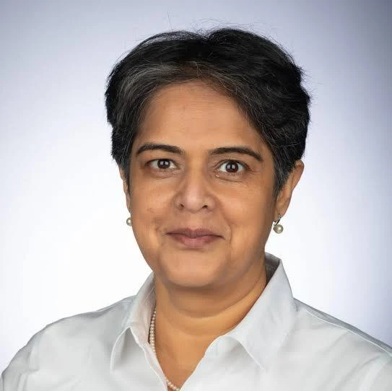
Tanu Malik
University of Missouri
POSITION STATEMENT · 5 MIN
Reproducibility, repeatability, and trustworthiness in scientific discovery
Session: Shared Requirements for Federated Autonomous Science
Monday, October 19, 2026 · 2:15–3:00 PM CT
Tanu Malik is an Associate Professor of Electrical Engineering and Computer Science at the University of Missouri, where she leads the RADIANT Lab and conducts research in big data management, distributed and parallel systems, and trustworthy AI. An NSF CAREER Award recipient, her work develops reproducible and accountable computing systems for AI and scientific research, supported by organizations including NSF, NASA, and the U.S. Department of Energy.
PARTNER INSTITUTIONS
21
NSF Award #2609465
Notes:
Talk: Reproducibility, repeatability, and trustworthiness in scientific discovery
Format: Position Statement (5 min).
Session: Shared Requirements for Federated Autonomous Science (Monday, October 19, 2026 · 2:15–3:00 PM CT). Moderator: Virginia Trueheart, TACC.
Individual talk times within a session are not listed on the program page; the time above is the session block.
Event: NSDF Summit on Federated Autonomous Science, Oct 19 (all day) and Oct 20 (morning), 2026. Discovery Partners Institute, 200 S Wacker, Chicago, IL 60606, 4th floor. Held in conjunction with PACT 2026. All times Central.
Not on the program page (left blank): title/role, headshot, organization logo, talk summary, speaker bio.
Source: https://nationalsciencedatafabric.org/news/event-nsdf-summit/#program

Slide 23

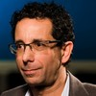
Steven Frank
sophic-compute.com
POSITION STATEMENT · 5 MIN
Dissolving the Data/Compute Boundary — in Both Directions, at Runtime
Session: Shared Requirements for Federated Autonomous Science
Monday, October 19, 2026 · 2:15–3:00 PM CT
Steven Frank is a technology innovator and entrepreneur specializing in deep parallel computing, with more than 40 years of experience in parallel and distributed systems. He has founded four technology companies—including Kendall Square Research, MangoSoft, and Ultrata—and holds more than 100 patents spanning parallel computing, networks, caching, runtime systems, synchronization, algorithms, and hardware and software.
PARTNER INSTITUTIONS
22
NSF Award #2609465
Notes:
Talk: Dissolving the Data/Compute Boundary — in Both Directions, at Runtime
Format: Position Statement (5 min).
Session: Shared Requirements for Federated Autonomous Science (Monday, October 19, 2026 · 2:15–3:00 PM CT). Moderator: Virginia Trueheart, TACC.
Individual talk times within a session are not listed on the program page; the time above is the session block.
Event: NSDF Summit on Federated Autonomous Science, Oct 19 (all day) and Oct 20 (morning), 2026. Discovery Partners Institute, 200 S Wacker, Chicago, IL 60606, 4th floor. Held in conjunction with PACT 2026. All times Central.
Not on the program page (left blank): title/role, headshot, organization logo, talk summary, speaker bio.
Source: https://nationalsciencedatafabric.org/news/event-nsdf-summit/#program

Slide 24
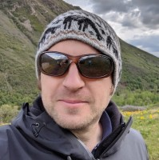
Eric Sokol
National Ecological Observatory Network (NEON), Battelle
POSITION STATEMENT · 5 MIN
FAIR4AI-Bio: AI-Ready Data Infrastructure for Ecology and Biodiversity / NEON
Session: Shared Requirements for Federated Autonomous Science
Monday, October 19, 2026 · 2:15–3:00 PM CT
Eric Sokol is a Senior Quantitative Ecologist with the National Ecological Observatory Network (NEON), specializing in biodiversity, ecological forecasting, and large-scale environmental data science. His work advances open and FAIR ecological data, reproducible research, and AI-ready biodiversity infrastructure, while developing tools and methods for synthesizing long-term ecological datasets at continental scales.
PARTNER INSTITUTIONS
23
NSF Award #2609465
Notes:
Talk: FAIR4AI-Bio: AI-Ready Data Infrastructure for Ecology and Biodiversity / NEON
Format: Position Statement (5 min).
Session: Shared Requirements for Federated Autonomous Science (Monday, October 19, 2026 · 2:15–3:00 PM CT). Moderator: Virginia Trueheart, TACC.
Individual talk times within a session are not listed on the program page; the time above is the session block.
Event: NSDF Summit on Federated Autonomous Science, Oct 19 (all day) and Oct 20 (morning), 2026. Discovery Partners Institute, 200 S Wacker, Chicago, IL 60606, 4th floor. Held in conjunction with PACT 2026. All times Central.
Not on the program page (left blank): title/role, headshot, organization logo, talk summary, speaker bio.
Source: https://nationalsciencedatafabric.org/news/event-nsdf-summit/#program

Slide 25

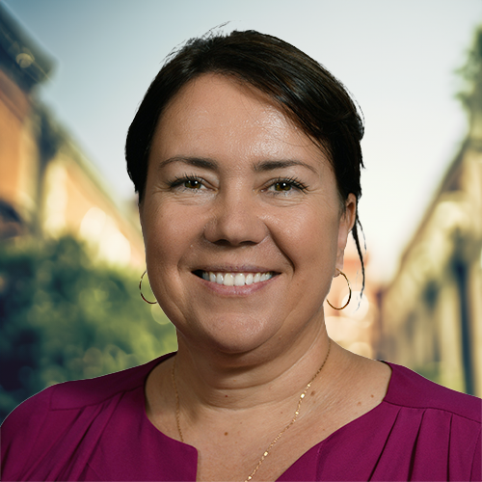
Yaroslava Yingling
North Carolina State University
POSITION STATEMENT · 5 MIN
The Need for Effective Data Fusion Methods in Materials Manufacturing
Session: Shared Requirements for Federated Autonomous Science
Monday, October 19, 2026 · 2:15–3:00 PM CT
Yaroslava Yingling is the Kobe Steel Distinguished Professor of Materials Science and Engineering at NC State University and leads the AI and Materials Simulations (AIMS) Laboratory. Her research integrates artificial intelligence, data science, high-performance computing, and multiscale molecular modeling to accelerate materials discovery and design, with applications spanning biomimetic materials, nanomaterials, polymers, and sustainability.
PARTNER INSTITUTIONS
24
NSF Award #2609465
Notes:
Talk: The Need for Effective Data Fusion Methods in Materials Manufacturing
Format: Position Statement (5 min).
Session: Shared Requirements for Federated Autonomous Science (Monday, October 19, 2026 · 2:15–3:00 PM CT). Moderator: Virginia Trueheart, TACC.
Individual talk times within a session are not listed on the program page; the time above is the session block.
Event: NSDF Summit on Federated Autonomous Science, Oct 19 (all day) and Oct 20 (morning), 2026. Discovery Partners Institute, 200 S Wacker, Chicago, IL 60606, 4th floor. Held in conjunction with PACT 2026. All times Central.
Not on the program page (left blank): title/role, headshot, organization logo, talk summary, speaker bio.
Source: https://nationalsciencedatafabric.org/news/event-nsdf-summit/#program

Slide 26

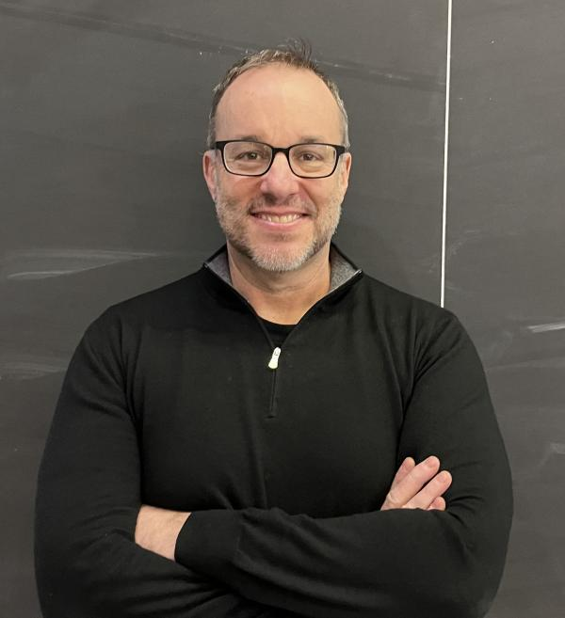
Ronald Koder
City College of New York
POSITION STATEMENT · 5 MIN
AI-BIOME: The AI-Enabled Bio-Inspired Materials Ecosystem
Session: Shared Requirements for Federated Autonomous Science
Monday, October 19, 2026 · 2:15–3:00 PM CT
Ronald Koder is a Professor of Physics at The City College of New York and co-Director of the CCNY High Throughput Experimentation Core Facility, working at the intersection of machine learning, biodesign, synthetic biology, and experimental biological physics. His research focuses on designing novel proteins and biomaterials for applications including biosensing, energy materials, and therapeutics, including work on engineered proteins capable of highly selective molecular detection.
PARTNER INSTITUTIONS
25
NSF Award #2609465
Notes:
Talk: AI-BIOME: The AI-Enabled Bio-Inspired Materials Ecosystem
Format: Position Statement (5 min).
Session: Shared Requirements for Federated Autonomous Science (Monday, October 19, 2026 · 2:15–3:00 PM CT). Moderator: Virginia Trueheart, TACC.
Individual talk times within a session are not listed on the program page; the time above is the session block.
Event: NSDF Summit on Federated Autonomous Science, Oct 19 (all day) and Oct 20 (morning), 2026. Discovery Partners Institute, 200 S Wacker, Chicago, IL 60606, 4th floor. Held in conjunction with PACT 2026. All times Central.
Not on the program page (left blank): affiliation, title/role, headshot, organization logo, talk summary, speaker bio.
Source: https://nationalsciencedatafabric.org/news/event-nsdf-summit/#program

Slide 27

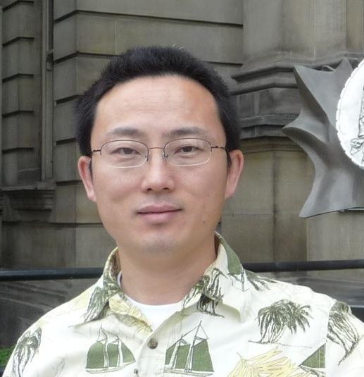
Guangzhi Qu
Oakland University
POSITION STATEMENT · 5 MIN
Can Autonomous Science Trust What It Perceives?
Session: Shared Requirements for Federated Autonomous Science
Monday, October 19, 2026 · 2:15–3:00 PM CT
Guangzhi Qu is a Professor in the Department of Computer Science and Engineering at Oakland University, where his research spans artificial intelligence, applied machine learning, software analysis, embedded systems, multicore computing, and discrete-event simulation. He holds a Ph.D. from the University of Arizona and teaches courses in operating systems, artificial intelligence, and machine learning.
PARTNER INSTITUTIONS
26
NSF Award #2609465

Slide 28
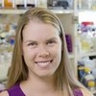
Claire Robertson
Lawrence Livermore National Laboratory
PILOT PITCH · 5 MIN
Real-Time Experiment Steering in 3D Biological Microscopy
Session: From Position Papers to Collaborative Pilots
Monday, October 19, 2026 · 3:30–4:10 PM CT
Claire Robertson is a Materials Engineer at Lawrence Livermore National Laboratory and a biomedical engineer specializing in how cells interact with their microenvironment through advanced microscopy, materials science, biomechanics, and cell biology. Her research spans 3D cell culture, extracellular matrix biology, tissue biomechanics, and organ-on-chip systems, with applications across cancer, cardiovascular, pulmonary, and musculoskeletal biology.
PARTNER INSTITUTIONS
26
NSF Award #2609465
Notes:
Talk: Real-Time Experiment Steering in 3D Biological Microscopy
Format: Pilot Pitch (5 min).
Session: From Position Papers to Collaborative Pilots (Monday, October 19, 2026 · 3:30–4:10 PM CT). Moderator: Timo Bremer, Lawrence Livermore National Laboratory and University of Utah.
Individual talk times within a session are not listed on the program page; the time above is the session block.
Event: NSDF Summit on Federated Autonomous Science, Oct 19 (all day) and Oct 20 (morning), 2026. Discovery Partners Institute, 200 S Wacker, Chicago, IL 60606, 4th floor. Held in conjunction with PACT 2026. All times Central.
Not on the program page (left blank): title/role, headshot, organization logo, talk summary, speaker bio.
Source: https://nationalsciencedatafabric.org/news/event-nsdf-summit/#program

Slide 29

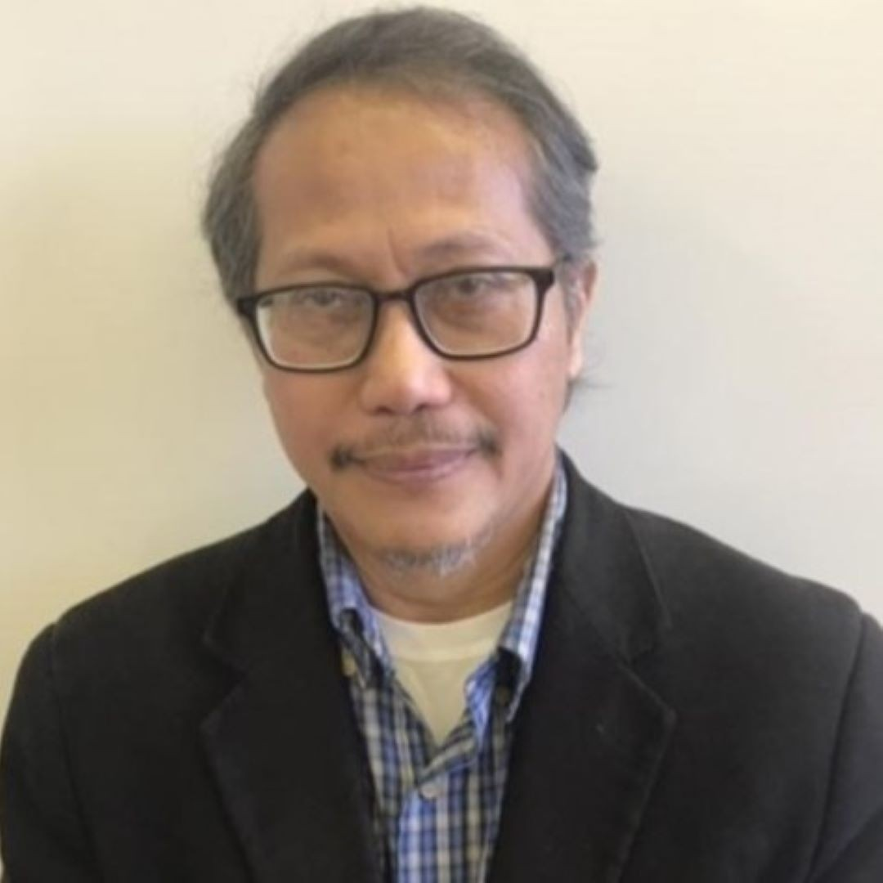
Widodo Samyono
Jarvis Christian University
PILOT PITCH · 5 MIN
Applications of ML in Life STEM
Session: From Position Papers to Collaborative Pilots
Monday, October 19, 2026 · 3:30–4:10 PM CT
Widodo Samyono is an Associate Professor of Mathematics at Jarvis Christian University whose work spans mathematics, statistics, data mining, and interdisciplinary STEM education. He is a co-principal investigator on Jarvis’s $2.25 million NSF-funded I-RISE initiative and has contributed to interdisciplinary research and student training connecting quantitative methods with biomedical and cancer research.
PARTNER INSTITUTIONS
27
NSF Award #2609465
Notes:
Talk: Applications of ML in Life STEM
Format: Pilot Pitch (5 min).
Session: From Position Papers to Collaborative Pilots (Monday, October 19, 2026 · 3:30–4:10 PM CT). Moderator: Timo Bremer, Lawrence Livermore National Laboratory and University of Utah.
Individual talk times within a session are not listed on the program page; the time above is the session block.
Event: NSDF Summit on Federated Autonomous Science, Oct 19 (all day) and Oct 20 (morning), 2026. Discovery Partners Institute, 200 S Wacker, Chicago, IL 60606, 4th floor. Held in conjunction with PACT 2026. All times Central.
Not on the program page (left blank): title/role, headshot, organization logo, talk summary, speaker bio.
Source: https://nationalsciencedatafabric.org/news/event-nsdf-summit/#program

Slide 30

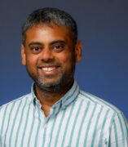
Sidharth Kumar
University of Illinois Chicago
PILOT PITCH · 5 MIN
In-Space Manufacturing
Session: From Position Papers to Collaborative Pilots
Monday, October 19, 2026 · 3:30–4:10 PM CT
Sidharth Kumar is an Associate Professor of Computer Science at the University of Illinois Chicago specializing in high-performance computing and large-scale data management. His research develops scalable algorithms and data structures at the intersection of HPC, analytics, visualization, databases, topology, and machine learning, enabling scientists to extract insights from massive and complex computational datasets.
PARTNER INSTITUTIONS
28
NSF Award #2609465
Notes:
Talk: In-Space Manufacturing
Format: Pilot Pitch (5 min).
Session: From Position Papers to Collaborative Pilots (Monday, October 19, 2026 · 3:30–4:10 PM CT). Moderator: Timo Bremer, Lawrence Livermore National Laboratory and University of Utah.
Individual talk times within a session are not listed on the program page; the time above is the session block.
Event: NSDF Summit on Federated Autonomous Science, Oct 19 (all day) and Oct 20 (morning), 2026. Discovery Partners Institute, 200 S Wacker, Chicago, IL 60606, 4th floor. Held in conjunction with PACT 2026. All times Central.
Not on the program page (left blank): title/role, headshot, organization logo, talk summary, speaker bio.
Source: https://nationalsciencedatafabric.org/news/event-nsdf-summit/#program

Slide 31
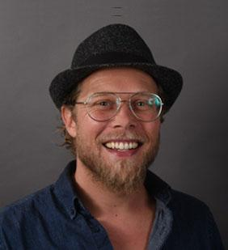
Daniel Haehn
University of Massachusetts Boston
PILOT PITCH · 5 MIN
From Browser to DGX: Federated AI and Computing for Interactive Science
Session: From Position Papers to Collaborative Pilots
Monday, October 19, 2026 · 3:30–4:10 PM CT
Daniel Haehn is an Associate Professor of Computer Science at UMass Boston specializing in biomedical imaging, visualization, and computer graphics. His research explores brain connectivity and machine perception to advance biologically inspired artificial intelligence, with a strong emphasis on open science and open education.
PARTNER INSTITUTIONS
29
NSF Award #2609465
Notes:
Talk: From Browser to DGX: Federated AI and Computing for Interactive Science
Format: Pilot Pitch (5 min).
Session: From Position Papers to Collaborative Pilots (Monday, October 19, 2026 · 3:30–4:10 PM CT). Moderator: Timo Bremer, Lawrence Livermore National Laboratory and University of Utah.
Individual talk times within a session are not listed on the program page; the time above is the session block.
Event: NSDF Summit on Federated Autonomous Science, Oct 19 (all day) and Oct 20 (morning), 2026. Discovery Partners Institute, 200 S Wacker, Chicago, IL 60606, 4th floor. Held in conjunction with PACT 2026. All times Central.
Not on the program page (left blank): title/role, headshot, organization logo, talk summary, speaker bio.
Source: https://nationalsciencedatafabric.org/news/event-nsdf-summit/#program

Slide 32

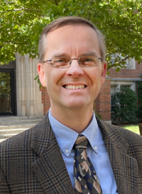
Dean Hougen
University of Oklahoma
PILOT PITCH · 5 MIN
From Explainable to Informative AI: Understanding the World, Not Just the Model
Session: From Position Papers to Collaborative Pilots
Monday, October 19, 2026 · 3:30–4:10 PM CT
Dean Hougen is the Lloyd & Joyce Austin Presidential Professor of Computer Science at the University of Oklahoma, with more than 30 years of experience in artificial intelligence and machine learning. His research spans robotics, deep and interpretable learning, reinforcement learning, evolutionary computation, and multi-agent systems, with more than 115 refereed publications and over $21 million in jointly secured research funding.
PARTNER INSTITUTIONS
30
NSF Award #2609465
Notes:
Talk: From Explainable to Informative AI: Understanding the World, Not Just the Model
Format: Pilot Pitch (5 min).
Session: From Position Papers to Collaborative Pilots (Monday, October 19, 2026 · 3:30–4:10 PM CT). Moderator: Timo Bremer, Lawrence Livermore National Laboratory and University of Utah.
Individual talk times within a session are not listed on the program page; the time above is the session block.
Event: NSDF Summit on Federated Autonomous Science, Oct 19 (all day) and Oct 20 (morning), 2026. Discovery Partners Institute, 200 S Wacker, Chicago, IL 60606, 4th floor. Held in conjunction with PACT 2026. All times Central.
Not on the program page (left blank): title/role, headshot, organization logo, talk summary, speaker bio.
Source: https://nationalsciencedatafabric.org/news/event-nsdf-summit/#program

Slide 33
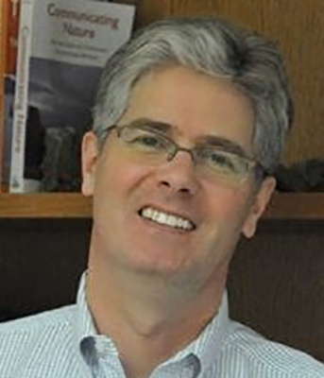
David Elbert
Session Moderator
Johns Hopkins University
MODERATOR · 40 MIN
Shared Agenda for NSDF and Federal Agencies and Labs
Monday, October 19, 2026 · 4:10–4:50 PM CT
David Elbert is a Faculty Research Scientist at Johns Hopkins University, working at the intersection of materials science and data infrastructure. He designs autonomous, semantic data-provenance systems that connect instruments, databases, analysis pipelines, and AI agents — including linked-data infrastructure for the AIMD-L Process Control Lab at Johns Hopkins and a digital-twin system for NASA’s IMQCAM program.
PARTNER INSTITUTIONS
31
NSF Award #2609465

Slide 34

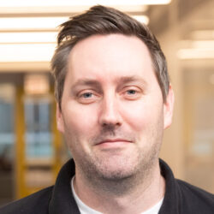
Kyle Chard
University of Chicago
POSITION STATEMENT · 5 MIN
Academy: A Federated Platform for Scientific AI Agents
Session: Shared Agenda for NSDF and Federal Agencies and Labs
Monday, October 19, 2026 · 4:10–4:50 PM CT
Kyle Chard is a Research Associate Professor of Computer Science at the University of Chicago with a joint appointment at Argonne National Laboratory, specializing in high-performance, distributed, cloud, and data-intensive computing. He co-leads Globus Labs and leads NSF-funded research on parallel and distributed computing, scientific reproducibility and automation, research data management, and scalable, cost-aware computing infrastructure.
PARTNER INSTITUTIONS
32
NSF Award #2609465
Notes:
Talk: Academy: A Federated Platform for Scientific AI Agents
Format: Position Statement (5 min).
Session: Shared Agenda for NSDF and Federal Agencies and Labs (Monday, October 19, 2026 · 4:10–4:50 PM CT). Moderator: TBA.
Individual talk times within a session are not listed on the program page; the time above is the session block.
Event: NSDF Summit on Federated Autonomous Science, Oct 19 (all day) and Oct 20 (morning), 2026. Discovery Partners Institute, 200 S Wacker, Chicago, IL 60606, 4th floor. Held in conjunction with PACT 2026. All times Central.
Not on the program page (left blank): title/role, headshot, organization logo, talk summary, speaker bio.
Source: https://nationalsciencedatafabric.org/news/event-nsdf-summit/#program

Slide 35

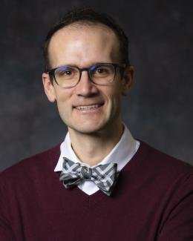
Chris Fancher
ORNL
POSITION STATEMENT · 5 MIN
TBA
Session: Shared Agenda for NSDF and Federal Agencies and Labs
Monday, October 19, 2026 · 4:10–4:50 PM CT
Christopher Fancher is a Senior Research Staff Scientist and Advanced Manufacturing Diffraction Scientist at Oak Ridge National Laboratory, specializing in materials science, advanced characterization, and data science. His research uses X-ray and neutron scattering to understand structure–processing–property relationships in metal additive manufacturing, including how non-equilibrium thermal conditions influence material structure and performance.
PARTNER INSTITUTIONS
33
NSF Award #2609465
Notes:
Talk: TBA
Format: Position Statement (5 min).
Session: Shared Agenda for NSDF and Federal Agencies and Labs (Monday, October 19, 2026 · 4:10–4:50 PM CT). Moderator: TBA.
Individual talk times within a session are not listed on the program page; the time above is the session block.
Event: NSDF Summit on Federated Autonomous Science, Oct 19 (all day) and Oct 20 (morning), 2026. Discovery Partners Institute, 200 S Wacker, Chicago, IL 60606, 4th floor. Held in conjunction with PACT 2026. All times Central.
Not on the program page (left blank): title/role, headshot, organization logo, talk summary, speaker bio.
Source: https://nationalsciencedatafabric.org/news/event-nsdf-summit/#program

Slide 36


Kristi Potter
National Laboratory of the Rockies
POSITION STATEMENT · 5 MIN
Autonomous Science at NLR
Session: Shared Agenda for NSDF and Federal Agencies and Labs
Monday, October 19, 2026 · 4:10–4:50 PM CT
Kristi Potter is Acting Director of Computational Science at the National Laboratory of the Rockies and a scientist specializing in data visualization, uncertainty visualization, and high-dimensional data analysis. Her research develops visualization methods that communicate uncertainty, error, confidence, and reliability in complex scientific data, with more than 15 years of experience spanning atmospheric science, materials modeling, geographic mapping, and other disciplines.
PARTNER INSTITUTIONS
34
NSF Award #2609465
Notes:
Talk: Autonomous Science at NLR
Format: Position Statement (5 min).
Session: Shared Agenda for NSDF and Federal Agencies and Labs (Monday, October 19, 2026 · 4:10–4:50 PM CT). Moderator: TBA.
Individual talk times within a session are not listed on the program page; the time above is the session block.
Event: NSDF Summit on Federated Autonomous Science, Oct 19 (all day) and Oct 20 (morning), 2026. Discovery Partners Institute, 200 S Wacker, Chicago, IL 60606, 4th floor. Held in conjunction with PACT 2026. All times Central.
Not on the program page (left blank): title/role, headshot, organization logo, talk summary, speaker bio.
Source: https://nationalsciencedatafabric.org/news/event-nsdf-summit/#program

Slide 37

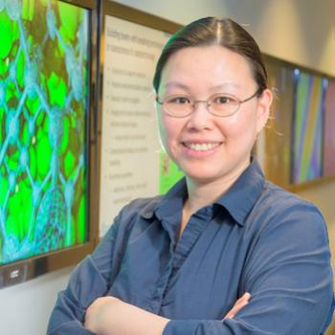
Maria Chan
Argonne National Laboratory
POSITION STATEMENT · 5 MIN
Integrating AI-Ready Computational and Experimental Data for Materials Science
Session: Shared Agenda for NSDF and Federal Agencies and Labs
Monday, October 19, 2026 · 4:10–4:50 PM CT
Maria Chan is a Scientist at Argonne National Laboratory’s Center for Nanoscale Materials specializing in computational modeling and AI/ML for materials discovery and understanding. Her research integrates first-principles and atomistic modeling, machine learning, and experimental characterization to advance nanomaterials and renewable-energy technologies including batteries, photovoltaics, catalysts, and thermoelectrics.
PARTNER INSTITUTIONS
35
NSF Award #2609465
Notes:
Talk: Integrating AI-Ready Computational and Experimental Data for Materials Science
Format: Position Statement (5 min).
Session: Shared Agenda for NSDF and Federal Agencies and Labs (Monday, October 19, 2026 · 4:10–4:50 PM CT). Moderator: TBA.
Individual talk times within a session are not listed on the program page; the time above is the session block.
Event: NSDF Summit on Federated Autonomous Science, Oct 19 (all day) and Oct 20 (morning), 2026. Discovery Partners Institute, 200 S Wacker, Chicago, IL 60606, 4th floor. Held in conjunction with PACT 2026. All times Central.
Not on the program page (left blank): title/role, headshot, organization logo, talk summary, speaker bio.
Source: https://nationalsciencedatafabric.org/news/event-nsdf-summit/#program

Slide 38

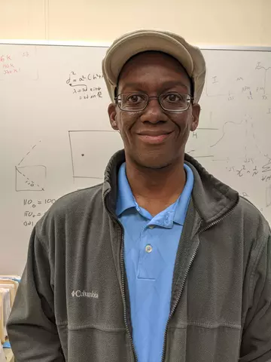
William D. Ratcliff
NIST Center for Neutron Research
POSITION STATEMENT · 5 MIN
AI Readiness and the User Facilities: Autonomy, Metadata, and Agentic AI at the NCNR User Facility
Session: Shared Agenda for NSDF and Federal Agencies and Labs
Monday, October 19, 2026 · 4:10–4:50 PM CT
William D. Ratcliff is a physicist at the NIST Center for Neutron Research specializing in condensed matter physics, neutron scattering, quantum materials, and artificial intelligence. An American Physical Society Fellow and two-time NIST Bronze Medal recipient, his current research focuses on topological and multiferroic materials and applying AI to neutron-scattering experiments and analysis.
PARTNER INSTITUTIONS
36
NSF Award #2609465
Notes:
Talk: AI Readiness and the User Facilities: Autonomy, Metadata, and Agentic AI at the NCNR User Facility
Format: Position Statement (5 min).
Session: Shared Agenda for NSDF and Federal Agencies and Labs (Monday, October 19, 2026 · 4:10–4:50 PM CT). Moderator: TBA.
Individual talk times within a session are not listed on the program page; the time above is the session block.
Event: NSDF Summit on Federated Autonomous Science, Oct 19 (all day) and Oct 20 (morning), 2026. Discovery Partners Institute, 200 S Wacker, Chicago, IL 60606, 4th floor. Held in conjunction with PACT 2026. All times Central.
Not on the program page (left blank): title/role, headshot, organization logo, talk summary, speaker bio.
Source: https://nationalsciencedatafabric.org/news/event-nsdf-summit/#program

