Slide 1

UTEP class with support by the NSDF
Brian E. Schuster, Ph.D. bschuster@utep.edu
Associate Professor
Metallurgical, Materials and Biomedical Engineering The University of Texas at El Paso

Slide 2
Acknowledgements
Professor Valerio Pascucci, University of Utah
Duncan Greeley and Professor John Allison, University of Michigan

Slide 3
Overview
Introduction to UTEP and the Metallurgical, Materials and Biomedical Engineering Department
An introduction to Dynamic Materials Research at UTEP
MME 1205 Graphics:
MME 1205 Syllabus

Slide 4


El Paso, TX and Ciudad Juarez, Chihuahua MX

Slide 5
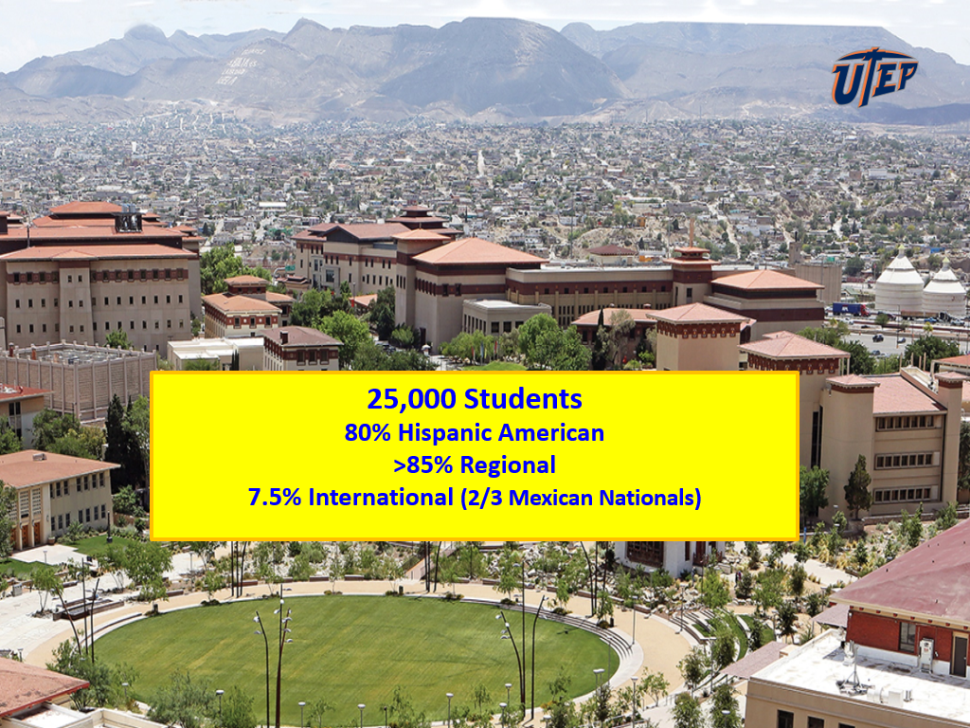

Slide 6
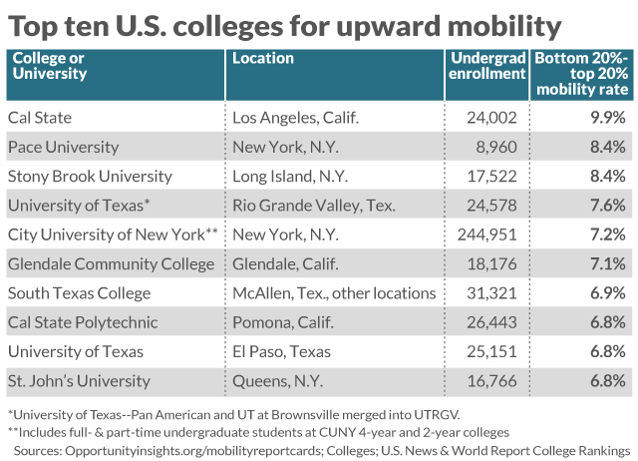

Slide 7
WE ARE 1 OF 8
METALLURGICAL ENGINEERING PROGRAMS
IN THE US

Slide 8
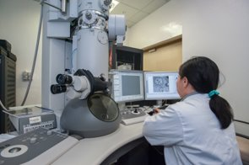
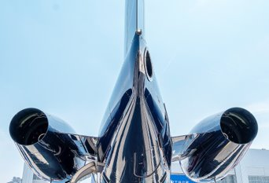
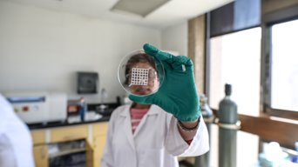
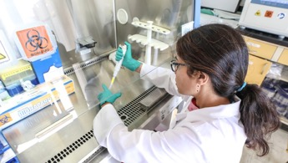
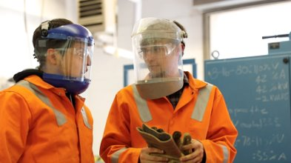
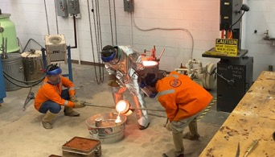
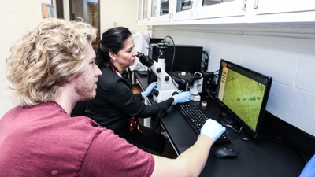

CONCENTRATIONS
FORENSIC ENGINEERING & MATERIAL PERFORMANCE
BIOMATERIALS
EXTRACTIVE & PROCESS METALLURGY
GENERAL METALLURGY

Slide 9
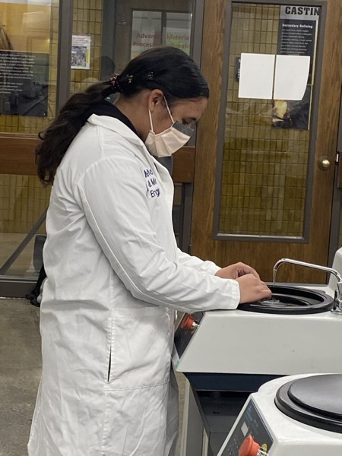
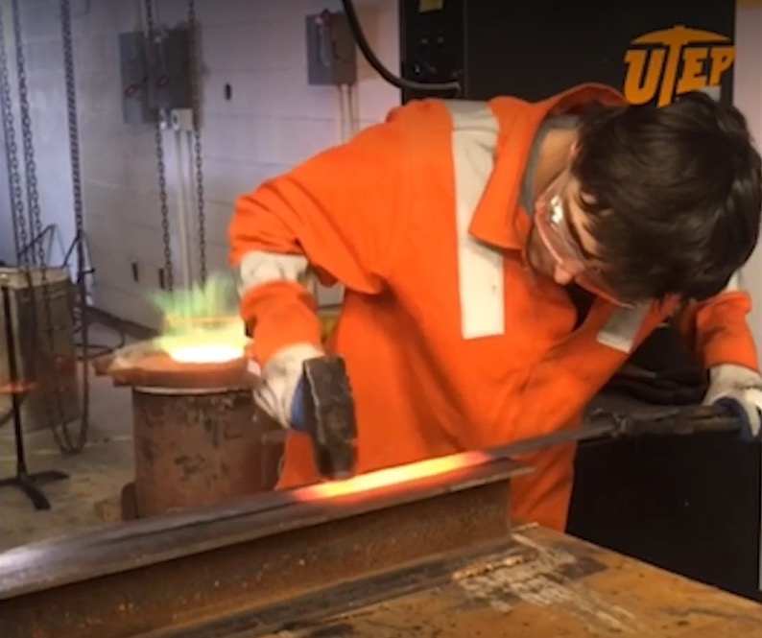
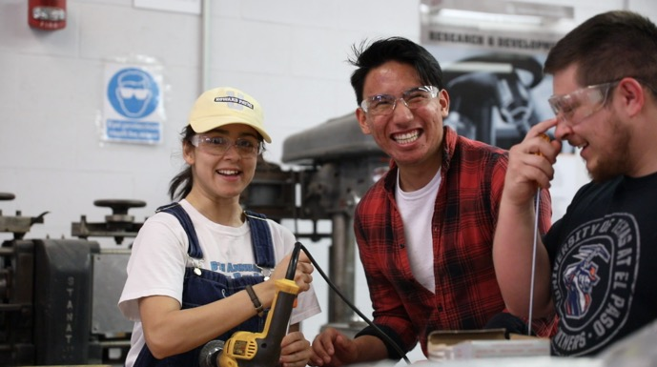
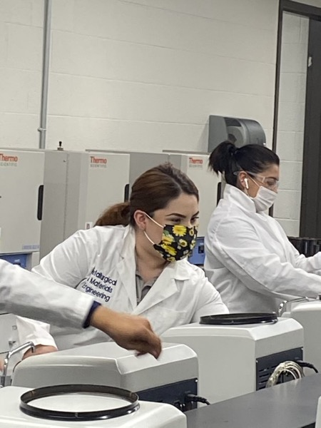

Hands-on Project Based Curriculum

Slide 10
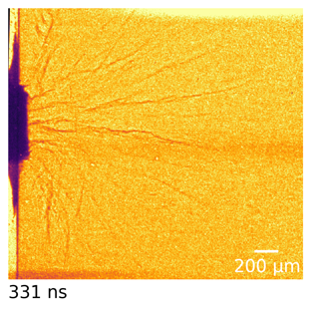
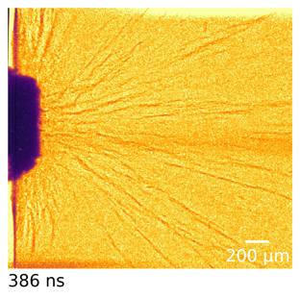
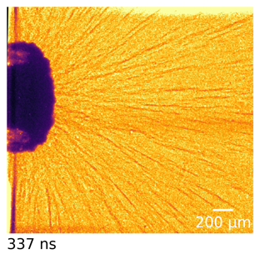
Incipient Damage in B₄C
1123 m/s
1498 m/s
2442 m/s

Slide 11
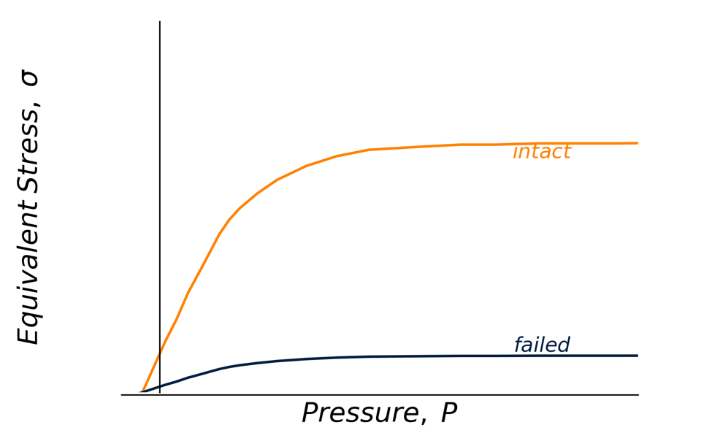
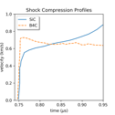
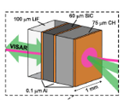
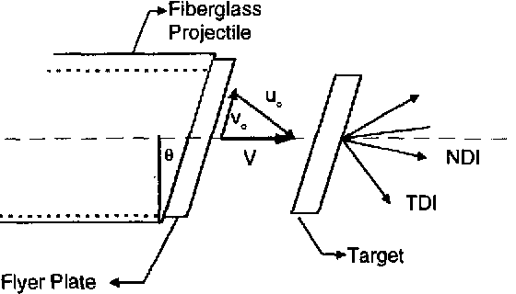

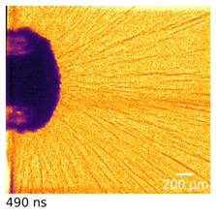
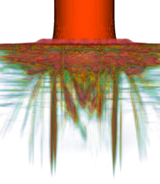

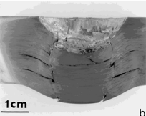

Time, Path, and Pressure Dependent Failure
Pressure Shear
Shock
Kolsky/Hopkinson Bar Compression
Clifton
Grady
Tracy
Magagnosc et al.
Ceramic
Modeling
Tension
Metal
Murr
Schuster
Tonge
Magagnosc et al.
bschuster@utep.edu

Slide 12
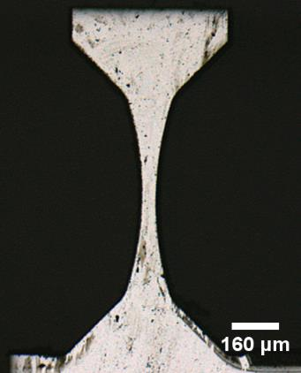
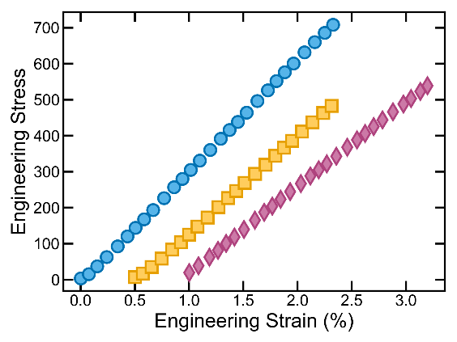
Representative SiC-N Tensile Response
Hourglass specimen used to minimize unwanted stress concentrations
Quasistatic tensile tests performed at ~10⁻³ s⁻¹
Bulk
strengths
https://doi.org/10.1016/j.msea.2019.138297
Notes:
Stress concentration: 1.01
Final gage length: 0.7mm, width: 50um

Slide 13
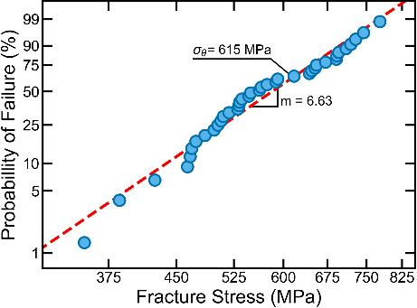
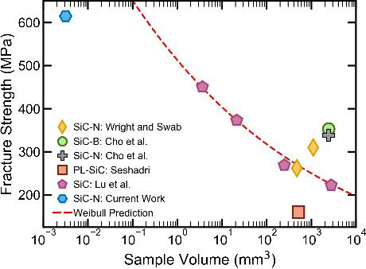
Size Effects in Silicon Carbide Fracture Stress
Performed 38 tensile tests on fs-laser fabricated tensile bars
Significant increase in strength compared to literature reports
Expected size scaling indicates strength saturation
K. Cho et al., ARL-TR-1406 (1997).; J. C. Wright et al., ARL-TR-6794 (2014).; C. Lu et al., Phys. Rev. E, 65 (2002).,
S. G. Seshadri et al., JACERS, 70 (1987)
https://doi.org/10.1016/j.msea.2019.138297
Notes:
Expected characteristic strengths >1000 MPa

Slide 14
MME 1205
COURSE DESCRIPTION MME 1205 (Graphics) is a required 2-credit course (1 hours of lecture and 3 lab hours).
Three broad topics will be covered in this class:
An introduction to the Python programming language
Applications of Python programming to problems that are unique to Metallurgical, Materials and Biomedical Engineering (MMBME) including numerical analysis of experimental data, quantitative image analysis and basic statistical analysis of material response
An introduction to digital manufacturing and engineering drawing software using Solidworks

Slide 15
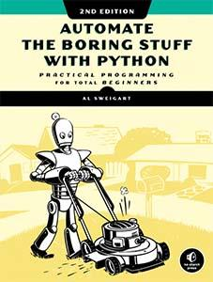
Textbook (Free Online) Link

Slide 16
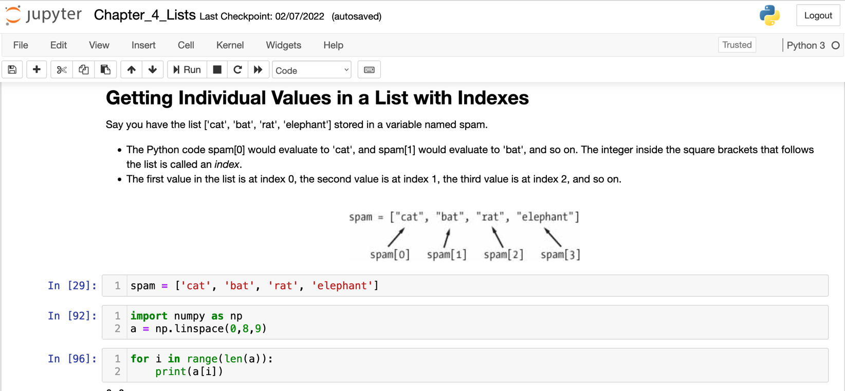
Automate the Boring Stuff with Python

Slide 17
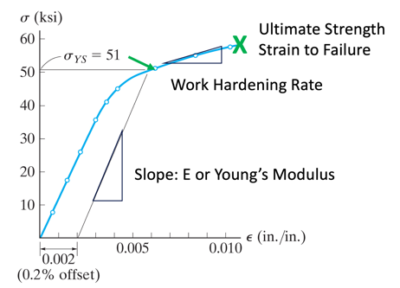
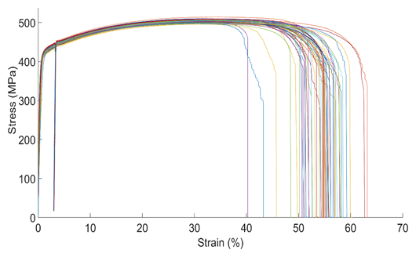
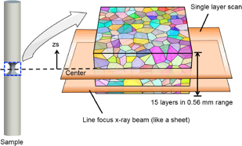
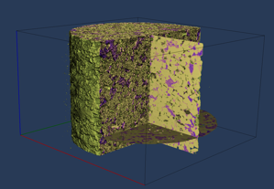
Modules
Python Basics
Applications to Mechanical Testing
Microstructural/Image Analysis (with Pascucci, Allison, Greeley)

Slide 18

High Energy Diffraction Microscopy
https://doi.org/10.1016/j.ijsolstr.2016.05.010

Slide 19
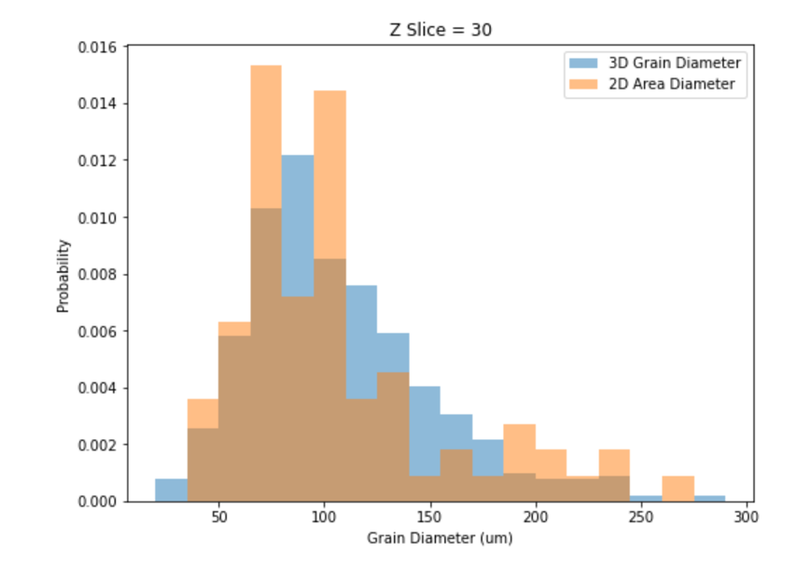
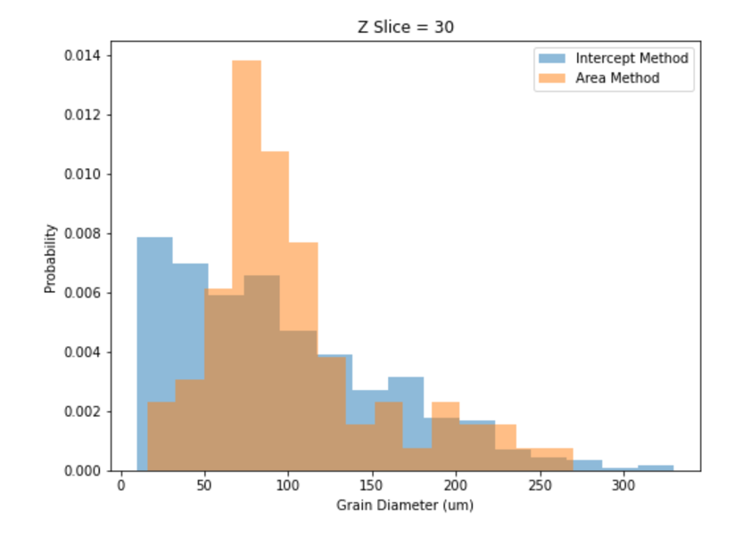
Image Analysis in MME 1205
The students will explore highly curated 3 dimensional data sets of real material microstructures characterized using state of the art methods

Slide 20
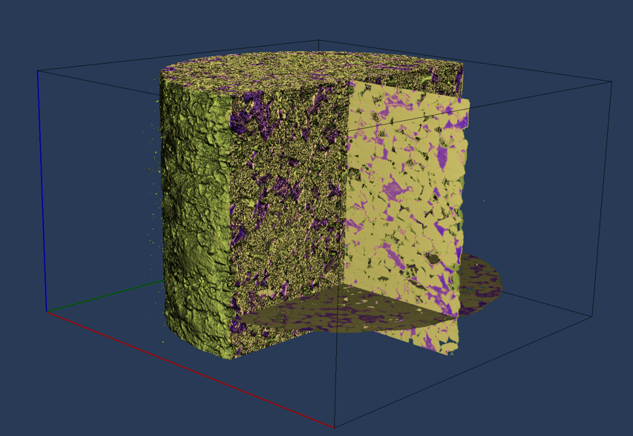
Other 3D and HR Datasets

Slide 21
Thanks!
I would love to hear suggestions (I’ve never taught programming or data science….HELP!)
bschuster@utep.edu

