Slide 1
Content Delivery Network – State of the Art
Chris Shelley Solutions Engineer

Slide 2

Who am I?
Chris Shelley
Currently a Solution Engineer specializing in SASE deployments for Public Sector (Federal and SLED) customers.
Working with State, Local, and Federal government for 6 years. 3 years at Cloudflare and 3 years at Verisign prior to joining Cloudflare.

Slide 3
The Network Has Changed

Slide 4
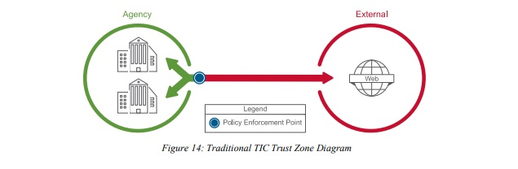
When Networks Were Simple
“Castle and Moat” Model
One point of entry and exit along the boundary
Policy enforcement at boundary with internal network segmentation
Only two zones of Trust -- either you’re inside the boundary or you aren’t

Slide 5
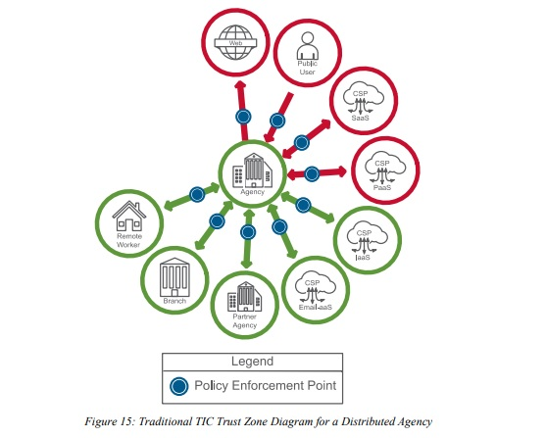
Networks More Complex Than Ever
Hub and Spoke Model
Connectivity from every possible device, user, and appliance imaginable.
Massive Complexity, Scale, and Security Issues

Slide 6

A New Framework
S
Strengthen Security
Reduce Complexity and Costs
E
A
Enable Zero Trust
Increase Effectiveness and Resilience
S

Slide 7
SASE: The new CDN

Slide 8
What is SASE?
A secure access service edge (SASE) is a term coined by analyst firm Gartner. SASE was promoted for computer security in wide area networks (WANs) by delivering both as a cloud computing service directly to the source of connection (user, device, branch office, Internet of things (IoT) device, or edge computing location) rather than a data center. Security is based on digital identity, real-time context with company and regulatory compliance policies. A digital identity may be attached to anything from a person to a device, branch office, cloud service, application software, IoT system, or an edge computing location.[1]
[1]Wikipedia

Slide 9
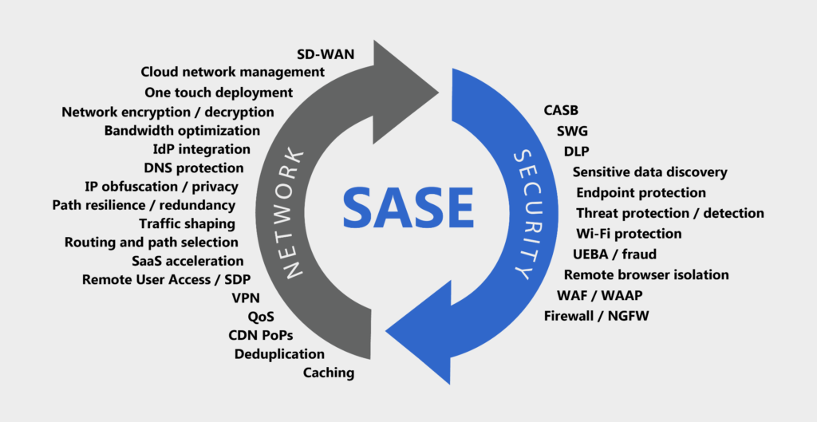
SASE: A Convergence of Technologies

Slide 10
Cloudflare: Built Different

Slide 11
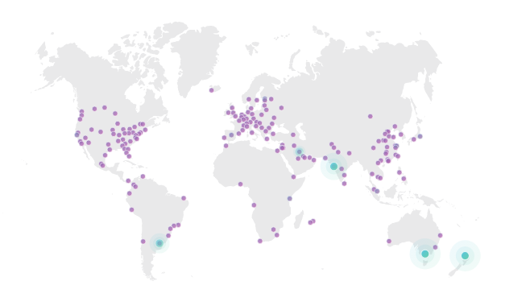

Leveraging Edge Intelligence from over 15M+
Internet Properties
250 PoPs Growing to 300 by year end
10%+ Global HTTP Internet requests
#1
connectivity to internet exchanges globally
95+ Tbps Network capacity
25M+ Customers/Unique domains

Slide 12
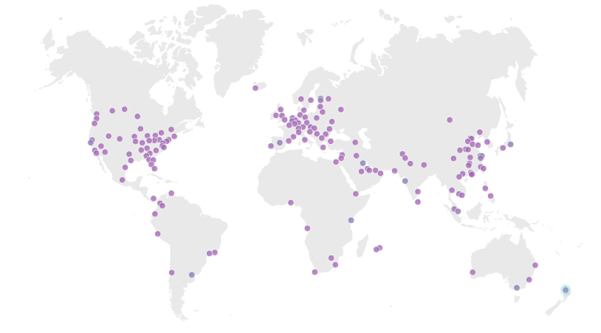











Cloudflare’s modern architecture enables efficient devops practices
Scalable global network with a modern, unified architecture across all datacenters
Integrated stack of security, performance and reliability services
DNS & Load Balancing
DDoS
TLS
Firewall
Rate Limiting
WAF & Bots
Edge Compute
CDN
Smart Routing
Cloudflare Data Center
Rapid onboarding, easy configurations,
fast propagation (within 5 seconds)
Load Balance Across Environments
Origin Server
On-Prem
Origin Server
On-Prem
Origin Server
Public Cloud
Origin Server
Public Cloud
Notes:
Talk Track:
So let’s summarize here.
The three common problems we often see customers wanting to solve are:
Staying online during a DDoS attack
Keep sensitive data secure
Stop malicious bots
At the core to the solution is Cloudflare’s global network, which gives us a scale advantage in terms of resilience and intelligence.
Within every data center, we run an integrated, easy-to-use stack of security, performance, and reliability services.
This means we can secure your site or application without compromising speed. In fact, it will likely be faster than without Cloudflare.
Even though we have a robust stack of services, they can be easily configured and administered, either programmatically through APIs, or through different members of your team through multi-user, role-based access control.

Slide 13
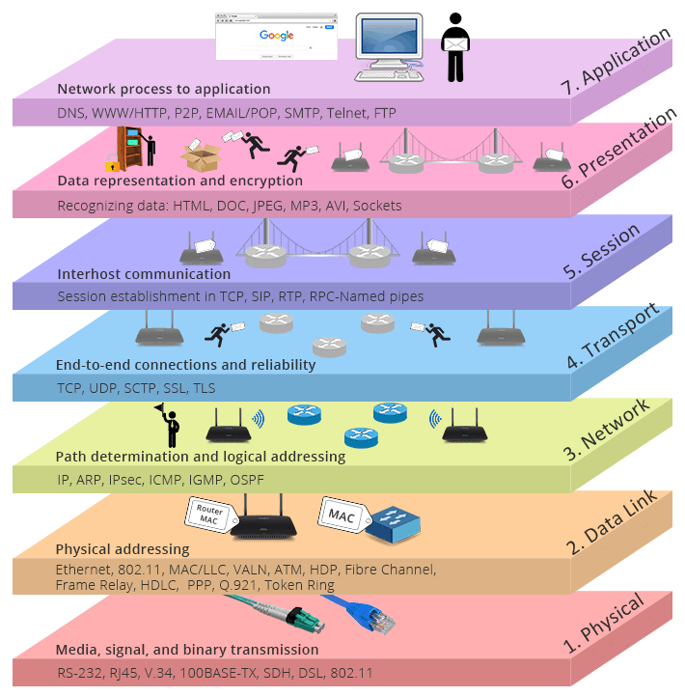
Different Layers
HTTP, DNS
Authoritative DNS
CDN
Argo
Load Balancing
WAF
Bot Management
Video Streaming
7
Application Layer
6
Presentation Layer
5
Session Layer
TCP/UDP
Spectrum
Argo
Load Balancing
4
Transport Layer
Transport Layer
3
Network Layer
IP, GRE, any packet/protocol
Magic Transit
Network Layer
2
Data Link Layer
Physical interconnects with over 9,100 networks globally*
1
Physical Layer
When speaking about DDoS:
Magic Transit → DDoS protection for your Network
Everything else → DDoS protection for your Application

Slide 14
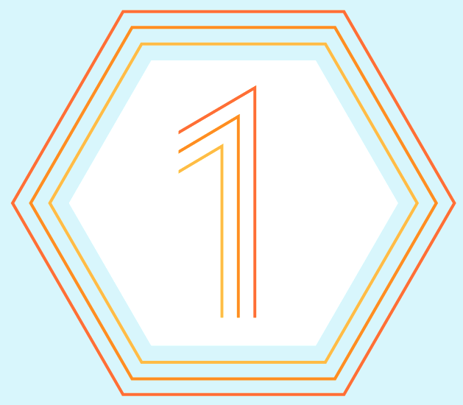


SERVICE PORTFOLIO
Cloudflare - Defining the Edge
Application Services
Network Services
Zero Trust Services
Web Application Firewall
SSL/ TLS
Bot Management
WANaaS
FWaaS
ZTNA
SWG
Cloudflare One
Products & Services
Rate Limiting
Layer 7 DDoS Protection CDN
Load Balancing
L3 & L4 DDoS Protection
*IDS/ IPS
RBI
*DLP
Stream Delivery
DNS Services
Logs and Analytics
Smart Routing
Network Interconnect
Serverless Developer Platform
Workers
Workers KV
Pages
Durable Objects
Video Streaming
Cloudflare Platform
Cloudflare Network Infrastructure
~25 million Internet properties | 59 Tbps capacity | 200+ cities in 100 countries | 99% of population within 100ms
ISO/SOC/PCI/GDPR Compliance Certified | Support for latest web standards | China network
*Previewed, but not available yet
Notes:
This is our new marketecture—how Cloudflare perceives the value and solutions we deliver to our customers.
The core or heart and sole of our platform is our network, as previously discussed
On top of our network we build API first. Make that platform available to developers through APIs our serverless development platform which includes Workers, Workers KV, and most recently Pages.
On top of that platform we deliver 3 solutions to market:
One squarely focused on protecting and accelerate web-based applications,
The next providing Access and Zero Trust capabilities to Enterprise IT
And most recently our solutions to accelerate and protect at the Network Layer

Slide 15
Am I ready for this?

Slide 16
How do I implement this?
JAN
Mar
June
Sep
Nov
Dec
DNS Services
Proxy/CDN
SD-WAN
SWG
FWaaS
ZTNA

Slide 17
Should I do SASE?
Does your current web or cloud security give you full visibility and context across all web and cloud traffic?
What level of cloud-scale does your current security solution provide?
Does your current network support high performance and consistent availability?
How many consoles and policies do you currently have to use to manage your existing security stack?

Slide 18

Thank you!
Q&A

Slide 19
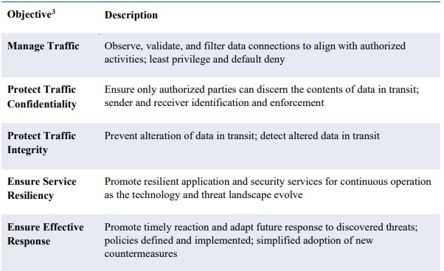
Security Objectives of TIC 3.0
As the Federal Government continues to expand into cloud and mobile environments, an agency’s assets, data, and components are commonly located in areas beyond their network boundary – on remote devices, at cloud data centers, with external partners, etc. To protect these dispersed assets, the TIC program defines encompassing security objectives to guide agencies in securing their network traffic. The objectives intend to limit the likelihood of a cybersecurity event. Agencies are granted discretion to apply the objectives at a level commensurate to the type of resources being protected.

