Slide 1

MINORITY SERVING CYBERINFRASTRUCTURE CONSORTIUM
(MS-CC)
Damian Clarke, CIO
Meharry Medical College, Nashville, TN

Slide 2
Minority Serving Institutions (MSI)
MSIs are traditionally defined by one of two overarching categories:
Historically-defined
Enrollment-defined institutions.

Slide 3
Minority Serving Institutions (MSI)
Historically defined MSIs were established with the express purpose of providing access to higher education for a specific minority group
Historically Black Colleges/Universities (HBCUs)
Tribal Colleges/Universities (TCUs).

Slide 4
Minority Serving Institutions (MSI)
Five other MSI types are federally designated based on student enrollment and institutional expenditure thresholds:
Hispanic Serving Institutions (HSIs),
Alaska Native-Serving and Native Hawaiian-Serving Institutions (ANNHIs),
Asian American and Native American Pacific Islander Serving Institutions (AANAPISIs),
Predominantly Black Institutions (PBIs), and
Native American-Serving Nontribal Institutions (NASNTIs).

Slide 5

The Salt Wagon Story
In the 1820s, 16-year-old Samuel Meharry was hauling a load of salt through Kentucky when his wagon slid off the road into a muddy ditch. With rain and nightfall limiting his options, Samuel searched for help. He saw a modest cabin that was home to a black family recently freed from slavery.
The family, still vulnerable to slave hunters paid to return freedmen to bondage, risked their freedom to give Meharry food and shelter for the night.
At morning’s light, they helped lift the wagon from the mud, and Meharry continued his journey. The black family’s act of kindness touched young Meharry so deeply that he vowed to repay it. I have no money now, he said as he departed, but, when I am able, I shall do something for your race.

Slide 6
The Salt Wagon Story
40 years later, as the Civil War ended and black citizens began their long struggle for rights guaranteed by the Constitution, Meharry seized an opportunity to redeem his vow.
When leading Methodist clergymen and laymen organized the Freedmen’s Aid Society in August 1866, to elevate former slaves, intellectually and morally, Meharry acted. He and his four brothers Alexander, David, Hugh, and Jesse, pledged their support to Central Tennessee College’s emerging medical education program.
With $30,000 in cash and real property, the Meharry brothers repaid the black family’s Act of Kindness with one of their own. In 1876, they funded the College’s Medical Department, which evolved over time into what we now know as Meharry Medical College.

Slide 7
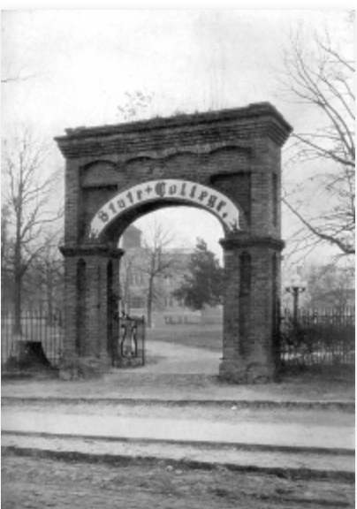
Public HBCUs
Founded in 1896 (1889) as the state’s sole public college for black youth, SOUTH CAROLINA STATE UNIVERSITY has played a key role in the education of African-Americans in the state and nation.
As a land-grant institution, it provides agricultural and mechanical training to generations of black youngsters.
Through its extension program, it sent farm and home demonstration agents into rural counties to provide knowledge and information to impoverished black farm families.

Slide 8



MS-CC Purpose
MS-CC Guiding Principles
Inclusion | Innovation | Stakeholder Value
MS-CC Stakeholders
Increasing access to CI resources
Enhancing interactions and effectiveness among researchers and CI professionals
Professional and career development
Researchers and educators
Students
Cyberinfrastructure professionals
Campus leaders
Industry partners
Foundations and funding agencies
Notes:
Emily notes From Joel’s latest DRAFT charter sent on 1/20/22
Purpose:
Increasing Access to CI Resources: The Consortium explores and develops effective strategies and leading practices that campuses may use to empower their students, faculty, and staff to access and become more effective users of advanced research and educational cyberinfrastructure (CI) at the campus, regional, national, and international levels.
Enhancing interactions and effectiveness among researchers and CI professionals: The Consortium is further dedicated to extending and enhancing the reach and impact of campus and national research computing infrastructures to institutions with minority serving missions to promote research conducted at the campus level and through multi-institutional collaborations.
Professional and Career Development: The Consortium is dedicated to providing and sharing in career development activities, curricula, and training for professional CI staff and faculty, researchers, and students. This includes supporting campus research computing and data efforts through enhancing interactions among both professional CI staff and researchers to better utilize, share, and prepare a workforce for the future using advanced computing resources.
Guiding Values:
Inclusion: Dignity, respect, diversity, equity, and trust are advanced based on productive engagement and the principle of equitable voice: “nothing about us without us.”
Innovation: Creativity, learning, dialogue, and action are advanced through mentoring, coaching, collaboration, and the principle of being “hard on the problem, not each other.”
Stakeholder Value: Voice, governance, independence, interdependence, safety, risk, and reward are advanced based on the principles of “accomplishing together what can’t be accomplished separately.”
Stakeholders:
Researchers and Educators: Enabling researchers and educators to harness the power of data and computing resources to advance the frontiers of knowledge in ways that are aligned with the mission of HBCUs, TCUs, HSIs, and other minority serving colleges and universities – spanning science, engineering, social science, humanities, arts, and other domains.
Students: Enabling students at HBCUs, TCUs, HSIs, and other minority serving colleges and universities to address issues of importance to them with data and computing capabilities, as well as to preparing to be the next generation workforce – including future cyberinfrastructure professionals.
Cyberinfrastructure Professionals: Connecting cyberinfrastructure professionals across HBCU, TCU, HSI, and other minority serving colleges and universities so we can accomplish together what we can’t do separately – including building capability, bringing in funding, establishing career paths, advancing knowledge, and pioneering new technologies.
Campus Leaders: Making wise investments in the capabilities needed for a post-industrial, digital world – advancing the mission and impact of HBCUs, TCUs, HSIs, and other minority serving colleges and universities.
Industry Partners: Enabling industry leaders to coordinate engagement with HBCU, TCU, HSI, and other minority serving colleges and universities around new technologies, services, resources, and next-generation talent relevant to research and educational cyberinfrastructure.
Foundations and Funding Agencies: Enabling foundations and funding agencies to coordinate engagement with HBCU, TCU, HSI, and other minority serving colleges and universities around research priorities community development relevant to research and educational cyberinfrastructure.

Slide 9

THE VISION:
MS-CC envisions a transformational partnership to promote advanced cyberinfrastructure (CI) capabilities on HBCU, HSI, TCU, and MSI campuses. We are advancing connections across campuses around data, research computing, teaching, curriculum development, professional development, and capacity-building.
We will learn and grow as a consortium, lifting up all participating institutions by advancing cyberinfrastructure for research and education across diverse fields, disciplines, and communities in ways that reflect the unique voices and interests of our communities.
We will engage as full
contributors to the
global R&E community
Notes:
From Joel’s latest DRAFT charter sent on 1/20/22

Slide 10

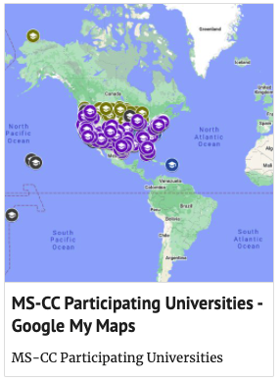
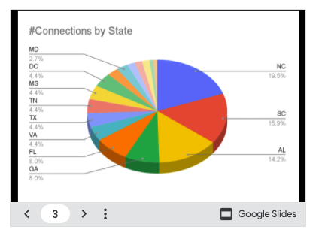
Website
New Features
Participant information
Interactive map of participating universities, including listings for all HBCUs, HSIs, TCUs, and other MSIs
Notes:
Leslie-could you make these images larger and for the MS-CC website, it’s distracting to have the header multiple times with the slide header so maybe a different snap of the ms.cc.org website?
I recommend removing the site screenshot altogether. There is a ton of redundancy on this graphic… in the header, below the header, in the main content are. It’s very distracting on the website. Could use some help…

Slide 11














NSF CI Center of Excellence Demonstration Pilot
Minority Serving Cyberinfrastructure Consortium (MS-CC)
Objectives
Create a connective and collaborative organization that serves as a centralized hub for HBCUs, TCUs, and other MSIs to utilize for CI advocacy, guidance, and expertise
Increase awareness, availability, and financial support for professional development opportunities for faculty, staff, and students at HBCUs, TCUs, and other MSIs
Enhance communication among researchers, university leadership, and CI professionals
Increase access to shared CI resources at MS-CC organizations
Award # OAC-2137123
Scientific and Broader Impacts of $3 Million Grant
Advance understanding of the benefits for shared CI across a distributed community of colleges and universities in a mix of urban, suburban, and rural settings
Advance understanding around the importance of multi-stakeholder consortia supporting CI
Increase diversity in the STEM talent pool and workforce
Increase the availability of workforce development opportunities for researchers, professional staff, and students at HBCUs, TCUs, and other MSIs
Advancing CI capabilities at these and other minority serving campuses
Principal Investigator:
Ana Hunsinger,
Internet2
ana@internet2.edu
Co-Principal Investigators:
Dr. Richard Aló, Florida A&M University
Dr. Damian Clarke, Meharry Medical College
Dr. Deborah Dent, Jackson State University
Jim Bottom, American Indian Higher
Education Consortium

Slide 12

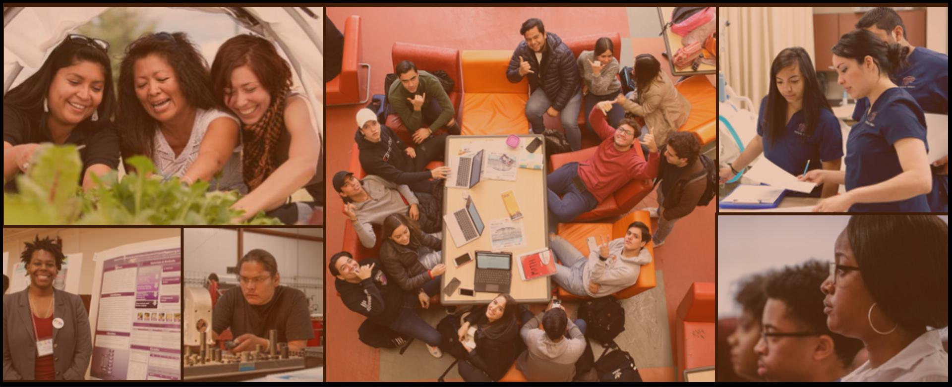
December 2020: Survey to HBCUs, TCUs, HSIs, and other MSIs
Survey to collect current data and computing infrastructure landscape
Determine needed funding
Establish priorities for HBCUs, TCUs, HSIs, other minority serving institutions
291 respondents across 144 institutions (44 HBCUs, 63 HSIs, 32 TCUs)
Themes included:
Need for high-speed broadband,
Access to cloud resources, and
High-performance computing capabilities
Interested in seeing the full results?
Catch a webinar replay:
https://bit.ly/35qdv7B
Notes:
Leslie – fix title color – see slide 10
Emily notes:
Does Joel do this slide? (THAT’S MY PLAN)
Do we add something about how people can still get the results from that? (DONE)

Slide 13

During the two-year grant we will be checking in with key stakeholders for additional input on these and other topics. May we continue to send you very short surveys such as this to further guide the development of programs, services and resources for you and others? If so, the email address that you enter below will be redacted from any reports on the results from this survey in order to ensure confidentiality. Yes n= 161 (77%) No n= 49 (23%)
Responses to Date:
N=211
Organization Type:
HBCU n=105 (50%)
TCU n=49 (23%)
HSI n=46 (22%)
Another MSI n=6 (3%)
Other n=5 (2%)
Respondent Role:
University Executive Administrator (President, Provost, Vice Provost, Vice President, CIO, etc.) n=78 (37%)
University educator and/or researcher n=65 (31%)
University research data, computing and cyberinfrastructure professional n=12 (6%)
Graduate or undergraduate student n=17 (8%)
Other n=39 (19%)

Slide 14
HBCUs
Alabama A&M University (n=16)
Alabama State University
Allen University
Bowie State University
Claflin University
Denmark Technical College (n=2)
Dillard University (n=2)
Drake State Community & Technical College
Florida Memorial University (n=5)
Fort Valley State University
Harris-Stowe State University (n=3)
Jackson State University
Jarvis Christian College (n=2)
Kentucky State University
Lane College
MeHarry Medical College (n=20)
North Carolina Central University
Praire View A&M University (n=2)
Shaw University
Stillman College
Tuskegee University
University of Maryland Eastern Shore
University of the Virgin Islands (n=3)
Virginia State University
Wiley College
Winston-Salem State University
Xavier University of Louisiana
Those providing an email address…
HSIs
California State University, Northbridge
Bergen Community College
California Baptist University
Dodge City Community College
Dominican College
EDP University
Florida Atlantic University
Fresno State
Houston Baptist University (n=2)
Lamar State College, Port Arthur
Lee College
New Mexico State University (n=2)
Rutgers University, Newark (n=2)
San Joaquin Delta College
South Florida State University
Texas A&M University, Corpus Christi (n=3)
Texas Lutheran University
Universidad del Sagrado
University New Mexico Los Alamos (n=2)
University of California, San Diego
University of Central Florida (n=2)
University of Puerto Rico (n=3)
University of Texas El Paso
University of Texas Rio Grande Valley
Ventura County Community College District
Yakima Valley College (n=2)
TCUs
Aaniiih Nakoda College (n=3)
Cankdeska Cikana Community College
College of the Desert
Dalton State College
Ilisagvik College (n=4)
Keweenaw Bay Ojibwa Community College
Lac Courte Oreilles Ojibwe College (n=11)
Little Priest Tribal College
Nebraska Indian Community College (n=4)
Nueta Hidatsa Sahnish College
Sitting Bull College
Southwestern Indian Polytechnical Institute (n=3)
United Tribes Technical College
White Earth Tribal & Community College
Other MSIs
Keiser University
Old Dominion University
Southern Connecticut State University
University of California, Davis
University of Maryland, Baltimore County
University of North Carolina, Greensboro

Slide 15
When considering cyberinfrastructure needs on your campus, which is most important at this time (please rank these items highest to lowest) based which is the most immediate priority:
Topic | Rank |  | Score
Cybersecurity (campus assessment, improving risk profile, and shared services) | 1 |  | 1,094
Funding for advancing campus cyberinfrastructure | 2 |  | 1,050
Cyberinfrastructure tools and methods (including best practices, technology road maps, self-assessment, and new technology/solutions) | 3 |  | 972
Career and Workforce Development (research data professionals and cyberinfrastructure engineers) | 4 |  | 780
Research Acceleration (fostering research on topics of priority to students, faculty, staff, and the local community) | 5 |  | 737
Collaboration opportunities with other institutions and organizations on research data, computing, and cyberinfrastructure | 6 |  | 707
Science DMZs (a research environment that secure, scalable, and structured for data transfer, use, instrumentation, and computing) | 7 |  | 567

Slide 16
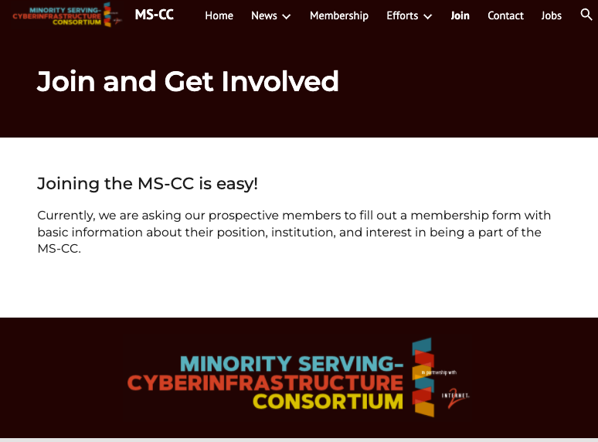
GET INVOLVED.
Join MS-CC today!
Join
Simple, quick, and easy
Fill out the form
Join the mailing list
Stay informed about upcoming meetings and activities
Notes:
Please have this be more consistent with slides 9. 10, etc with headline color, text bold, etc

Slide 17



Minority Serving
Cyber-Infrastructure Consortium (MS-CC)
https://www.ms-cc.org/
Doing Better Together What We Cannot Do Alone!
Nothing About Us Without Us!

