Slide 1


Winter 2022 Meeting
This work funded by the National Science Foundation, award 2138811.

Slide 2
Overview
SDSC systems in NSDF ‘system of systems’
Open Storage Network (OSN)
Open Science Grid + USS Storage & SDSC Cloud
GO FAIR - FAIR Data Point
Federated Infrastructure Working Group

Slide 3
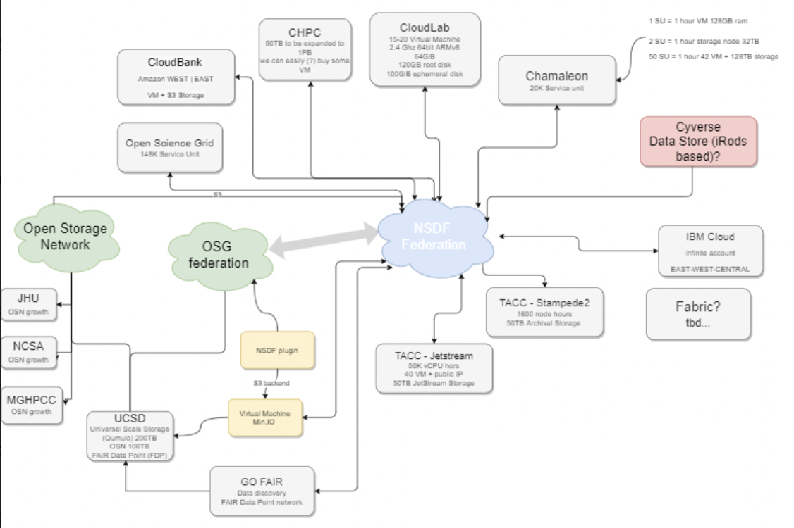
SDSC Contributions to NSDF Architecture

Slide 4
Open Storage Network (OSN)

Slide 5
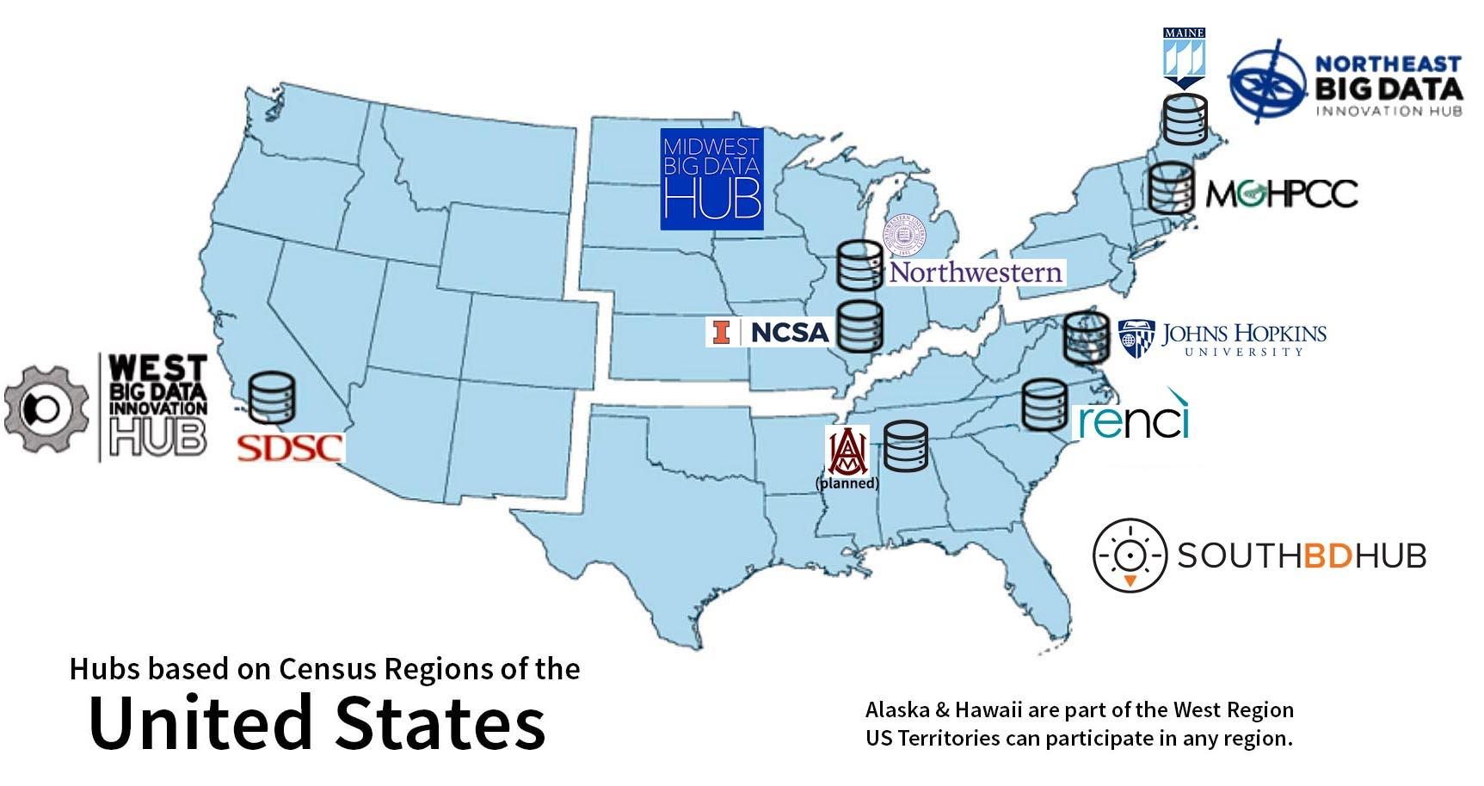
Open Storage Network
Goals:
Simple, performant, reliable object store for sharing research data during active research
Substrate to layer other services on top of/access via API, e.g. data catalogue, analysis, notebook data source
Open source, low annual cost, upkeep of storage distributed
Johns Hopkins University
MGHPCC
San Diego Supercomputing Center
NCSA at University of Illinois
RENCI UNC Chapel Hill
Northwestern University (Starlight)
Alabama AMU
University of Maine
The Open Storage Network was funded by the National Science Foundation under grants #1747552, 1747493, 1747507, 1747490, 1747483 and by Schmidt Futures.

Slide 6
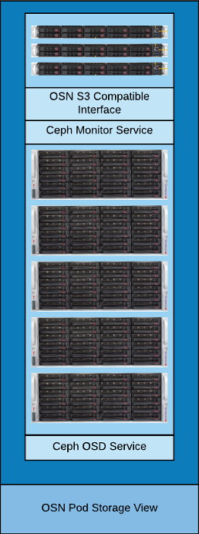

OSN Pod Overview
Hardware is deployed in scalable units aka Pods
Each Pod is:
A single bill of materials
Delivered with all hardware racked and configured
Sites just need to connect power and networking
Capable of 40Gbps sequential IO
Target cost $150,000
1 PB useable storage (2019 hard drive prices)
Open source, distributed object storage service
S3 Compatible
Block storage
POSIX-compatible
Two Versions of Ceph
Red Hat Ceph Storage (RHCS) - Licensed
Community Supported - Free
All OSN Pods are running version 16.2 (Pacific) w/ Docker Containers
Using ceph-ansible for deployment & config. mgmt
Audited by TrustedCI

Slide 7
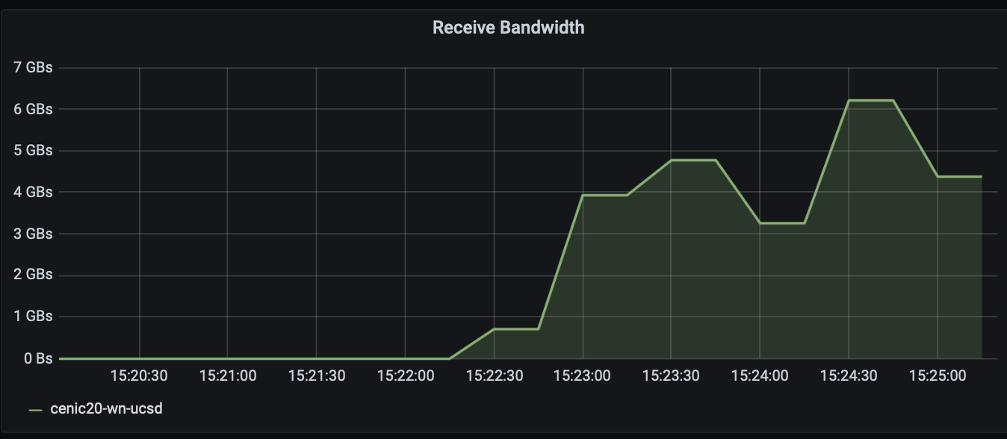
OSN Stats
Pod Durability
Network Benchmarks
Assumptions:
0.44% Annual Failure Rate (Seagate)
Failed disk removed <1 day of failure
https://github.com/Backblaze/erasure-coding-durability
IceCube (SDSC): 5.5 GBps read speed from 10 nodes
Same test w/ Azure Storage and AWS S3 was only able to achieve 4 GBps
Erasure Code Profile | Durability
3+1 (OSN First Gen) | 99.9999% (6 9s)
4+2 (OSN Future Variation) | 99.99999999% (10 9s)
AWS S3 Standard | 99.999999999% (11 9s)
8+3 (OSN Future Variation) | 99.999999999999% (14 9s)
Notes:
For example, if you store 10,000,000 objects, you can on average expect to incur a loss of a single object once every 1,000 years.
Amazon S3 Standard has 11 9s of durability

Slide 8

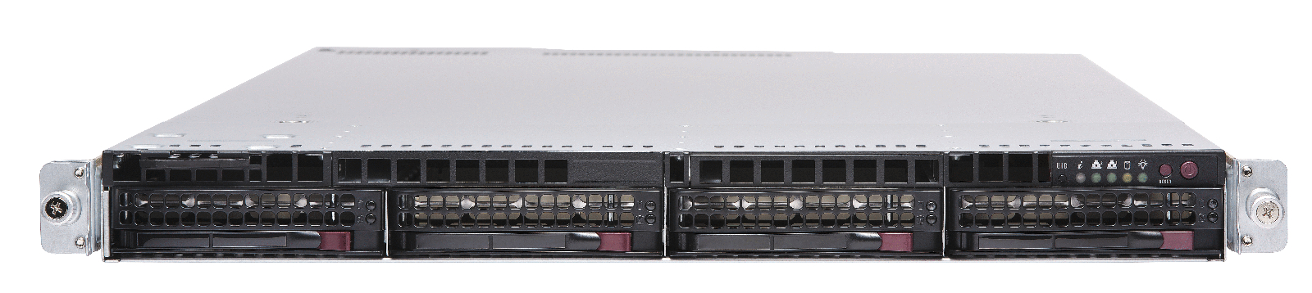
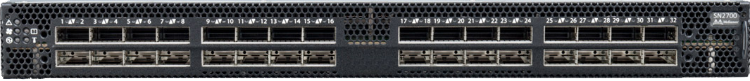
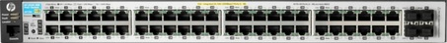

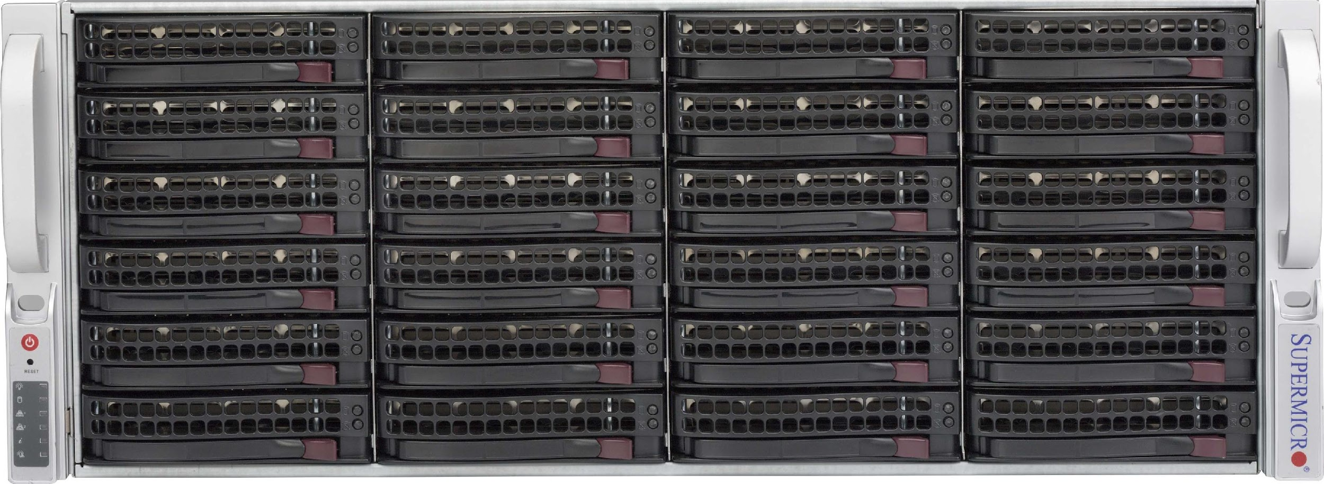

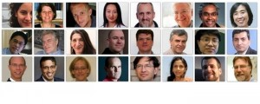
Support, Configuration, and Maintenance
Central command center w/ remote hands
Developer checks out a bugfix/feature branch
Modify, debug, and test locally
Trial deployment on a single pod
Implementation team review and and approval
Branch is merged to main branch for deployment in next update
GitHub
Release
Candidate
Release
Command Center
Branch
Validate
Release
Review/merge
Local Test HW/VMs
Test
Develop
Test/Staging
OSN
Sites
Community Development

Slide 9
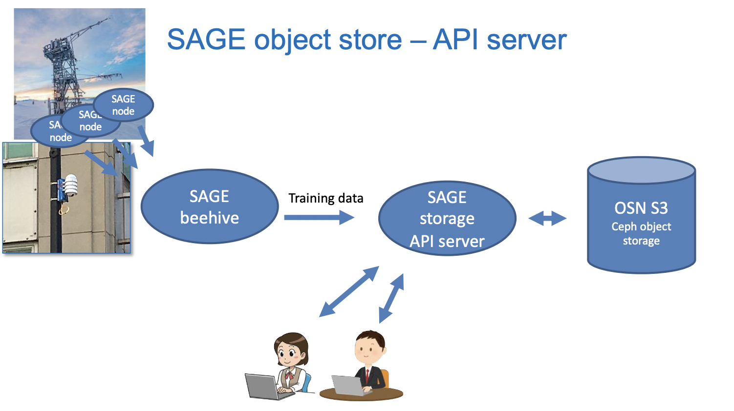
OSN in Use

Slide 10
Open Science Grid (OSG) + Universal Scale Storage (USS) & SDSC Cloud

Slide 11
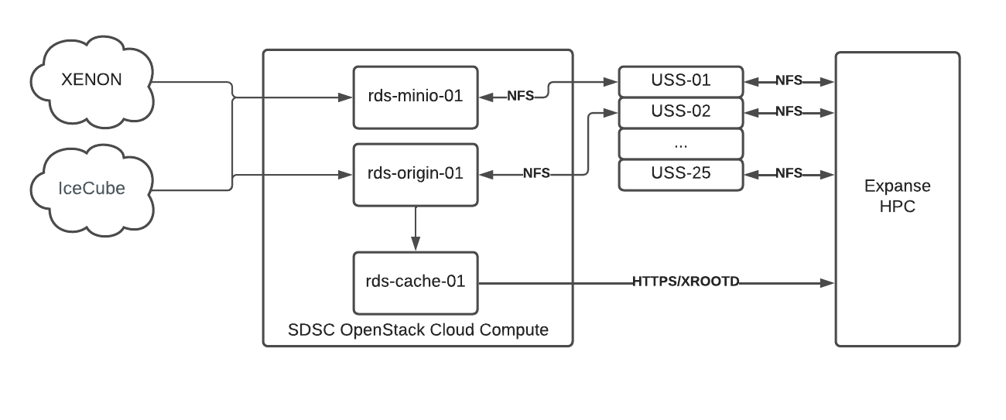
OSG Integration with NSDF

Slide 12

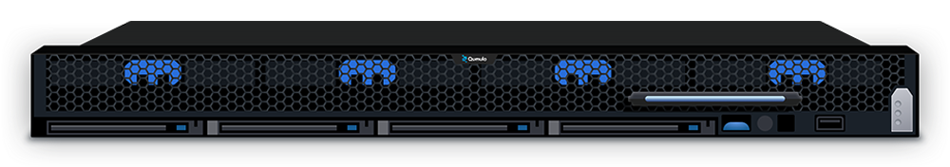
SDSC Universal Scale Storage
25 Qumulo QC260
26 x 10 TB HDD + 13 x 480 GB SSD
2x40GbE LACP per node connected to a 100 GbE switch group
NFS, SMB and S3 access via MinIO

Slide 13

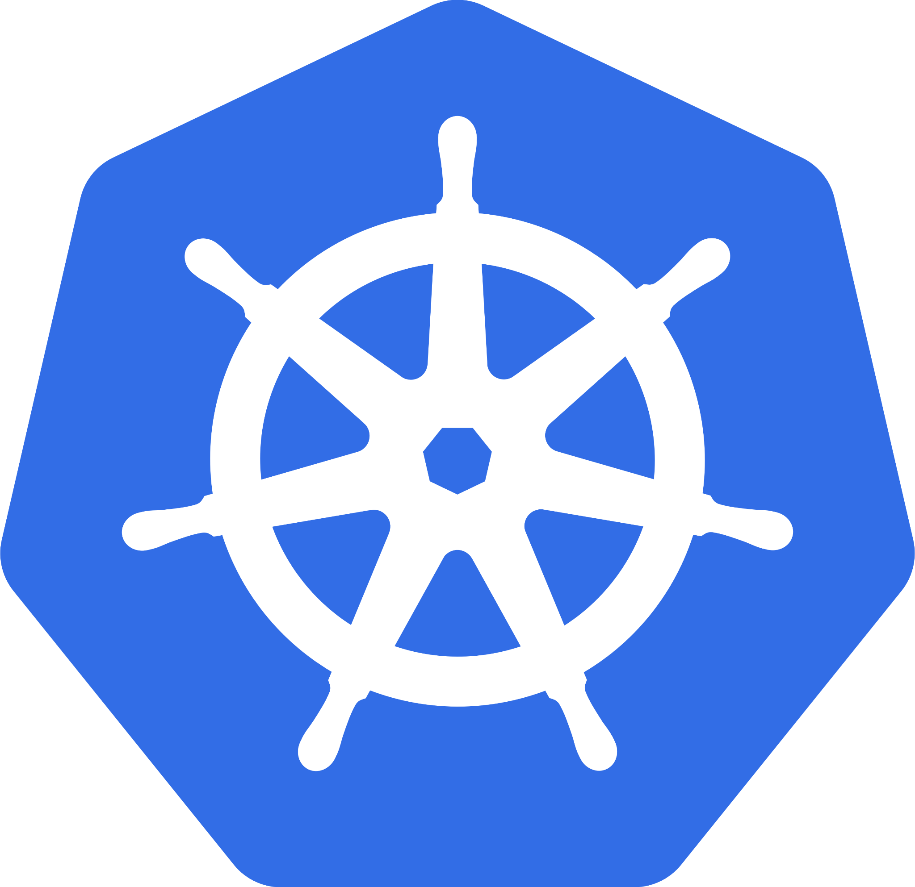
SDSC OpenStack Cloud Compute
22 hypervisors
~1200 vCPUs
~10 TB RAM
10GBe internal networking
4x 40GBe networking to SDSC
100 GBe networking upgrades in 2022
SDSC has been using OpenStack to run Kubernetes since 2018.
Deployment using Ansible + Kubespray

Slide 14
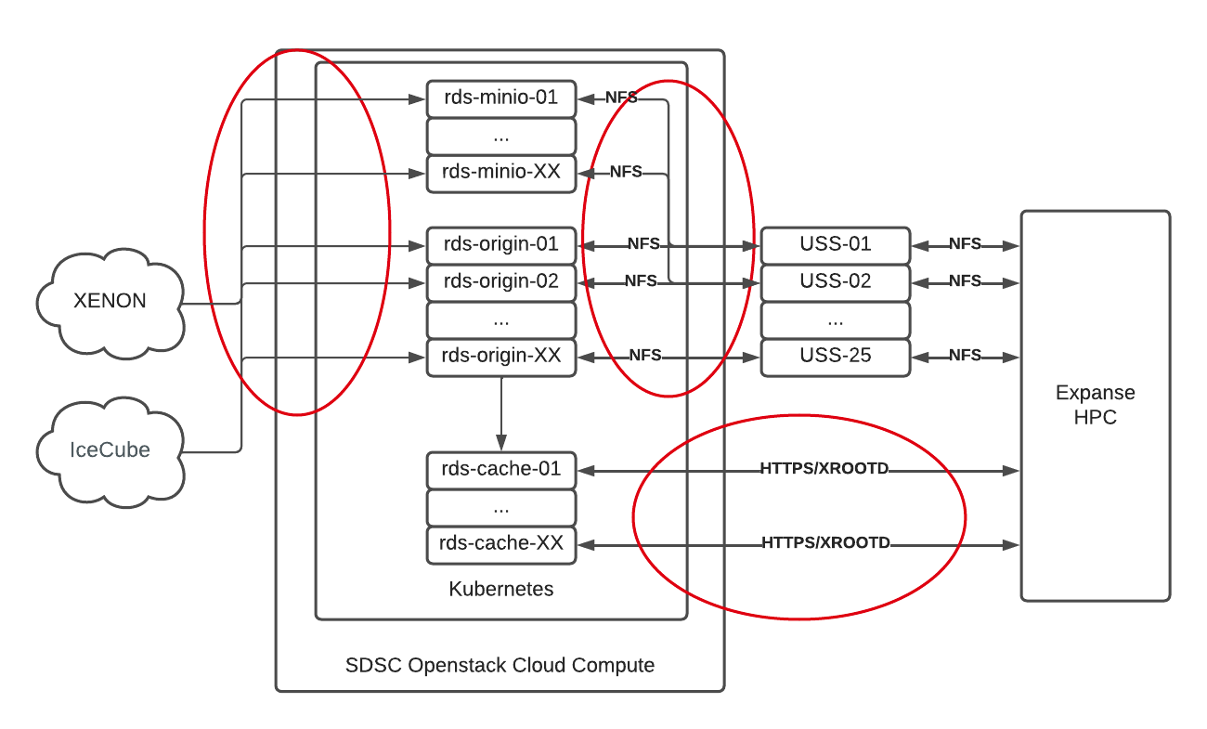
Scaled Out OSG Integration with NSDF

Slide 15
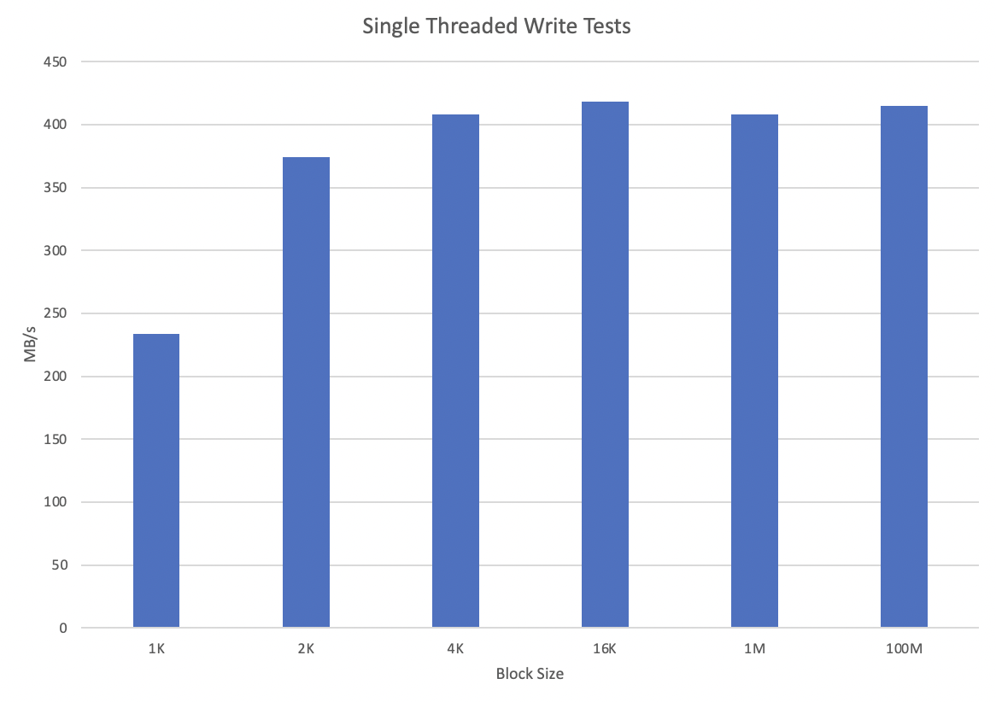
USS Performance Benchmarks
Single Server: 6 core + 16 GB with x 10 GBe

Slide 16
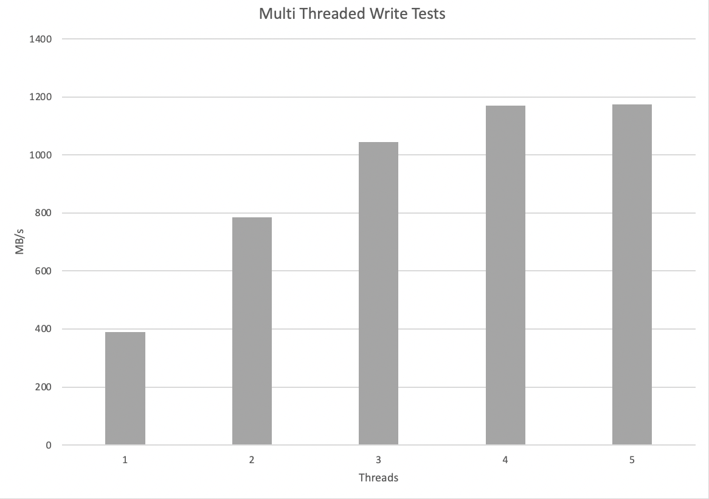
USS Performance Benchmarks
Single Server: 6 core + 16 GB with x 10 GBe

Slide 17


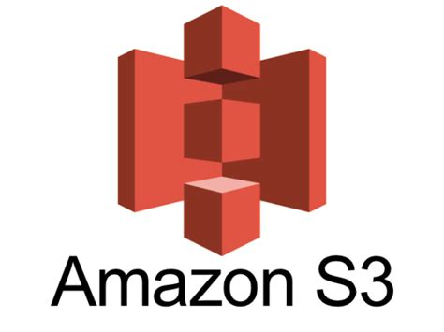

Access Methods
Protocols Supported
xrootd
https
S3
Authentication Methods
SciTokens
X.509 Certificates
S3 API Keys (minio)

Slide 18
GO FAIR: FAIR Data Point (FDP)

Slide 19

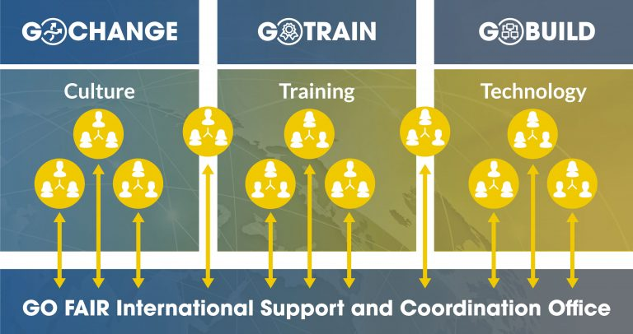

Initiative
Founded by FAIR paper authors (2016) to advance practical implementations of FAIR
emphasis on machine actionable data
GFISCO (GO FAIR International Support & Coordination Office)
National Offices
France, Brazil, Germany, Netherlands, Austria, U.S.
(SDSC)
Mobilization around Pillars
Pillars

Slide 20

FAIR Data Points
3 point FAIRification framework along with FAIR Implementation Profiles and Metadata for Machines workshops
Standards-based, web-accessible store of information about data sets
Components include
Defined “API”
Reference implementation
API client
NSDF datasets can be offered via the FDP along with simple metadata
https://www.fairdatapoint.org/

Slide 21
Federated Infrastructure Working Group

Slide 22



Federated Infrastructure Charter Goals
Understand the NSDF and the national research ecosystem as a system of systems (Task 1)
Facilitate interactions between OSN, OSG, public clouds, CloudBank, etc. and the NSDF to create a neutral infrastructure (Task 2-3)
Understand the operational needs of the federated NSDF components and to prepare for scale up.

Slide 23
NSDF as a System of Systems
System of Systems
Leverage existing systems to grow the NSDF ecosystem
Create additional value by extending existing systems; only build where gaps exist
Operational and Managerial Independence
Systems should be able to be operated independent of the NSDF and agreements, like a Service Level Agreement, should dictate system to system interactions
Systems from Different Domains should be able to Coexist
Common low level APIs should be used to bring together systems from different domains

Slide 24
NSDF as a System of Systems
Loosely Coupled
Construct the system of systems so each system can run independent of each other
Don’t federate by “reaching in” to a system, maintain a clean boundary between systems
Each system should be allowed to evolve independently
Agile
Interact with common APIs so the systems can be interchanged and updated with new functionality
Take advantage of the price competition between cloud providers
Be ready to integrate with new systems as new researcher needs are identified

Slide 25
A Neutral Infrastructure
Use tools that abstract cloud deployment
Terraform and Ansible can deploy the same infrastructure to multiple clouds with little modifications
Use services that have open APIs
Services like Kubernetes and S3 are ubiquitous and the APIs are well supported by many tools
Maintain a list of infrastructure providers
Track services provided and APIs used so developers know where their applications can be deployed
Track locations so services can be deployed in geographically similar areas for latency or geographically different areas for fault tolerance

Slide 26
Task 1: Federated Infrastructure Providers
Expanded on services map to include:
Links to documentation by infrastructure providers
Physical locations of the infrastructure
Allocations
The APIs the infrastructure supports
Summary available at NSDF → Resources
https://nsdf-fabric.github.io/resources.html

Slide 27
Task 1 ct: Service Level Agreement for Federated Partners and Users
Draft SLA available for comment: https://tinyurl.com/nsdf2022-sla
Key recommendations:
Create a single point of contact for federated partners and users
Create a status page for federated partners and users to go to for updates on production services
Collect a single point of contact for all federated partners in order to alert them of planned and unplanned outages

Slide 28
Questions?

