Slide 1
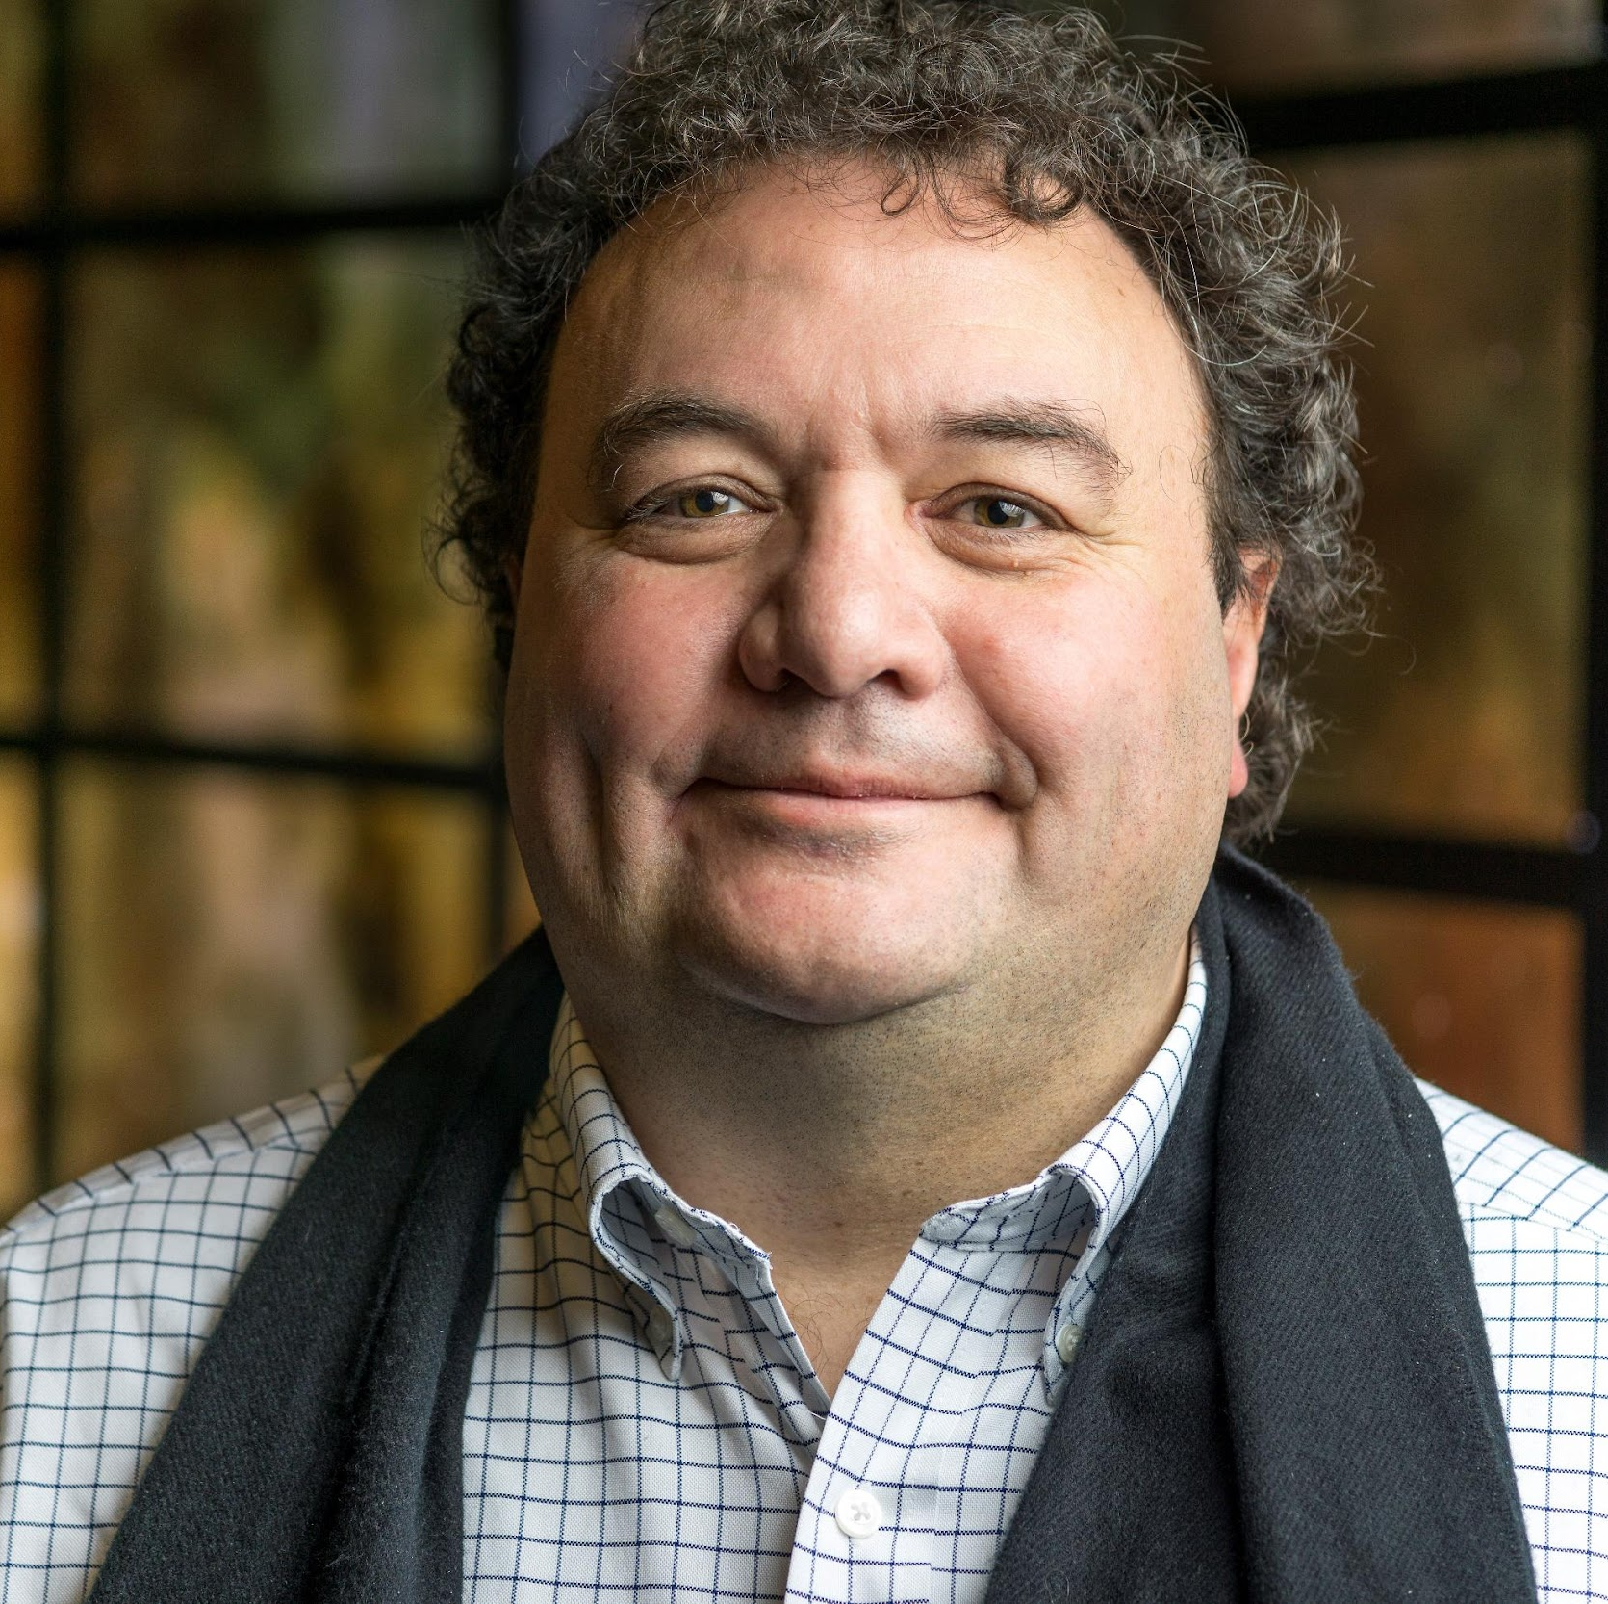


Scientific Computing and Imaging Institute
Center for Extreme Data Management Analysis and Visualization
Data and Science Democratization
Smart, Scalable CI for Data, Computing and People
Equity in Data Access for the “Missing Millions”
Big Data for Science and Workforce Development
Content Delivery Network (CDN) for Science
Scientific Data Analytics and Visualization
Valerio Pascucci
pascucci.valerio@gmail.com

Slide 2
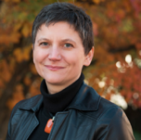


The University of Tennessee, Knoxville
Global Computing Lab (CGL)
https://globalcomputing.group
Smart CI for science and engineering, with emphasis on reproducibility, replicability, and transparency
AI/ML for smart CI and adaptive HPC, with emphasis on IO
Smart CI for international collaborations
Next generation workforce for smart CI
Michela Taufer
taufer@acm.org
Project Title

Slide 3
The University of Tennessee, Knoxville
Global Computing Lab (CGL)
https://globalcomputing.group
Research support on convergence of HPC and big data
Scheduling and deployment of AI/ML apps on Cloud and HPC
Smart CI for international collaborations
Multidisciplinary research and collaborations
Research publications and proposals
Naweiluo Zhou
naweiluo.zhou@utk.edu

Slide 4
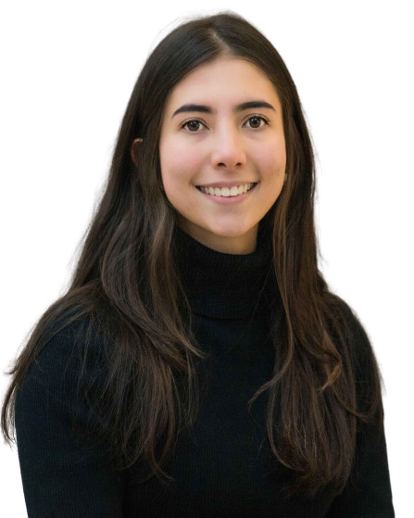
The University of Tennessee, Knoxville
Global Computing Lab (CGL)
https://globalcomputing.group
Research support and definition of best practices on convergence of HPC, Cloud, and big data
Facilitate reproducibility, replicability, and transparency of data-intensive and scientific workflows
Research publications and proposals
Paula Olaya
polaya@vols.utk.edu

Slide 5
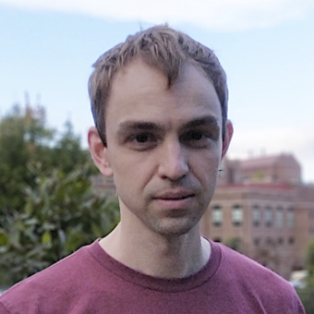
The University of Tennessee, Knoxville
Global Computing Lab (CGL)
https://globalcomputing.group
Research on the intersection of scientific workflows and HPC I/O subsystems and middleware
Performance analysis and visualisation in distributed environments
Smart CI for science and engineering workflows
Jakob Luettgau
jluettga@utk.edu

Slide 6
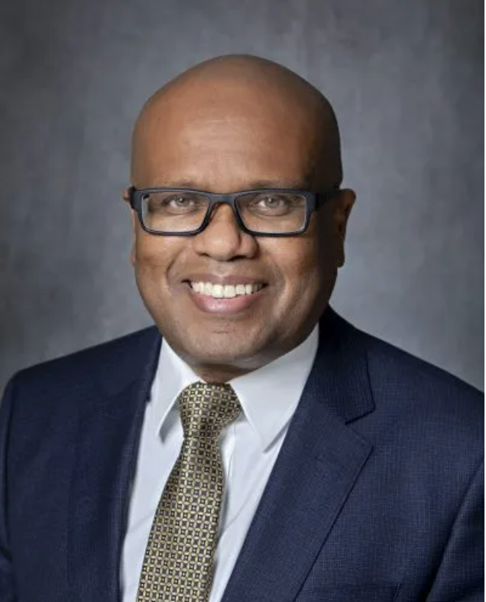

Meharry Medical College
https://home.mmc.edu/
CIO
Research Support and Acceleration - Creating a joint research database to encourage interdisciplinary research among MSIs
Workforce Development - Developing a talent pipeline of students and professionals at MSIs
Community and Capacity Building - Creating a single unified Science DMZ for Collaborative Research for MSIs
DAMIAN CLARKE
dclarke@mmc.edu

Slide 7
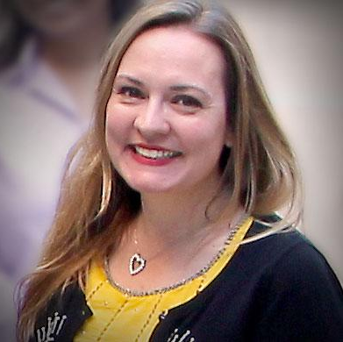

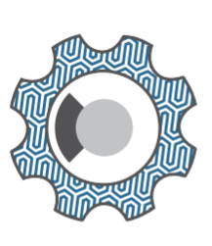

San Diego Supercomputer Center
Open Storage Network
West Big Data Hub
GO FAIR US
Reducing ‘time to science’ and streamlining CI for researchers
Putting platforms and processes in place that promulgate research data management practices and FAIR data
Christine Kirkpatrick
christine@sdsc.edu

Slide 8
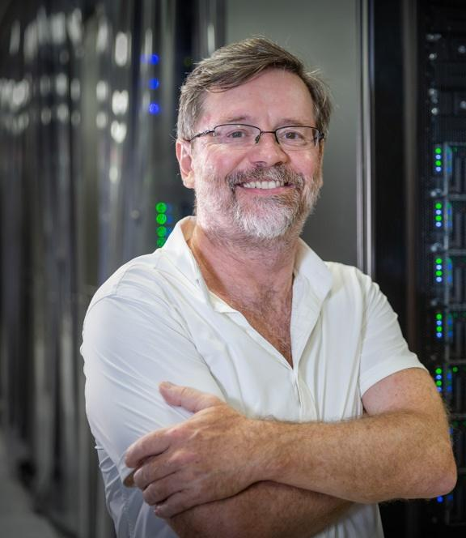
San Diego Supercomputer Center
Open Storage Network
West Big Data Hub
GO FAIR US
Integration of HTC resources
Highspeed and performance networks and storage
Translating innovation into practice
Frank Wuerthwein
FrankW@sdsc.edu

Slide 9
San Diego Supercomputer Center
Open Storage Network
Cloud Computing Integration
Configuration Management Reproducibility & Best Practices
Continuous Integration and Continuous Deployment
Kevin Coakley
kcoakley@sdsc.edu

Slide 10
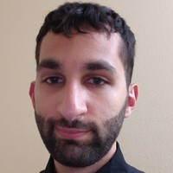
San Diego Supercomputer Center
Open Storage Network
Configuration Management and Automation
Cloud Infrastructure
Redundancies, Rollovers and Recovery Plans
Danny Saba
dbsaba@sdsc.edu

Slide 11
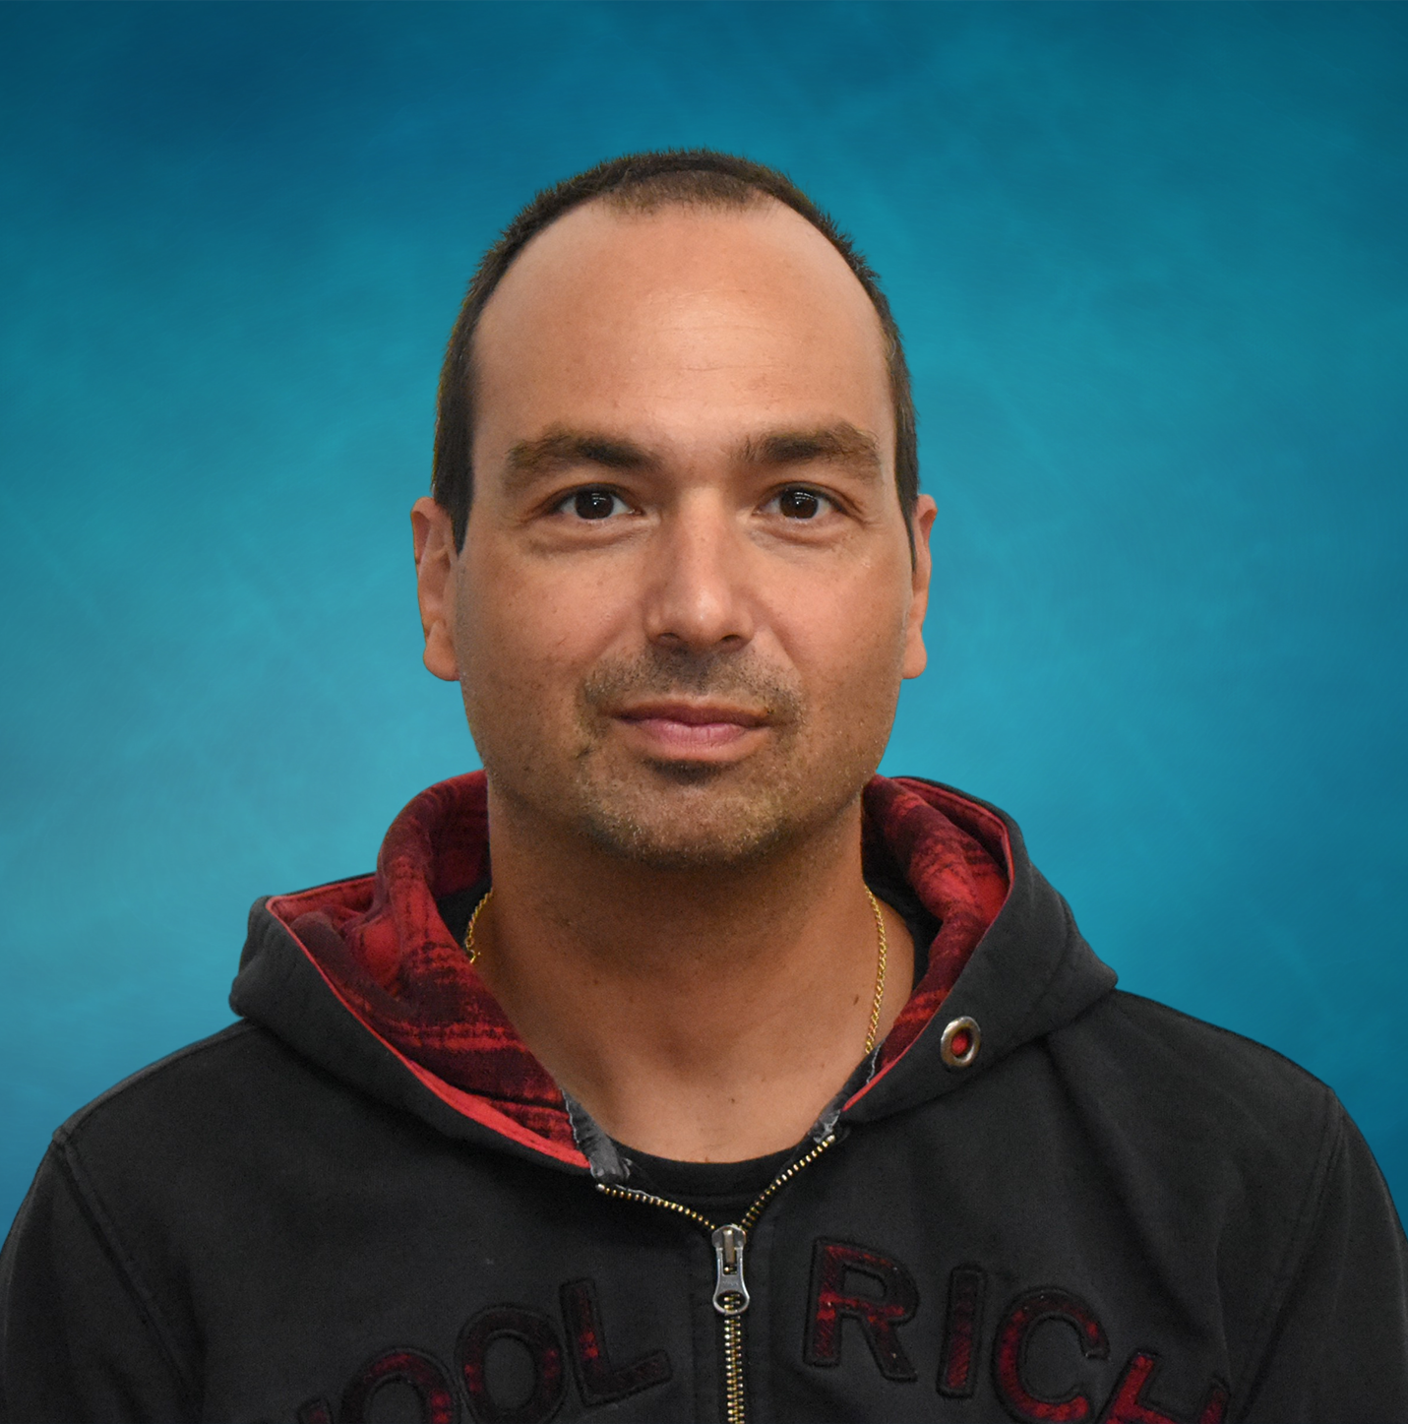
Scientific Computing and Imaging Institute
Center for Extreme Data Management Analysis and Visualization
Cloud Computing and Storage
Complex software systems in High-Performance Computing
Big Data Analytics and Efficient I/O
Content Delivery Network (CDN) for science
Giorgio Scorzelli
scrgiorgio@gmail.com

Slide 12
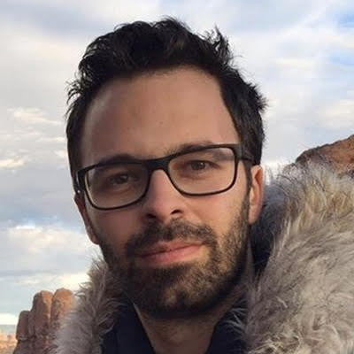
Scientific Computing and Imaging Institute
Center for Extreme Data Management Analysis and Visualization
High performance computing for large scale data analysis and visualization
Large scientific data interactive exploration
Edge Computing
Steve Petruzza
spetruzza@sci.utah.edu

Slide 13
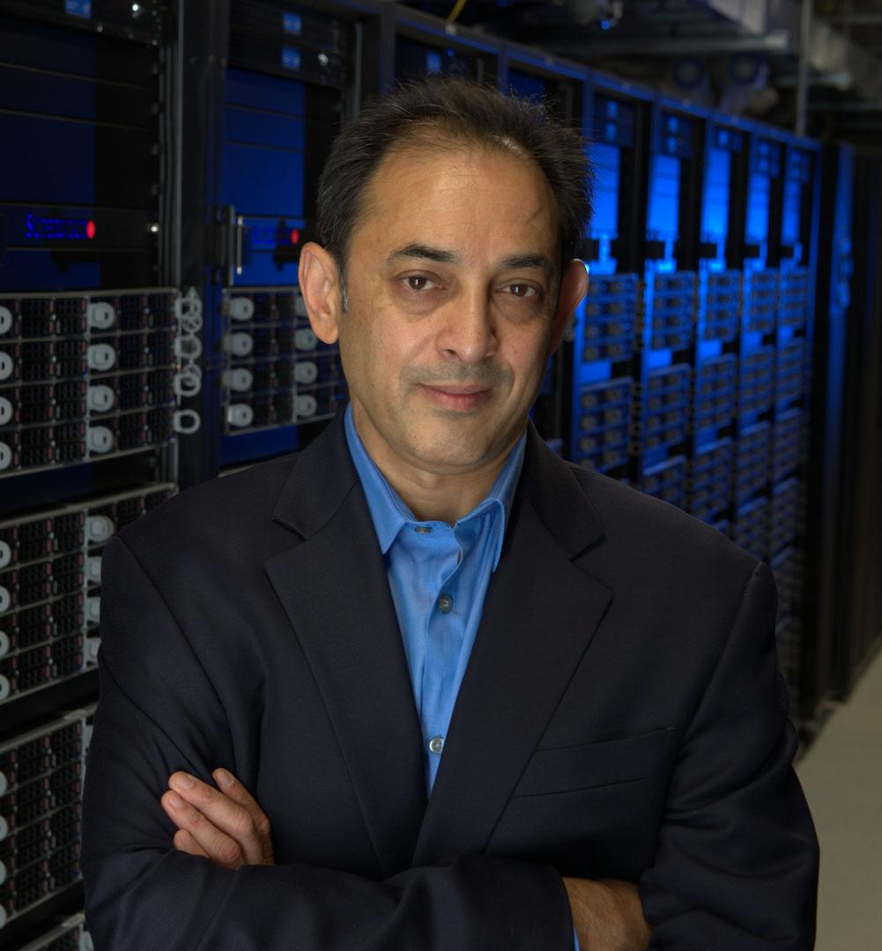
Scientific Computing and Imaging (SCI) Institute
Large-scale data-management and analytics
Extreme-scale computing
Computing continuum and core-edge integration
Robust science
Manish Parashar
manish.parashar@utah.edu

Slide 14
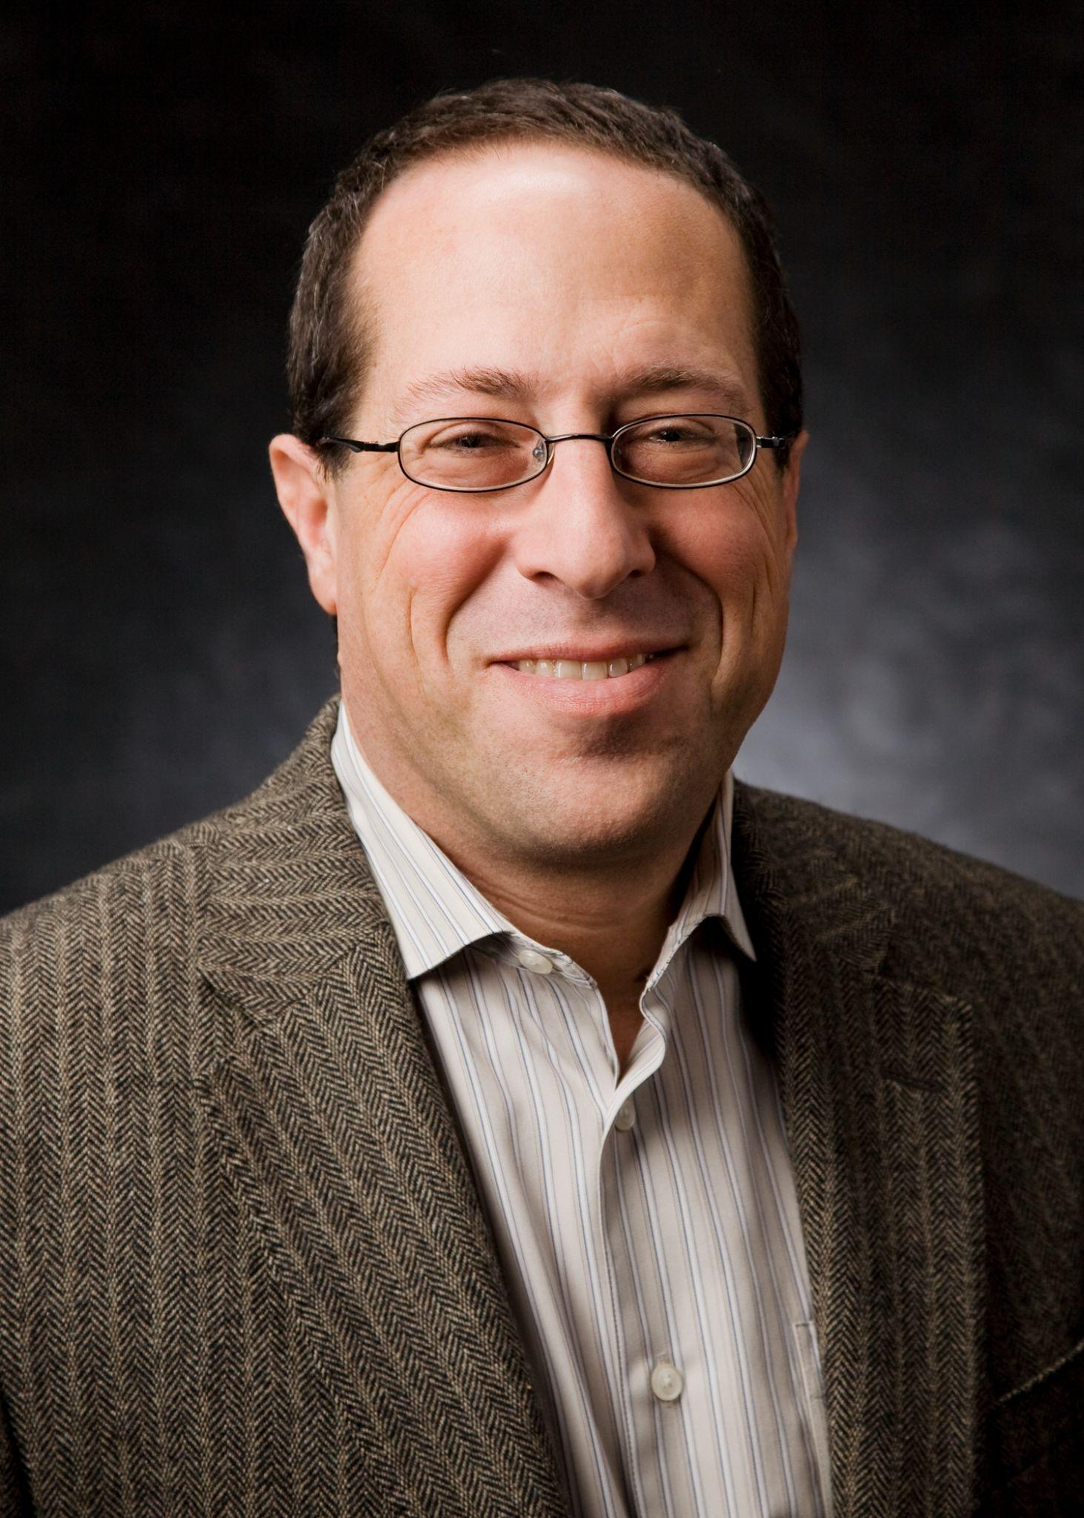

Information Assurance, Trust, and Identity
CISO
Securing Cyber Infrastructure
Cybersecurity as Research Facilitation
Federated Identities supporting Research
mcorn@ucsd.edu

Slide 15
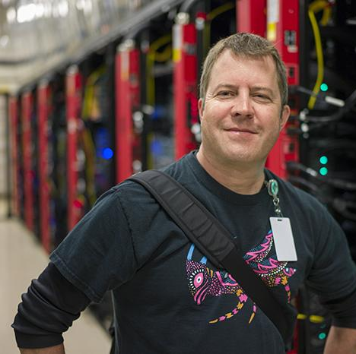
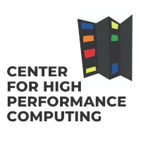

Department of Medicinal Chemistry &
Center for High Performance Computing
& https://carcc.org University of Utah
Advocacy and support for research computing and data (RCD)
Protected compute and data environments for restricted data
Research facilitation, student workforce development
Interface between researchers and RCD technology / infrastructure
Large-scale biomolecular simulation
Thomas Cheatham
tec3@utah.edu

Slide 16
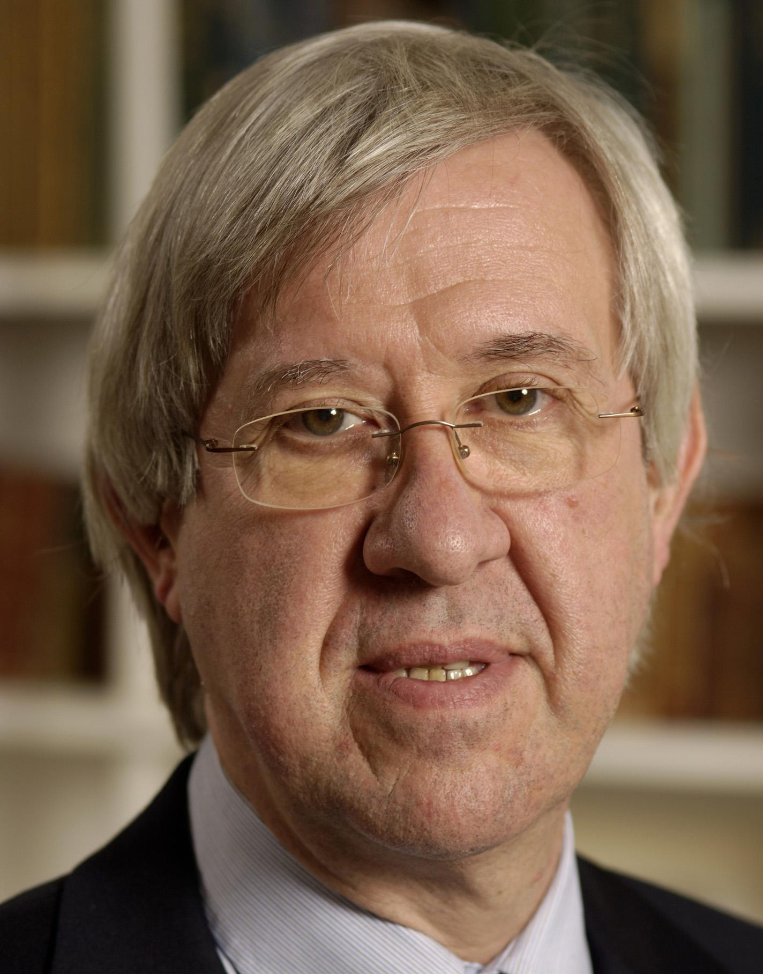

Institute for Data-Intensive Engineering and Science Johns Hopkins University
Data-Intensive Scientific Computing
Creation of large open scientific data sets
Creating scalable national solutions for Big Data problems
Big Data analytics on large spatial data
Use AI in designing and controlling large experiments
Alex Szalay
szalay@jhu.edu

Slide 17
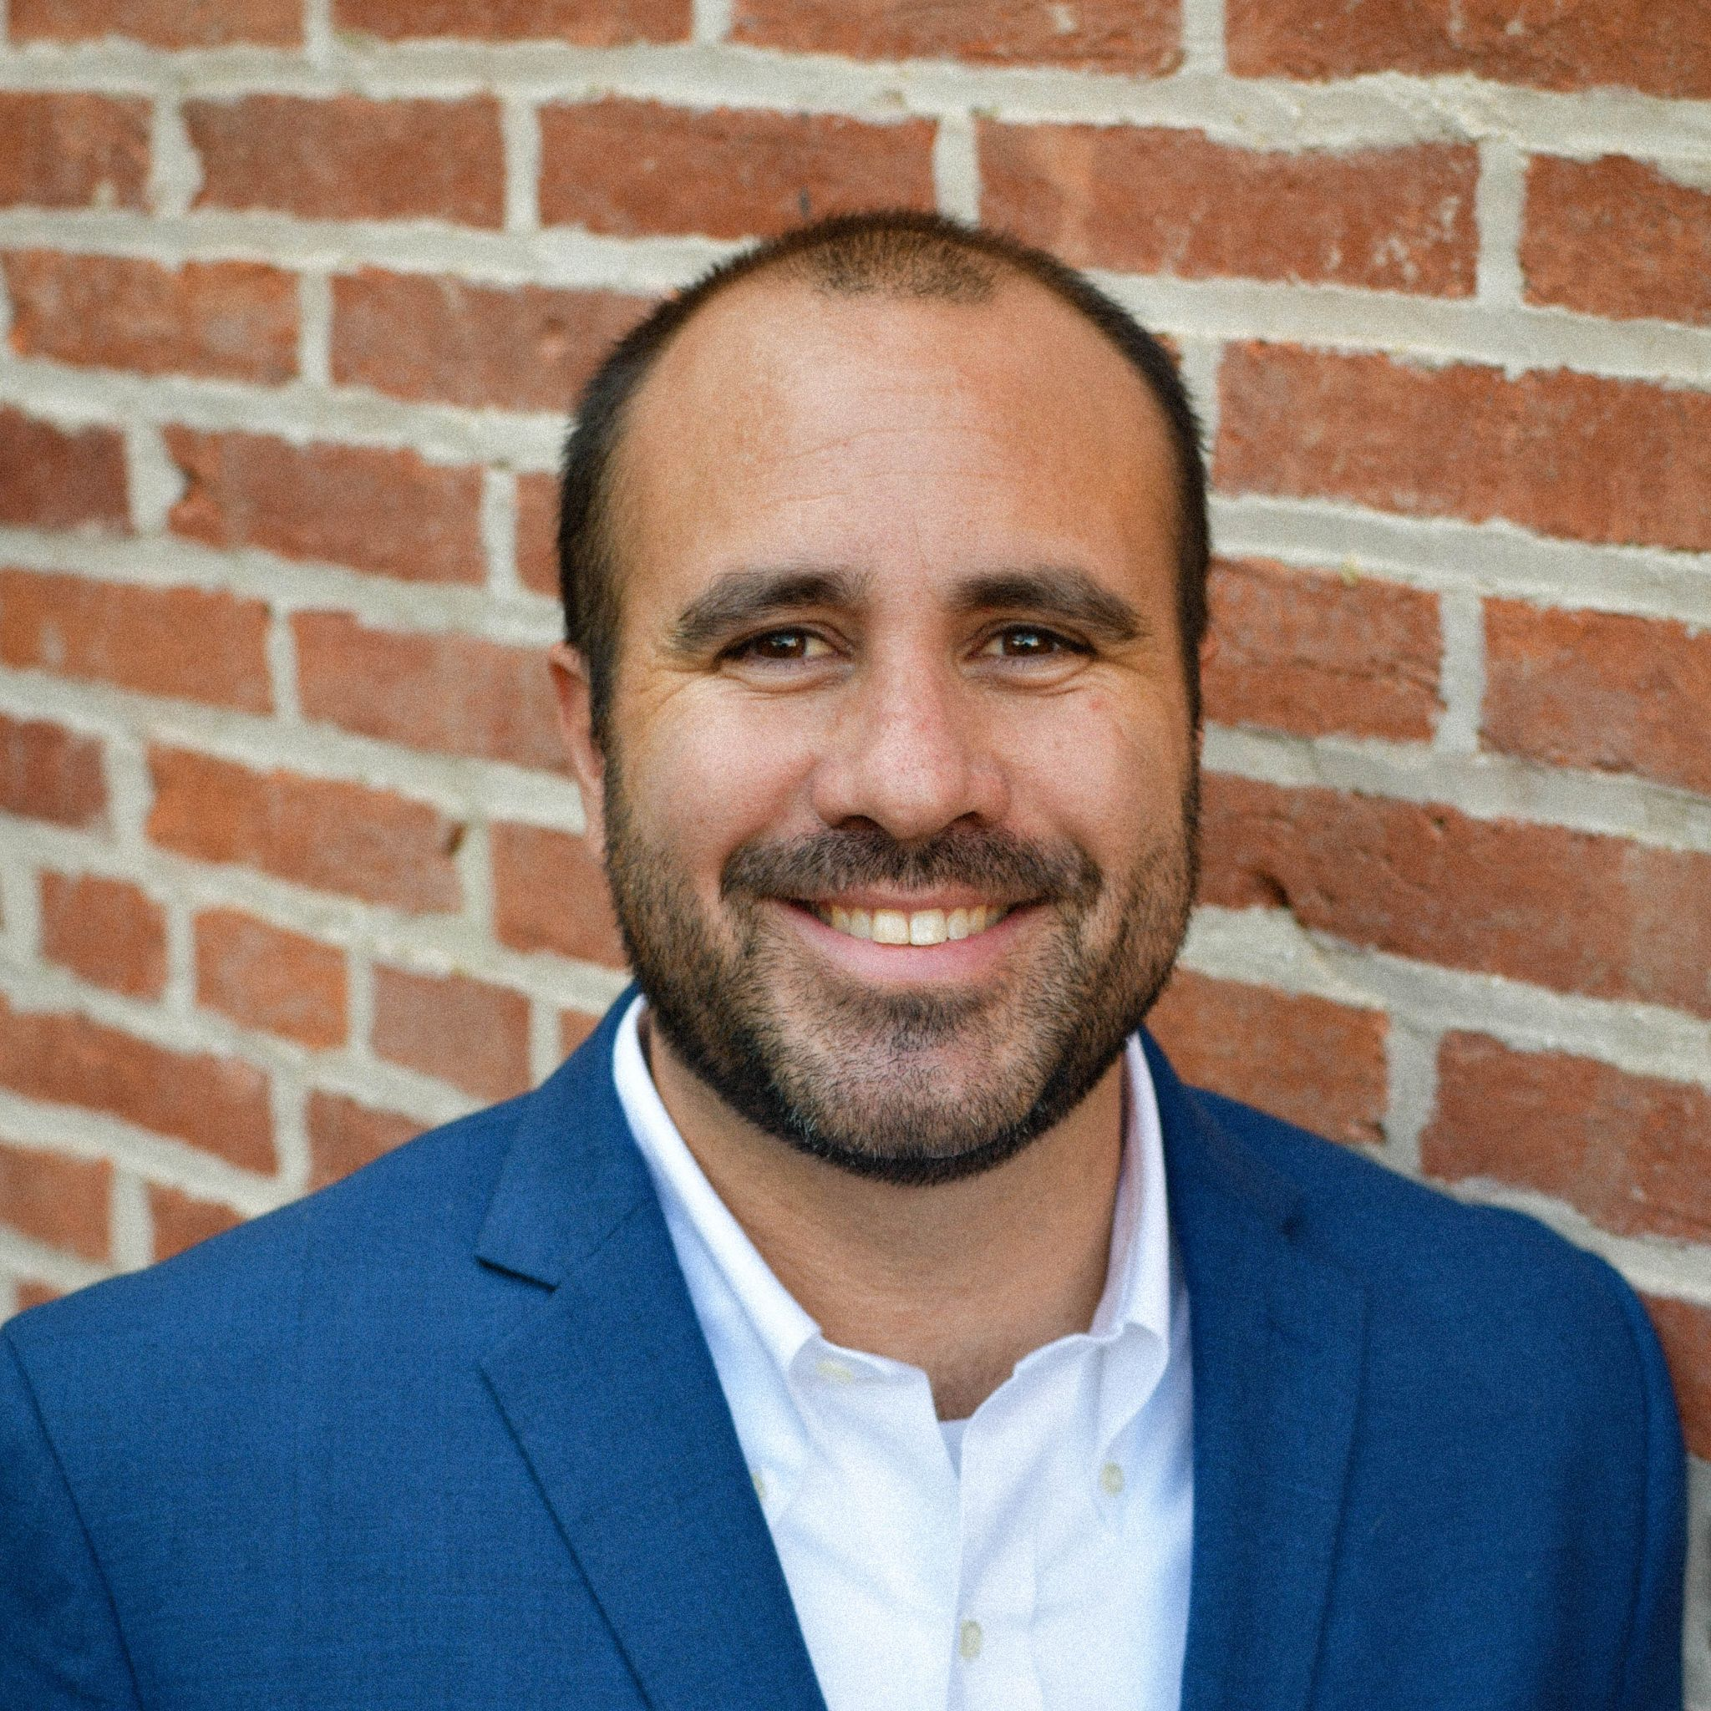

UNIVERSITY of TEXAS at EL PASO
Dynamic Material Laboratory (UDML)
Data Science and Machine Learning for Rapid Quantification of the Structure and Properties of Materials
Analytical and Computational Modeling of Materials
In-situ and In-Operando Experiments on Materials and Structures
Expanding Access and Experience with Data Tools

Slide 18
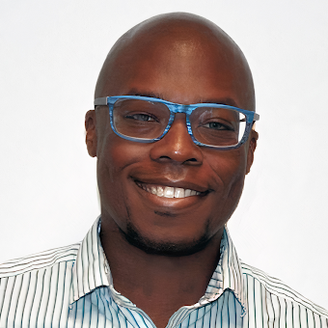
Scientific Computing and Imaging Institute
Computing Continuum
Urgent Analytics
Programming models and resource management for large-scale distributed analytics
Daniel Balouek-Thomert
daniel.balouek@utah.edu

Slide 19
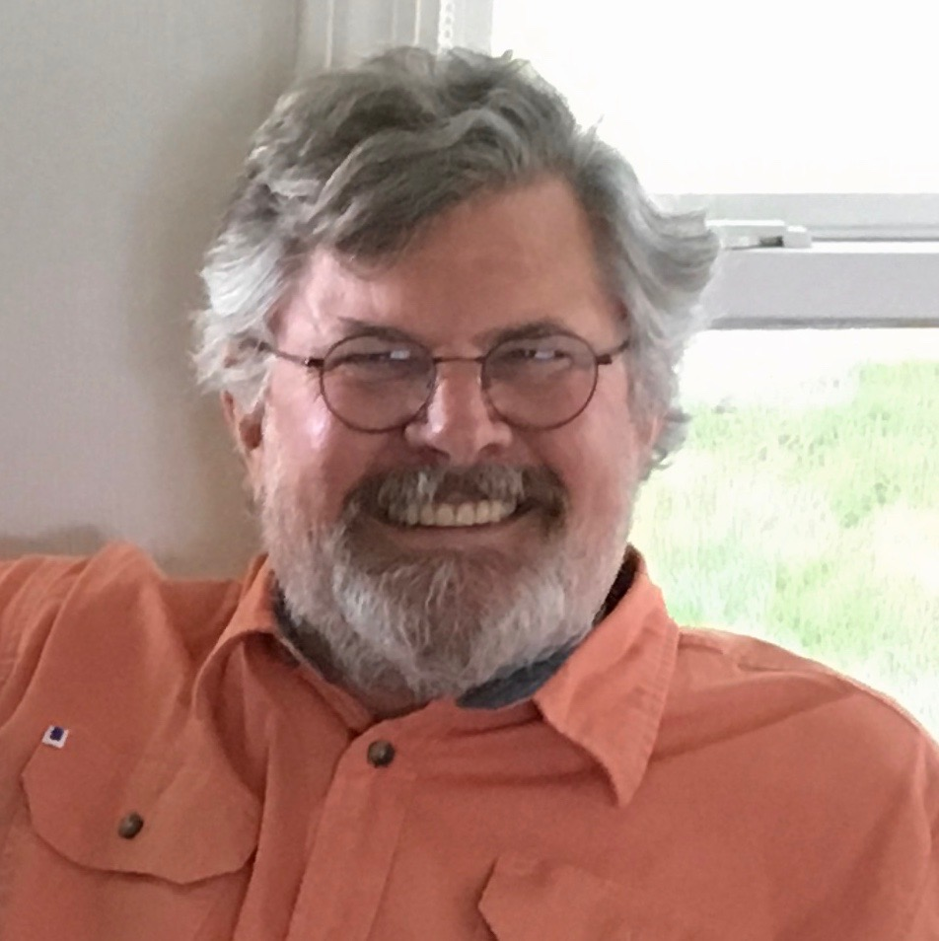

University of Michigan
Materials Commons
Center for PRedictive Integrated Materials Science (PRISMS Center)
Democratizing materials information
Integrating Materials Commons to cloud storage and fast data movement via NSDF
Visualization of materials information
John Allison
johnea@umich.edu

Slide 20
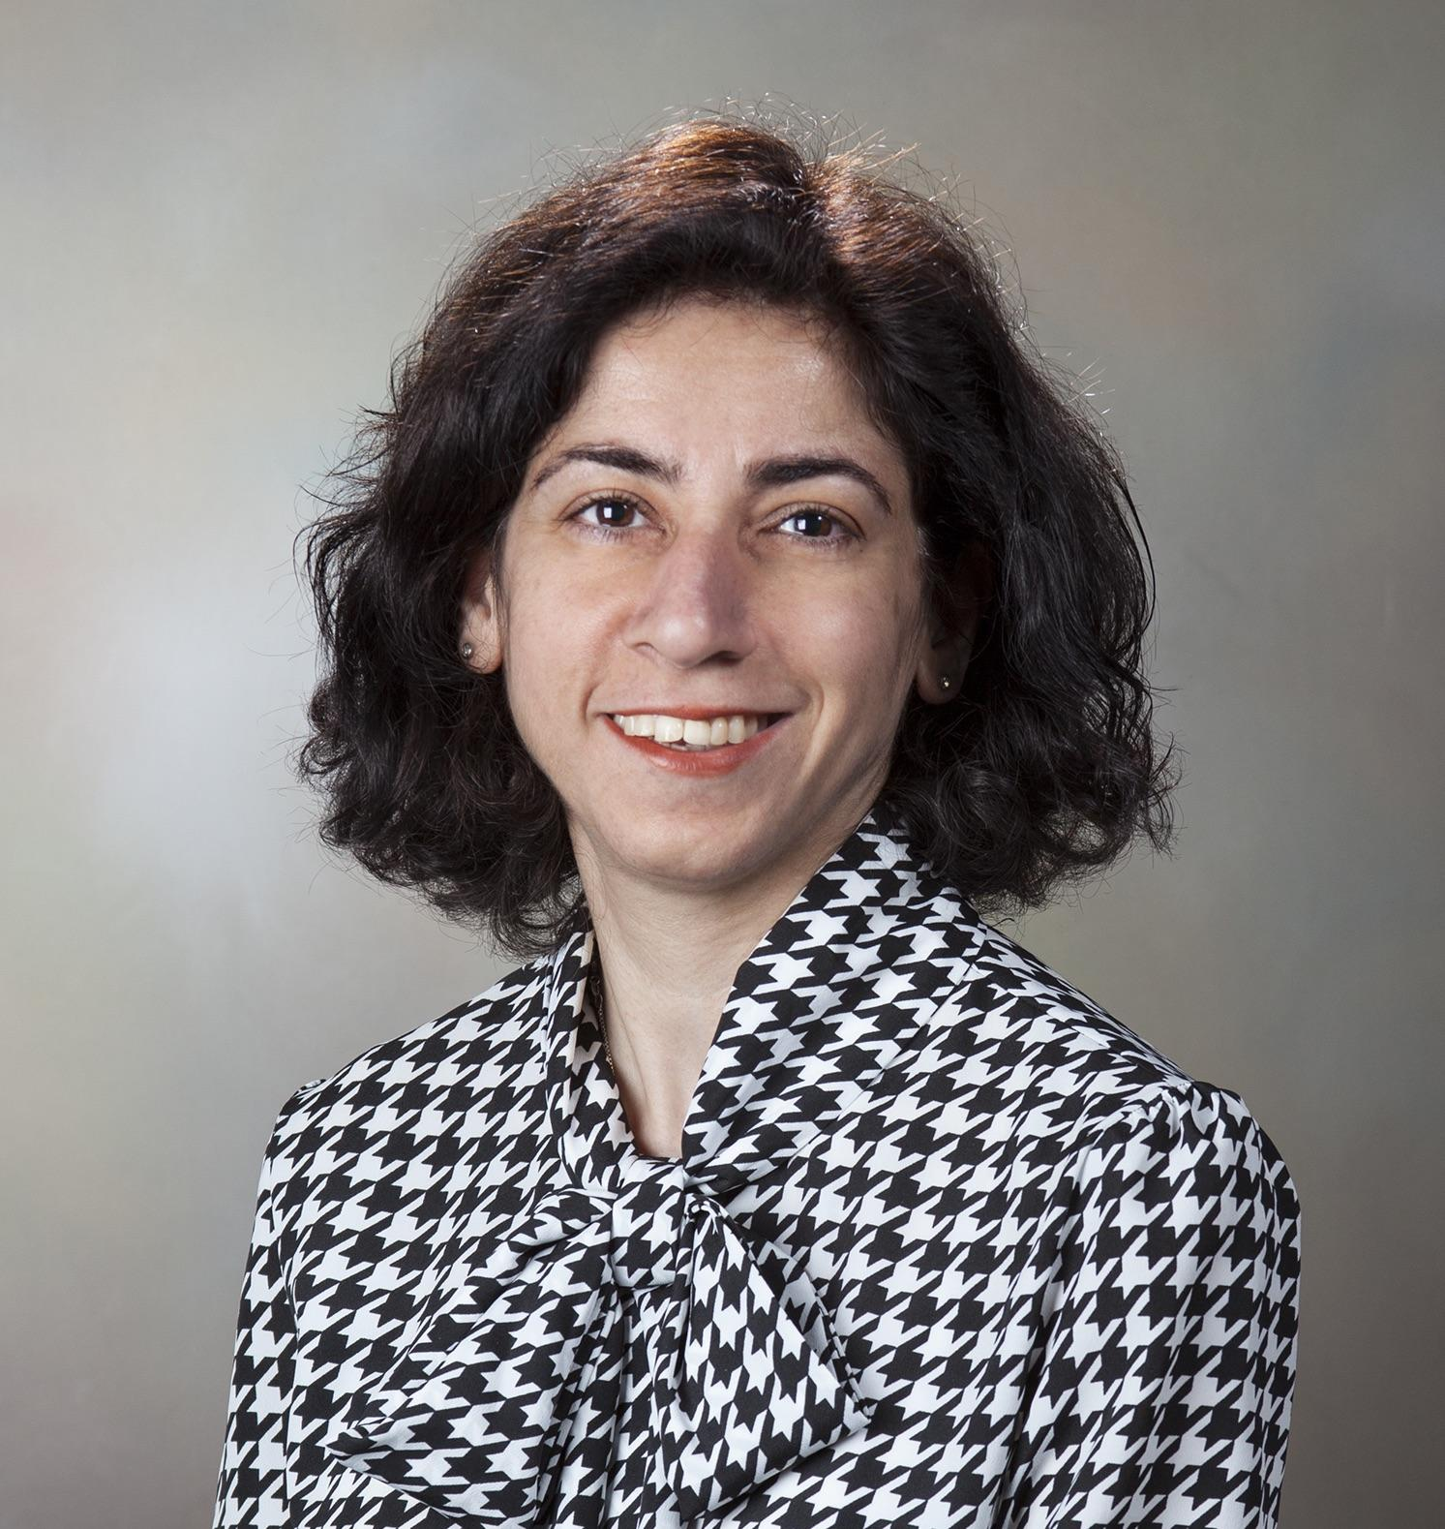

Integrated Multi-Physics Laboratory
Mechanical Engineering Department
Analytical and Computational Modeling of Hierarchical Porous Materials
In-situ Multi-Physics Experiments on Heterogeneous Porous Materials
Data Science and Machine Learning to Extract Properties of Porous Materials Across Scales
Pania Newell
pania.newell@utah.edu

Slide 21
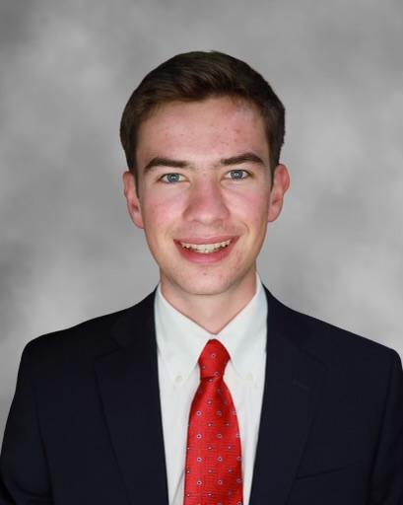
Scientific Computing and Imaging Institute
Center for Extreme Data Management Analysis and Visualization
Democratizing data access
Accessible and shareable scientific data visualizations
Big Data Analytics
Owen Koppe
owen.koppe@gmail.com

Slide 22
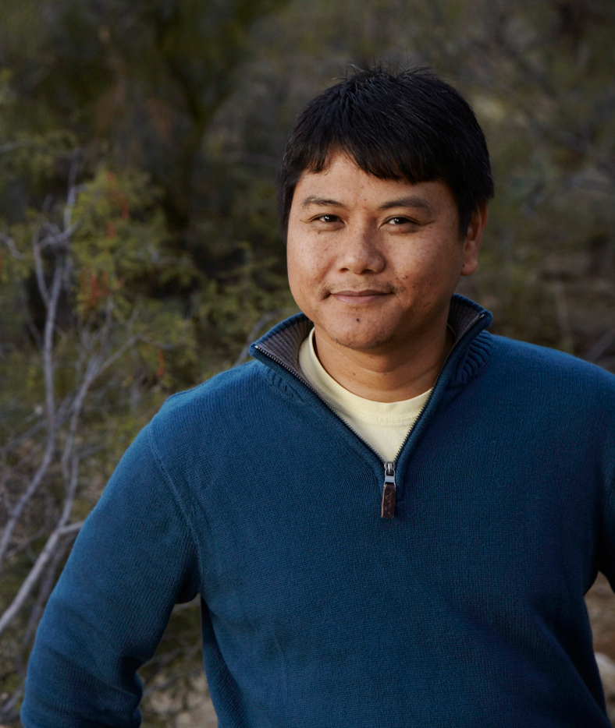


University of Arizona / CyVerse
Multi-cloud computing and storage
Scientific computing and workflow reproducibility
Edwin Skidmore
edwins@arizona.edu

Slide 23
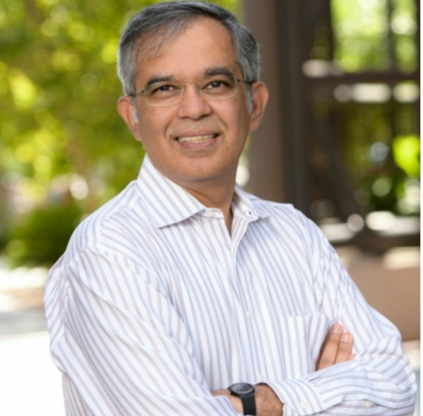
University of Arizona / CyVerse
Data Management Platforms
Managed cloud technologies
Distributed computing
Data Science Literacy and Training
Nirav Merchant
nirav@arizona.edu

Slide 24
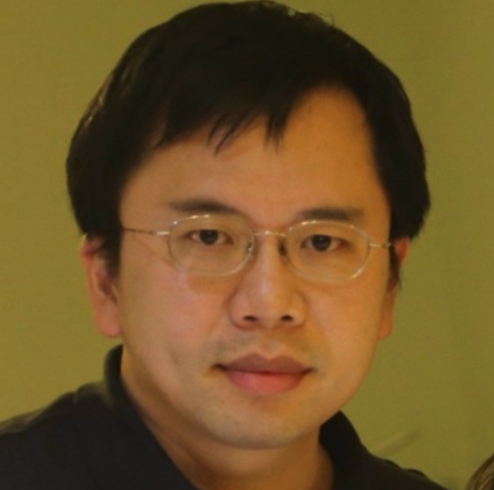

IBM T.J. Watson Research Center
Cloud Infrastructure Research
High Performance Computing
Performance Tuning, Tooling, Analysis and Modeling
I-Hsin Chung
ihchung@us.ibm.com

Slide 25
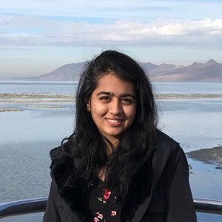
Scientific Computing and Imaging Institute
Big data visualization
Data storage and efficient IO
Computer graphics application
Nishita Kharche
nkharche@sci.utah.edu

Slide 26
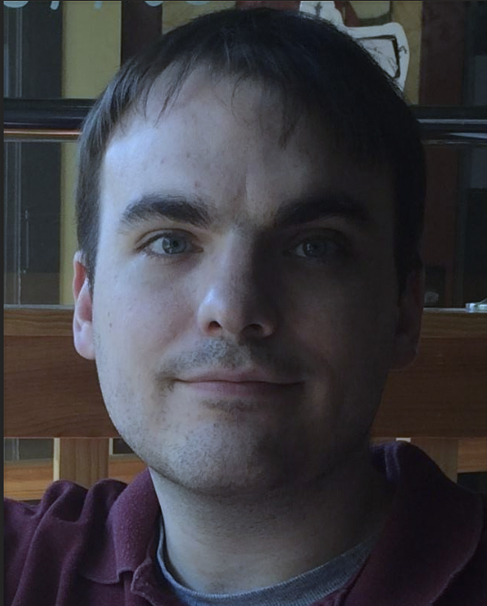
Scientific Computing and Imaging (SCI) Institute
Data management for scientific workflows running across sites
Semantics for coordinating highly distributed workflows across heterogenous infrastructure
Data engineering for HEC infrastructure
Philip Davis
philip.davis@sci.utah.edu

