Slide 1



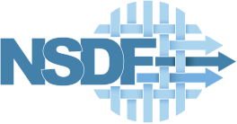

Building trust in Earth Science Findings through Data Traceability and Results Explainability
Paula Olaya*, Dominic Kennedy*, Ricardo Llamas↟, Rodrigo Vargas↟, Jay Lofstead†, and Michela Taufer*
*University of Tennessee, Knoxville; ↟University of Delaware; †Sandia National Lab

Slide 2
Trusting scientific workflows
Motivation: Scientists need to trust the data, software, infrastructure, and humans in the scientific discovery loop
Trust can be measured through:
Traceability: The ability to track down the dataflow and data provenance
Explainability: The ability to explain the results based on the methods deployed
Trust enables reusability of workflow components and composability of complex workflows
Reusability: The ability to reuse a workflow component (data or application) with no modification
Composability: The ability to build application workflows from component parts that can be selected from a dictionary and assembled in various combinations to satisfy specific user requirements

Slide 3
Modeling containerized workflows
We propose a computational environment that seamlessly builds on top of container technology
We use a fine-grained approach to encapsulate each workflow component into its own independent container
Native
Original execution in an HPC or a cloud cluster
App₁
App₂
Input_{a}
Input_{b}
Inter
Out
Fine-grained Workflow in Container
Decoupled workflow. Every workflow component (data and apps) as a single service
App₁
App₂
Input_{a}
Input_{b}
Inter
Out
Data
Data Container
App
Application Container

Slide 4
Connecting containerized workflows
We connect our containers using a zero-copy data transfer approach. This allows containers to directly exchange data without creating extra copies or using external storage
App₁
App₂
Two-copy data transfer in fine-grained containerization
Inter
Out
Input
Input
Inter
Inter
Out
App₁
App₂
Zero-copy data transfer in fine-grained containerization
Input
Inter
Out
‹#›

Slide 5
Annotating containerized workflows
We annotate our workflow at a fine-grained level where each of our containers is annotated with provenance information
The metadata includes:
Container identification [UUID, name]: the unique identification of each component
Creation time: the point in time when the container is written to disk
Command line: the set of instructions to execute the application
Container record trail {[UUID, name]}: the pipeline of containers used to generate a new result
The information in the metadata enables building the in-depth data lineage and the complete record trail of the applications generating the results
Input_{a}
Input_{b}
App₁
Inter
Out
App₂
Metadata
Metadata
Metadata
Metadata
Metadata
Metadata
Data
Data Container
App
Application Container
Metadata

Slide 6
Content of the metadata
App₁
App₂
Input
Inter
Out
[UUID_inp, input]
[UUID_app1, app1]
[UUID_inter, inter]
[UUID_app2, app2]
[UUID_out, output]
Creation_time_{input}
Creation_time_{app1}
Creation_time_{inter}
Creation_time_{app2}
Creation_time_{out}
Command line = noop
Command line = noop
Command line = app1…
Command line = noop
Command line = app2…
Record trail
Record trail
NULL
Record trail
Record trail
NULL
Record trail
Out:[UUID_in, input]
Out:[UUID_inter, inter]
Out:[UUID_out, out]
App:NULL
App:[UUID_app1, app1]
App:[UUID_app2, app2]
In:NULL
In:{[UUID_in, input]}
In:{[UUID_inter, inter]}

Slide 7
Implementing our environment using Singularity
Data container:
Data compressed and added as an EXT3 file systems partition
Metadata added as a JSON partition
Input
Out
Metadata
Metadata

Slide 8
Implementing our environment using Singularity
Data container:
Data compressed and added as an EXT3 file systems partition
Metadata added as a JSON partition
App
Input
Out
Application container:
Application executable or scripts + software stack compressed in a squashFS partition
Metadata added as a JSON partition
Metadata
Metadata
Metadata

Slide 9
Implementing our environment using Singularity
Data container:
Data compressed and added as an EXT3 file systems partition
Metadata added as a JSON partition
zero-copy
zero-copy
App
Input
Out
Application container:
Application executable or scripts + software stack compressed in a squashFS partition
Metadata added as a JSON partition
Metadata
Metadata
Metadata
Zero-copy data transfer:
Bind mount functionality that links a directory from a source container to a directory in a destination container
Multiple containers can be connected

Slide 10
Implementing our environment using Singularity
Singularity plugin
Data container:
Data compressed and added as an EXT3 file systems partition
Metadata added as a JSON partition
zero-copy
zero-copy
App
Input
Out
Application container:
Application executable or scripts + software stack compressed in a squashFS partition
Metadata added as a JSON partition
Metadata
Metadata
Metadata
Singularity plugin:
Package dynamically that interacts with the containerized environment to generate the metadata
Zero-copy data transfer:
Bind mount functionality that links a directory from a source container to a directory in a destination container
Multiple containers can be connected

Slide 11
Implementing our environment using Singularity
Singularity plugin
Data container:
Data compressed and added as an EXT3 file systems partition
Metadata added as a JSON partition
zero-copy
zero-copy
App
Input
Out
Application container:
Application executable or scripts + software stack compressed in a squashFS partition
Metadata added as a JSON partition
Metadata
Metadata
Metadata
User interface
Singularity plugin:
Package dynamically that interacts with the containerized environment to generate the metadata
Zero-copy data transfer:
Bind mount functionality that links a directory from a source container to a directory in a destination container
Multiple containers can be connected
User interface
Jupyter notebook interface that facilitates the study of the metadata

Slide 12
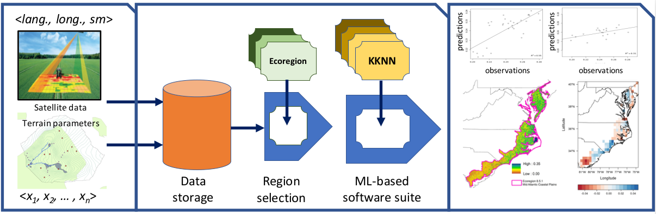
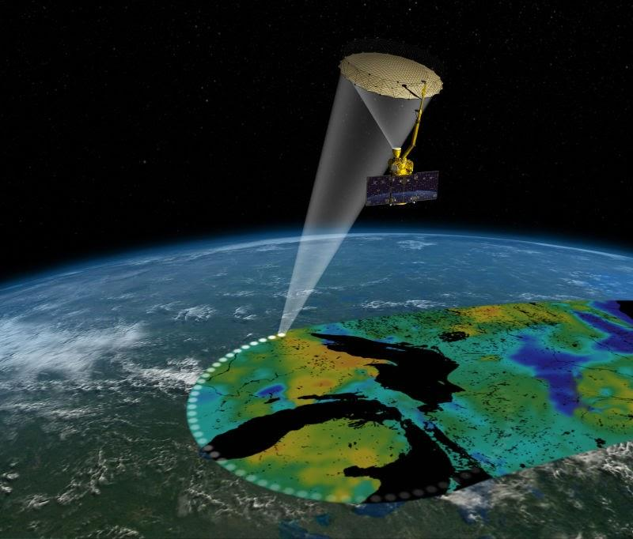
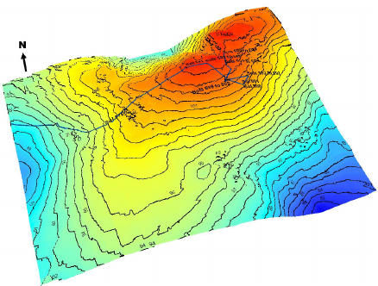
SOMOSPIE: Modeling soil moisture data
SOMOSPIE is a modular workflow that models and predicts fine-grained soil moisture values from coarse-grained satellite measurements and terrain parameters
Satellite data
Region of Interest (ROI)
KNN
The SMAP mission [online: https://www.ntsg.umt.edu/project/smap.php]
<long., lat., sm>
Terrain parameters
Data storage
Region selection
ML Modeling
Di, Kaichang & Li, Rainie. 2007
<p₁,p₂,...,p_{n}>
Data collection
Preprocessing
Modeling
Analysis

Slide 13
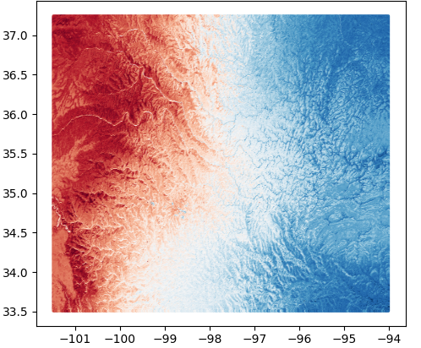
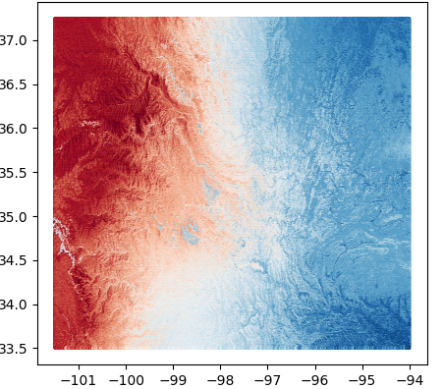
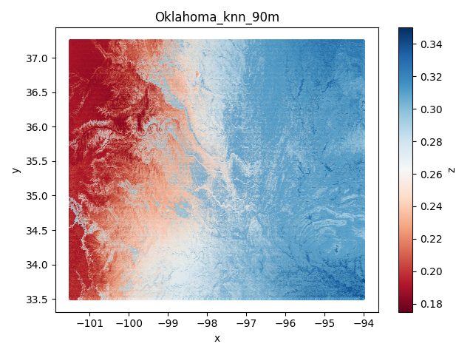
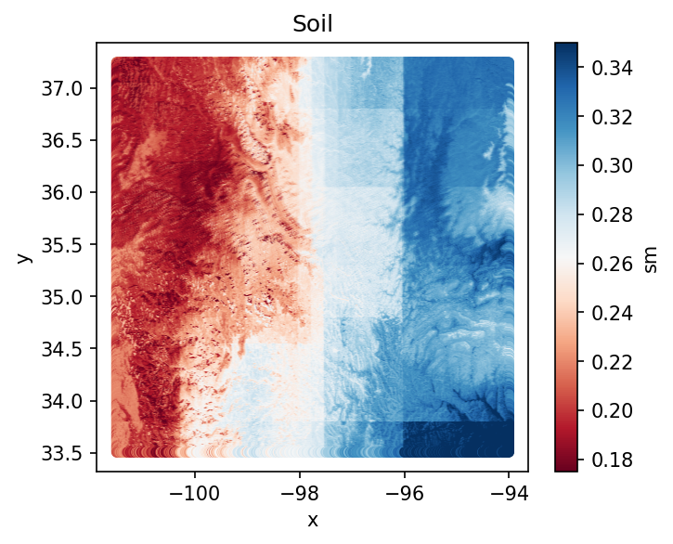
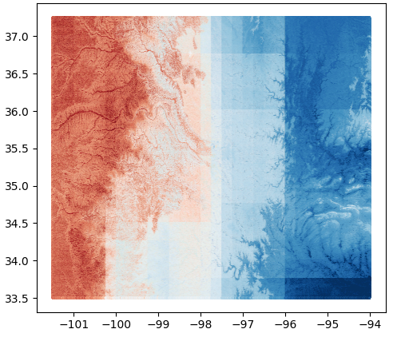
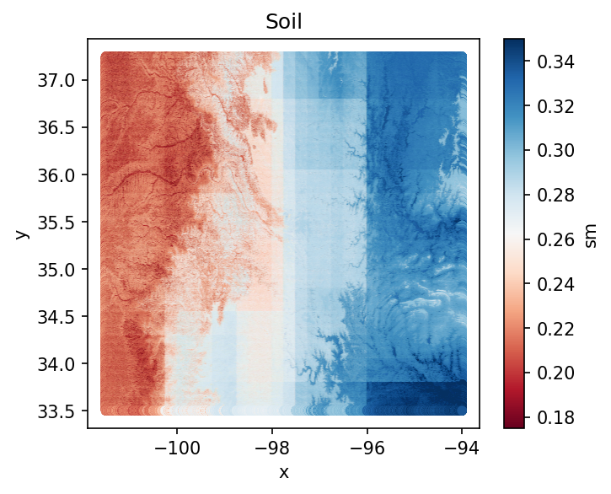
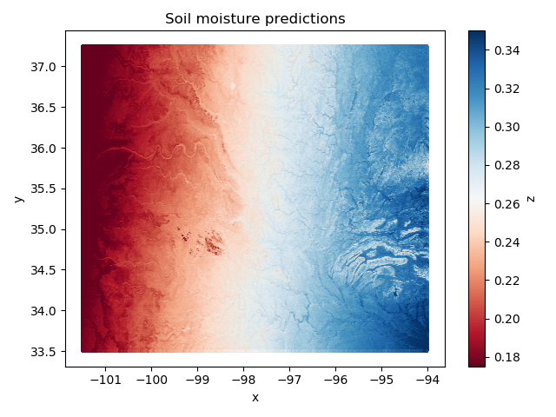
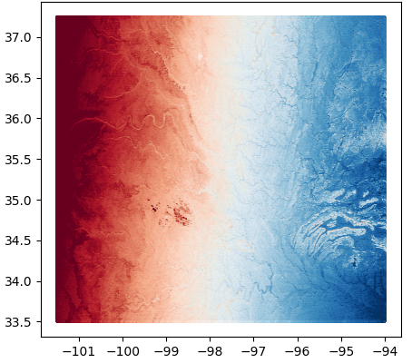
SOMOSPIE in a fine-grained containerized environment
How does the fine-grained containerized environment enable scientist to trust SOMOSPIE findings ?
Traceability of data
(data lineage and transformations)
Explainability of results
(computational methods)
Satellite data Oklahoma 27km
KNN
Predictions (KNN) Oklahoma 1km
Predictions (KNN) Oklahoma 250m
Predictions (KNN) Oklahoma 90m
Terrain Parameters Oklahoma 1km
Metadata
Metadata
Metadata
Metadata
Metadata
Metadata
RF
Predictions (RF) Oklahoma 1km
Predictions (RF) Oklahoma 250m
Predictions (RF) Oklahoma 90m
Visual
Terrain Parameters Oklahoma 250m
Terrain Parameters Oklahoma 250m
Metadata
Metadata
Metadata
SBM
Metadata
Metadata
Metadata
Terrain Parameters Oklahoma 90m
Predictions (SBM) Oklahoma 1km
Predictions (SBM) Oklahoma 250m
Predictions (SBM) Oklahoma 90m
Metadata
Metadata
Metadata
*Example of ML-model stage execution with 3 models and 3 resolutions for Oklahoma (1km, 250m, and 90m) and visualization of CONUS predictions
Metadata
Metadata
Metadata

Slide 14
Integrating traceability to scientific workflows
Can scientists identify the difference between these visualizations by tracing back to the data sources?
Latitude
Soil Moisture
Longitude
Longitude
Longitude
1km
(b) 250 m
c) 90 m

Slide 15
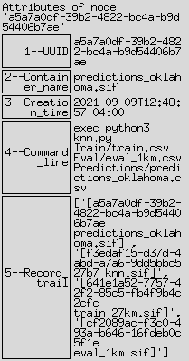
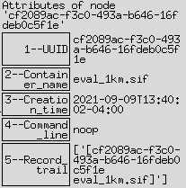
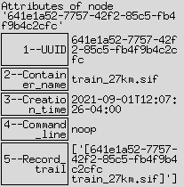
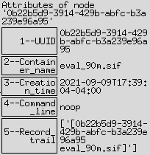
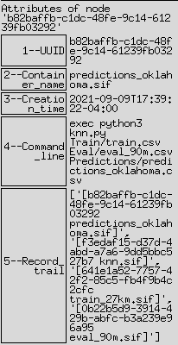
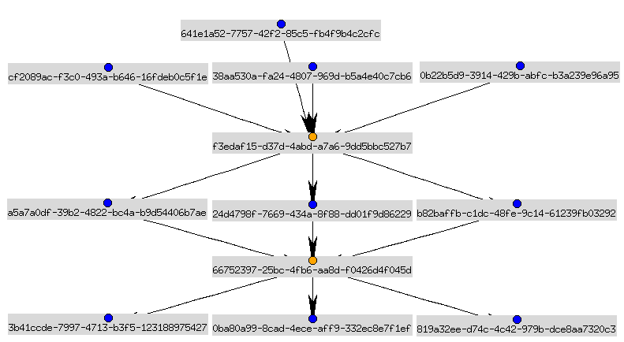
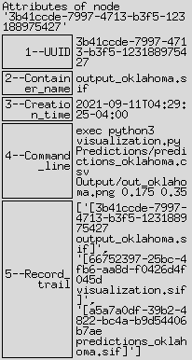
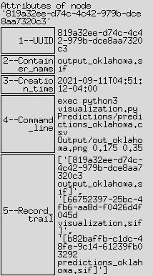

Slide 16
In our containerized environment, scientists can answer their question by tracing back to the data sources
The observed output differences come from three input datasets, each with a different resolution

Slide 17
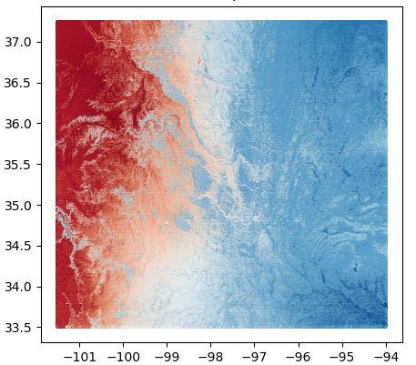
Integrating explainability to scientific workflows
Can scientists explain the different results by linking them to a specific method?
Latitude
Soil Moisture
Longitude
Longitude
Longitude
KNN
(b) RF
c) SBM

Slide 18
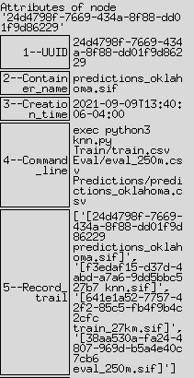
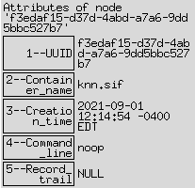
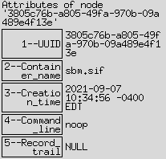
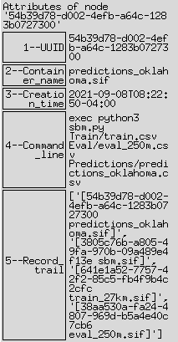
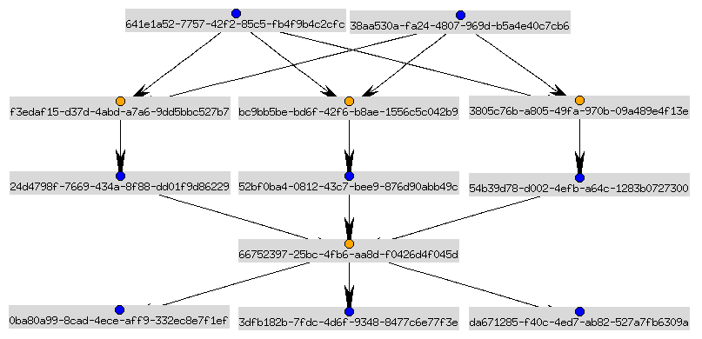
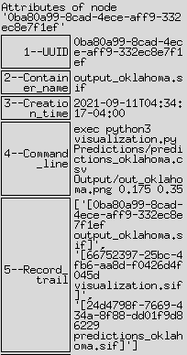
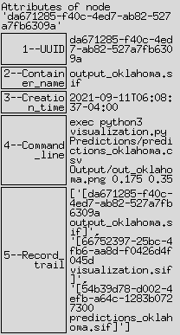

Slide 19
In our containerized environment, scientists can explain the results by linking them back to the ML methods
The observed output differences come from three different ML methods used during the soil moisture downscaling

Slide 20
Costs
We study the trade-offs of ensuring scalability considering the fine-grained containerization of the workflow
We compare the differences between the native environment and our fine-grained containerized environment by measuring:
Execution time [s]
Storage space: Data and application containers

Slide 21
Execution times
Average execution time in seconds of the SOMOSPIE workflow over 10 runs with three ML methods using the native environment (KNN, RF, SBM) vs. our environment (c_KNN, c_RF, c_SBM).
Resolution | KNN | c_KNN | RF | c_RF | SBM | c_SBM
1 km | 9.9 | 11.3 | 39.9 | 42.5 | 1036.5 | 902.5
250 m | 157.3 | 152.6 | 101.0 | 95.66 | 1453.3 | 1276.5
90 m | 624.3 | 672.5 | 347.7 | 320.0 | 5502.1 | 5146.4
We observe that the mean execution times obtained with our environment are in the same range as the native performance
Singularity can perform better given its lightweight solution and no CPU restrictions set by daemon
Notes:
Our environment is even 1.14 times faster than the native system when using SBM, the most costly ML method.

Slide 22
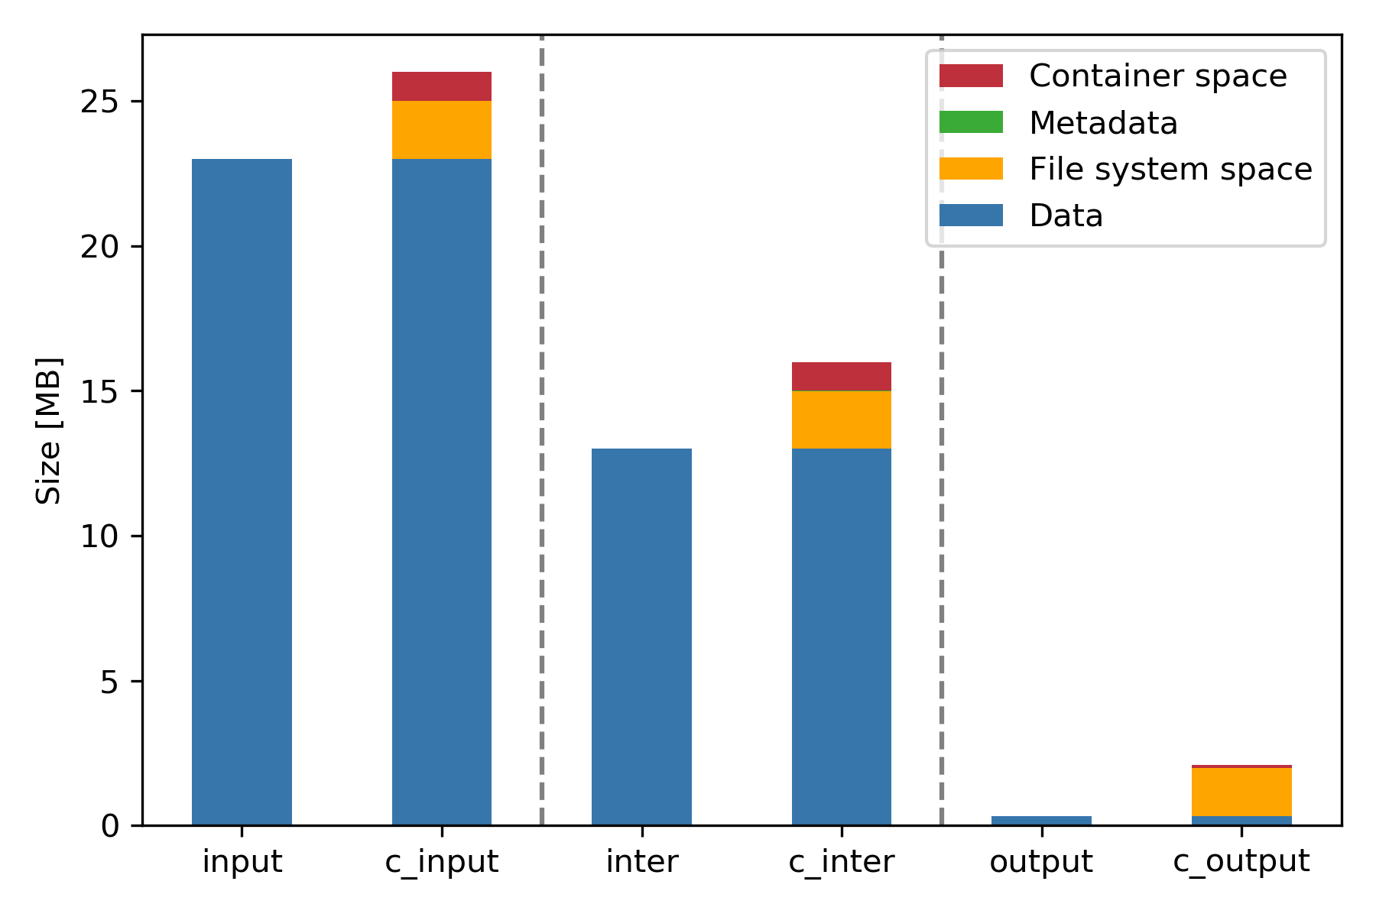
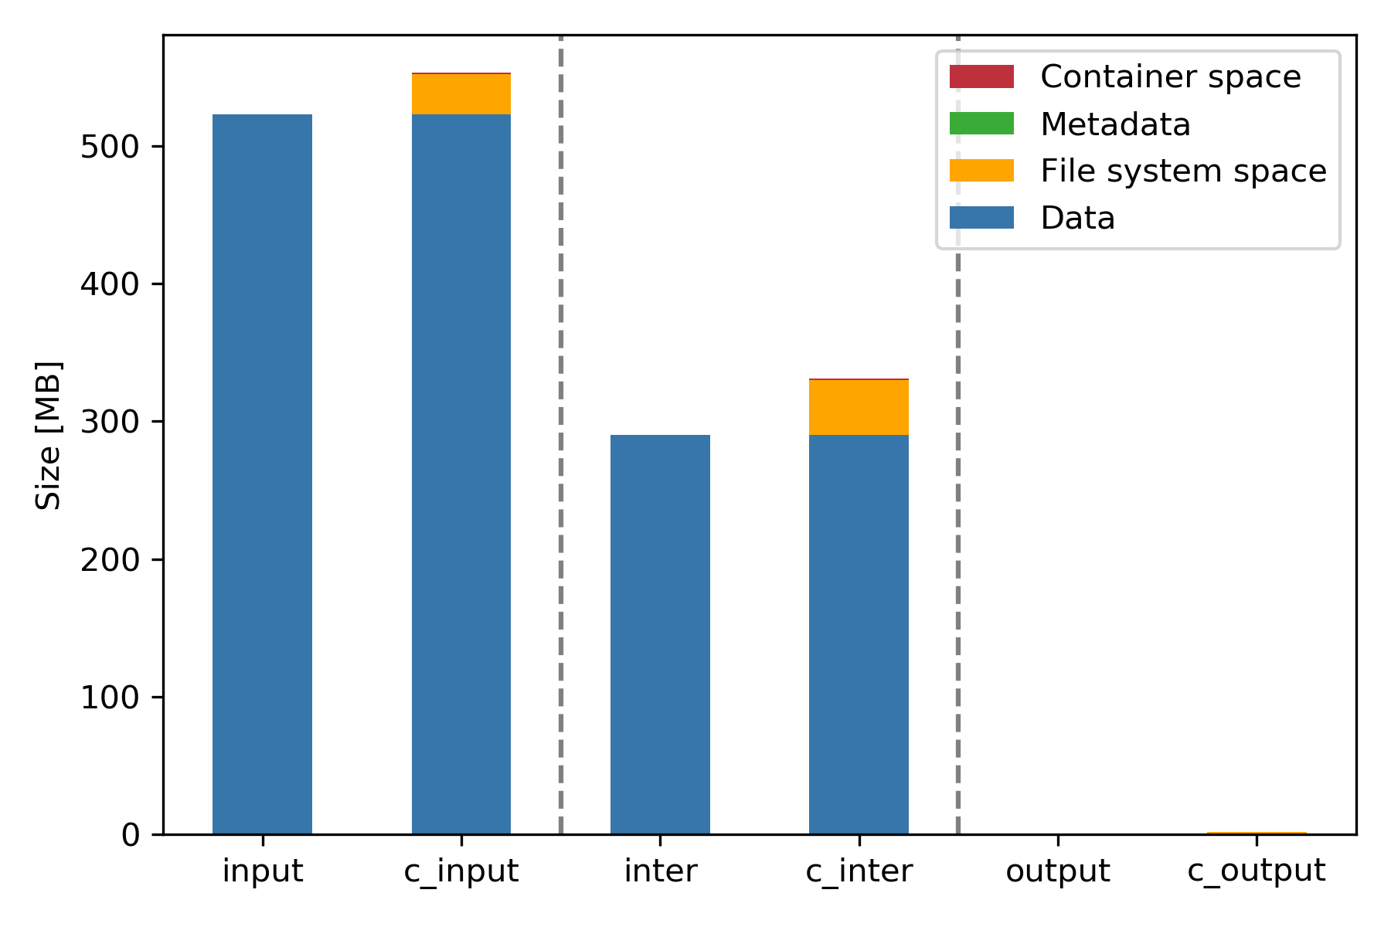
Storage space: Data containers
Oklahoma 1 km
Oklahoma 250 m
The extra space in the data container is mostly part of the Ext3 file system space
Ext3 reserves space for the journaling information and 5% space for root processes

Slide 23
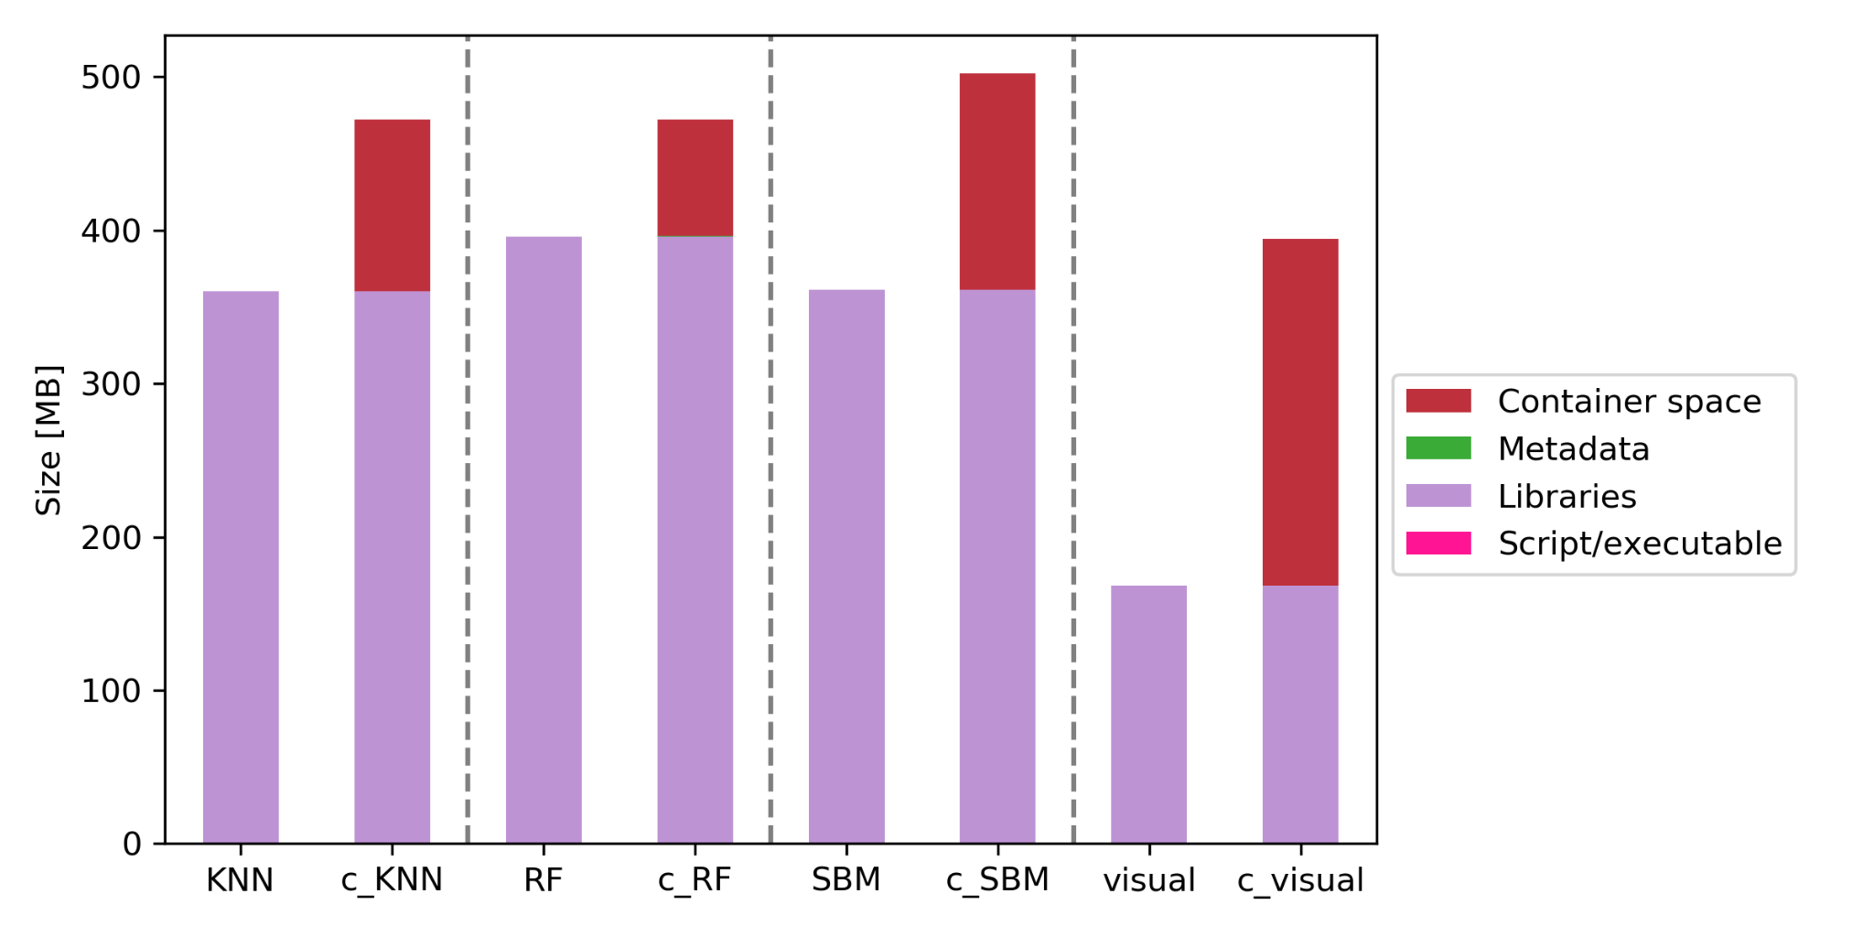
Storage space: Application containers
The extra space in the application container comes from the container space which includes the OS and software dependencies
The identification of libraries, software dependencies, and OS by the application container ensures replicability and transparency of the software system

Slide 24
Next directions
In an object storage each object is a simple, self-contained repository that includes:
the data
metadata (descriptive information associated with an object)
a unique identifying ID number (instead of a file name and file path)
We can leverage object storage technology to enable scientists to achieve trust in their workflow findings
Data Fabric is a current initiative that facilitates the end-to-end integration of data pipelines and cloud environments through the use of intelligent and automated systems. The main use case has been for banking applications (e.g., customer profiles, credentials, fraud detection, etc.)
We can integrate our solution to this initiative and extend it for scientific applications

Slide 25
Summary
We present a computational environment using containerized technology that enables scientists to achieve trust in their findings by seamlessly providing data traceability and result explainability
We demonstrate the benefits of our environment for an earth science workflow that uses machine learning to downscale satellite soil moisture data to a resolution necessary for practical use in policymaking and precision agriculture

