Slide 1





Composition of a data-driven workflow in the cloud
Paula Olaya*, Jakob Luettgau*, Naweiluo Zhou*, Giorgio Scorzelli↟,
Jay Lofstead†, Sophia When‡, I-Hsin Chung‡, Seetharami Seelam‡, and Michela Taufer*
*University of Tennessee, Knoxville; ↟University of Utah; †Sandia National Labs; ‡IBM-HCIR

Slide 2
Working group mission
Dealing with data means dealing with caching, chucking, concurrent requesting, and other advanced settings to obtain optimal performance of data-intensive workflows
What cutting edge storage technology is available to deal with data (block vs object storage)?
What is the effective setting for accessing and caching data?
How do we deploy HPC in the cloud?
How much does the deployed technology affect the performance of caching, chunking and requesting data?
Notes:
WORKING GROUP: MEMBERS STORAGE/DATA IN CLOUD
COMPOSITION OF A WORKFLOW IN CLOUD

Slide 3
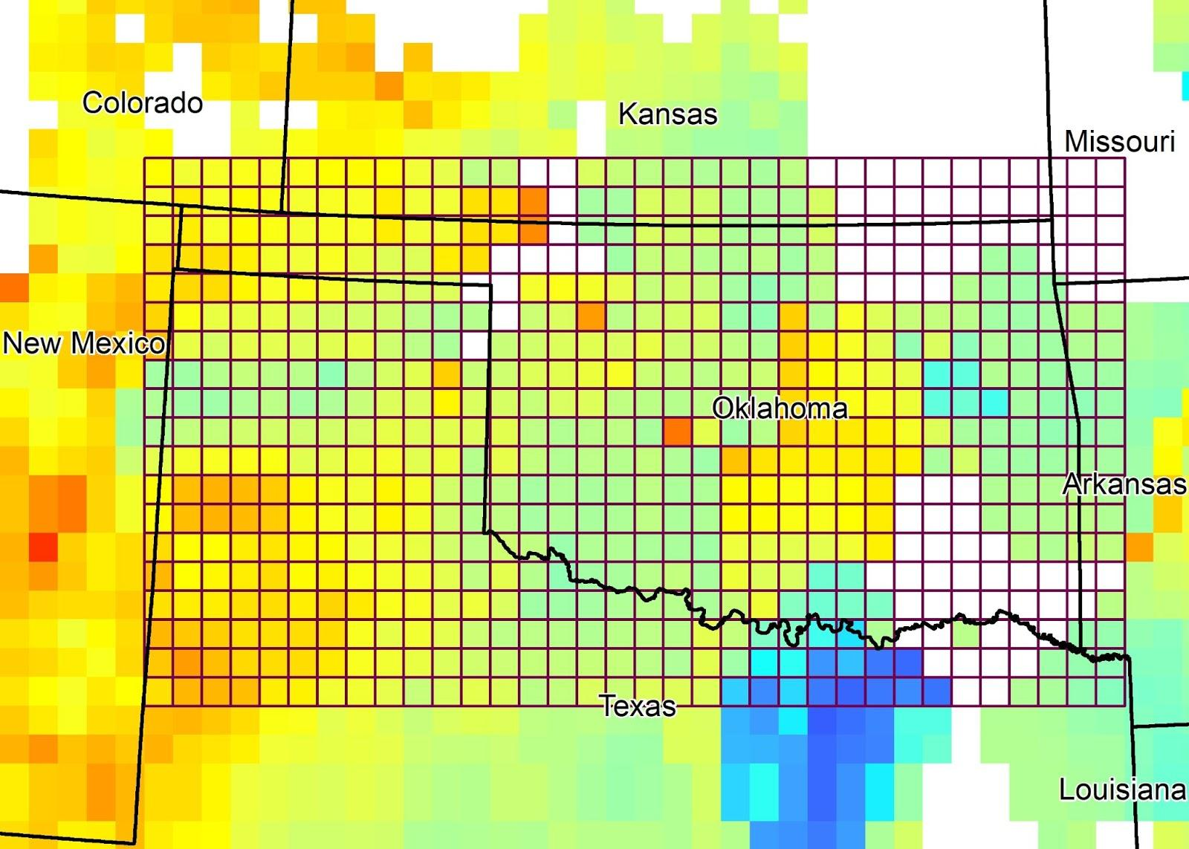
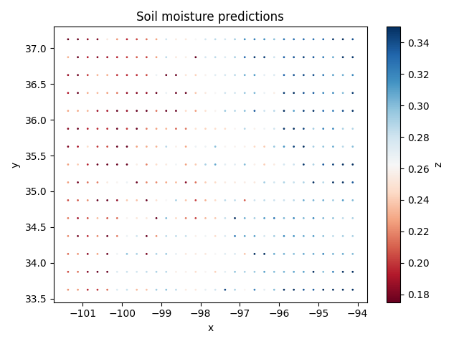
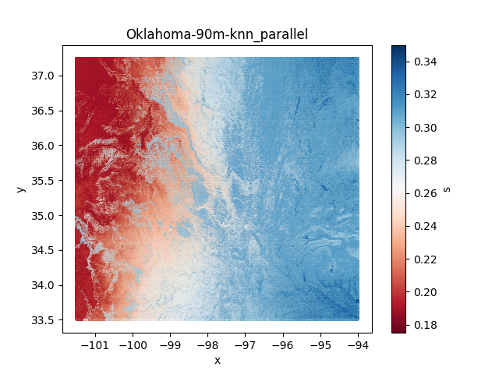
SOMOSPIE: Transforming soil moisture data
The original satellite data have coarse granularity (i.e., 27 km x 27 km)
SOMOSPIE uses ML to generate fine predictions of soil moisture (e.g., 90 m x 90 m)
Given a region of interest
(e.g., Oklahoma)
Latitude
Soil moisture
Longitude
Longitude
The data in this workflow can go from 5 GB (90 m x 90 m) to 42 TB (1 m x 1 m) based on the resolution of prediction

Slide 4
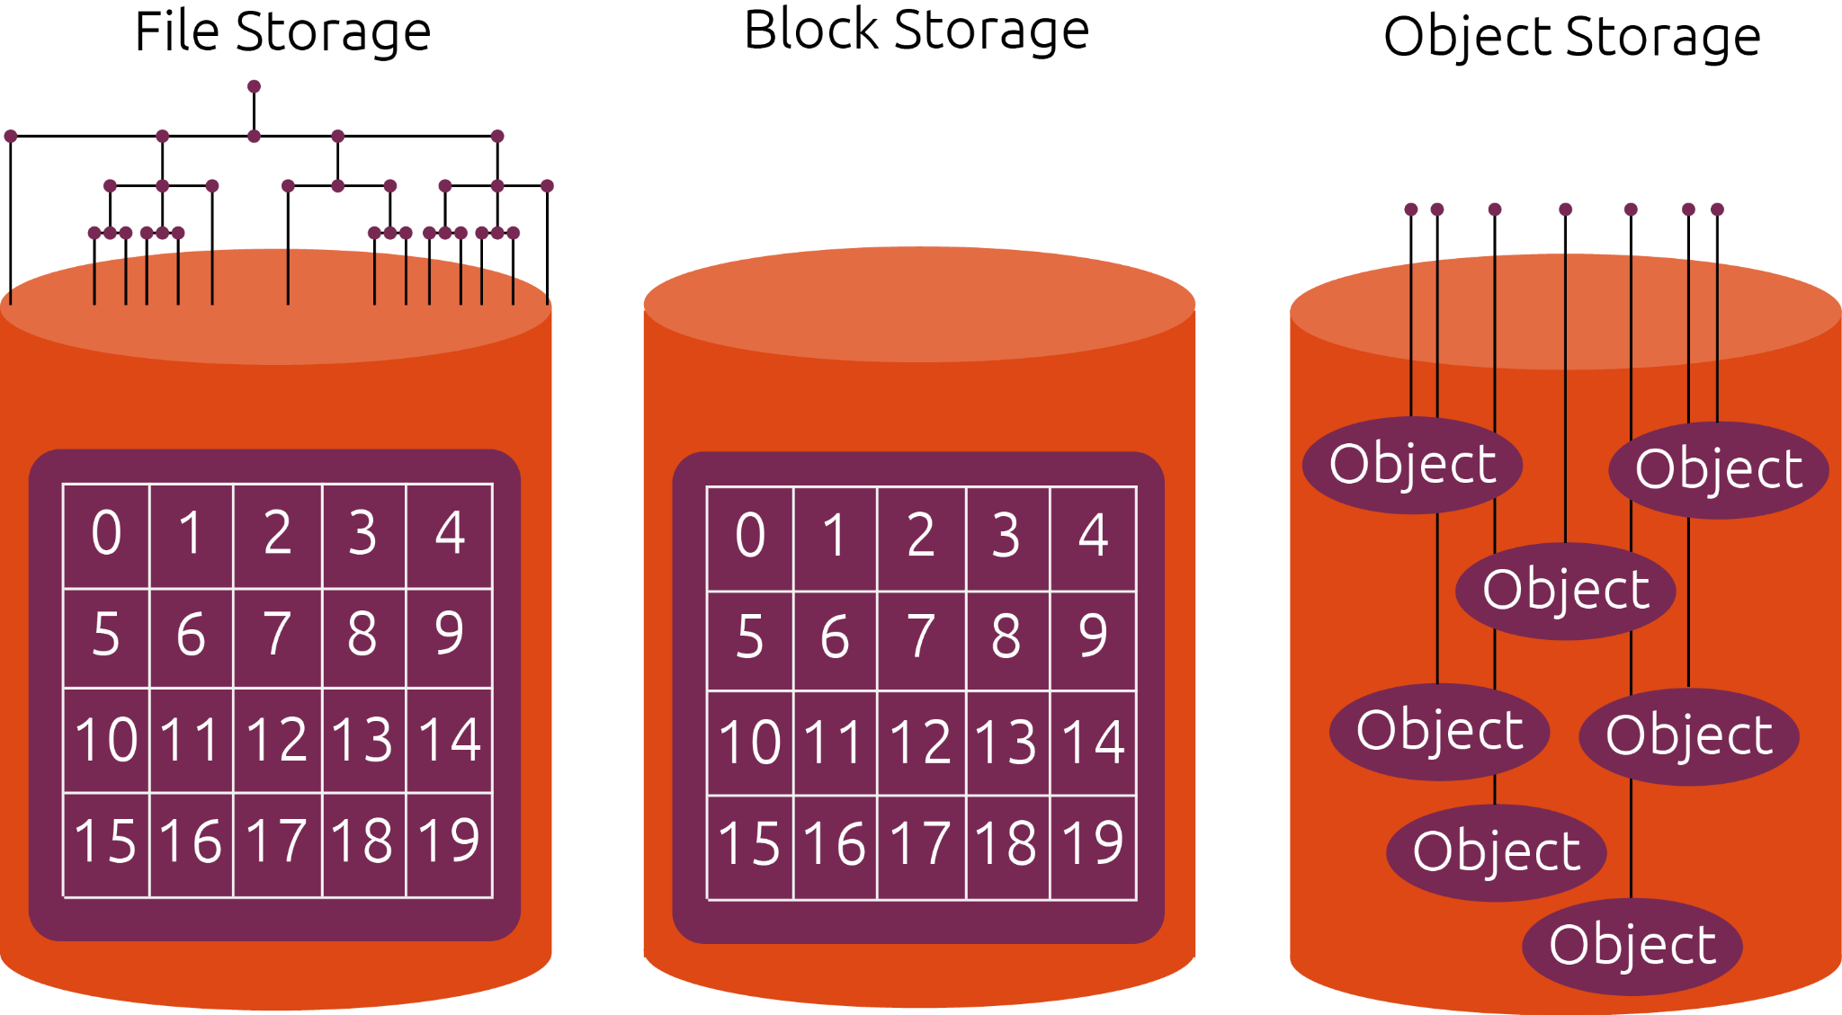
Storage technology: Block vs object storage
Block storage
High capacity
High scalability
Multiple access
High data resilience
Object storage
Low latency
I/O intensive
High frequency
Data center-specific
Locality | Definition | IBM resources | Storage solution
Data Center | Physical facility | 60 data centers | Block and Object
Zone | Combine 2 or more data centers | 3 zones per region → a multizone region (MZR) | Object
Region | Combine 2 or more zones | us-south, us-east, eu-de, eu-gb, jp-osa, au-syd, jp-tok | Object
Metroarea | Combine 2 or more regions | Dallas, Washington DC, Frankfurt, London, Osaka, Sydney, Tokyo | Object
Notes:
Block storage is when the data is split into fixed blocks of data and then stored separately with unique identifiers.
Object storage is a system that divides data into separate, self-contained units that are re-stored in a flat environment, with all objects at the same level.
Comparison between object vs block: https://www.ibm.com/cloud/blog/object-vs-file-vs-block-storage
Images from https://ubuntu.com/blog/what-are-the-different-types-of-storage-block-object-and-file

Slide 5
Storage technology: Block vs object storage
Block storage
High capacity
High scalability
Multiple access
High data resilience
Object storage
Low latency
I/O intensive
High frequency
Data center-specific
Locality | Definition | IBM resources | Storage solution
Data Center | Physical facility | 60 data centers | Block and Object
Zone | Combine 2 or more data centers | 3 zones per region → a multizone region (MZR) | Object
Region | Combine 2 or more zones | us-south, us-east, eu-de, eu-gb, jp-osa, au-syd, jp-tok | Object
Metroarea | Combine 2 or more regions | Dallas, Washington DC, Frankfurt, London, Osaka, Sydney, Tokyo | Object
Notes:
Block storage is when the data is split into fixed blocks of data and then stored separately with unique identifiers.
Object storage is a system that divides data into separate, self-contained units that are re-stored in a flat environment, with all objects at the same level.
Comparison between object vs block: https://www.ibm.com/cloud/blog/object-vs-file-vs-block-storage
Images from https://ubuntu.com/blog/what-are-the-different-types-of-storage-block-object-and-file

Slide 6


Data access: From object storage to file system
An Object Storage stores the data as objects.
No file hierarchy → High scalability
Global locality and data resilience
COS bucket (Object Storage)
s3fs
How do we access our data in a COS bucket from a cluster?
We use s3fs to mount the bucket via FUSE while preserving the native object format for files
s3fs provides advanced options to increase performance
Caching
Chunking
Requesting data concurrently
File system
VSI
(Virtual Server Instance)
Notes:
Data resilience: https://www.ibm.com/cloud/object-storage/resiliency
-S3FS: s3fs or s3fs-fuse is an Amazon S3 (Simple Storage Service) and S3-based object stores compatible FUSE filesystem disk management utility that supports a subset of Single UNIX Specification (SUS) or POSIX including reading/writing files, directories, symlinks, mode, uid/gid, and extended attributes, while preserving the original file format
-Filesystem in Userspace (FUSE) lets non-privileged users create a file system in their user space. The FUSE project consists of two components: a FUSE kernel module that is part of the Linux kernel since version 2.6.14, and the libfuse userspace library. The libfuse library provides a reference implementation for communication with the FUSE kernel module, providing client functions to mount the file system, unmount it, read requests from the kernel, and send responses back. FUSE is particularly useful for writing Virtual File Systems (VFS).

Slide 7
Data access: From object storage to file system
An Object Storage stores the data as objects.
No file hierarchy → High scalability
Global locality and data resilience
COS bucket (Object Storage)
s3fs
How do we access our data in a COS bucket from a cluster?
We use s3fs to mount the bucket via FUSE while preserving the native object format for files
s3fs provides advanced options to increase performance
Caching
Chunking
Requesting data concurrently
File system
VSI
(Virtual Server Instance)
Notes:
Data resilience: https://www.ibm.com/cloud/object-storage/resiliency
-S3FS: s3fs or s3fs-fuse is an Amazon S3 (Simple Storage Service) and S3-based object stores compatible FUSE filesystem disk management utility that supports a subset of Single UNIX Specification (SUS) or POSIX including reading/writing files, directories, symlinks, mode, uid/gid, and extended attributes, while preserving the original file format
-Filesystem in Userspace (FUSE) lets non-privileged users create a file system in their user space. The FUSE project consists of two components: a FUSE kernel module that is part of the Linux kernel since version 2.6.14, and the libfuse userspace library. The libfuse library provides a reference implementation for communication with the FUSE kernel module, providing client functions to mount the file system, unmount it, read requests from the kernel, and send responses back. FUSE is particularly useful for writing Virtual File Systems (VFS).

Slide 8
Caching setting: No caching
No caching (I/O network)
WN
COS bucket (Object Storage)
Throughput (observed) = 10.2 MB/s

Slide 9
Caching setting: Boot volume, RAM, and storage node
No caching (I/O network)
WN
COS bucket (Object Storage)
Throughput (observed) = 10.2 MB/s
Cache in boot volume
Cache in RAM
Cache in storage node
WN₁
Storage node
WN
WN
files
files
WN₂
files
files
boot
files
RAM
files
Block
WN_{n}
files
files
files
COS bucket (Object Storage)
COS bucket (Object Storage)
COS bucket (Object Storage)
Throughput (observed) = 42.0 MB/s
Throughput (observed) = 38.2 MB/s
Throughput (observed) = 37.2 MB/s

Slide 10
Caching setting: Boot volume
No caching (I/O network)
WN
COS bucket (Object Storage)
Throughput (observed) = 10.2 MB/s
Cache in boot volume
Cache in RAM
Cache in storage node
WN₁
Storage node
WN
WN
files
files
WN₂
files
files
boot
files
RAM
files
Block
WN_{n}
files
files
files
COS bucket (Object Storage)
COS bucket (Object Storage)
COS bucket (Object Storage)
Throughput (observed) = 42.0 MB/s
Throughput (observed) = 38.2 MB/s
Throughput (observed) = 37.2 MB/s

Slide 11
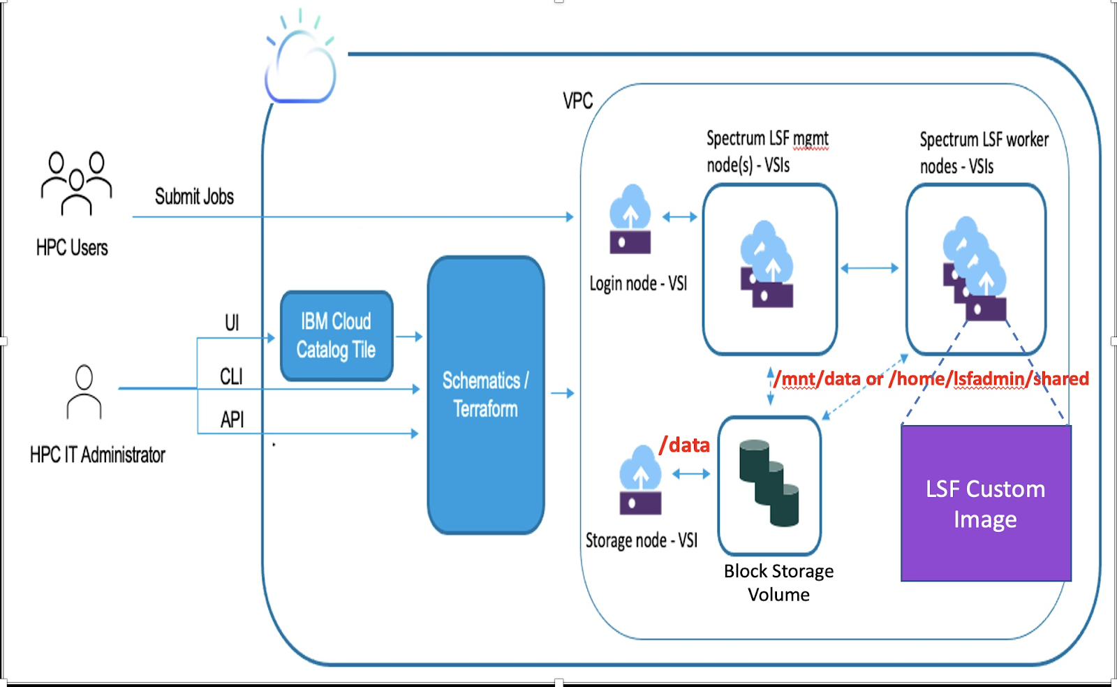
Deploy a HPC Cluster in the Cloud
The IBM Spectrum LSF provides set of tools that customers can use and customize to build HPC clusters on IBM Cloud
The IBM Spectrum LSF consists of:
Login node: Jump host. Only node which IP address is public
LSF management nodes: LSF manager. It operates and connects to the worker nodes
LSF worker nodes: Compute nodes. They can be a static or dynamic resource
Storage node: NFS server with a block storage volume mounted to a shared directory by all the nodes in the cluster
LSF custom image: The HPC cluster solution provides a base custom image which includes the LSF installation. Users have the option to create their own custom image on top of the base image if they decided to
Notes:
Change cluster image of openshift so then it matches when we mount

Slide 12
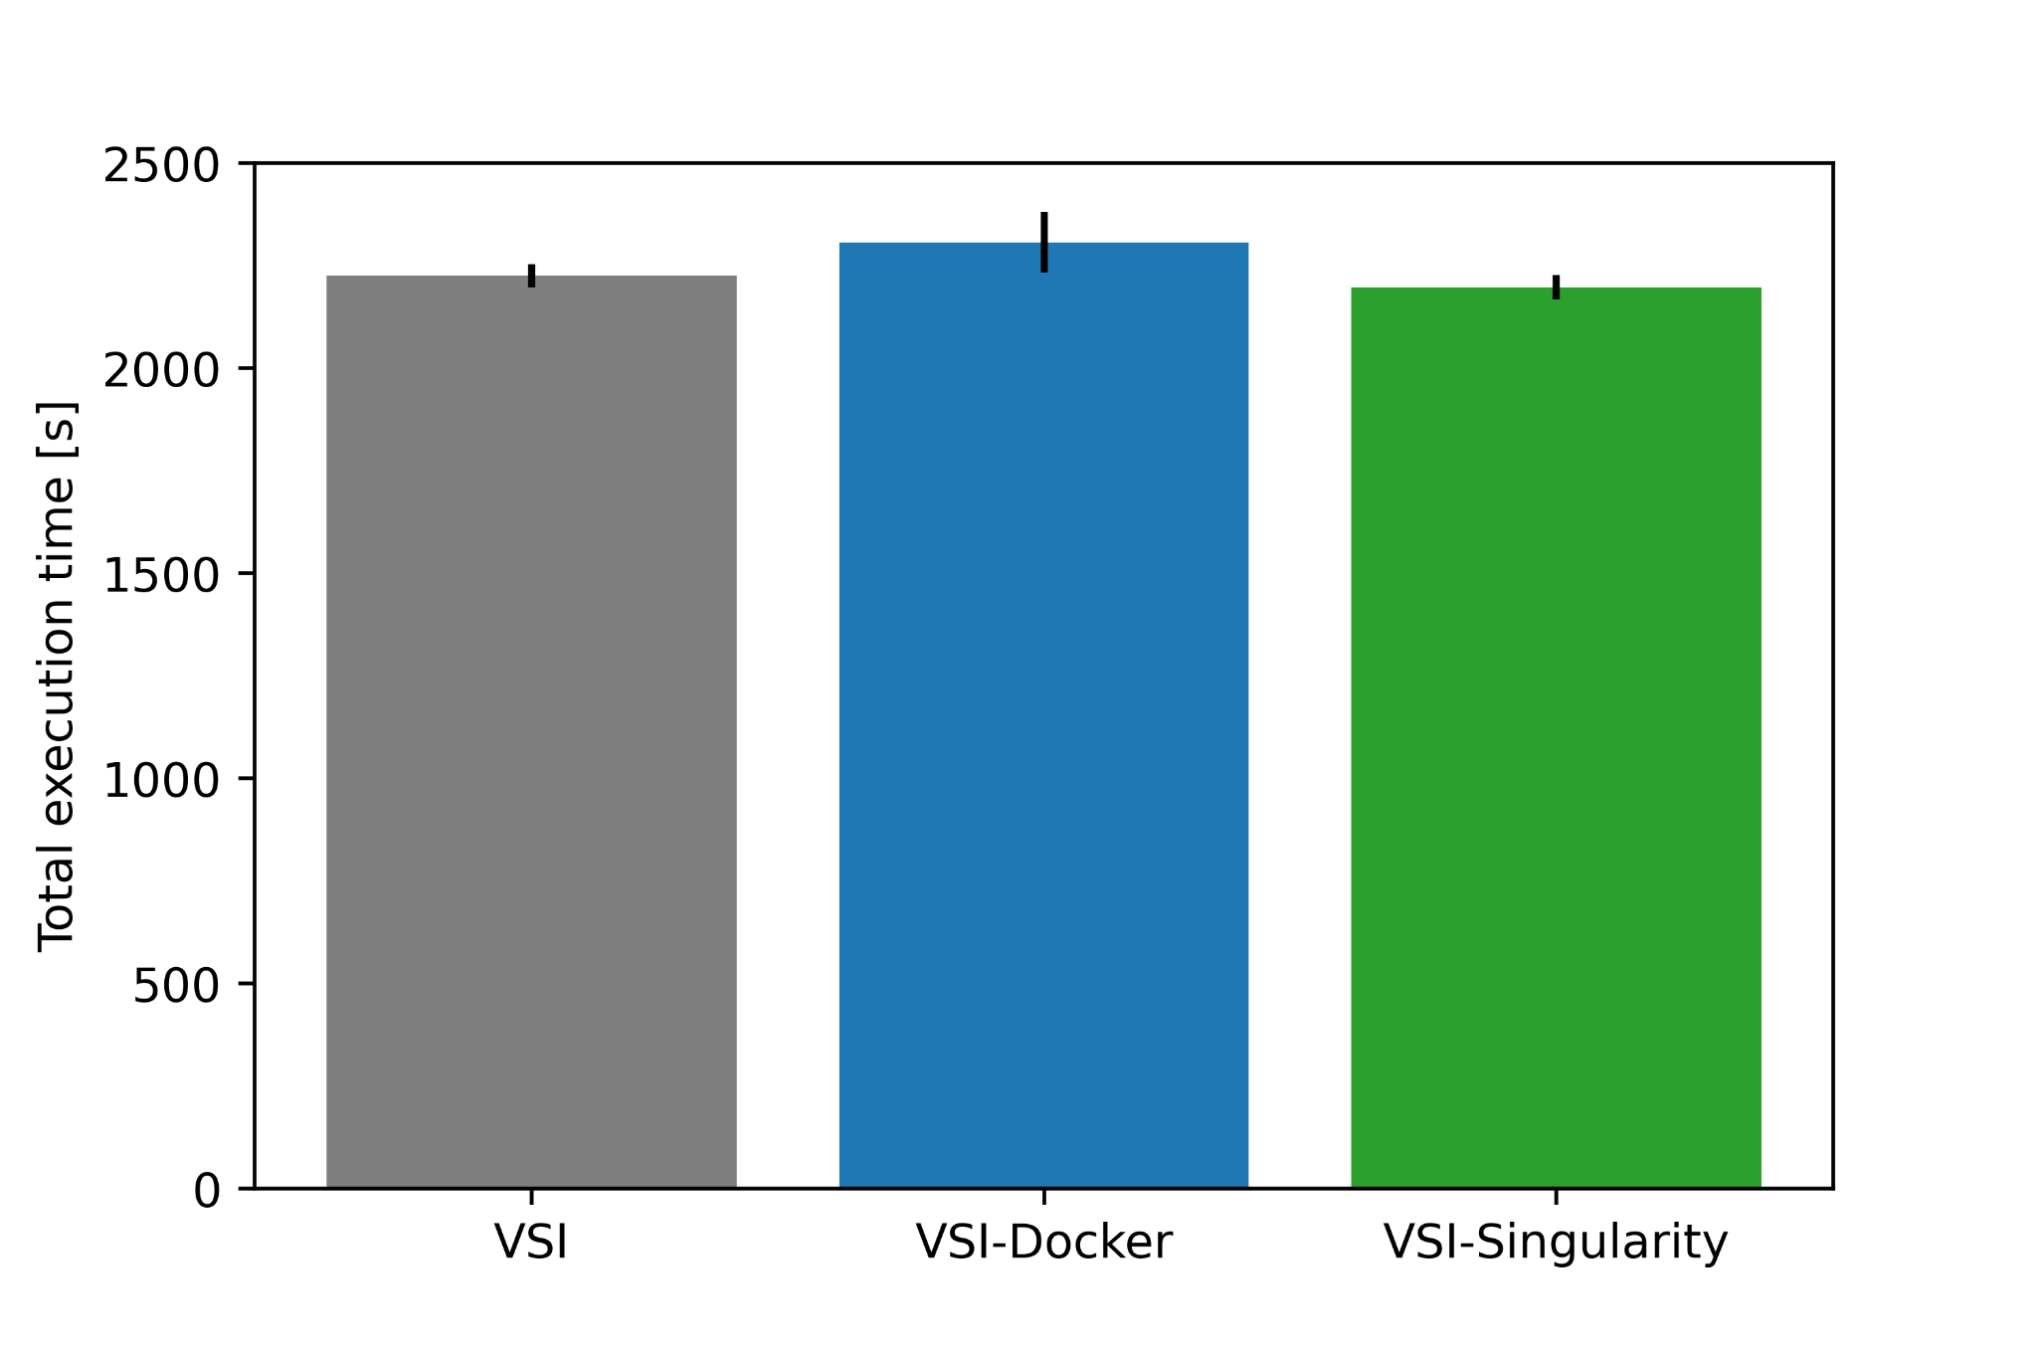
Deploy a HPC Cluster in the Cloud
Total execution time evaluation Oklahoma-10m [s]
SOMOSPIE with knn
ROI: Oklahoma
Resolution: 10m x 10m
Caching: In boot volume
Worker node: VSI, VSI-Docker, VSI-Singularity
WN
Docker
Container
Singularity
boot
37m:05s
38m:27s
36m:37s
Object Storage
Container
Container
Container
Container
...
Container
WN₁
WN₂
WN₃
WN₄
WN_{n}
The IBM Spectrum LSF provides set of tools that customers can use and customize to build HPC clusters on IBM Cloud
Portable software at runtime through container technologies (Docker and Singularity)
Singularity performs better given its lightweight solution and no CPU restrictions set by daemon
boot
boot
boot
boot
boot
Bucket Oklahoma-10m Training and Evaluation
Bucket Oklahoma-10m Predictions
‹#›

Slide 13
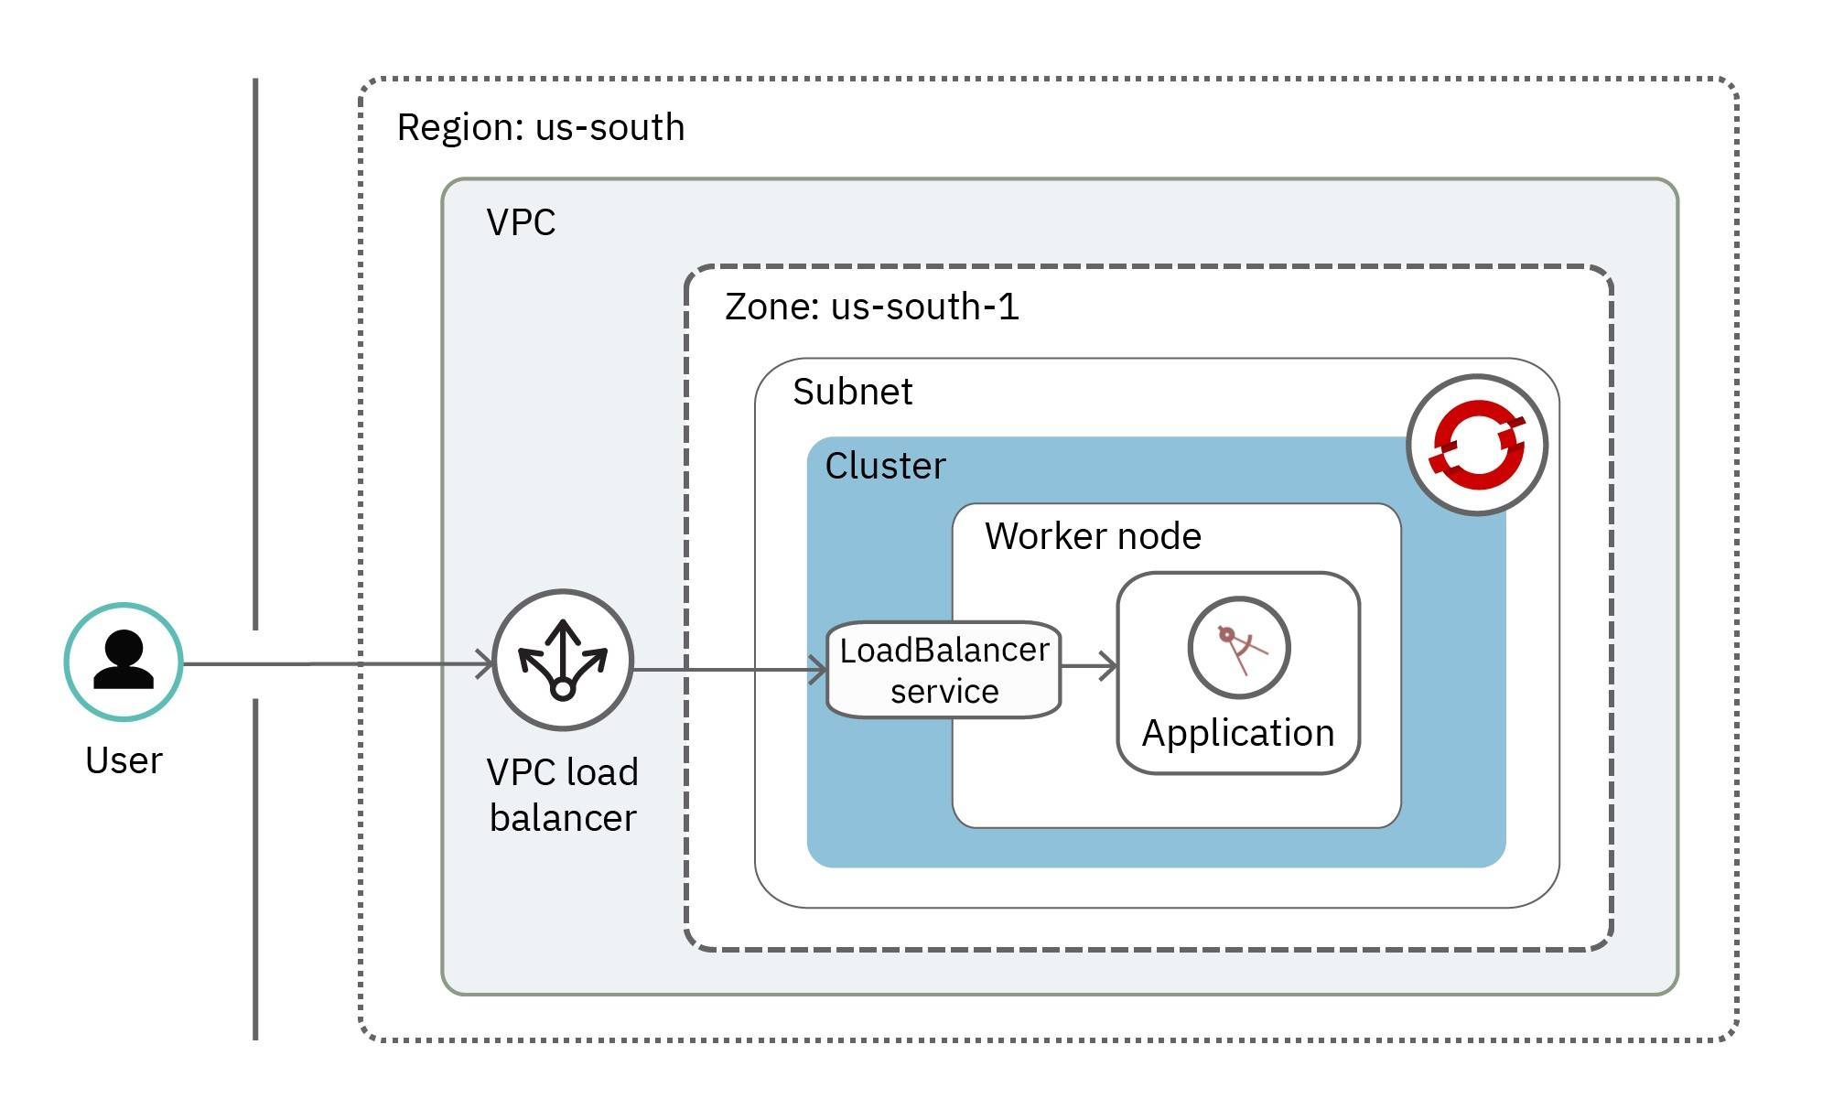
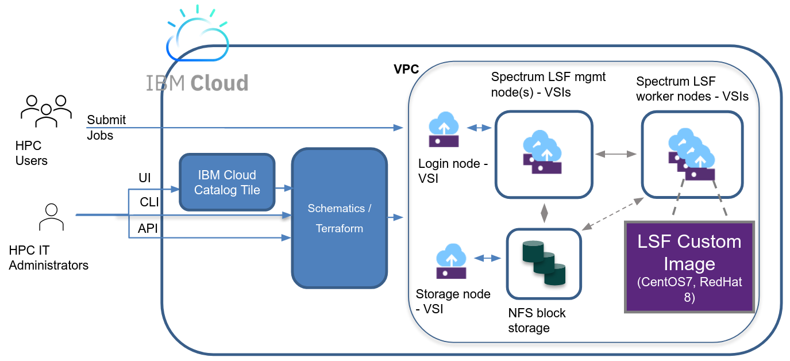
From HPC cluster to Openshift
HPC Cluster
Openshift
IBM Spectrum LSF: HPC cluster deployments on IBM Cloud that use IBM Spectrum LSF scheduling software
Application deployments on highly available clusters with Red Hat OpenShift on IBM Cloud Container Platform
Notes:
Change cluster image of openshift so then it matches when we mount

Slide 14
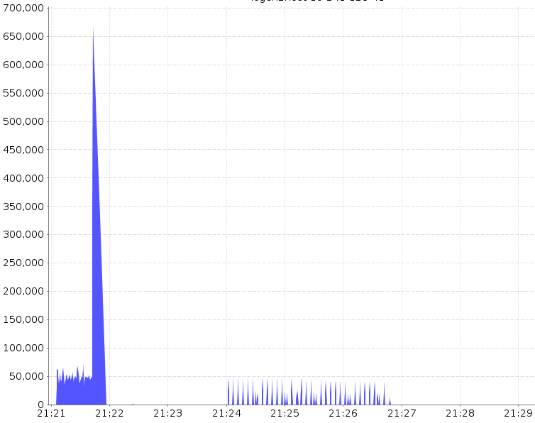
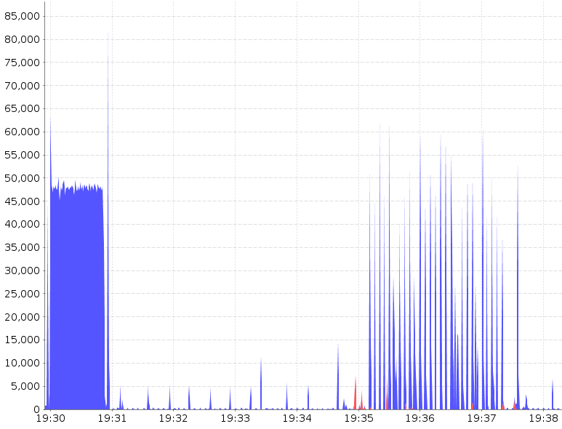
HPC vs Openshift: Total disk read and write
HPC Cluster
Openshift
max throughput: 660 MB/s
max throughput: 63 MB/s
KB/s
KB/s
time range = 480 s (8 mins)
time range = 480 s (8 mins)
Notes:
somospie workflow execution read and write with title to match the figure

Slide 15
Next directions
Platforms in cloud have been tuned for services deployments, when used out of the shelf for scientific workflows the performance decreases
We can leverage services deployments (e.g., Openshift, Kubernetes) to scale scientific workflows in an automated way
We need to retune these services deployments to obtain higher:
Throughput through s3fs advanced options
Computation performance through node tuning operator

Slide 17
s3fs advanced options
Option | Type | Default | Description | Recommendations
kernel_cache | Bool | False | Enables the kernel buffer cache on your s3fs mountpoint. | Not recommended if object is overwritten from other processes while mounted.
enable_noobj_cache | Bool | False | Enables cache entries for the object which does not exist. | You can specify this option for performance, s3fs memorizes in stat cache that the object(file or directory) does not exist.
use_cache | Str | “ “ | Local folder to use for local file cache. (default="" which means disabled) | If less than 100 GB place it in /tmp if VSI cluster
max_stat_cache_size | Int | 1000 entries (about 4MB) | Reduces the number of redundant HTTP HEAD requests sent by s3fs and reduces the time it takes to list a directory or retrieve file attributes. | Cache but consider memory implications of this caching.
parallel_count | Int | 5 | Sets the maximum number of requests sent concurrently to COS, per single file read/write operation. | For very large objects, you can get more throughput by increasing this value. As with the previous option, keep this value low if you only read a small amount of data of each file.
multipart_size (chunk-size-mb) | Int | 10 | Sets the maximum size of requests and responses sent and received from the COS server, in MB scale. | The optimal value for this option is around 50 MB. COS best practices suggest using requests that are multiples of 4 MB, and thus the recommendation is to set this option to 52 (MB).
max_background | Int | 12 | Improves s3fs concurrent file reading performance. | Setting it to an arbitrary high value (1000) prevents read requests from being blocked, even when reading a large number of files simultaneously.
rentries | Int | 2 | Number of times to retry a failed S3 transaction. | 2 or more
multireq_max | Int | 20 | This option limits the number of concurrent such requests sent to COS, for a single directory listing operation. | Note that this value must be greater or equal to the parallel_count option above.

Slide 18
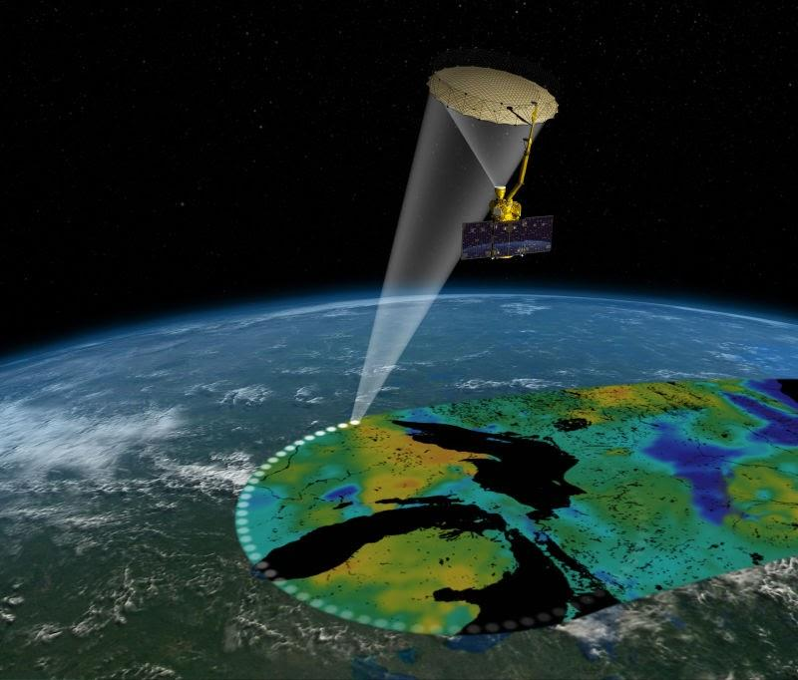
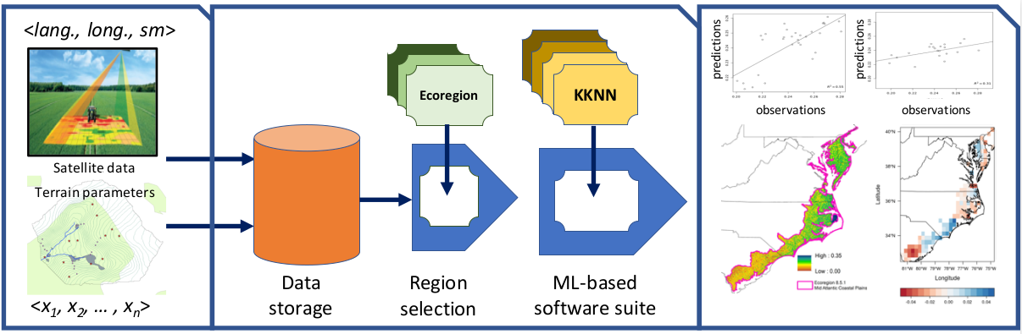
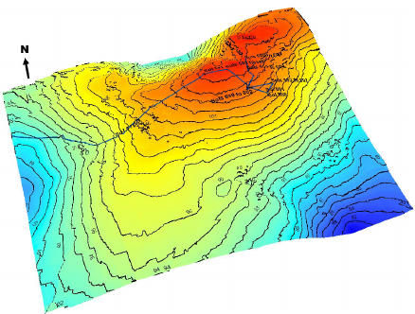
SOil MOisture SPatial Inference Engine (SOMOSPIE)
SOMOSPIE is a modular workflow that models and predicts fine-grained soil moisture values from coarse-grained satellite measurements and terrain parameters
Satellite data
Region of Interest (ROI)
KNN
The SMAP mission [online: https://www.ntsg.umt.edu/project/smap.php]
<long., lat., sm>
Terrain parameters
Data storage
Region selection
ML Modeling
Di, Kaichang & Li, Rainie. 2007
<p₁,p₂,...,p_{n}>
Data collection
Preprocessing
Modeling
Analysis

Slide 19

Data size for region of interest (Oklahoma)
Sample data of Oklahoma at different resolutions
Satellite data: 1 month (January, 2010)
Region of Interest
Resolution
Size of data
90 m x 90 m
4.55 GB
Oklahoma
10 m x 10 m
420.76 GB
1 m x 1 m
42,080.00 GB
Notes:
SOURCE OF DATA: STREAMING OR STATIC

Slide 20
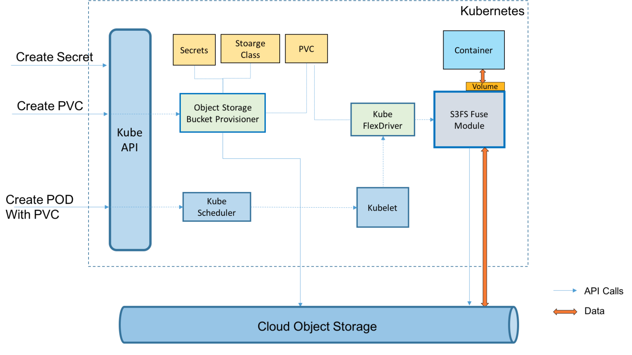
Mounting COS to the cluster
IBM Spectrum LSF
Openshift
boot
Mount automatically on all dynamic nodes
COS bucket (Object Storage)
Mount automatically on all pods through a persistent volume claim (PVC)
Notes:
Adapt both images to show how the cos is mounted

