Slide 1
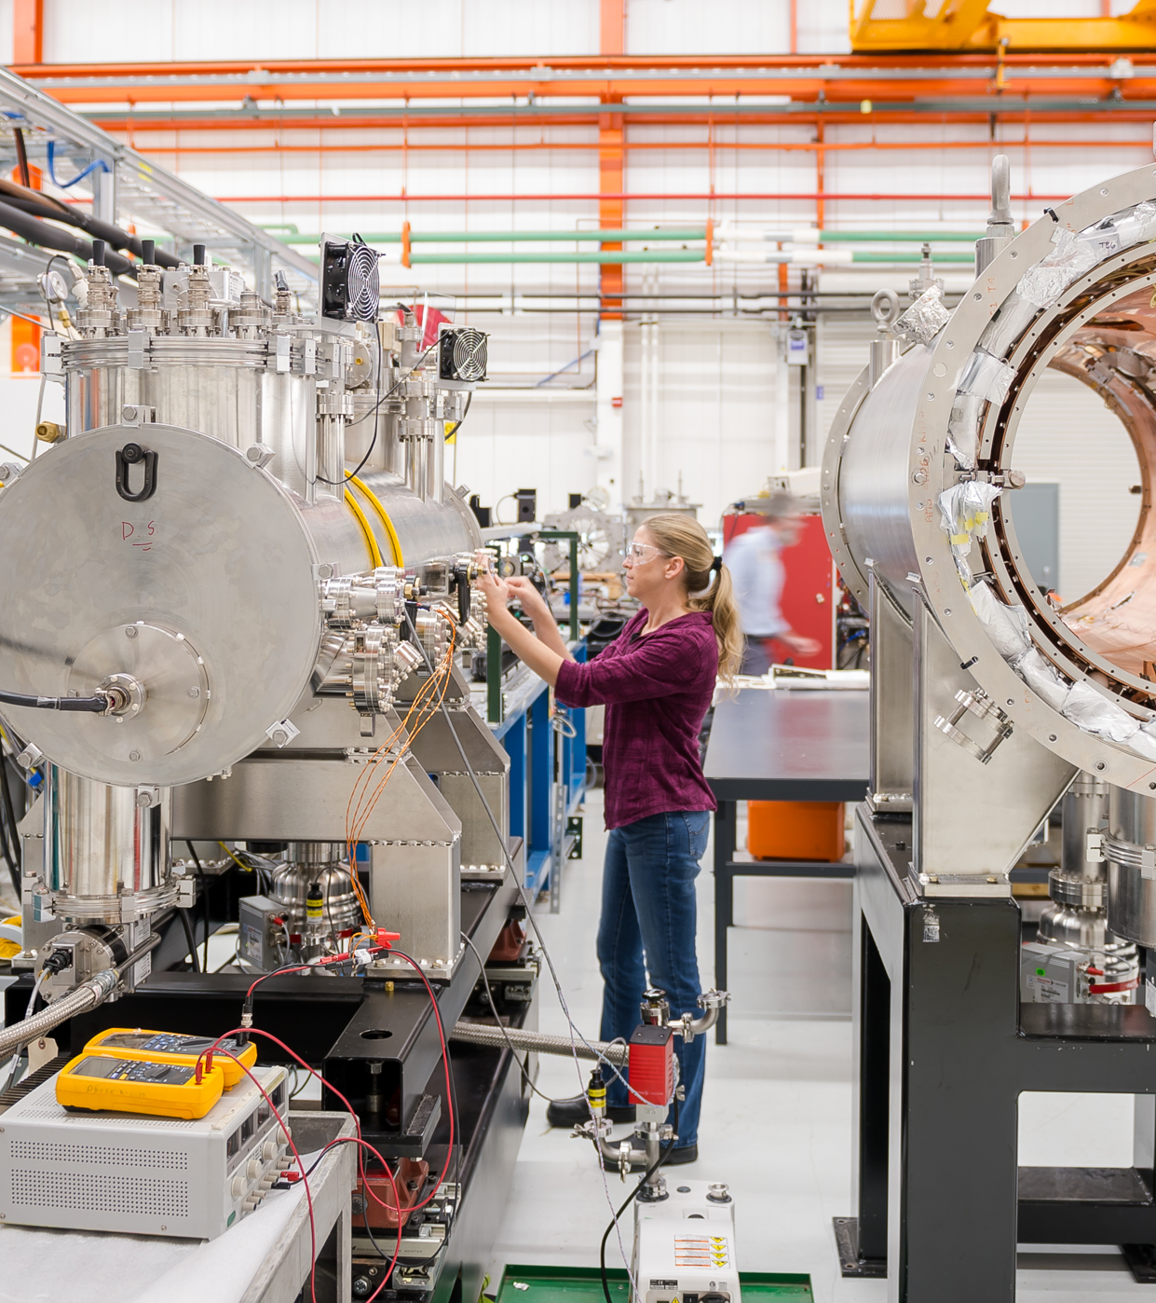




Experimental data acquisition and analysis at Advanced Photon Source Argonne National Lab
Dr. Steve Petruzza
National Science Data Fabric

Slide 2
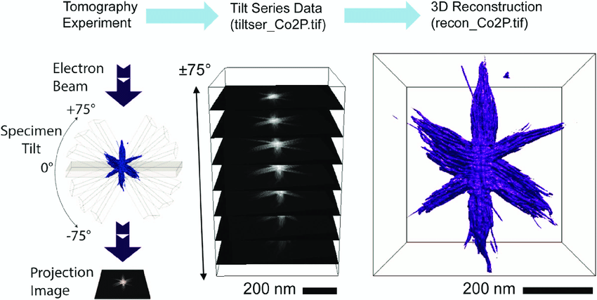
Data acquisitions process
Scientists book time to use a particular beamline
Perform tomographic and high energy X-ray diffraction microscopy experiments
Data are often saved to external hard drives
Final reconstruction is generally done weeks later

Slide 3

Preferred data transfer/sharing
In the last few years also Globus

Slide 4
Challenges
Limited computational capabilities during acquisition
Minimal quality check
Corrupted or missing data require another acquisition/trip
Remote assistance and access to the data is limited/slow

Slide 5
Data streaming test deployment at APS
Prof. Ashley Spears’s students had to collect multiple X-ray CT Volumes of size 1560x1024x1024 (per experiment)
She could not join the team during the acquisition
How to determine if the acquisition was good before leaving the facilities?
How to get any feedbacks from the professor or any collaborators during the acquisition?

Slide 6
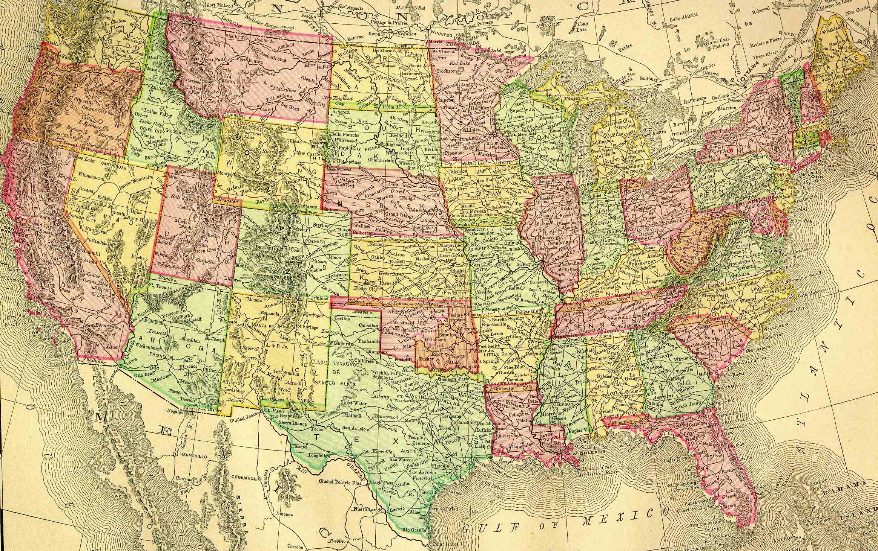


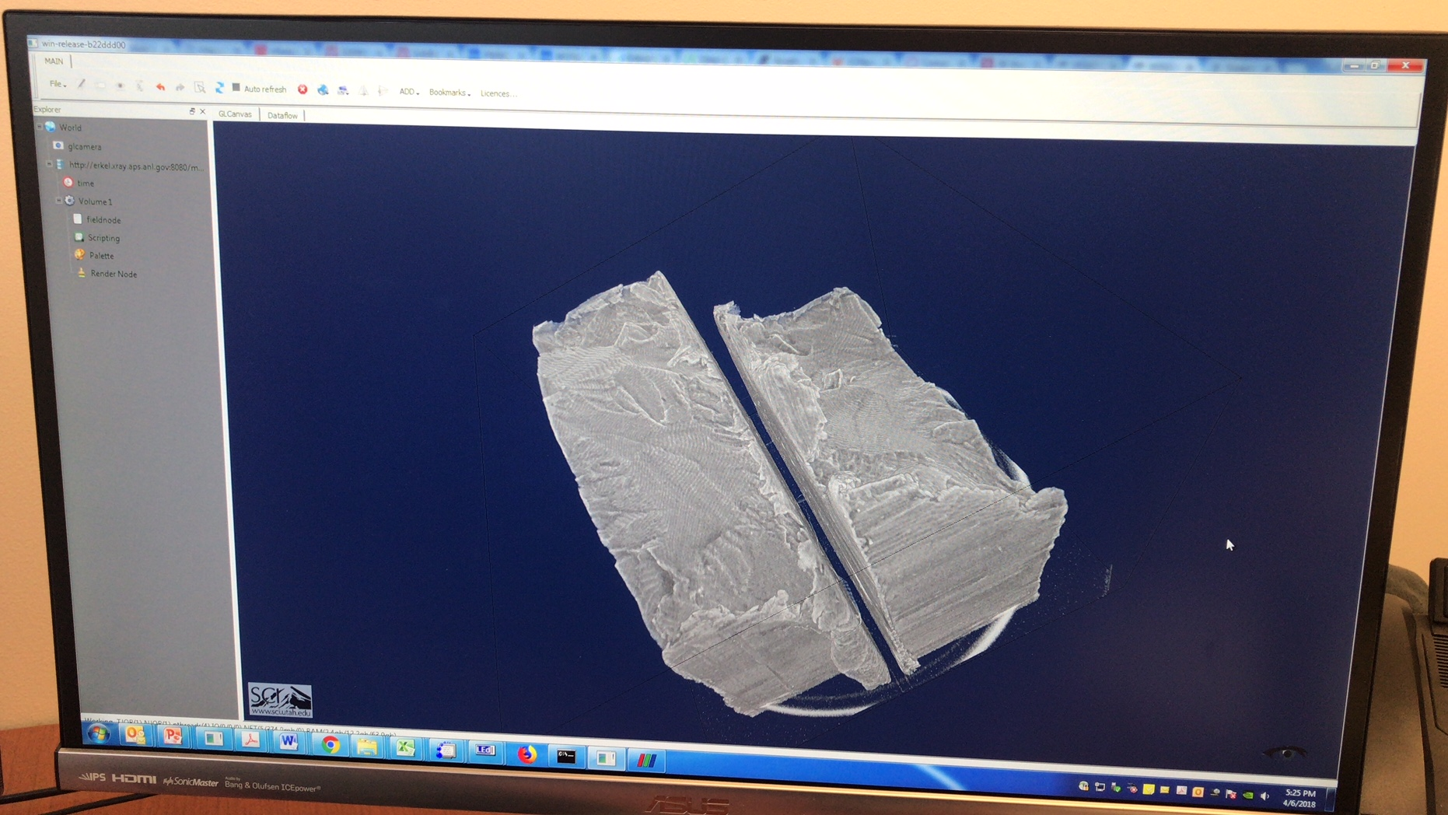
Deployment of data processing and streaming capabilities at APS
Docker Container
VPN
Data Processing
beamline
Data Streaming
Web Viewer

Slide 7
Timeline
Local test of data stitching, conversion and streaming: < 1 week
Deployment of the same setup on the beam line: < 1 day
Image data pre-processing and ready to stream streaming: < 1 hour
Get access to the VPN: >> 1 month (I am still waiting)

Slide 8
Demo Time

Slide 9
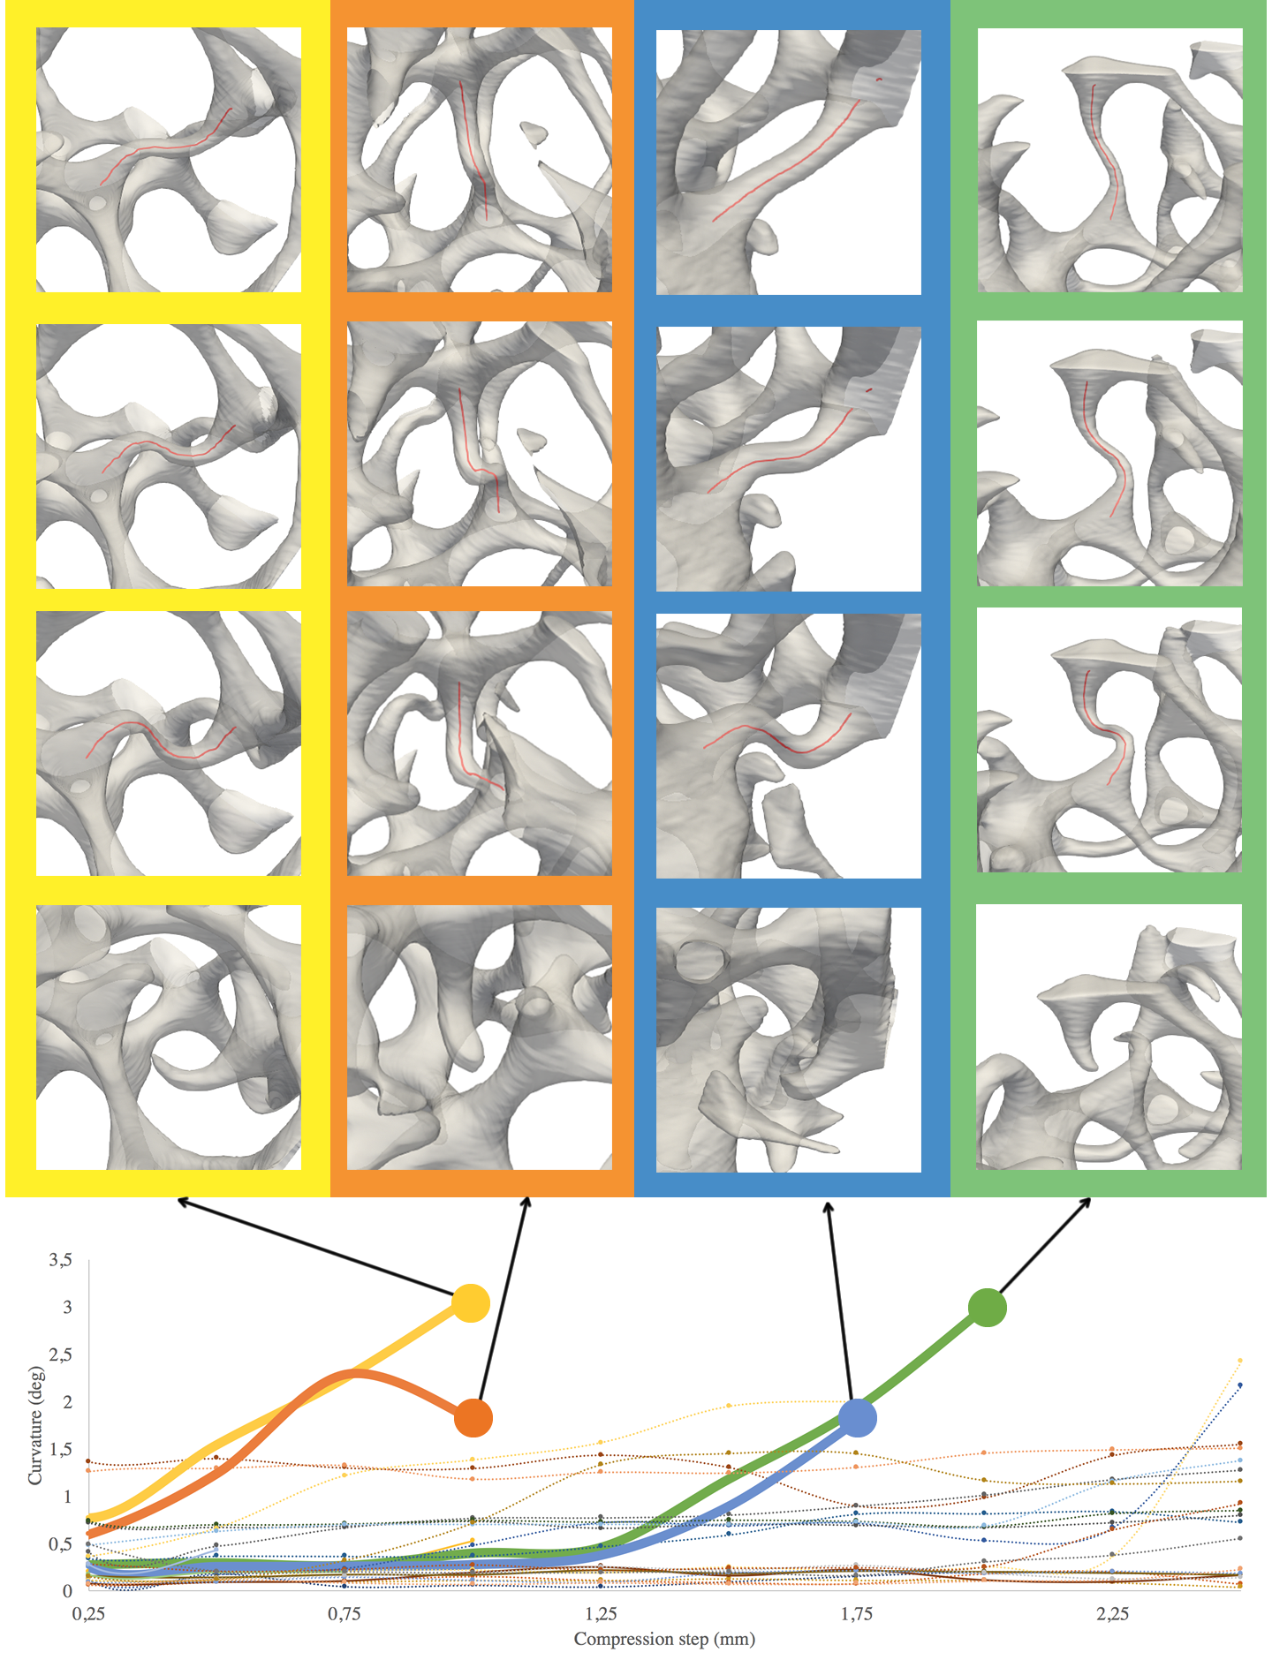
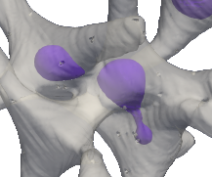
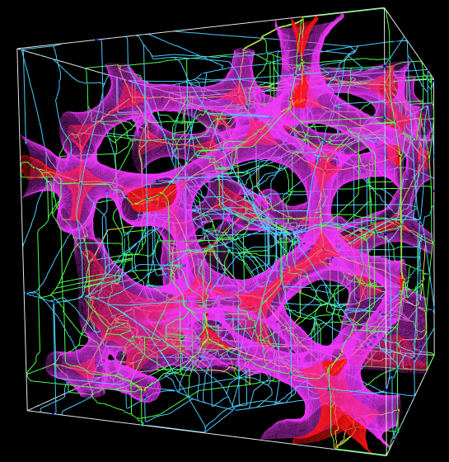
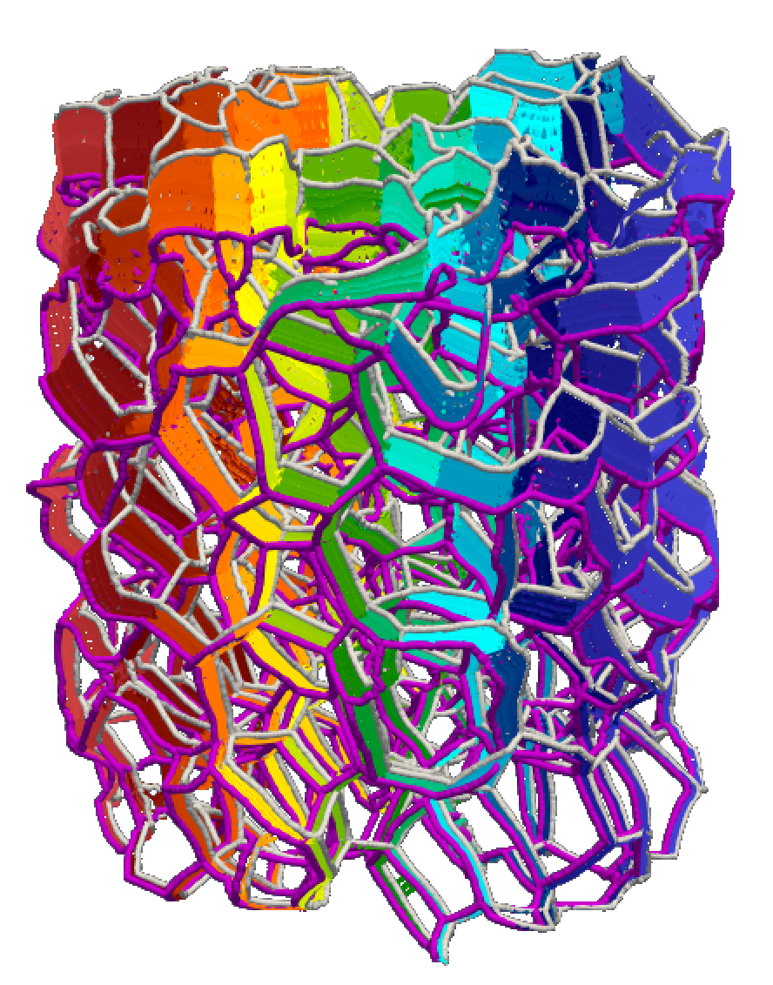
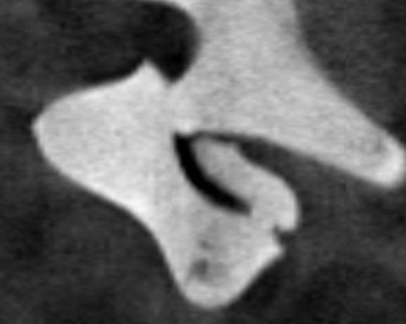
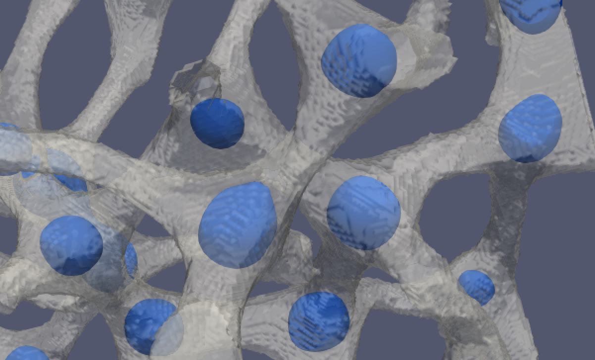
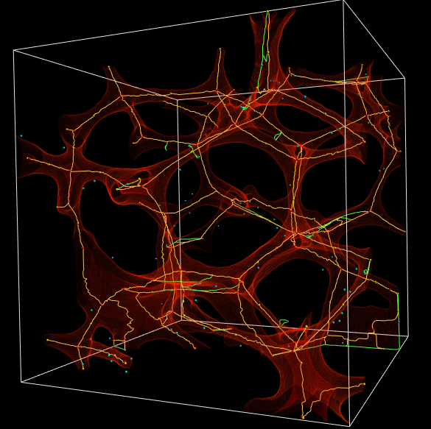
Advanced analysis Of Metallic Foam data
Metric analysis
junction segmentation
ligament extraction
time tracking
Raw Image Data

Slide 10
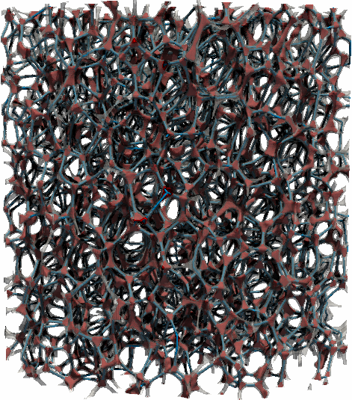
1024x1024x1043 voxels
3130 ligaments 1525 junctions

Slide 11
Current and future NSDF efforts
Automatization of common data reconstruction tasks
Easy deployment of data streaming services on site
Data sharing across sites could benefit from NSDF caching infrastructure
Easy integration/sharing with data repositories, such as materialscommons

Slide 12
Thank you
Questions?

Slide 13
Backup

Slide 14

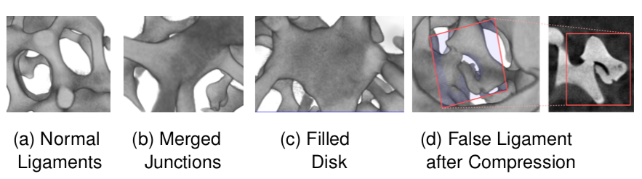
Segmentation challenges
Defects in the material make the identification of ligaments and junctions more challenging
Compression effects complicate even further the identification of the two components, and introduce false ligaments and merged junctions

Slide 15

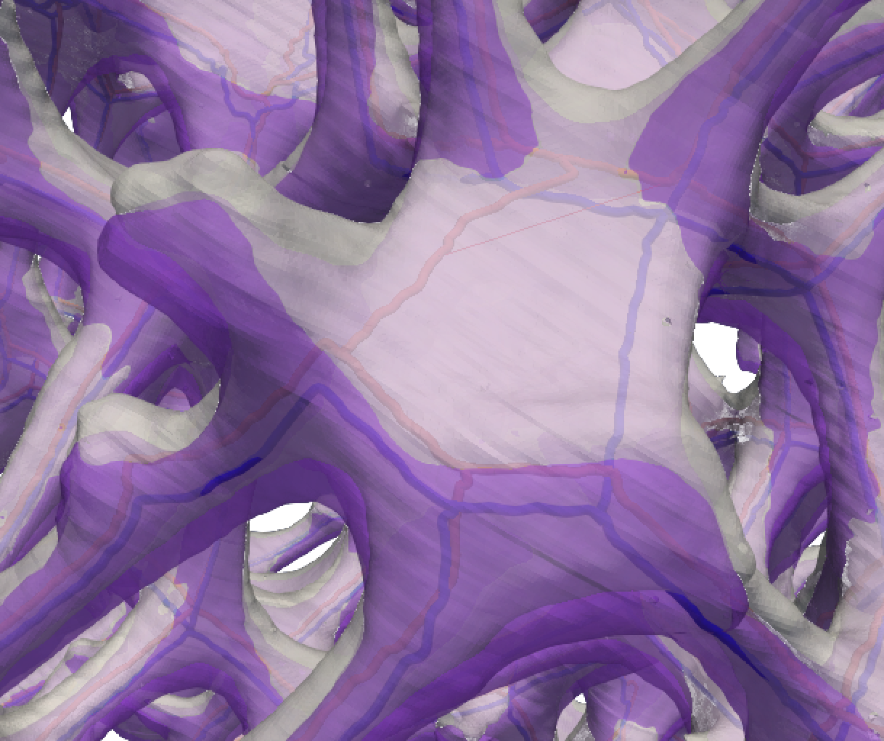



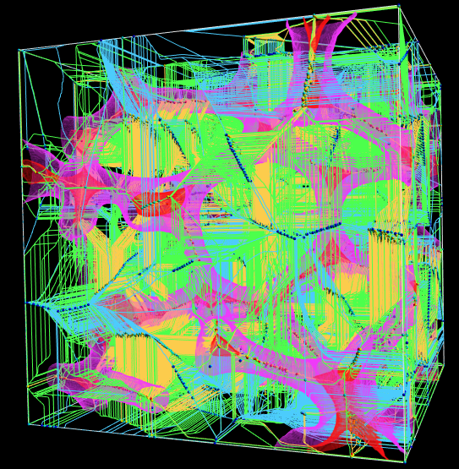
Skeletonization issues
Traditional skeletonization methods don’t keep track of lost components or their connectivity, or even their relation with the voids surrounding (i.e., pores of the foam)
We use an approach based on Morse-Smale complex to extract ligaments
Still, there is a large instability in some of the large agglomerates of material, which are flat junction regions (i.e., pancakes)
Notes:
- MSC historically more successful in addressing those issues

Slide 16

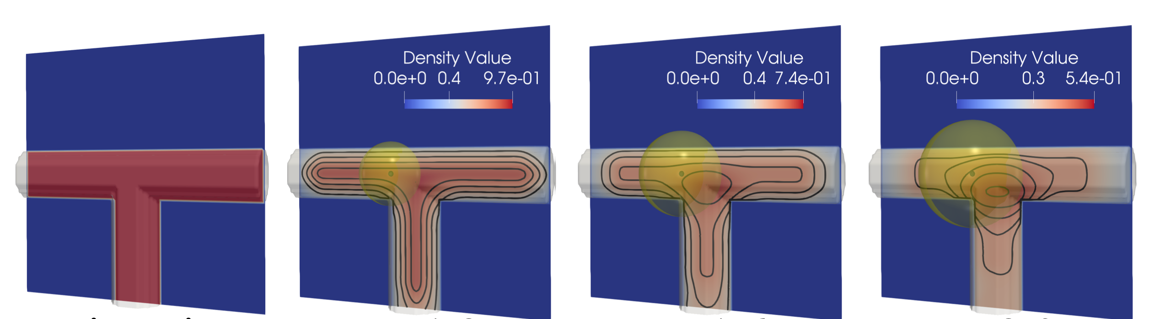
Generalized Geodesic density
For junction segmentation
Material density and geodesic density
a
material
r
r
Geodesic density = volume of material within a geodesic distance r ———————————————- volume of euclidean ball radius r

Slide 17
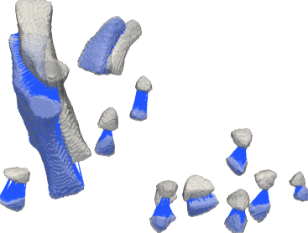
Junction tracking
Time t+1
Spatial acceleration structure to search for nearest neighbors among time-steps
Rank candidates based on the number of matching neighbors
Junction with highest number of hits/matches is a temporal match
Time t

Slide 18
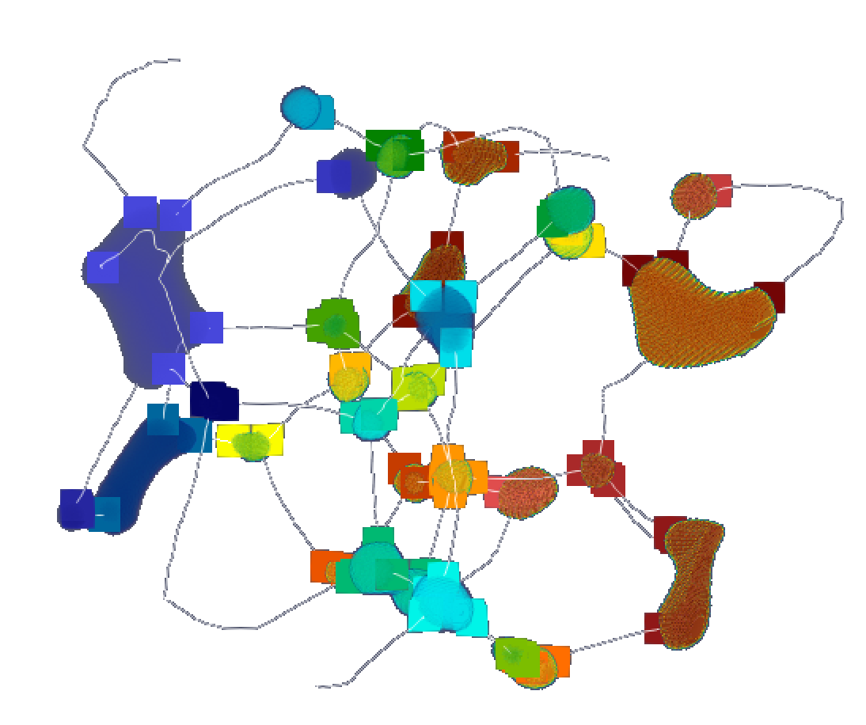
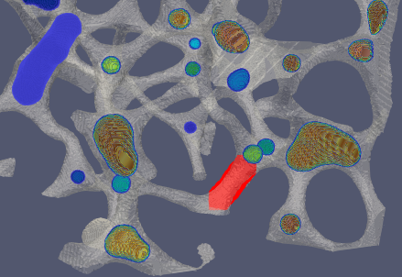
Ligament tracking
A ligament is a simple connected piece of the MSC 1-skeleton as cut by junctions
Build a connectivity graph between junctions and ligaments
Look at ligaments connecting the same junction pair
Check connectivity consistency over time

