Slide 1


NSDF-Catalog: Toward a Lightweight Indexing Service for the National Science Data Fabric
NSF: 2138811 (NSDF) and 2028923 (SOMOSPIE); IBM; XSEDE: TG-CIS210128; Chameleon: CHI-210923
Jakob Luettgau, Giorgio Scorzelli, Glenn Tarcea,
Christine Kirkpatrick, Valerio Pascucci, Michela Taufer
PI/Co-PIs:
Valerio Pascucci (U Utah)
Michela Taufer (UTK)
Alexander Szalay (JHU) John Allison (U. Michigan) Frank Wuerthwein (UCSD / SDSC)
http://nationalsciencedatafabric.org/

Slide 2
We are building a trans-disciplinary testbed that will democratize data-driven scientific discovery by connecting an open network of institutions, including minority serving institutions and with a shared, modular, containerized data delivery environment.
http://nationalsciencedatafabric.org/

Slide 3
We are building a trans-disciplinary testbed that will democratize data-driven scientific discovery by connecting an open network of institutions, including minority serving institutions and with a shared, modular, containerized data delivery environment.
→ Need for global index of data available
within National Science Data Fabric
http://nationalsciencedatafabric.org/

Slide 4
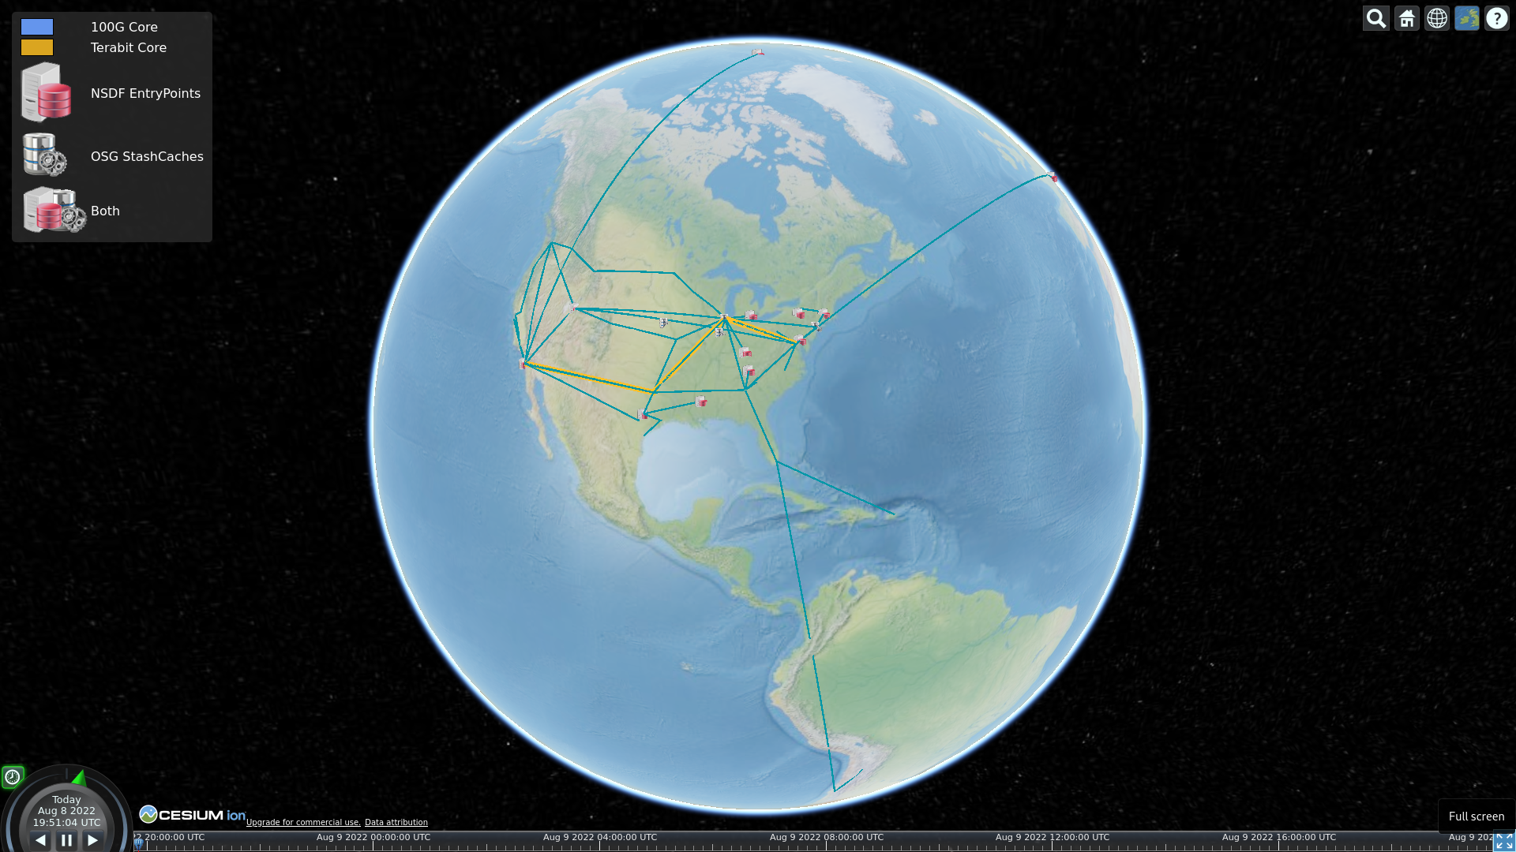
UMICH
UTAH
MCC
JHU
SDSC
UTK
UTEP
JSUMS
Notes:
The NSDF pilot supports the IceCube neutrino observatory and the XenonNT dark matter detector advances the understanding of the evolution of galaxies and the nature of “dark matter” and “dark energy.

Slide 5
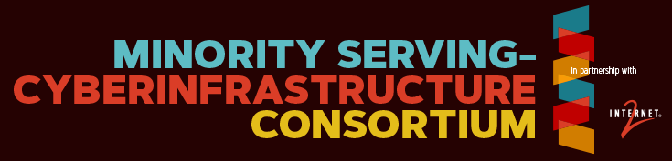
UMICH
UTAH
MCC
MMC
JHU
SDSC
UTEP
JSUMS
UTK
UTEP
MS-CC
Notes:
Now where does democatization come into the picture
https://www.minorityhealth.hhs.gov/assets/PDF/2020_Minority_Serving_Institutions.pdf
https://orise.orau.gov/msipp/documents/approved-msi-school-list.pdf

Slide 6
PRISMS Materials Commons UMICH
UTAH/SCI
CHESS/Cornell
MCC
MGHPCC + OSN
JHU
SDSC + OSG
UTK
UTEP
Digital Rocks
MS-CC
JSUMS
Notes:
The NSDF pilot supports the IceCube neutrino observatory and the XenonNT dark matter detector advances the understanding of the evolution of galaxies and the nature of “dark matter” and “dark energy.

Slide 7
IceCube
XenonNT
PRISMS Materials Commons UMICH
UTAH/SCI
CHESS/Cornell
MCC
MGHPCC + OSN
JHU
SDSC + OSG
UTK
UTEP
Digital Rocks
MS-CC
JSUMS
Notes:
The NSDF pilot supports the IceCube neutrino observatory and the XenonNT dark matter detector advances the understanding of the evolution of galaxies and the nature of “dark matter” and “dark energy.

Slide 8
IceCube
XenonNT
PRISMS Materials Commons UMICH
LLNL
UTAH/SCI
CHESS/Cornell
MCC
CHPC
MGHPCC + OSN
JHU
SDSC + OSG
SNL
UTK
UTEP
Digital Rocks
MS-CC
TACC
JSUMS
Notes:
Integrating HPC

Slide 9
IceCube
XenonNT
PRISMS Materials Commons UMICH
LLNL
UTAH/SCI
CHESS/Cornell
MCC
CHPC
MGHPCC + OSN
JHU
Internet2
SDSC + OSG
SNL
UTK
UTEP
MS-CC
TACC
JSUMS
XSEDE/ACCESS
Jetstream2
CloudLab
Chameleon
CyVerse
Notes:
The NSDF pilot supports the IceCube neutrino observatory and the XenonNT dark matter detector advances the understanding of the evolution of galaxies and the nature of “dark matter” and “dark energy.

Slide 10
IceCube
XenonNT
PRISMS Materials Commons UMICH
LLNL
UTAH/SCI
CHESS/Cornell
MCC
CHPC
MGHPCC + OSN
JHU
Internet2
SDSC + OSG
SNL
UTK
UTEP
MS-CC
TACC
JSUMS
XSEDE/ACCESS
Jetstream2
CloudLab
Chameleon
CyVerse
IBM Cloud
CloudBank (AWS, Azure, …)
Notes:
The NSDF pilot supports the IceCube neutrino observatory and the XenonNT dark matter detector advances the understanding of the evolution of galaxies and the nature of “dark matter” and “dark energy.

Slide 11

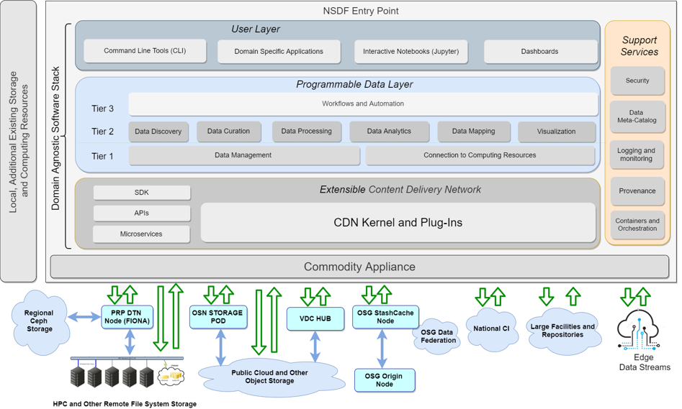
Entry
Point
Notes:
Now with this kind of surface area to countless services.. We end up with a relatively complicated software stack
But the abstraction that we envision for this is that of an “Entry Node”..
Which normalizes

Slide 12
Entry
Point
Scientists Educators
Students
Application Developers
Middleware/Service Developers
Infrastructure
Providers

Slide 13
Entry
Point
Scientists Educators
Students
Application Developers
Middleware/Service Developers
Infrastructure
Providers
HPC
Commercial
Clouds
Science
Clouds/Grids

Slide 14
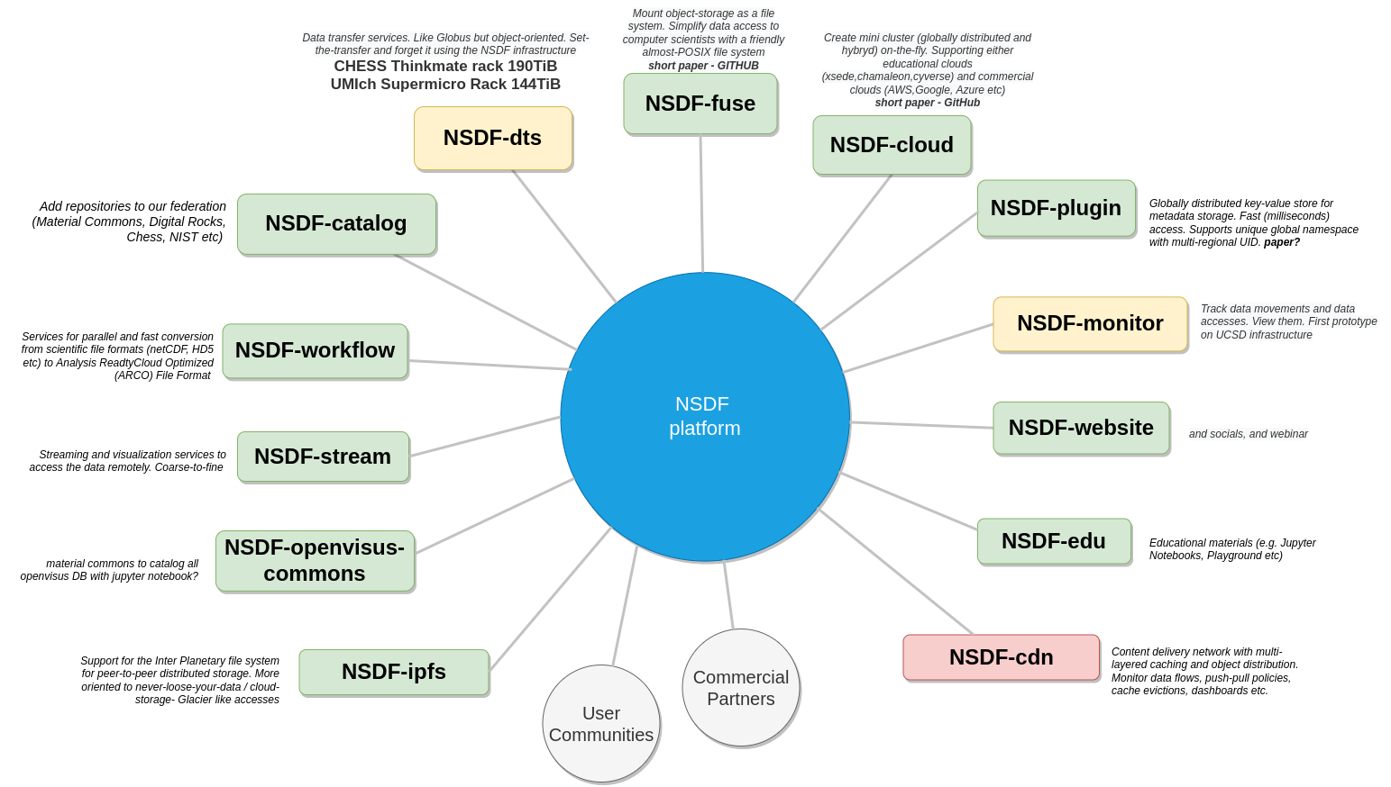
Services &
Building Blocks
Notes:
And on the other hand we have to idneitify the core services and building blocks that are currently often missing or elusive especially for organizations that haven’t been using advanced research infrastructure for decades

Slide 15
Services &
Building Blocks
Mapping object storage into POSIX namespaces for legacy support
Transfer Abstraction
with, e.g,, Globus or xrootd
Common APIs across cloud providers
Data Inventory and Discovery
System Health &
Optimization

Slide 16
NSDF-Catalog: Challenges
Support wide range of existing repositories
Catalog must be scalable to many entries with a pathway to trillions of datasets, files, or objects
Containerized to easy maintenance and scaling
Catalog must be federated for efficient indexing and to offer user/provider control over their data

Slide 17
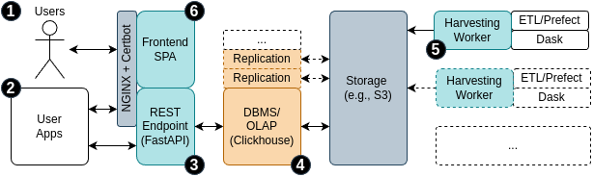
NSDF-Catalog: Architecture Overview

Slide 18
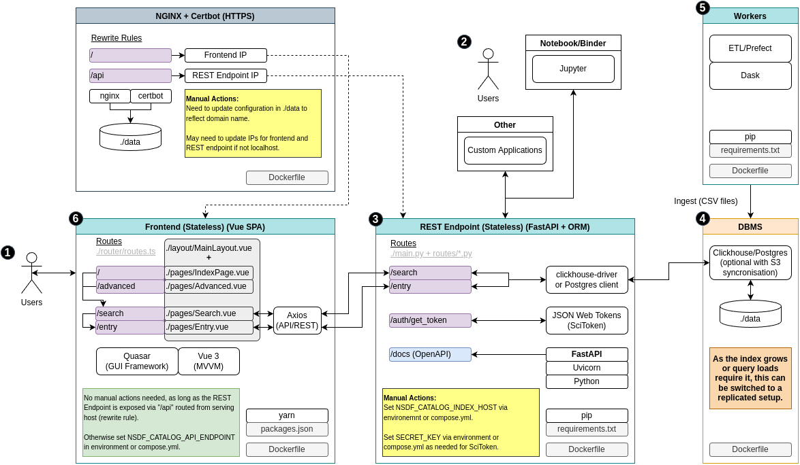
NSDF-Catalog: Architecture Overview

Slide 19
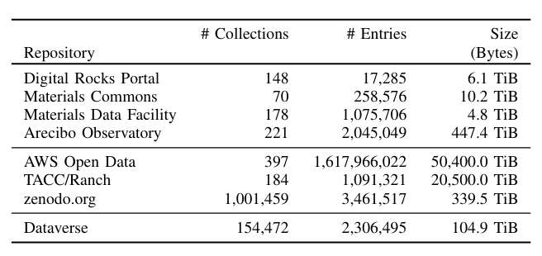
NSDF-Catalog: Challenges

Slide 20
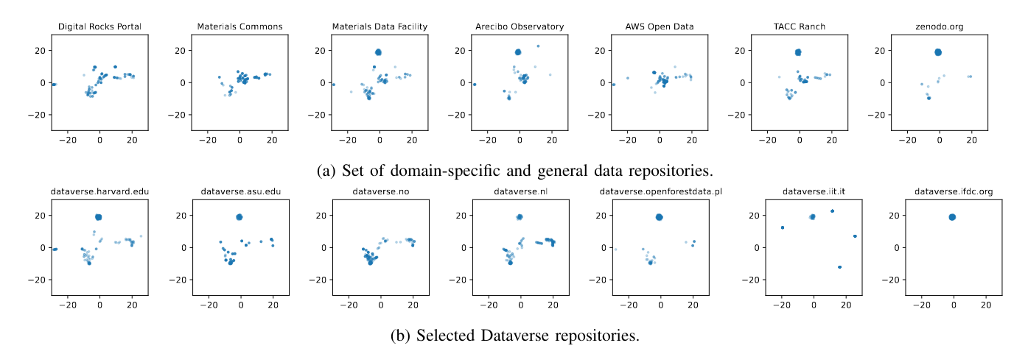
NSDF-Catalog: Finding Similarities Across Research Repositories

Slide 21
NSDF-Catalog: Finding Similarities Across Research Repositories

Slide 22
NSDF-Catalog: Finding Similarities Across Research Repositories

Slide 23
NSDF-Catalog: Finding Similarities Across Research Repositories

Slide 24
NSDF-Catalog: Finding Similarities Across Research Repositories

Slide 25
Collaboration Opportunities
We looking to collaborate with science teams that are sharing their or depend on other data to better understand needs for NSDF-Catalog
We are looking for large bodies of unindexed data to show how NSDF-Catalog can help scientists make searchable their data
We are looking for scientists performing cross-disciplinary research that would leverage our search and are willing to discuss their use case

