Slide 1
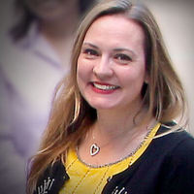
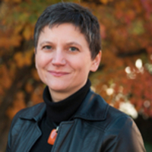
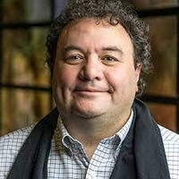
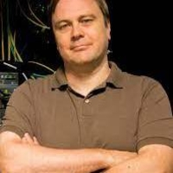
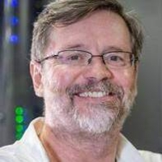
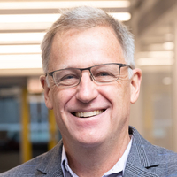
Unleashing the Power within Data Democratization:
Needs, Challenges, and Opportunities
Moderator: Christine Kirkpatrick (San Diego Supercomputer Center)
Panelists: Michela Taufer (University of Tennessee Knoxville), Valerio Pascucci (University of Utah), Ilya Baldin (Renaissance Computing Institute RENCI), Frank Wuerthwein (San Diego Supercomputer Center), Ian Foster (University of Chicago and Argonne National Laboratory)
This work is supported through NSF Award # 2138811

Slide 2
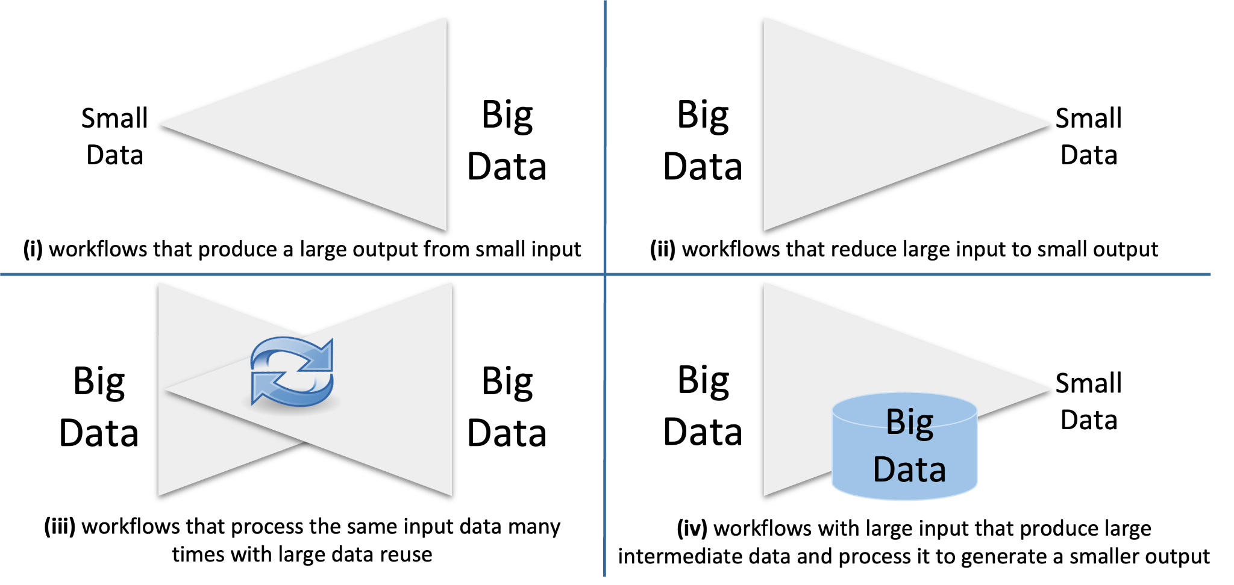
The Role of Data in Large-Scale Scientific Applications
Scientific workflows and their data pipelines in modern applications:
Courtesy of Frank Wuerthwein, SDSC

Slide 3
The "Missing Middle": Data-Intensive Discovery Pathways
Data Sources
Science Outcomes &
Results Dissemination
Transformations &
Knowledge Extraction
Disciplinary
Specific
Resources & Workflows
?
New science drivers, users and usage modes
Data lifecycle
End-to-end Workflows
(Assimilation, Integration, Modeling, Simulation, Analysis, Visualization)
Realtime, Streaming, On-Demand
Intelligent delivery, composition
(Al/ML)
…
Discover Publish, Share Integrate Collaborate Reuse
Instrument/Facility Portals & Data streams
,,>
Sources & Repositories
Middleware Infrastructure: Authentication, Access, Distributed Workflows
Transdisciplinary
Enabling Cl
Computing Resources, Data Infrastructure, Networking

Slide 4
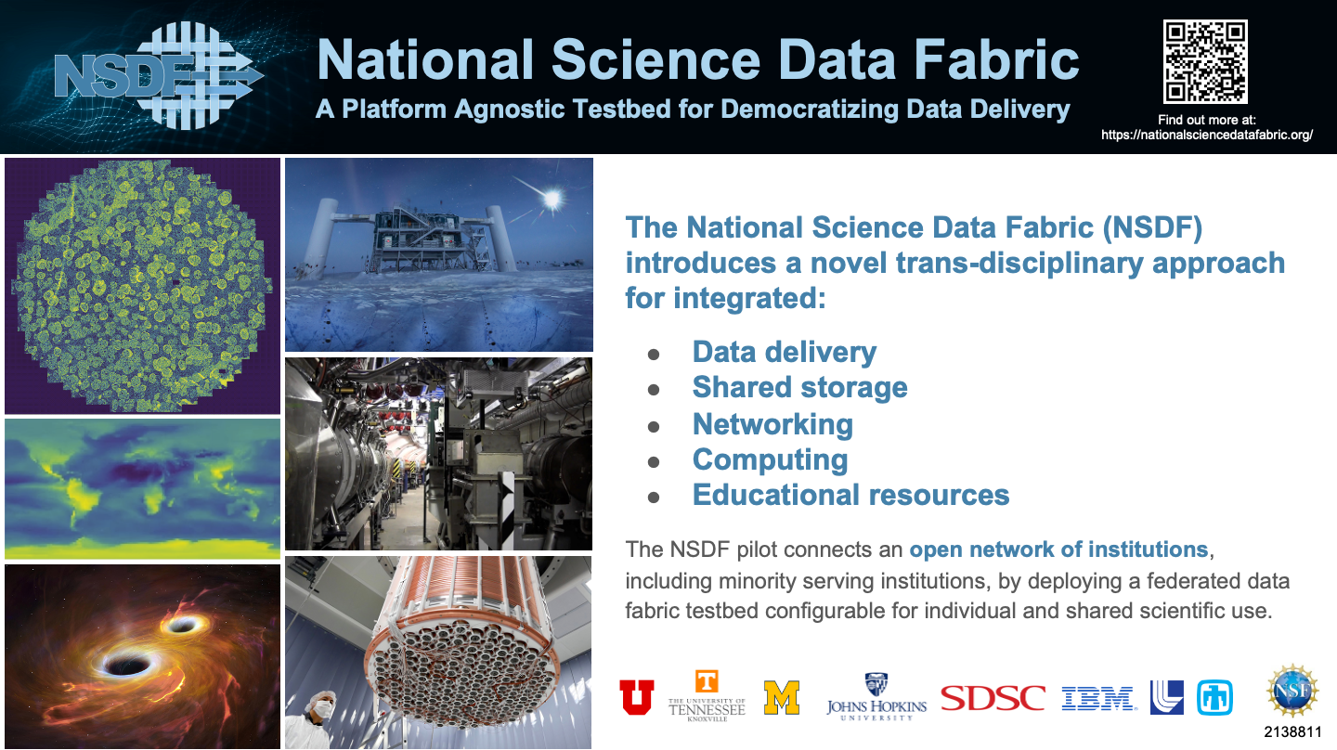
‹#›

Slide 5
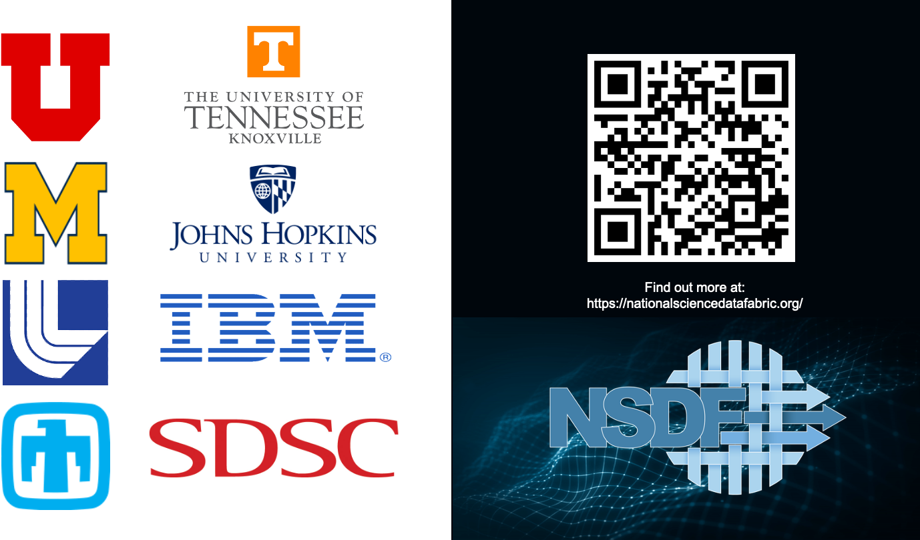

Slide 6
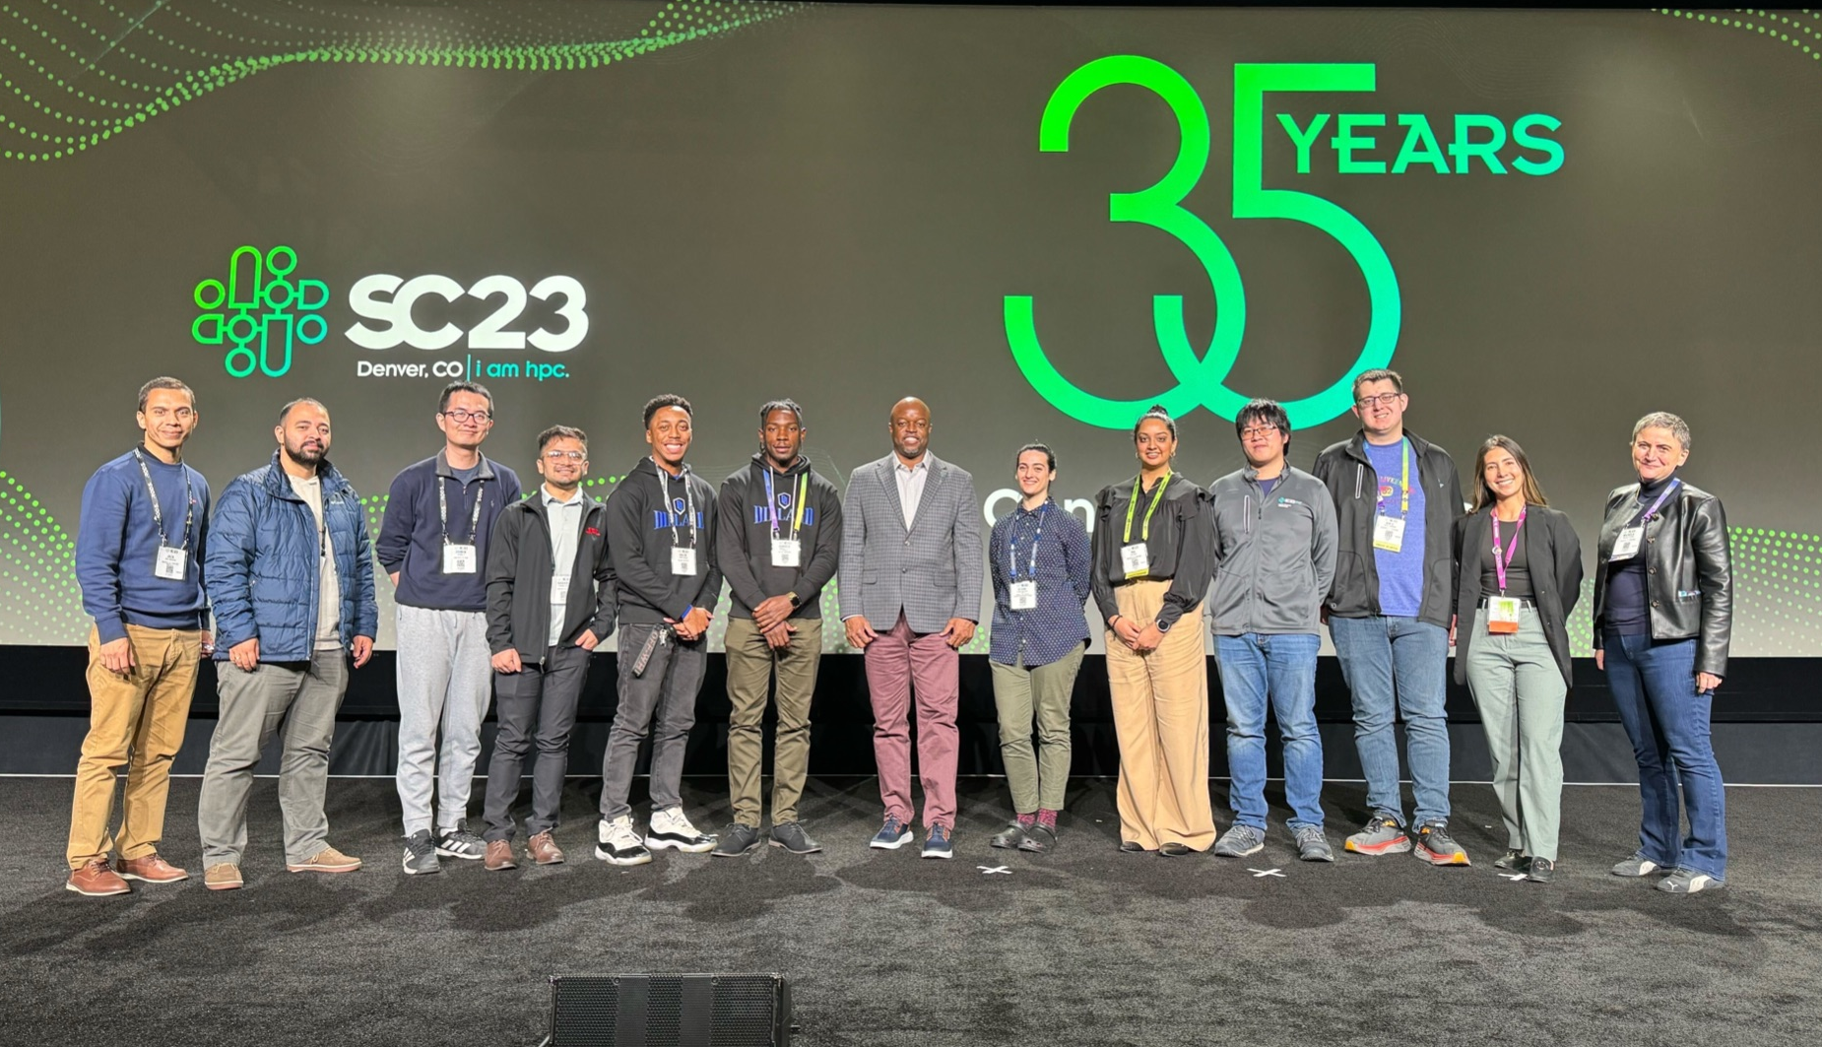
How to get involved
Attend our All Hands Meeting (February 28-March 1, La Jolla, CA)
Stay tuned for more information about travel support for early career researchers!
Attend our Distinguished Speaker Webinar: “Big Data at Synchrotron X-ray User Facilities: Challenges and Opportunities” with Dr. Joel Brock, Director, Cornell High Energy Synchrotron Source (CHESS) on December 12, 2pm ET
Participate in a User Community Interview
Follow NSDF on X and LinkedIn

