Slide 1


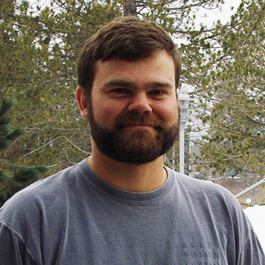




National Science Data Fabric User Communities:
Discovering the Pain Points in Data Management
Michela Taufer, University of Tennessee Knoxville
NSF AWARD #2138811
Attila Gyulassy, University of Utah
Steve Petruzza,
Utah State University
Julianne Christopher-Ohlin,
San Diego Supercomputer Center
Lauren Whitnah,
University of Tennessee Knoxville

Slide 2
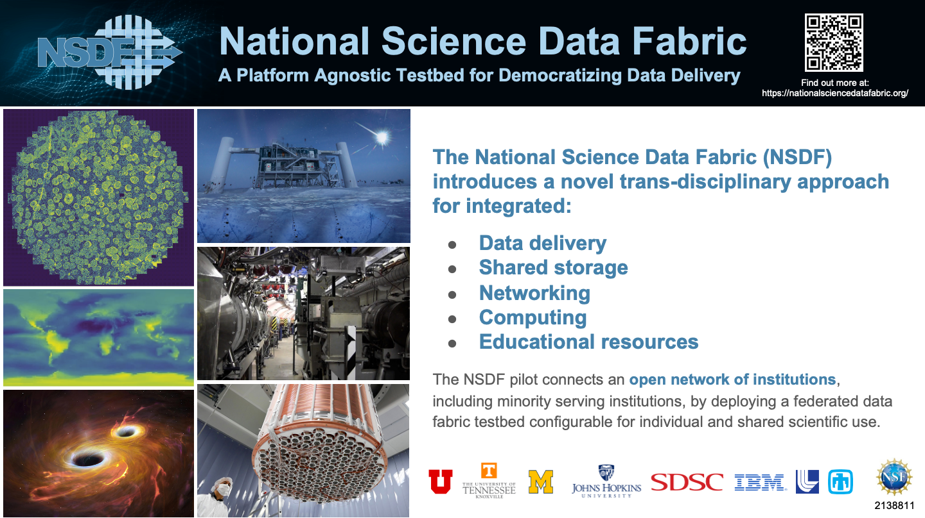
‹#›

Slide 3
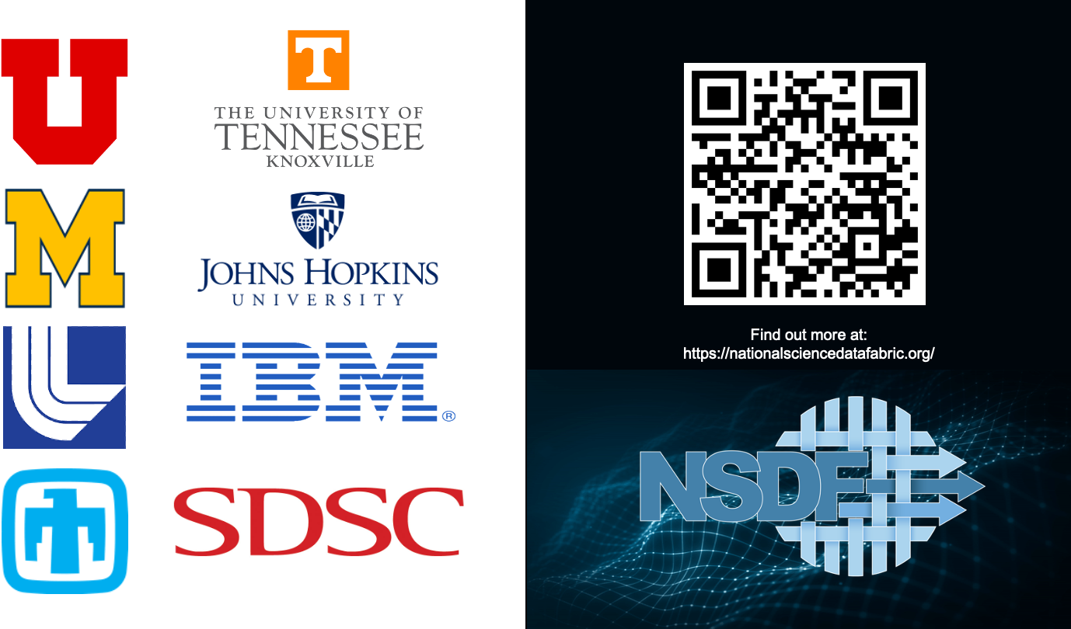

Slide 4
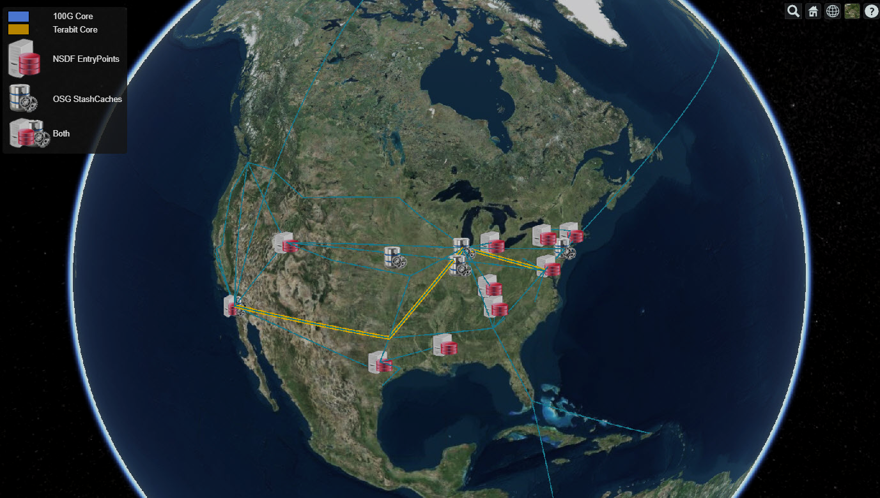
The National Science Data Fabric (NSDF) and its User Communities

Slide 5
Our Mission: Diagnose Pain Points in Data Management
Identify Users
Target Questions
Analyze Results
Diagnose Pain Points
Various roles: Domain scientists, CI professionals, developers
Various domains: materials science, data science, geography and more!
Various institutions: R1 universities, teaching colleges, MSIs, national labs, national imaging centers
General questions about data storage, data form, metadata storage, WMS, data catalogs, programming languages
Specific questions about unique challenges related to role, domain, and institution
Identify cross-cutting concerns
Identify concerns consistent for roles, domains, and institutions
Distill concerns into actionable, concrete problem statements

Slide 6
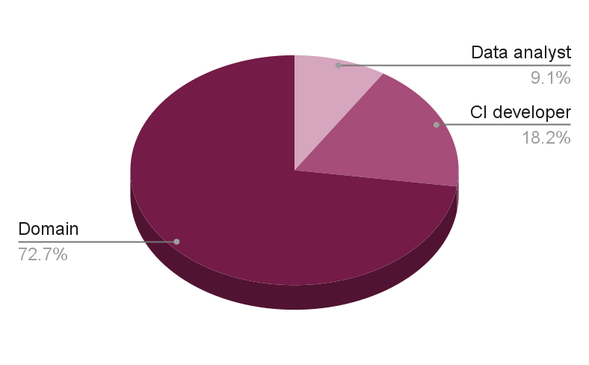
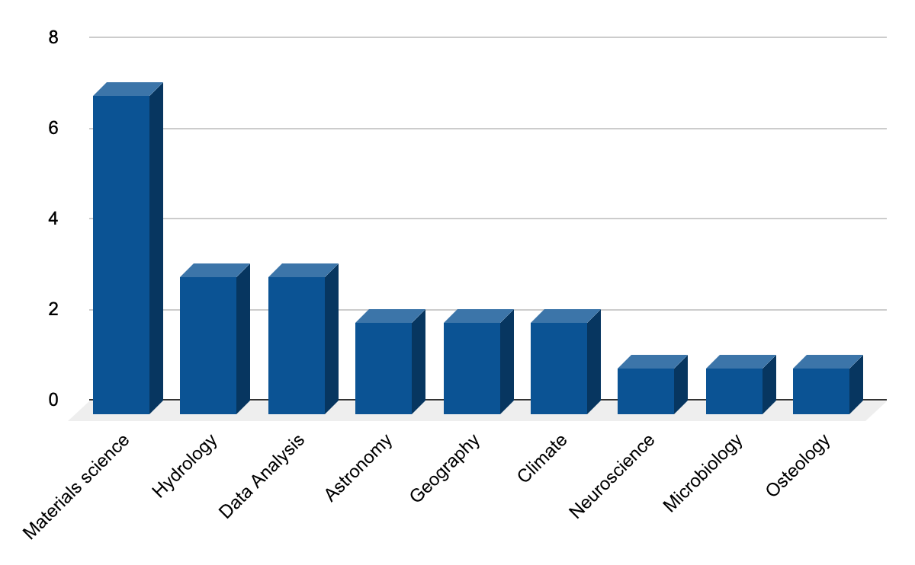
Identify Users: Roles and Domains

Slide 7
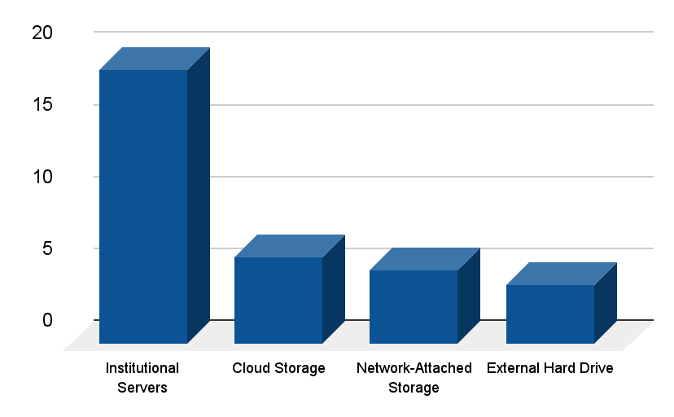
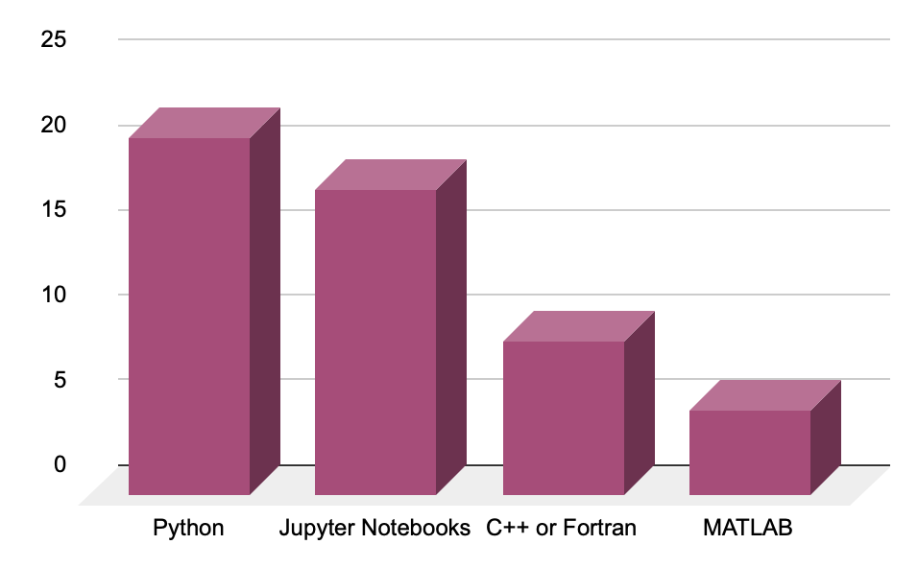
Target Questions: Some examples
Where do you store data?
What programming language do you use?

Slide 8
Analyze Results
“We don’t have a plan to scale storage if our cyberinfrastructure takes off.” - Cyberinfrastructure developer, Hydrology
“We can’t scale to PB data without massive funding or infrastructure. We need centralized point of access to federated data” - Cyberinfrastructure Developer, Materials Science
“If we make it easy, people will share their data. We need to extend the scalability of our infrastructure through community supplied storage.” - Project PI, Materials Science
“We lack personnel to do basic development and maintenance of our systems” - Cyberinfrastructure Developer, Astronomy
“The time and effort for using public repositories, and limited realized gains limits our data sharing” - Faculty, Materials Science
Cyber- infrastructure Developer
Senior Faculty, Multi-institution Project PI
NSDF
User Communities
“We can’t hire enough system maintainers and have research funding” - Data Analyst Group Lead
Technical Support Staff
“Remote quality control during acquisition would let us better use beamline time” - Faculty, Materials Science
Research Faculty, Smaller Projects
Research Staff
“Jupyter notebook access to data (TBs) would reduce barrier to entry ” - Research Staff, Climate Science
“Before I had funding to run my own experiments, data shared by a friend at a national lab launched my research career” - Faculty, Materials Science
Junior Faculty
Postdoc/Grad Students
“A student copies GBs of data from the scientist to my institution. I download to my laptop to prototype analysis. It is cumbersome and limits testing.” - Research Staff, Data Analysis
“I’m perplexed by the lack of urgency around reproducible and replicable processes for data management” - Faculty, Geography
“Our old data is kept on (external) drives. It's hard to keep things organized” - Graduate Student, Materials Science
“Our long-term storage is a shelf of external hard drives” - Research Staff, Neuroscience
“We move data (from light source) by flying back with TB hard drives” - Graduate Student, Materials science
Notes:
We found that the pain points, and potential gains of technology, we're different for different roles. for instance a common pain point for cyber instructor developers was a lack of personnel and inability to hire the needed people to sustain or grow cyber infrastructure. Research staff, post stocks and graduate students were involved with the majority of the day-to-day data movement and data management in scientific investigations and they reported pains ranging from cumbersome or slow data movement practices such as physically flying hard drives between image sources and home institutions, to organizational practices that in some extreme cases involve the project pi remembering which hard drives had which experiments. For junior faculty, a common theme was that access to others high quality data often launch their entire career, and led to their own funding to acquire data.

Slide 9
Diagnose Pain Points
Workforce development: Limited personnel hamper development of domain-specific CI
Scalability: No path to scale domain-specific CI
Movement: Bottlenecks hamper data movement
Management: Data management is ad hoc; organizing data and metadata requires replicating work
Longevity: Limitations in active storage size require data to be shelved
Accessibility: Cumbersome processes hinder data sharing
Immediacy: Delayed access to rapid data slows scientific discovery
Replicability: Programs and data versions are created, but not maintained as environments change
Notes:
the specific Pains, and the specific games possible through nsdf have a common theme. they save human time spent with data management. nsdf's Federation of data storage could provide a path to scale domain specific cyber infrastructure. the Technologies we develop furthermore can be a force multiplier, as a set of tools that can be integrated into domain specific cyber infrastructures. data movement between institutions Computing systems is still a real problem, with cumbersome workarounds. Currently need a management in terms of organization and where to store it and how to store metadata associated with experiments is often reinvented by each research group,.

Slide 10

What are your data pain points?
Let us know if you are willing to be interviewed!

