Slide 1




NATIONAL SCIENCE DATA FABRIC
They stole $1,440 and ¢1 from NSDF!!!!
Giorgio Scorzelli¹
¹ Scientific Computing Institute - University of Utah

Slide 2
What happened?
On December 17, 2021, we faced a security attack on one of the National Science Data Fabric (NSDF) AWS accounts.
The attack lasted for several hours
The attack caused $1440.01 worth of damage, most of which was Amazon Elastic Compute Cloud (EC2) costs.

Slide 3

Some background
NSDF is developing tools to automate the deployment of its software stack
Software is a combination of Python code and Jupyter Notebooks
Tools are designed to allow the agile and lightweight deployment of its Content Delivery Network (CDN) to mini multi-federated clusters.
GitHub repository was a private repository with private keys
ssh -I private_key username@host
We converted the repository to be PUBLIC in a way we considered to be safe

Slide 4
Timeline of the attack (GMT+0)
We fully erased the old private repository on December 17 at 9:52
We created two new repositories:
a public Python / Jupyter Notebook repository
a private Vault repository containing sensitive information
What did we do wrong?

Slide 5
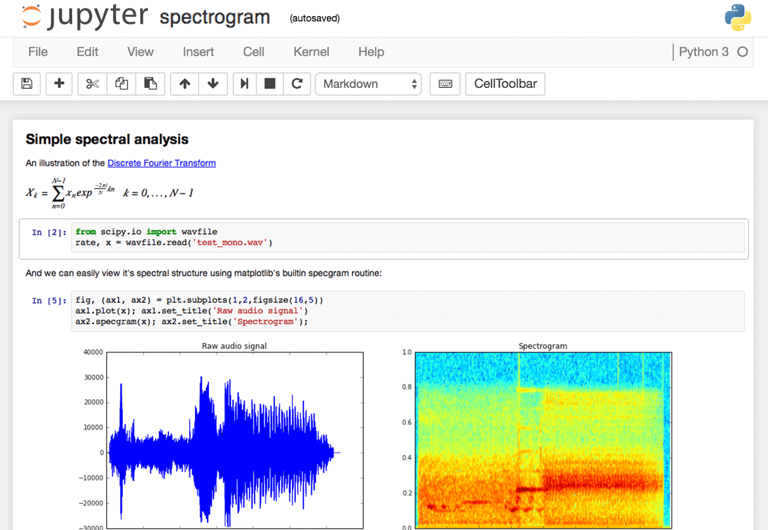
What is a Jupyter Notebook
Jupyter notebooks are human-readable text files containing:
Markdown Cells to describe the notebook
Python Cells to run Python code interactively
Output Cells to display (and cache) output messages.

Slide 6

And the culprit is….
The security leak happened in one Jupyter Notebook output cell that was not properly cleaned up

Slide 7
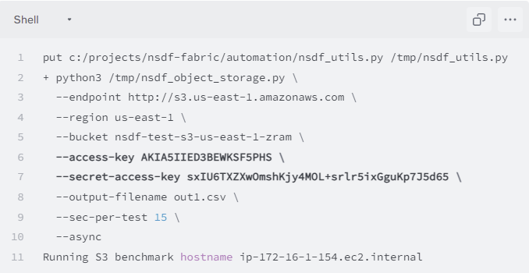
The guilty cell
We were testing object storage
comparing network speed, latency, bandwidth etc.

Slide 8
The guilty cell
We were using Amazon us-east-1 endpoint
Amazon budget is generously provided by CloudBank from a non-competitive allocation

Slide 9
The guilty cell
We created an ad-hoc Amazon bucket for testing purpose
The bucket is a container of cloud objects (like a directory in a filesystem)

Slide 10
The guilty cell
The output cell in VERBOSE/DEBUGGING mode is showing the credentials to connect to the AWS endpoint

Slide 11
In short
For DEBUGGING we set the shell verbose mode
During the benchmark execution the entire command line was printed to the standard output
The SECRET access key was part of the output
The output was part of the Jupyter Notebook
The Jupyter Notebook has been pushed to the new PUBLIC repo

Slide 12

Do we know exactly what happened?
NO
we cannot be sure
but we can guess

Slide 13

Do we know exactly what tools were used?
NO
we cannot be sure
but we can guess

Slide 14
Let’s guess
Very likely a vulnerability scanning tool was continuously watching for changes to our NSDF repositories.
WHY? Who knows… no clue
After the GitHub push event the malicious tool:
inspected the last commit (or even the entire GitHub history),
searched for passwords, security tokens, security credentials, etc.
Found the NSDF AWS access key

Slide 15
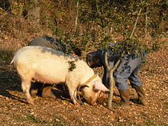
Our suspect: truffle hog
Wikipedia
A truffle hog is any domestic pig used for locating and extracting the fruit bodies of the fungi known as truffles from temperate forests in Europe and North America. Pigs have an exceptional sense of smell and can identify truffles from as deep as three feet underground.

Slide 16
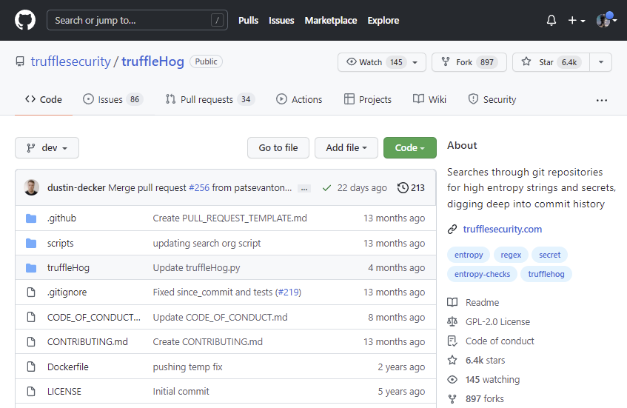
But truffleHog is also…
A well known open source software
can extract high entropy text in seconds
After the attack
not only truffleHog but also many other open-source tools, were able to extract that security token from our GitHub history

Slide 17

Timeline
The attack started at 09:55, just 3 minutes after the Git Push (!)
Between 09:55 and 13:50 no evidence of NSDF activity on the AWS platform.
we were not aware of the attack going on and did not realize that several cloud resources were being consumed.
At 13:50 we realized that there was some problem
It was not possible to launch new machines in the "us-east" region.
AWS was returning a “quota exceeded” message(==virtual CPU limit is hit)

Slide 18

Our reasoning process
Problem in our code? We checked the code
Problem on AWS? Check on Google if other AWS users were having the same problems;
on the same day the HUGE vulnerability with the Log4J library (link)
we were very convinced it was not our problem
NSDF is running benchmarks? At 2:24pm we sent a message to our Slack Channel
is anyone using the amazon account via CloudBank? Please let me know ASAP
Finally! We detected 100 EC2 instances on the EC2 global dashboard, and we realized that some password/security token must have leaked.
I found VM in africa too, it's not a good "sign"
This entire reaction process took 32 minutes and 12 seconds

Slide 19
Our reactions
We disabled immediately all AWS security tokens.
We tried to manually remove all the EC2 instances,
but they were flagged to avoid removals (DisableApiTermination flag),
there were weird cycles in the Security Groups.
After attack we realized: they knows a lot better AWS than us
manual deletion would have taken too much time considering the high number of instances. and AWS help desk was not real time

Slide 20
Our reactions (cont.)
We tried to use NSDF automation scripts to entirely remove Virtual Private Clouds (in other words, groups of EC2 instances).
scripts didn’t work out, and we had to make several non-trivial and time-consuming modifications.
But finally, scripts saved us

Slide 21
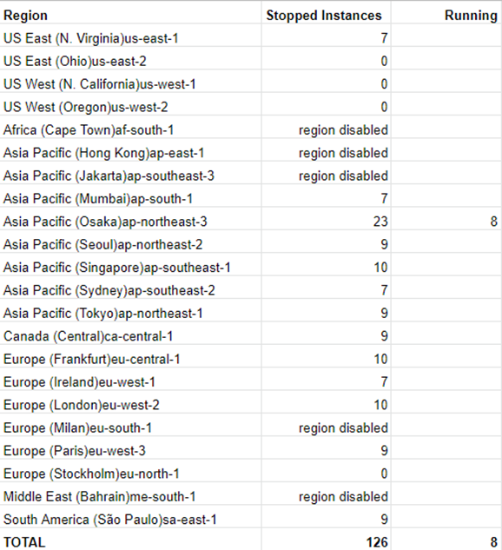

Difficult deletion
At 2:48pm most of the EC2 instances were in a stopped status
Still 8 running instances in the Asia Pacific "ap-northeast-3" region.
At 4:52pm all the EC2 instances were terminated and deleted.
At 5:05pm all other cloud resources (Virtual Private Cloud, Internet gateways, subnets, security groups, etc.) were deleted.

Slide 22

CloudBank Logs
THANKS Cloudbank for the help
Extra information and details are included in the Billing Excel Spreadsheet.
The attack started at 09:55 am and finished at 4:15 pm for a total of 380 minutes (6.33 hours).
The final cost is 1424.18$, or $3.74/minute
The accumulated cost per time shows a linear growth.
The attack consumed 29320 minutes (488 hours) on Amazon EC2.
Other Amazon services were not attacked
A total number of 151 machines were launched.
Sixteen Regions were involved:
US: us-east-1,2; us-west-1,2
Canada: ca-central-1
Europe: eu-west-1,2,3; eu-central-1; eu-west-2,3
Asia Pacific: ap-south-1; ap-northeast-1,2,3; ap-southeast-1,2
South America: sa-east-1

Slide 23

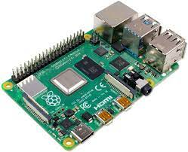
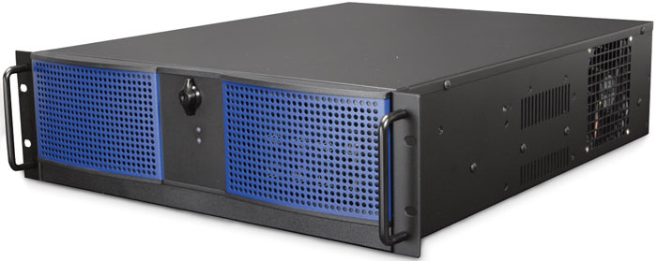
CloudBank Logs (cont.)
THe EC2 machine types were very different
FROM ac5.large ($0.107/hour)
2 vCPU
4 GiB RAM
10Gb/sec network
TO ac5d.24xlarge ($5.856/hour)
96 vCPU
192 GiB RAM
4x900SSD
25Gb/sec network

Slide 24
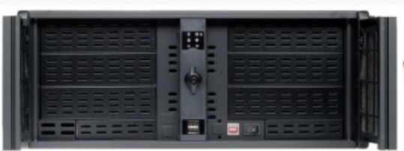
But we were “lucky”
u-12tb1.112xlarge
12 TiB RAM
448 vCPUs
100 Gigabit
$109.200000 hourly
109$ * 488 hours = 53.192$

Slide 25

CloudBank Logs (cont.)
At the beginning of the attack, from 9:55 to 10:05, 55 instances were launched: 26 in Europe and 28 in the Asian Pacific region.
Ten minutes after, between 10:05 and 10:15, 32 EC2 instances were launched in the US; 9 in Canada; and 9 in South America.
Not all machines were up and running for the whole attack timeframe. What’s the logic behind that? We don’t know

Slide 26

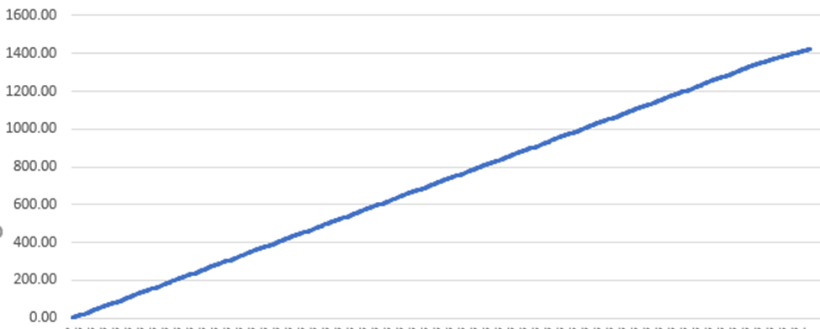
CloudBank Logs (cont.)
Accumulated cost over time. Linear function.

Slide 27

AWS CloudTrail Logs
Additional information is available from the AWS CloudTrail logs.
This source is informative but incomplete since it’ shows only the "us-east-1" region activity
we didn’t realize that AWS CloudTrail produces logs only for the currently selected region
to get the full logs it is necessary to enable a well hidden flag (link).
WHY??? We don’t know

Slide 28

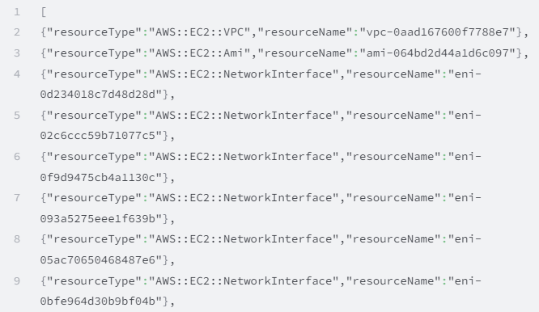

AWS CloudTrail Logs (cont.)
An lesson to learn: structured self-contained logs

Slide 29

AWS CloudTrail Logs
The attack in the "us-east-1 "region started at 10:00 am
Clients in Python 2. X , Python 3.8 with boto3; AWS CLI Power Shell ; and go 1.17 (“User-Agent” field).
At 2:11 pm NSDF started the recovery process.
At 4:52 pm all the EC2 instances were terminated.

Slide 30
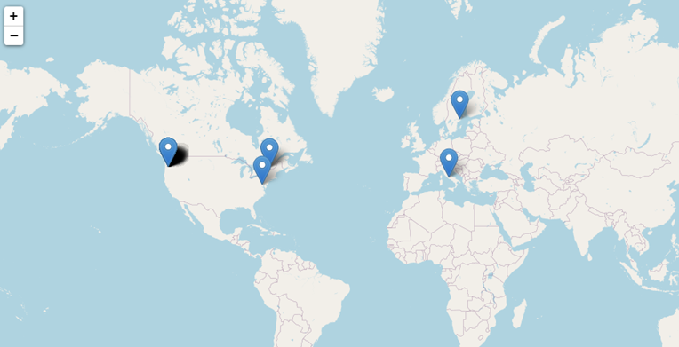
Who are the attackers?
Lot connections from Portland, Oregon, US.
One OVH Cloud IP from Canada. One IP from Sweden (EU).
The one in Italy is not an attacker

Slide 31
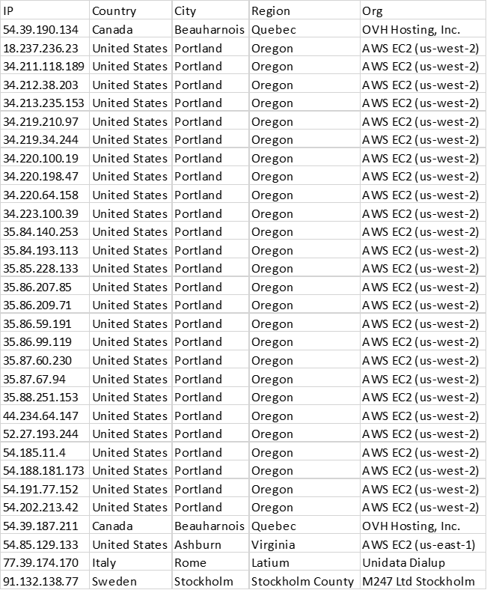
We have all IP addresses
Are they useful?
Probably NOT

Slide 32
POSSIBLE COUNTERMEASURES

Slide 33

Enforce Security of Sensitive Data
Use multi-factor authentication (MFA)
if password is stolen, it's impossible to log in without a second device
Create short-lived tokens:
limit its scope as much as possible
Use the token for a limited timeframe
Remove the token when the activity is finished
Follow the Principle of Least Privilege
do not create security tokens with full access permissions.
strong password policy for users
rotate the keys
the mistake was creating a full access token to create EC2 instances, keeping it indefinitely active

Slide 34
Enforce Security of Continuous Integration
Before pushing to GitHub, use some tools (e.g., truffleHog or gitleaks) to (*) search for secrets (*) dig into the commit history and branches, (*) find secrets
Before pushing to GitHub, clean up Jupyter Notebooks output using some tools (e.g., nb-clean)
After pushing to GitHub, use online open-source free scanning solutions (e.g., Spectral).
if we had run a scanning tool on the Jupyter Notebooks before the push event, we would have prevented the security breach.

Slide 35
Enforce Security of Continuous Deployment
CD tools automatically filter secure environment variables by obfuscation.
BUT once a VM is booted we have less control over what information are printed
Do a manual deployment.
Move your CI/CD pipeline on-premise.
Disable all settings that duplicate commands to standard output
Avoid printing secrets within the code
Avoid any shell commands that may expose tokens or secure variables
Avoid mistakes in string escaping
Avoid increasing command verbosity if not strictly necessary
Redirect output to /dev/null
Use standalone solutions to do the online CD scanning

Slide 36
Scan of Artifacts
Automatic find security issues in Python packages (e.g., Bandit)
Automatic safety checks on Python dependencies (e.g., Safety, Jake)
Automatic scan Docker images (e.g. Clair, Anchore, Dagda, Docker Benc)
security problems with the container image and the software running inside
security problems regarding the interaction between a container, the host OS, and other containers on the same host
security problems related to the host OS
container security networking and storage problems
NSDF will have to deal a lot with it

Slide 37
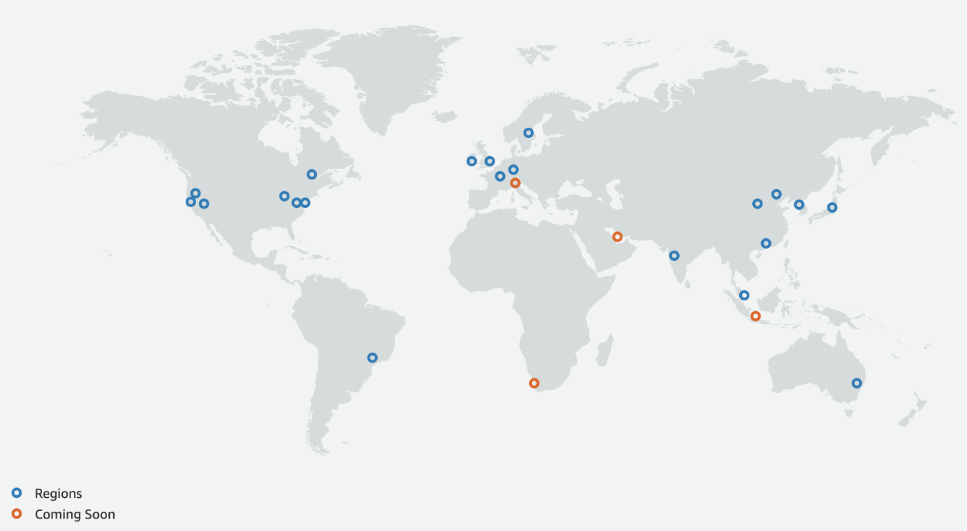
Restrict Cloud Allocations
Disable all unneeded regions.
we were not aware that some regions (for example Asian Pacific, Canada, South America) were enabled by default.

Slide 38

Real-Time Messaging
We did not receive any email/communication between 09:55 and 13:50
We need a real-time messaging system to track down activities:
launching new instances (VM, bare metal)
modifying existing instances
creating/removing S3 buckets
moving a large quantity of data,
adding new users or security tokens
modifying user roles and/or policies.
Any communication should be delivered to numerous users
covering all the time zones
end up on various slots (emails, short text messages, dashboards, Slack channels, etc.)

Slide 39

Real-Time Cost Monitoring
During the attack, we didn’t have a clue about what was spent and what we were going to spend, given the number of ECS instances.
We received an estimate of $400.21 from the AWS Billing Dashboard on December 17th,
but we knew charges were coming…
On the 18th the Dashboard showed a total charge of $1,440.01
CloudBank can help us:
have some real-time estimate code.
It's a Lambda code that runs every 10 mins and looks at the AWS accounts, lists the EC2 instances, and does an estimate of cost based on a pricing table.
collects the data in a Google Cloud Platform - BigQuery table
The cost data is an estimate. REAL PRICING IMPOSSIBLE?

Slide 40
The END… …until the next episode

