Slide 1



The Materials Commons 2.0 A Collaboration Platform and Information Repository for the Global Materials Community
Staff: Glenn Tarcea,
Domain Scientists: Brian Puchala, Tracy Berman,
and John Allison
The University of Michigan
Supported by DOE

Slide 2

Agenda
Overview
Upload, Share, and Collaborate
Publish
Search And Explore Data
Communities of Practice
Future Plans and Summary

Slide 3
PRISMS Overarching Vision Enable accelerated predictive materials science.
Collaboration
Experimental & Simulation Information
Seamless, Continuous Workflow
Provenance Tracking
Accelerate model building and validation
Leading Edge
Metals Science
PRISMS
Computational
Tools
The Materials
Commons

Slide 4
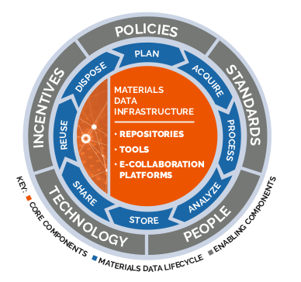
Materials Data Infrastructure
From: Minerals, Metals & Materials Society (TMS), Building a Materials Data Infrastructure: Opening New Pathways to Discovery and Innovation in Science and Engineering (Pittsburgh, PA: TMS, 2017). Electronic copies available at www.tms.org/mdistudy

Slide 5
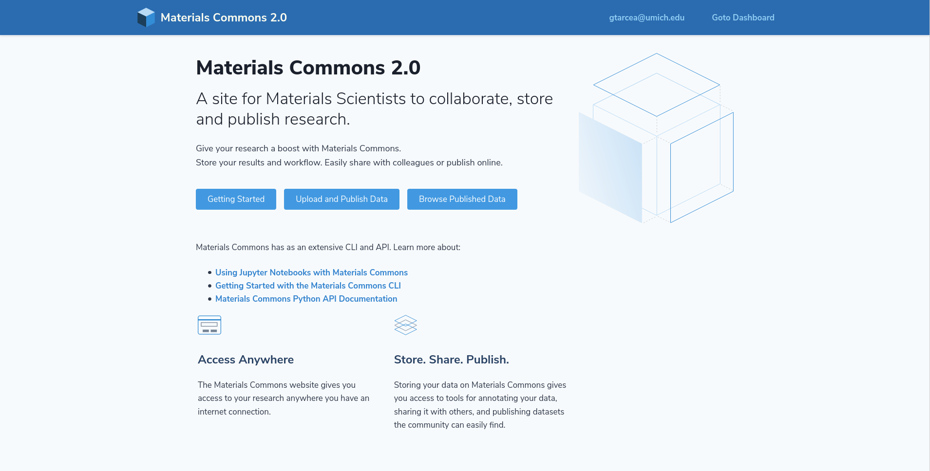
Materials Commons 2.0
August 2016 - MC 1.0
April 2020 - MC 2.0
Over 600 Registered Users
Over 3.5 Million files uploaded
20TB of Published Data
390 TB Storage Available (28TB used)
470,000 Sample and Process Attributes

Slide 6

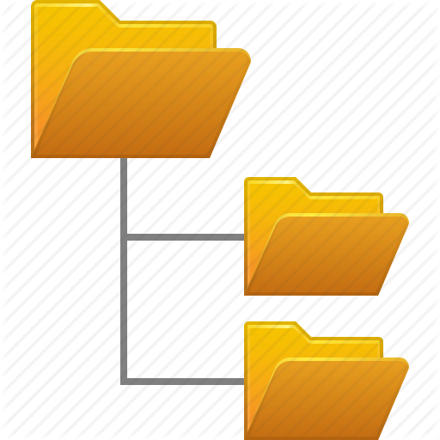


Materials Commons Hub
Materials Commons
Materials Community
Files
Data & Relationships
GDS
Spreadsheet import
PRISMS Software Tools
Globus file transfer
Cloud Storage
Datasets
Citrine
MDF
HT
MII Services
NIST

Slide 7
Agenda
Overview
Upload, Share, and Collaborate
Publish
Search and Explore Data
Communities of Practice
Future Plans and Summary

Slide 8
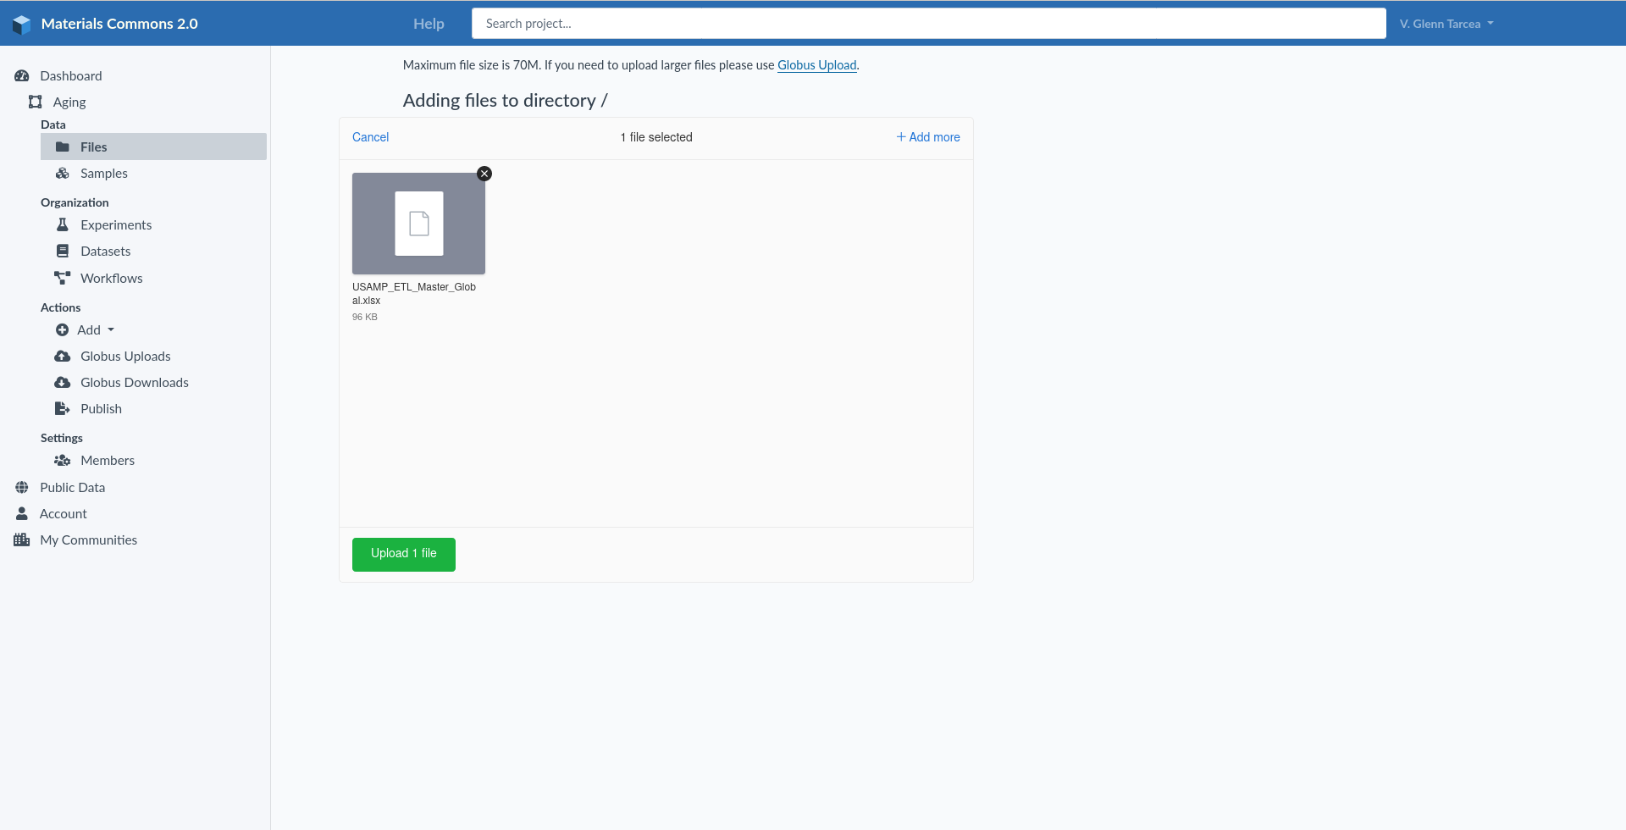
Direct Upload/Download
Directly upload files to Materials Commons
A great option if you don’t have a lot of files to upload and your files are small in size (no larger than 200 Mb in size)
Images and Office documents are automatically converted for display in the website
Directly download individual files

Slide 9
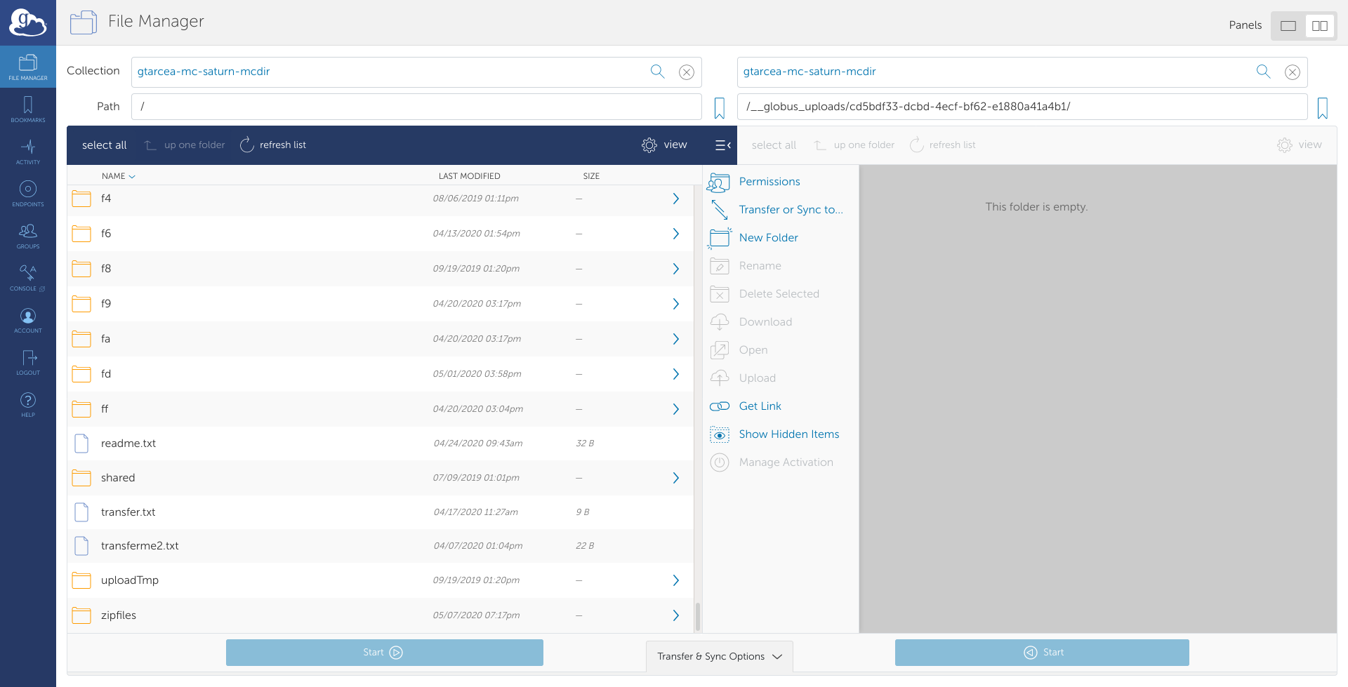
Globus Upload/Download
Easily upload/download any size files, including
Projects
Datasets
Globus uploads imported into Materials Commons
Datasets are automatically published with a Globus download point as well as a zipfile
Images and Office documents are automatically converted for display in the website
New version of Globus Upload/Download coming out
Use from API/Command Line

Slide 10
MC File Uploader/Downloader
File Upload Option for sites that have trouble using Globus
Allows for Directory, multiple and large file upload
Also available from the command line
Easier to configure and install
Coming Soon

Slide 11
Upload from spreadsheets
Many researchers record data in spreadsheets
Formats vary, but often:
Rows -> Samples
Columns -> Process parameters and Measurements
User defined meta-data and format

Slide 12
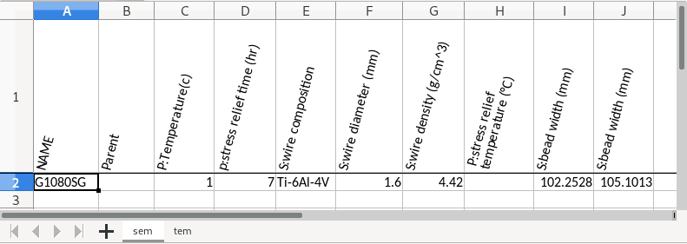
Upload from spreadsheets
Materials Commons Excel upload :
Very simple format for Spreadsheet:
First column is name of sample
Second column is optional for constructing a workflow
Remaining columns are attributes, files or notes
Worksheet name determines the processing step

Slide 13
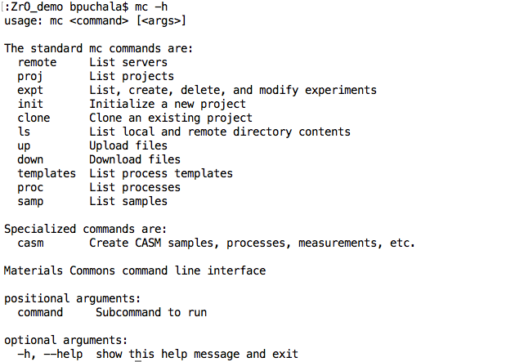
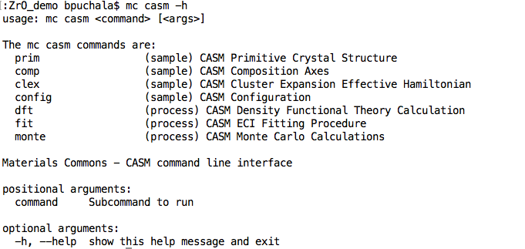
The Materials Commons - CLI
Generic project actions:
upload / download / query / etc.

Slide 14
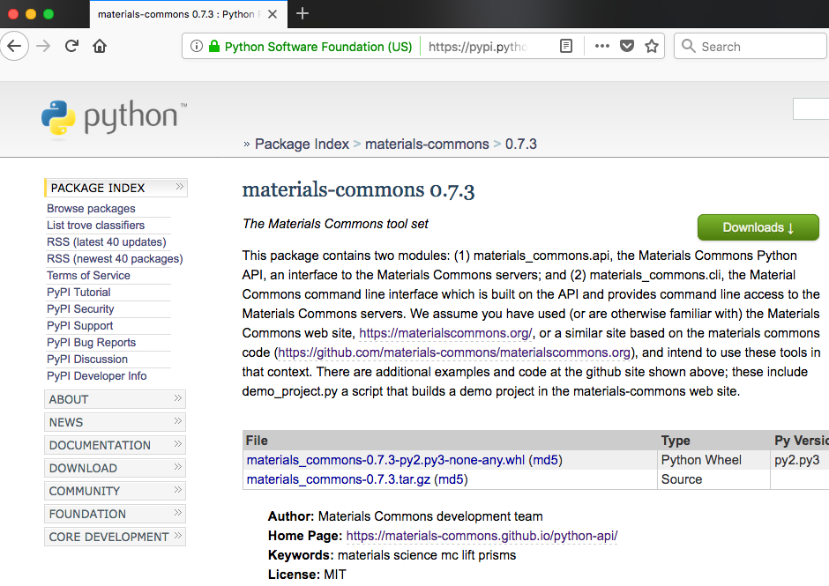
Python API – materials-commons
Enables writing scripts to interact with Materials Commons
Install with: `pip install materials-commons`
Documentation: https://materials-commons.github.io/python-api/

Slide 15
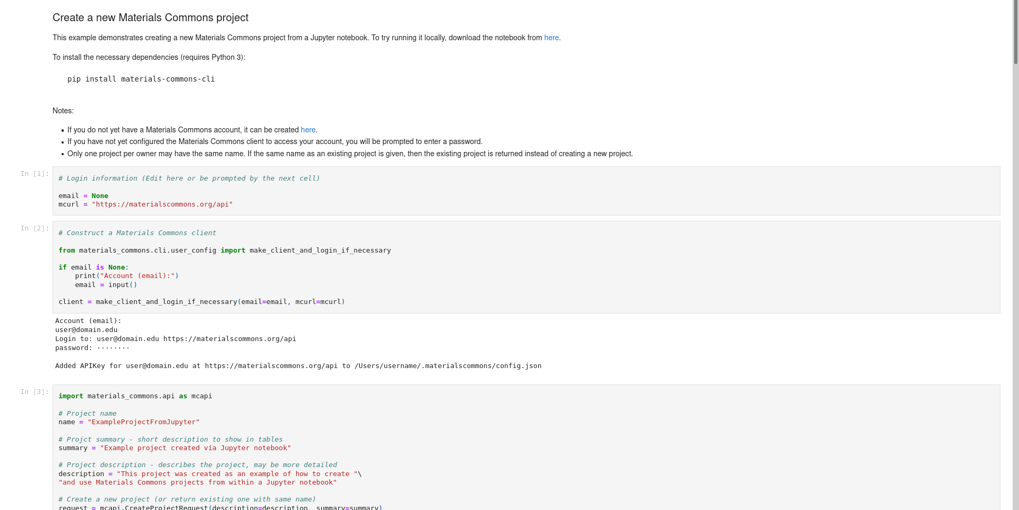
Jupyter Notebook Support
Create Projects
Upload/Download Files
Store files in Materials Commons, but work with them locally
Upload/Download Changes Easily
Integrate in with your computational and analysis tools

Slide 16
Agenda
Overview
Upload, Share, and Collaborate
Publish
Search and Explore Data
Communities of Practice
Future Plans and Summary

Slide 17
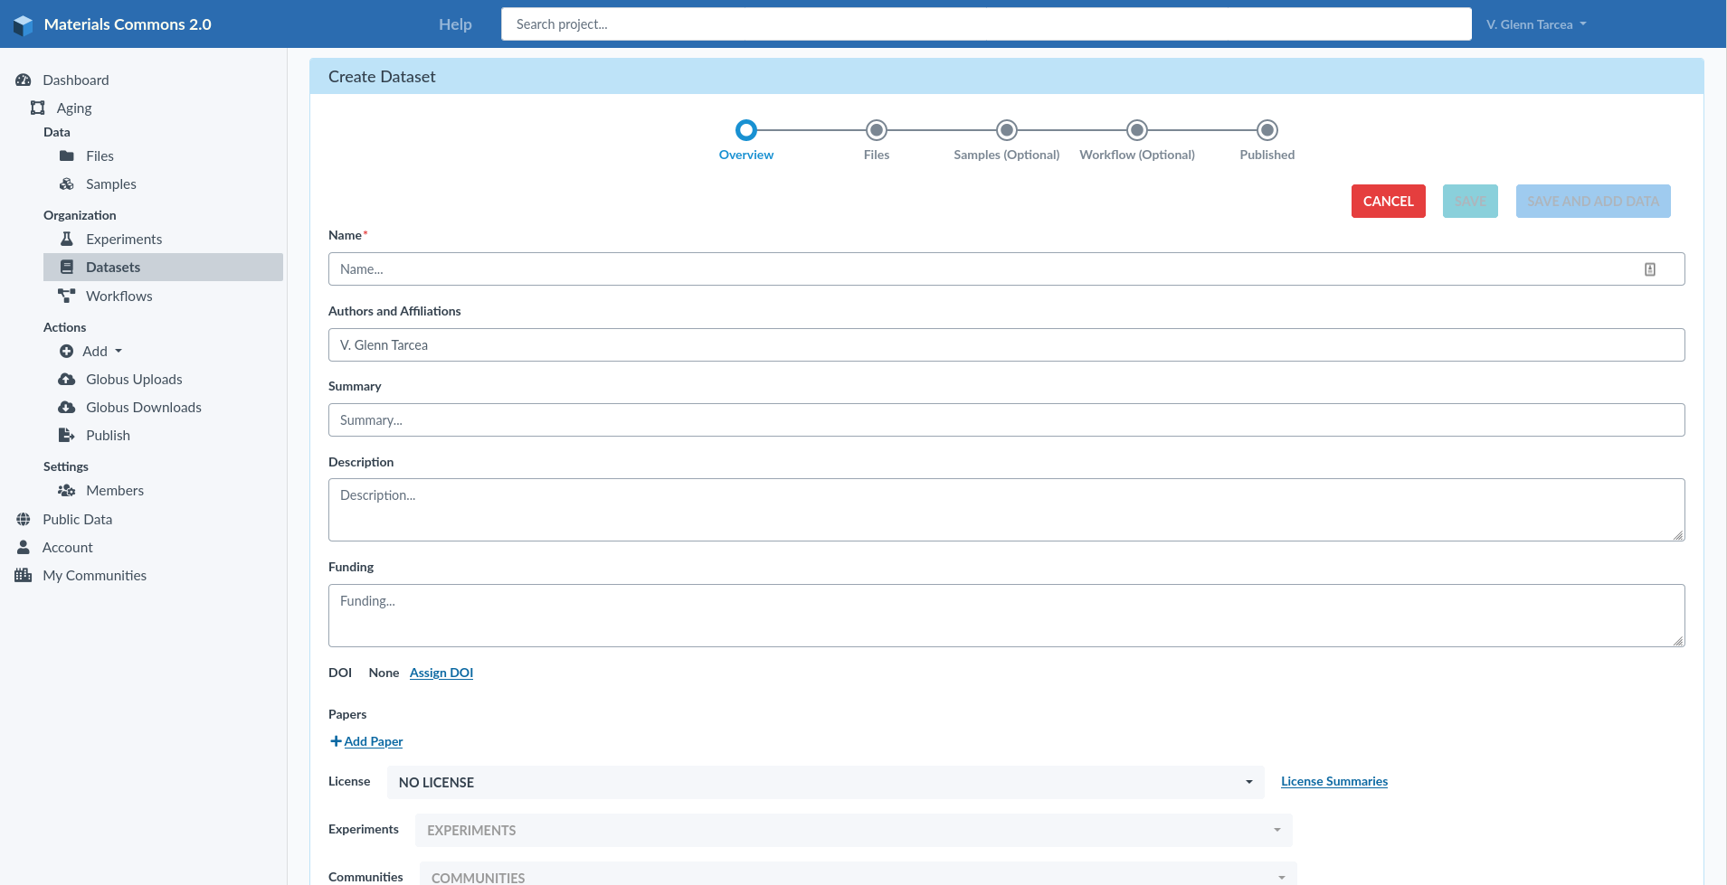
Creating A Dataset
DOI Support
Easy to add lots of data and metadata
Nicely formatted and presented
Automatically available on Google Datasets
Download Zipfile or use Globus

Slide 18
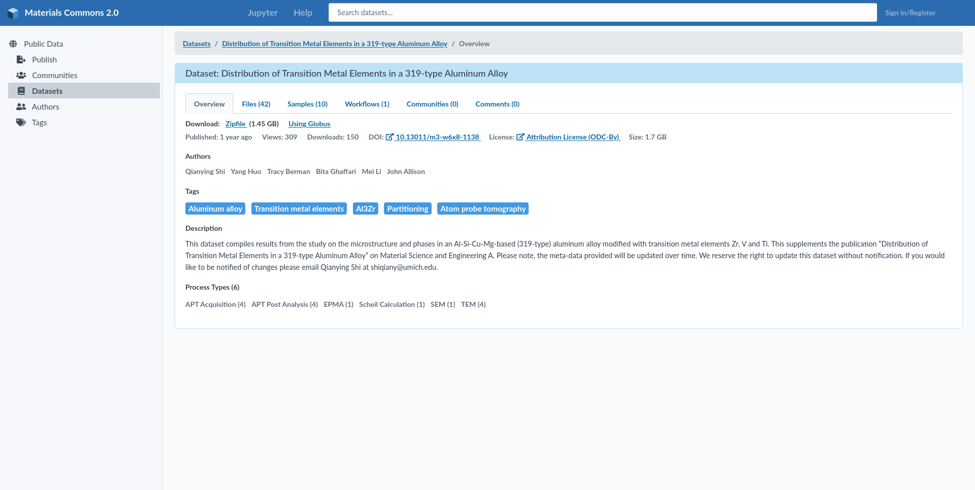
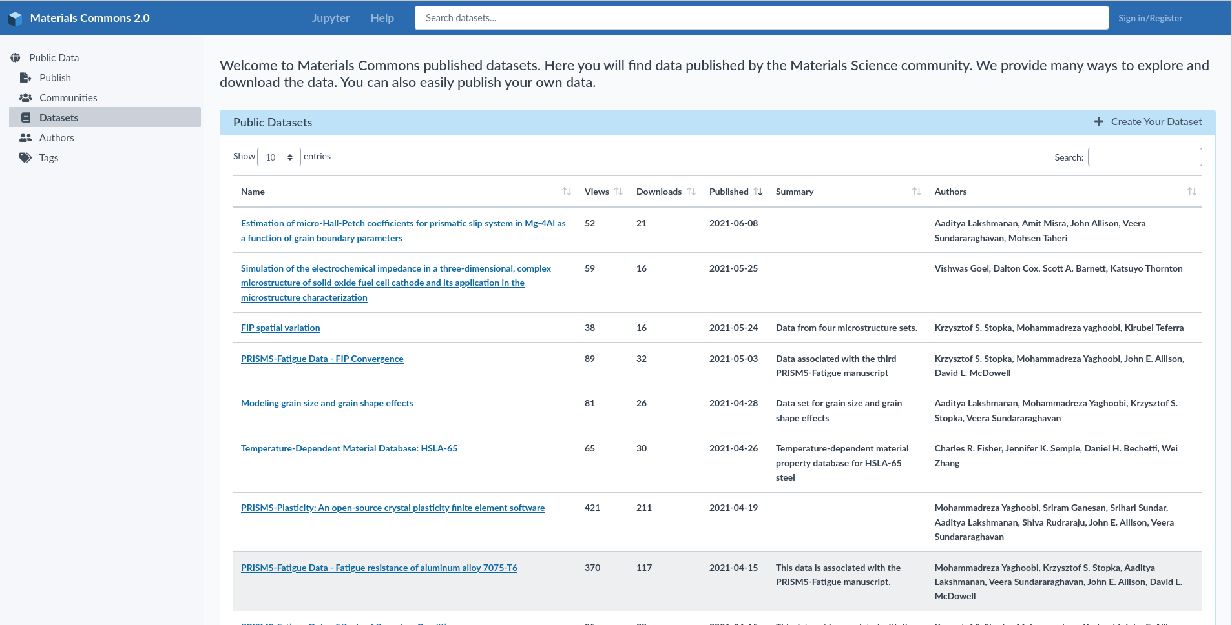
Published Datasets
Search published datasets
Browse by Author, Tags
Easily view files and data
Download files over the web, using Globus, or in a single Zip file

Slide 19
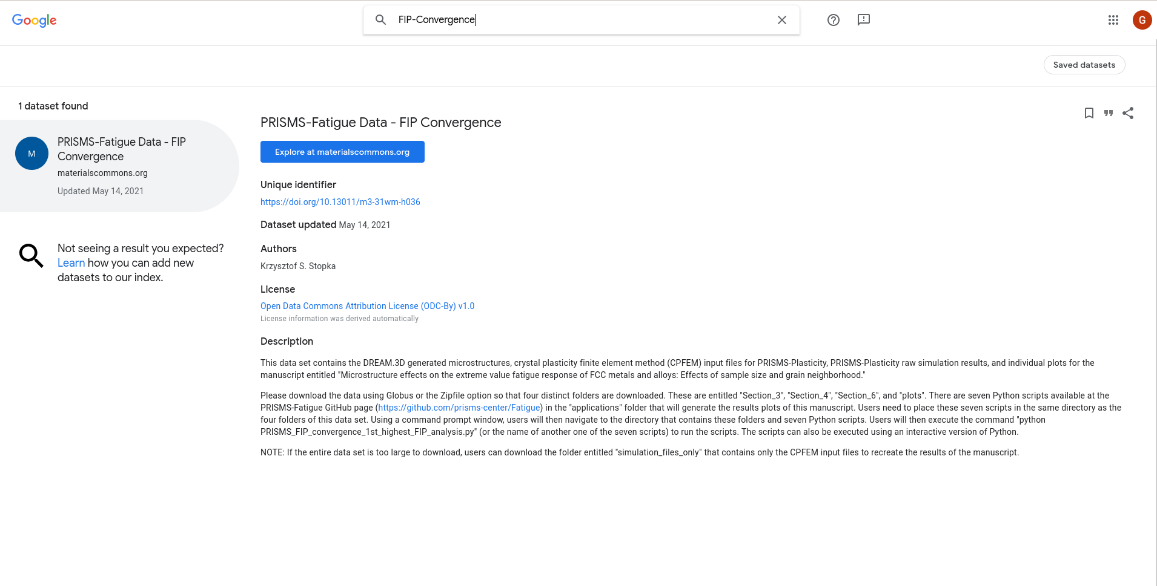
Google Dataset Search
Published Datasets are automatically made available in Google Dataset Search
Changes are updated nightly

Slide 20
Agenda
Overview
Upload, Share, and Collaborate
Publish
Search and Explore Data
Communities of Practice
Future Plans and Summary

Slide 21
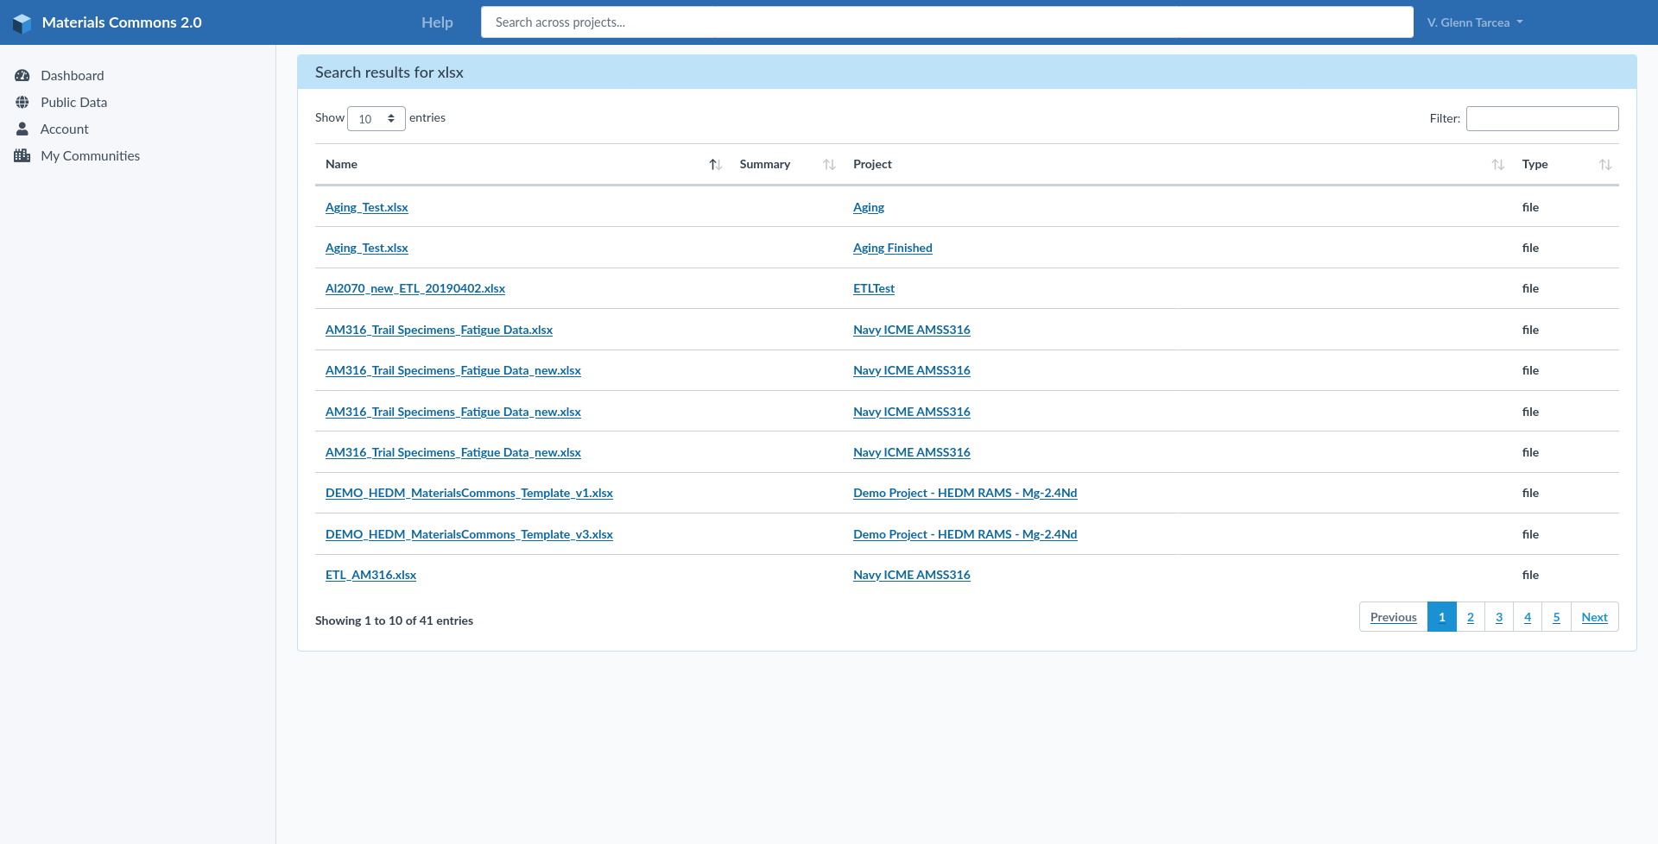
Search
Search Published Datasets
Search within or across projects
Search multiple elements such as files, processes, samples, datasets, etc…
In the future will be able to do more structured searches (multiple elements, attributes, etc…)

Slide 22
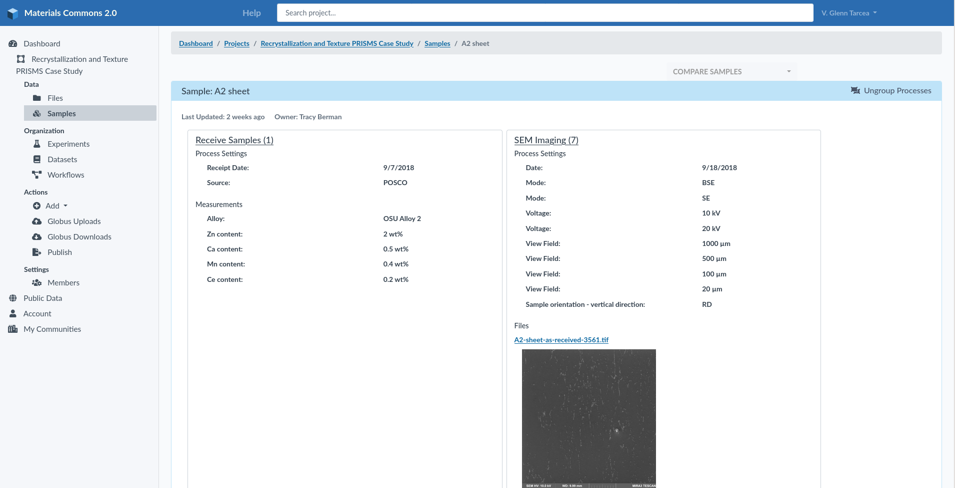
Explore Data Online
View Samples, processes, attributes
View relationships and files
See processing step order
Group/Ungroup similar processing steps

Slide 23
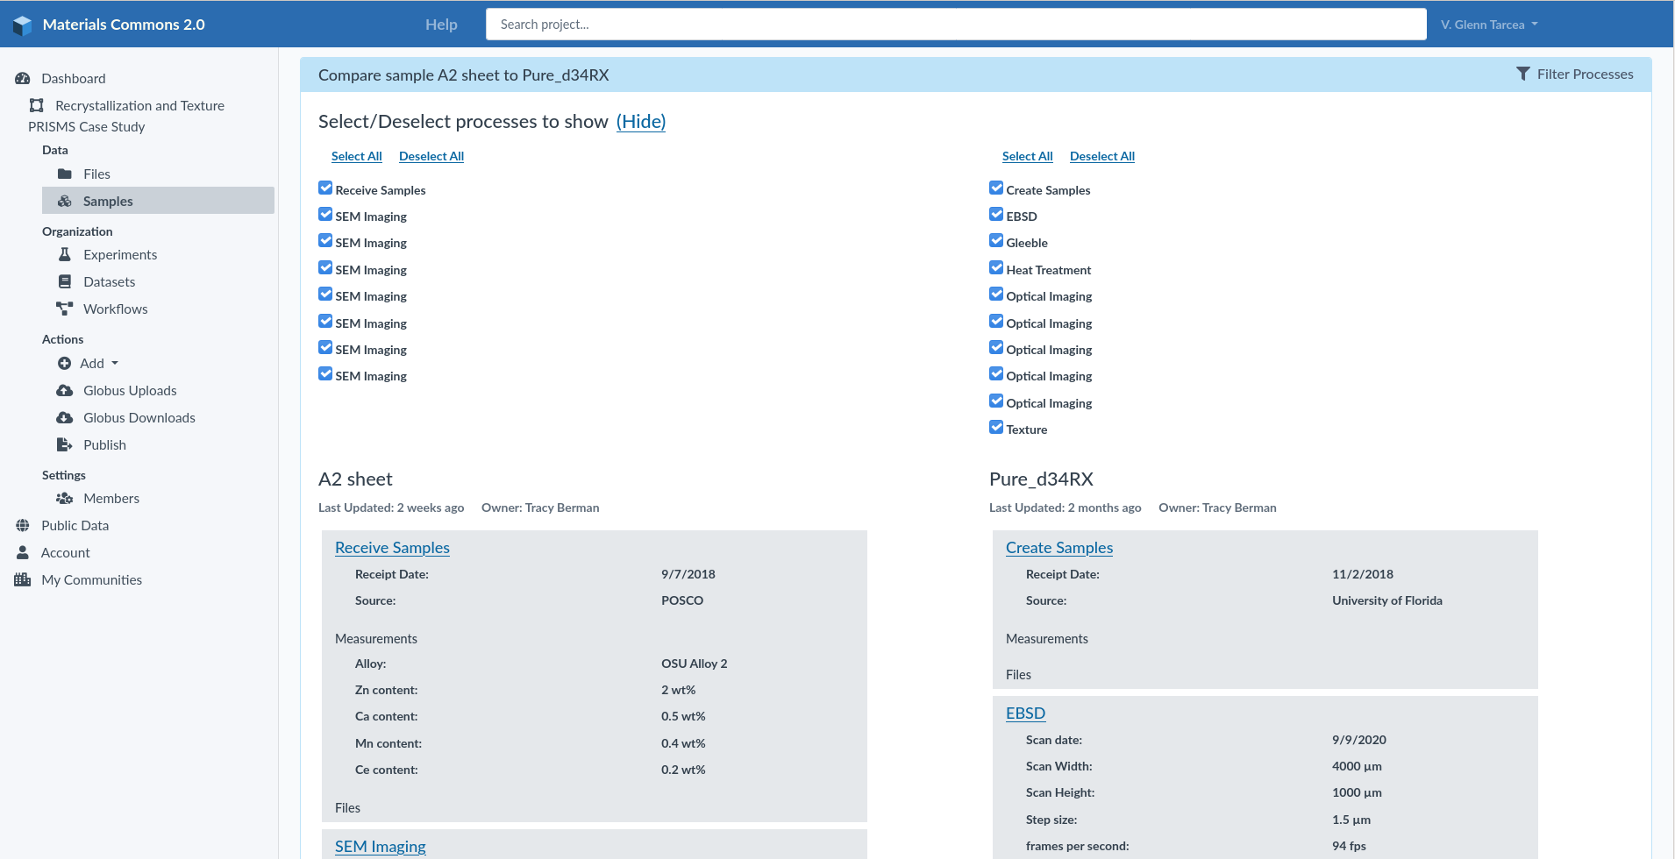
Compare Data Online
View Samples, processes, attributes
Compare and filter samples and processes
View processing step order
Hide/Show data
Select any 2 samples to compare

Slide 24
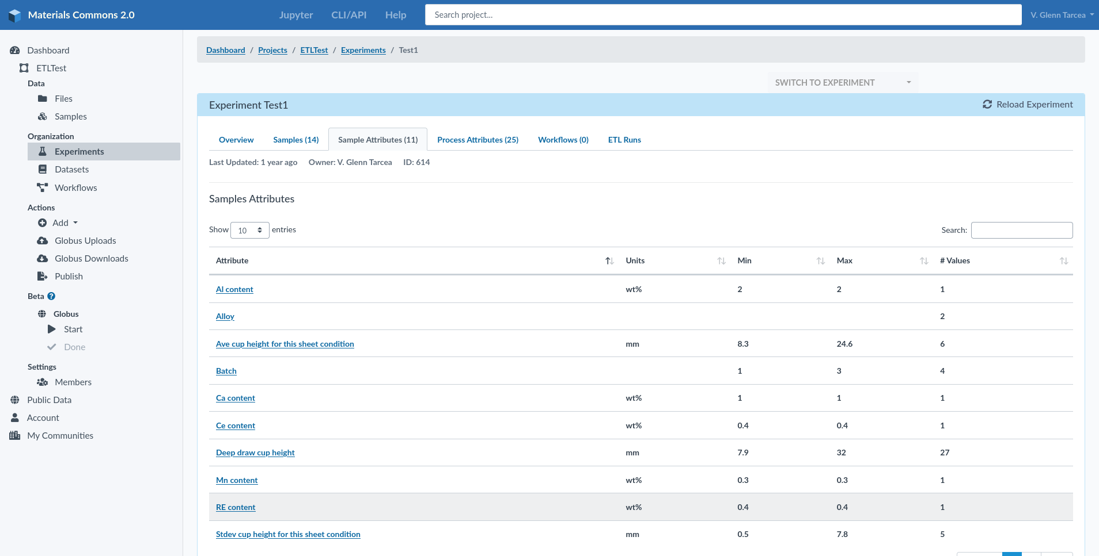
Data Dictionary
View Attributes across your experiments for both samples and processes
Validate data, names
View min/max and number of values
See units
View all values and origins

Slide 25
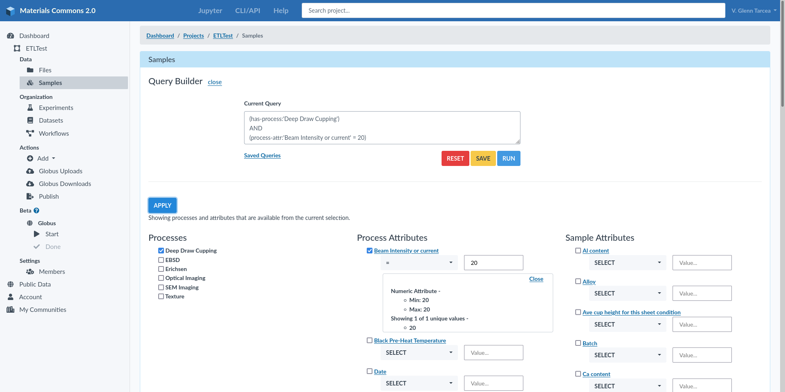
Query Builder UI
Construct complex queries
Explore Samples, Process, and Attributes
Save And Reuse Queries
Filter Attributes Based on Previous Query
Show Min/Max, and Snapshot of attribute values

Slide 26
Agenda
Overview
Upload, Share, and Collaborate
Publish
Search And Explore Data
Communities of Practice
Future Plans and Summary

Slide 27
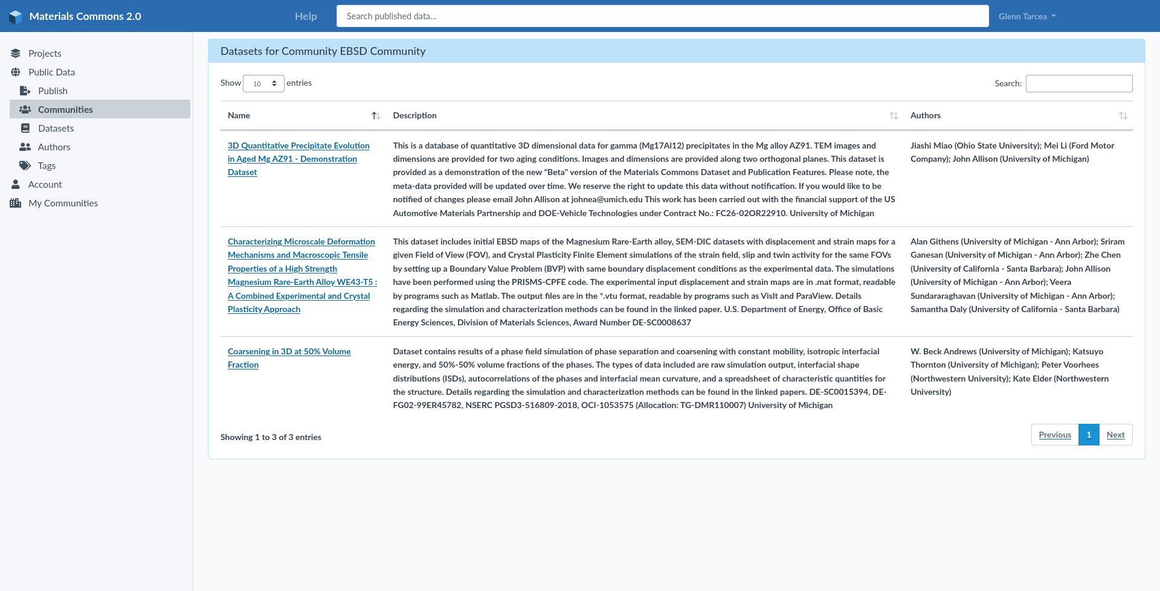
Community Of Practice – Providing value to communities with similar interests
A means to attract more information providers
Gathers similar data together
Datasets can be in multiple communities
Another way to find data

Slide 28
Agenda
Overview
Upload, Share, and Collaborate
Publish
Search and Explore Data
Communities of Practice (Work in Progress)
Future Plans and Summary

Slide 29
NSDF Integration
Make data available in the CDN
Metadata repository for Materials Data
Integration with OpenVisus
Federation of Materials Commons Storage to support locality of access

Slide 30
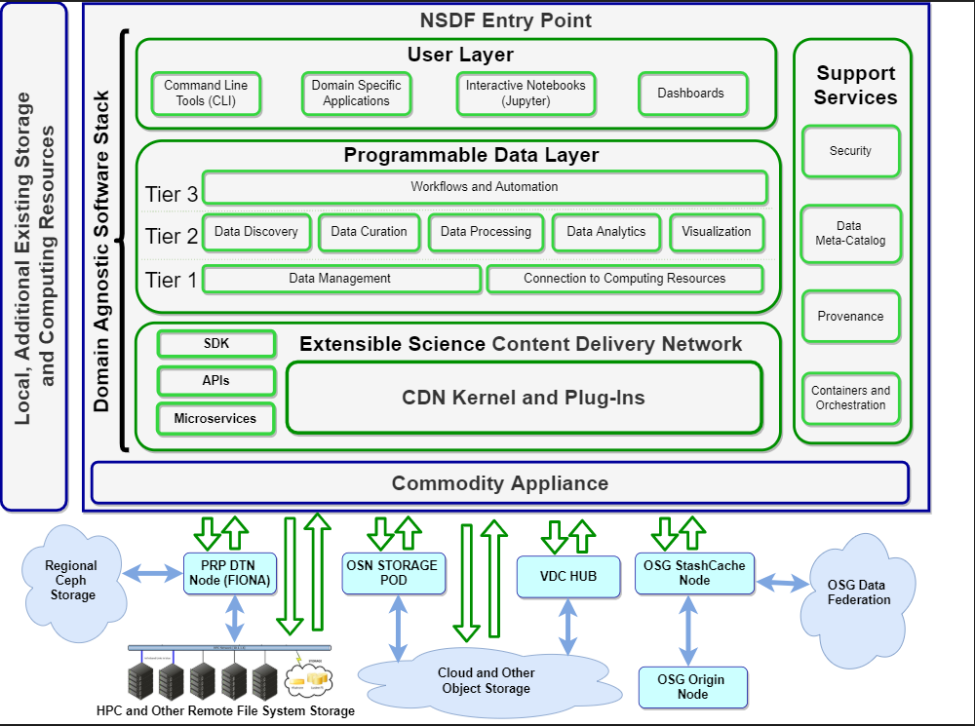
NSDF Integration
Materials Commons
Materials specific provenance and meta data services
Materials Commons storage and transfer services
Materials Commons XRootD Node
Materials Commons Jupyter Notebooks
Materials Commons API Services
Materials Commons Storage Services

Slide 31
Future Plans
Coming This Year (Hopefully!)
S3 support for storing your files
Visus Integration for 3D Image Exploration
Query Support for Samples, Processes and Attributes
Materials Commons File Uploader
Other Plans
Customize your published dataset pages
Additional ways to upload data (processes, samples, Attributes)
Communities of Practice improvements
Sharing with non-Materials Commons users

Slide 32
Materials Commons 2.0
https://materialscommons.org
Documentation:
https://materials-commons.github.io
Questions/Feedback -
Glenn Tarcea - gtarcea@umich.edu

