Slide 1




NSDF Software Development Life Cycle Procedures
Daniel Balouek¹, Kevin Coakley², Jakob Luettgau³, Paula Olaya³,
Giorgio Scorzelli⁴, Glenn Tarcea⁵, Naweiluo Zhou³
¹ Rutgers University; ² San Diego Supercomputer Center;
³ University of Tennessee, Knoxville; ⁴ University of Utah; ⁵ University of Michigan;

Slide 2
NSDF Software Development Life Cycle Procedures
Daniel Balouek, Kevin Coakley, Jakob Luettgau, Paula Olaya, Giorgio Scorzelli, Glenn Tarcea, Naweiluo Zhou
Have a look yourself:
https://github.com/nsdf-fabric/sdlc

Slide 3
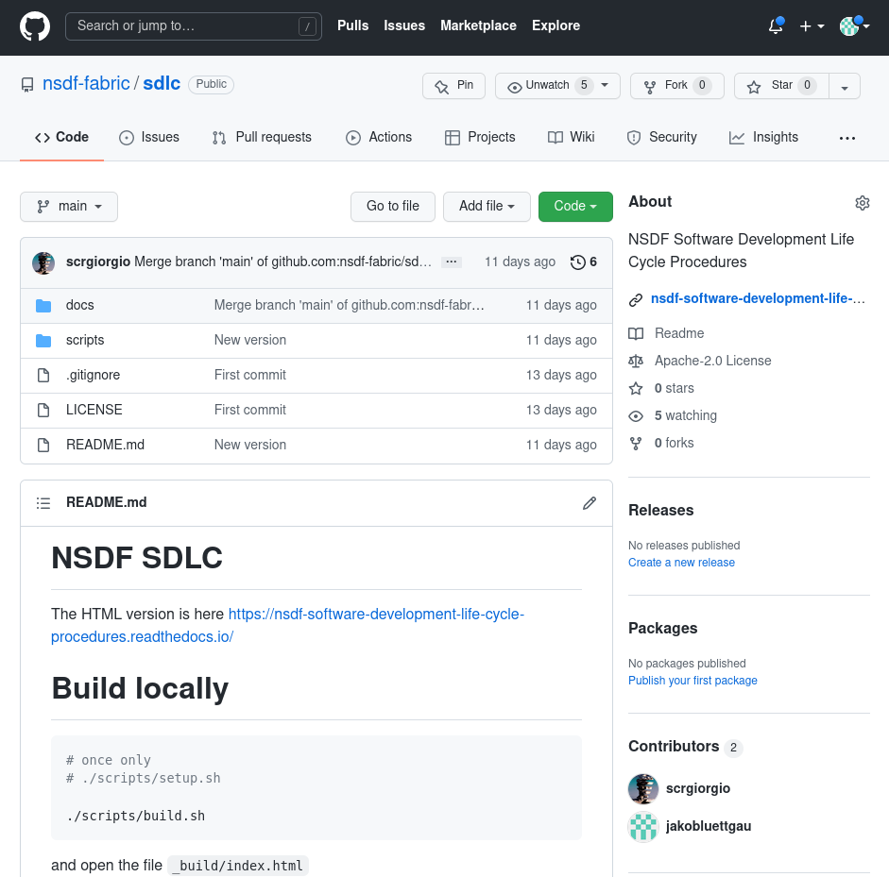
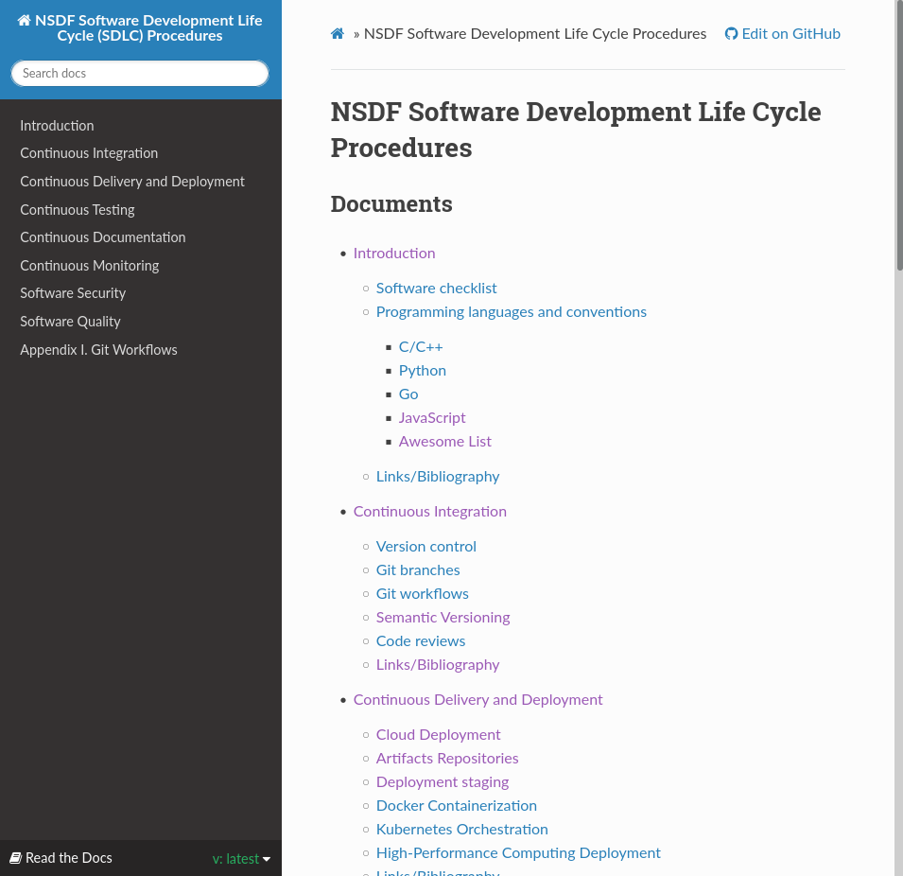
Have a look yourself:
https://github.com/nsdf-fabric/sdlc

Slide 4
Why we took the time to define the SDLC
Inventory of existing Skills and Capabilities
Identification of Needs (Skill & Infrastructure)
Software development is very opinionated.
High-Level Technology Exploration
State of the Practice (Full-Stack, but also Niche)
Sanity Check and Guide Development/Integration Strategy
SDLC serves as an entry-point for our development activities, to prevent us from thinning out to much across too many technology choices.

Slide 5
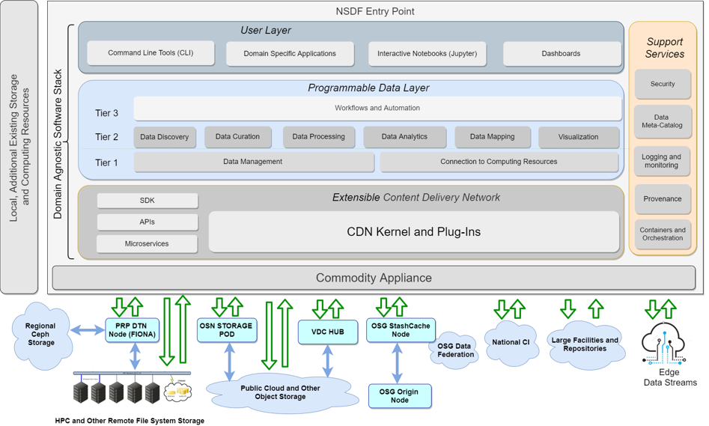

Slide 6
Scientists Educators
Students
Application Developers
Middleware/Service Developers
Infrastructure
Providers

Slide 7
Scientists Educators
Students
Application Developers
Middleware/Service Developers
Infrastructure
Providers
HPC
Commercial
Clouds
Science
Clouds/Grids

Slide 8











HPC
Science
Clouds/Grids
Commercial
Clouds
Notes:
NSDF has to cater to all of those to a degree, but we are a small team!
CHPC operates 6 clusters (2 over 7000 nodes, 3 with 1000-2100 nodes, 1 with only 150)

Slide 9
HPC
Science
Clouds/Grids
Commercial
Clouds
Notes:
NSDF has to cater to all of those to a degree, but we are a small team!
CHPC operates 6 clusters (2 over 7000 nodes, 3 with 1000-2100 nodes, 1 with only 150)

Slide 10
Software Quality
Reliability | How NSDF builds reliable code
Efficiency | How NSDF builds efficient code
Security | The practices that NSDF takes to ensure secured code
Maintainability | The practices that NSDF takes for code maintenance
Rate of Delivery | NSDF adopts the agile software development approach
Automatic tools | NSDF utilizes the CI/CD pipeline tool for checking software quality

Slide 11
What does the SDLC include?
Best practices, guidelines, and norms for the NSDF software development activities
Software Robustness (CI, Testing, Security)
Software Portability (Automation, Containerization)
Make software accessible (Docs, Jupyter Notebooks, Open Source) and citable (DOI)
“Keep it Simple”: Encapsulate complexity (microservices, containers), encourage limited programming languages (e.g., Python, C++/Go, Javascript)

Slide 12
Continuous Everything
Integration
Delivery and Deployment
Testing
Documentation
Monitoring
While we are tasked with “only” developing a testbed/pilot, we are dealing with many moving parts and the integration and maintenance burden will outgrow us when not establishing some consensus. This is necessary overhead on developers for security and to save time and effort in the big picture.

Slide 13
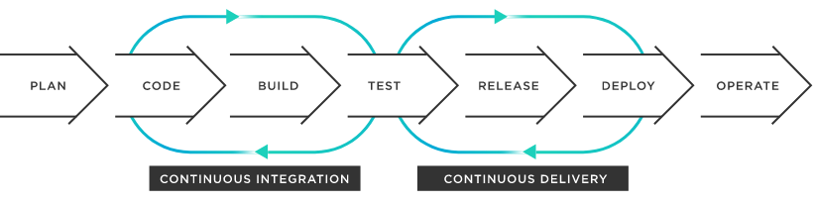
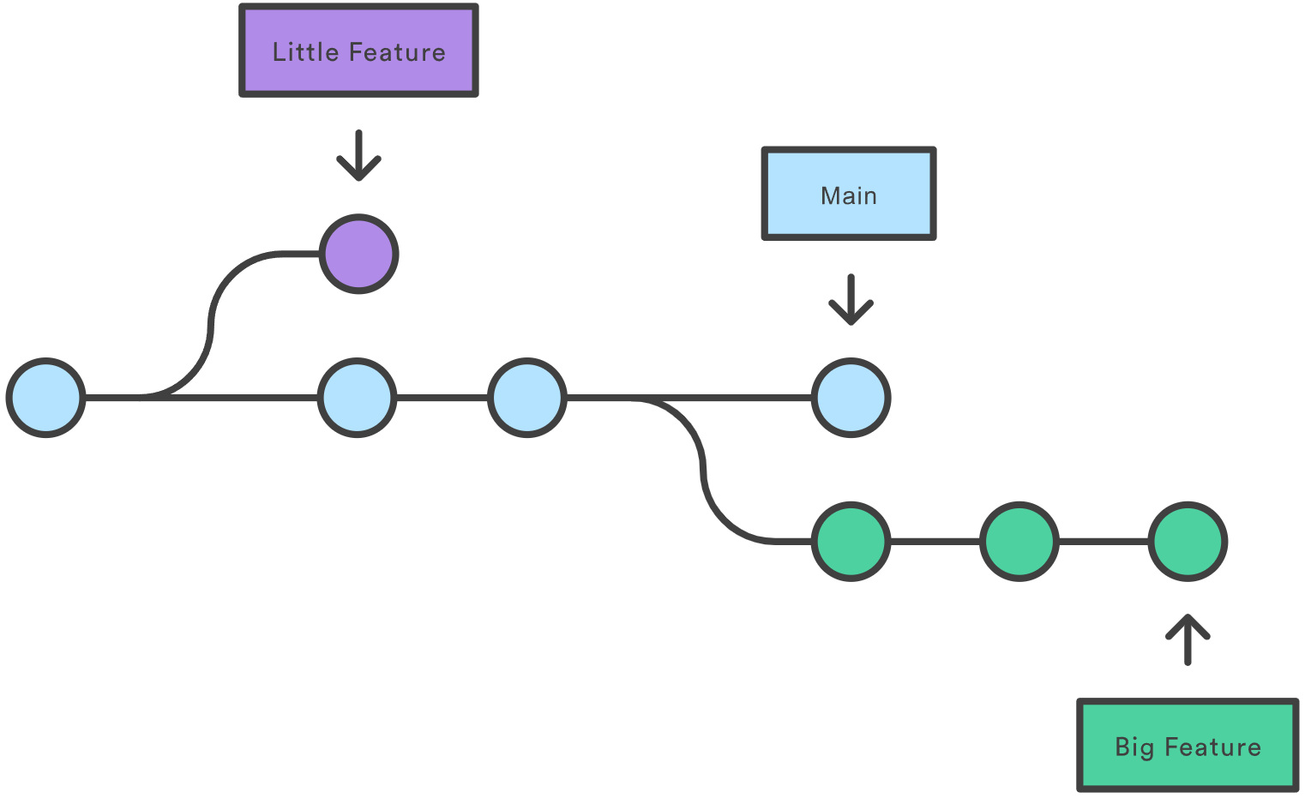
Development Life-Cycle

Slide 14
Scientists Educators
Students
Javascript
Python
Application Developers
C++/Go
Middleware/Service Developers
Infrastructure
Providers
Notes:
CHPC operates 6 clusters (2 over 7000 nodes, 3 with 1000-2100 nodes, 1 with only 150)

Slide 15
Containers/
Microservices/
Applications
Javascript
Python
C++/Go
Notes:
CHPC operates 6 clusters (2 over 7000 nodes, 3 with 1000-2100 nodes, 1 with only 150)

Slide 16
Orchestration
Containers/
Microservices/
Applications
Javascript
Python
C++/Go
Dev
Ops
Notes:
CHPC operates 6 clusters (2 over 7000 nodes, 3 with 1000-2100 nodes, 1 with only 150)

Slide 17
Orchestration
Containers/
Microservices/
Applications
Container Registries?
Docker,
Singularity
Packaging: NPM
MVC Frameworks: Vue/Rest/Angular
Code Quality: …
Javascript
Ansible
Kubernetes, Helm
Python
REST APIs
Monitoring
Logging
Packaging: PyPi
Guidelines: PEP, Manylinux
Code Quality: pytest, MyPy, Flake
…
C++/Go
Packaging/Libraries:
Code Quality:
…
Dev
Ops
Documentation
with Sphinx
(Breathe Doxygen Bridge for C++)
Notes:
CHPC operates 6 clusters (2 over 7000 nodes, 3 with 1000-2100 nodes, 1 with only 150)

Slide 18
Summary & Discussion
Committed to FAIR agile software development of microservices
Continuous …
Integration, Delivery and Deployment, Testing, Documentation, Monitoring
Reduce technologies to the bare minimum, but leverage existings solutions
Encapsulate complexity (containers) and focus on Interfaces/APIs
We certainly overlooked many details, so we would like to engage all of you!
Have a look yourself:
https://github.com/nsdf-fabric/sdlc

Slide 19
Not integrated (TODO)

Slide 20
Common Gotches
Security
Licences
Regressions
Deployment

Slide 21
Backup

Slide 22
Continuous Integration
Version Control
Development Workflows
Code Quality
Release Versioning
(in detail later: testing)
Git
Agile with with “git flow”
feature, release branches
Code Reviews
Semantic Versioning

Slide 23
Continuous Delivery and Deployment
Deployment
Containerization
and Microservices
integration HPC platfroms
=> Artifacts
Docker, Singularity
Kubernetes, Helm
Ansible
Package Repositories Language
Container Images

Slide 24
Continuous Testing
TDD overkill
but we can meet half-way
unit tests
code analysis
automation with CI
Best Practices for different languages:
C++
Python
Go

Slide 25
Continuous Documentation
Format
Documentation as Code
Code as Documentation
Code Examples
API Definition Standards
Markdown
“inline” = always updated
code speaks for itself
autogenerated
Jupyter
REST, OpenAPI

Slide 26
Continuous Monitoring
Granularity
Logging
Performance/Availability
QoS Optimization
Research Opportunity
Integration
Infrastructure, Applications, Network
Elastic Search
Prometheus/Grafana
Kubernetes+ Monitoring?

Slide 27
Software Security
Enforce Sensitivity
Enforce Security of CI
Enforce security of continuous deployment
Security Scans
Automatic Tools
We may store sensitive data
We expose attack surface because of our accounts across CI
Allow effortless revocation of credentials
Entropy/Play being the attacker
See Software Quality

Slide 28
Screenshots

