Slide 1
Intersecting Cybersecurity And Research Infrastructure: Partnership Not Rules
Michael Corn
UCSD Chief Information Security Officer
mcorn@ucsd.edu

Slide 2
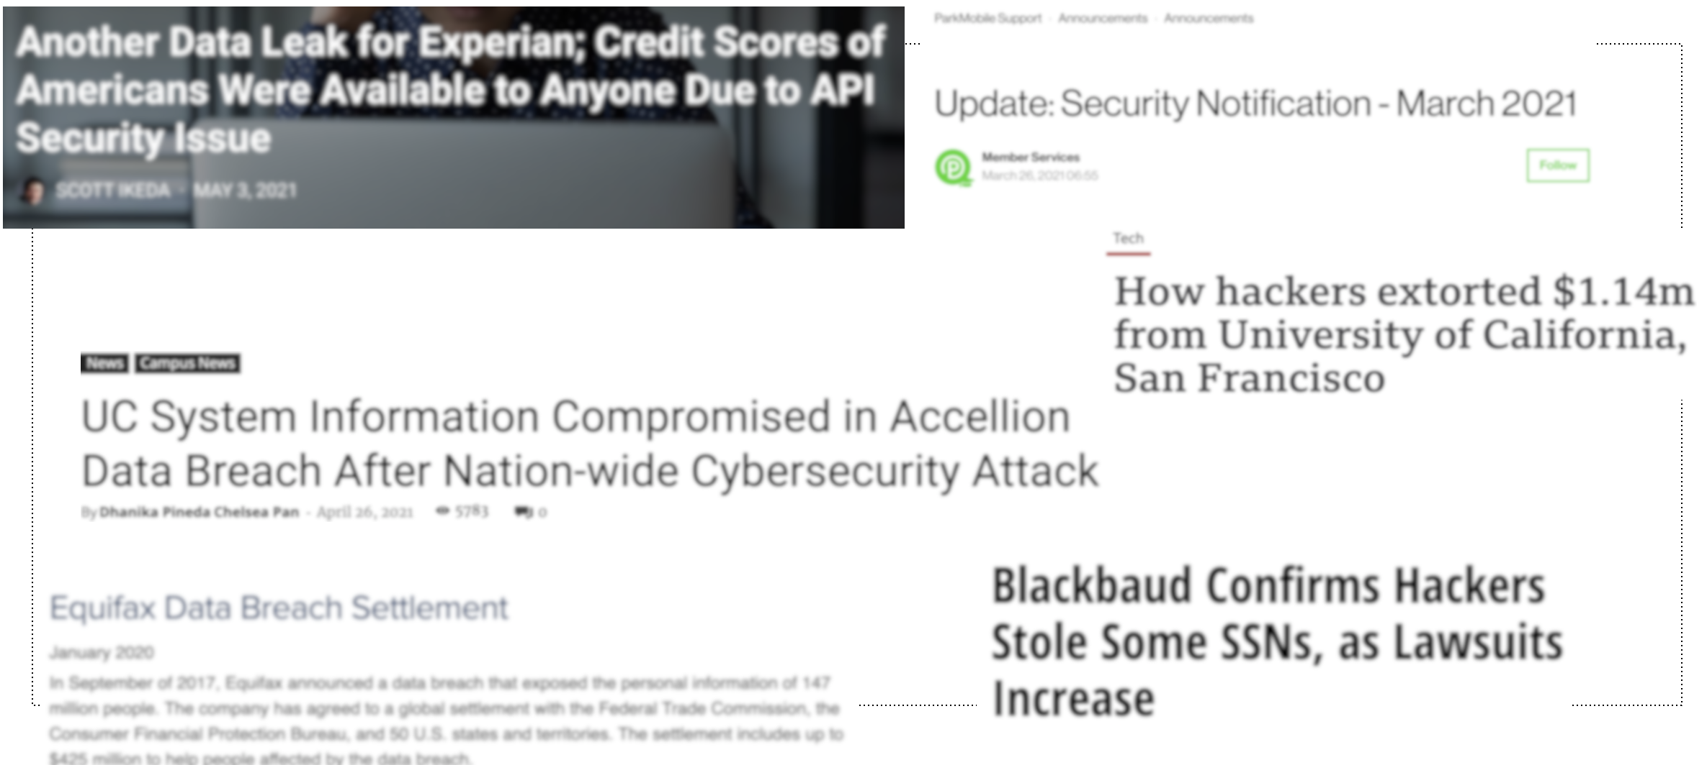
Why Am I Here?
No security porn
No hectoring of security professionals
In 2022, addressing cybersecurity concerns within research programs will require researchers to actively and aggressively include security in the design and implementation of scientific workflows

Slide 3


Securing Research Cyberinfrastructure: Challenges
Researcher Perceptions
IT is ‘free’
IT support = graduate students
I can buy it cheaper at Best Buy
I don’t need security, my data is public
Security Perceptions
It’s no different than enterprise security
We’re busy, we’ll be in touch
Why can’t you just use Windows?
Both cultures need
to change

Slide 4
Cybersecurity can no longer be considered merely a technical issue, But is an element of geopolitics

Slide 5
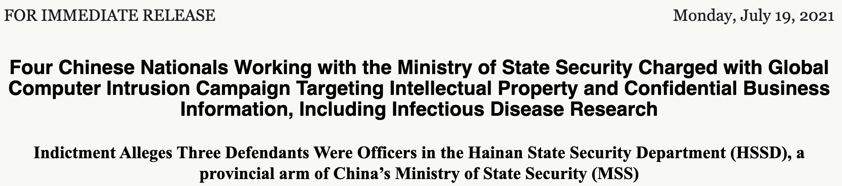
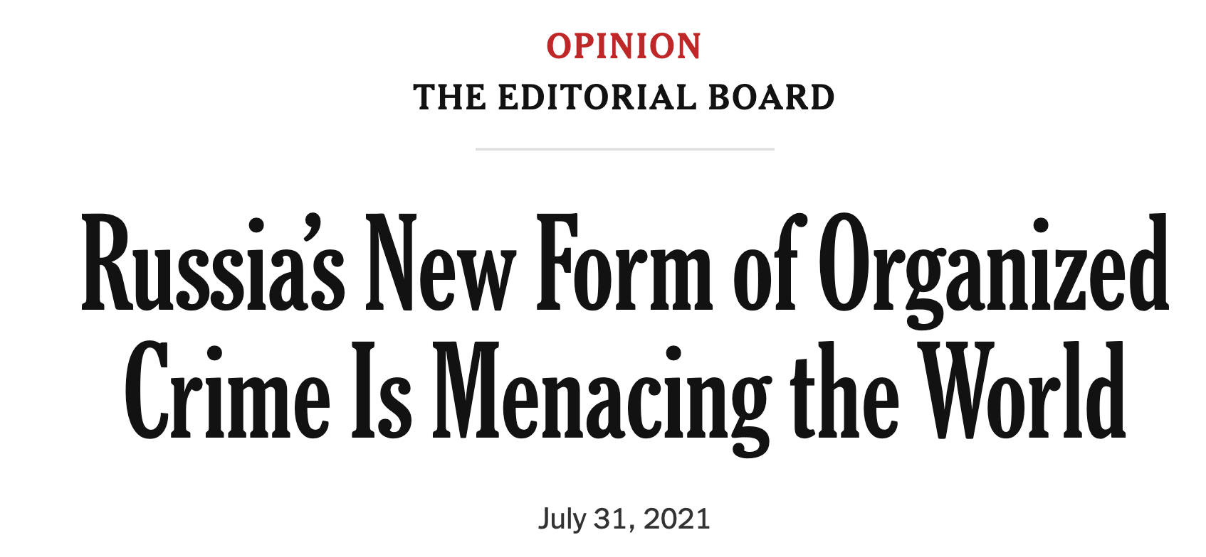
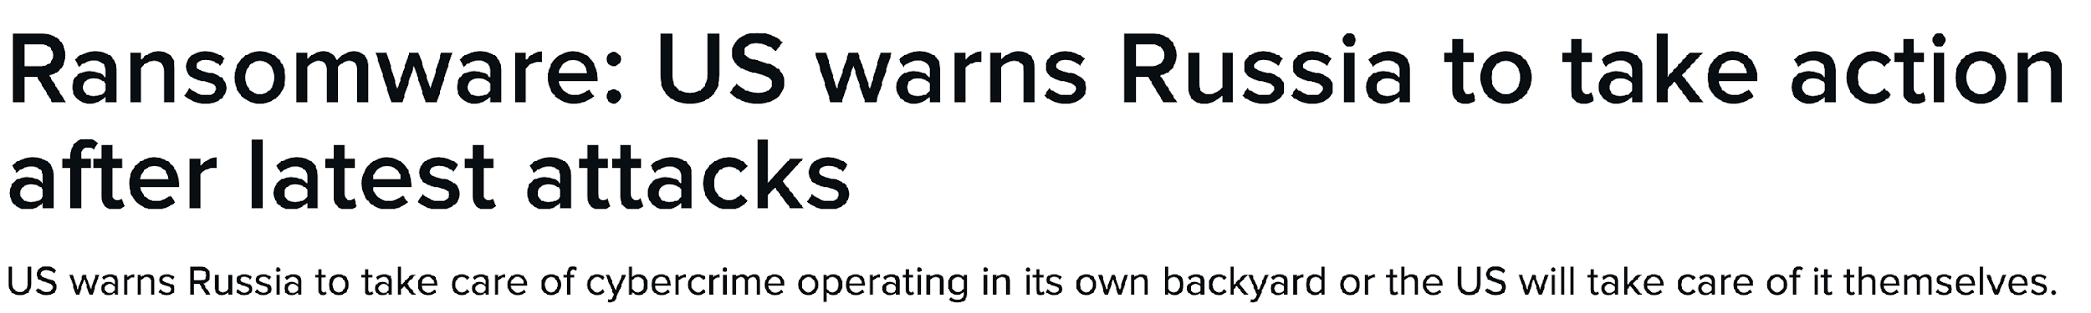
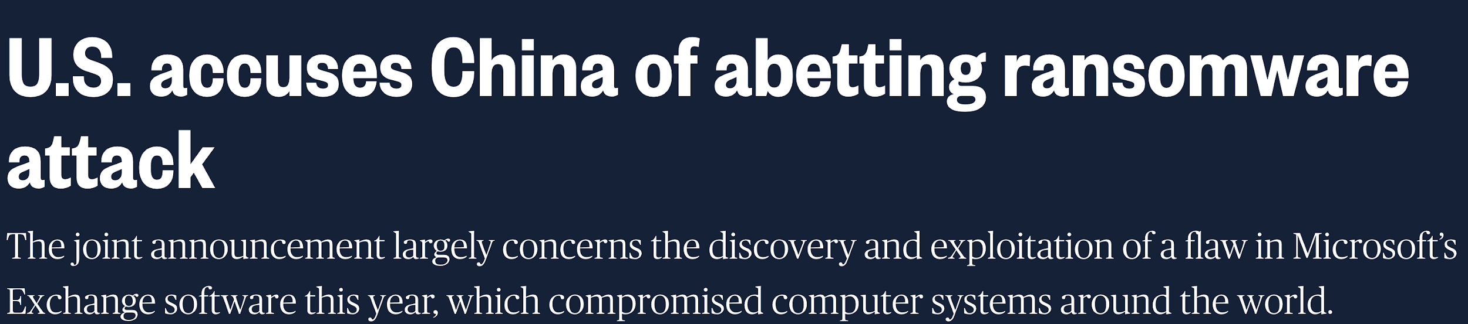

Slide 6
Research Is Existentially Threatened By Cyber
Loss of system availability
Loss of data collection
Loss of data integrity
Loss of reproducibility
Loss of third-party IP
Inability to submit new proposals
Potential career damage
Students unable to graduate
Regulatory fines
Reporting obligations to sponsors
Financial implications to third-party
Competitive disadvantage with sponsors
Reputational damage

Slide 7
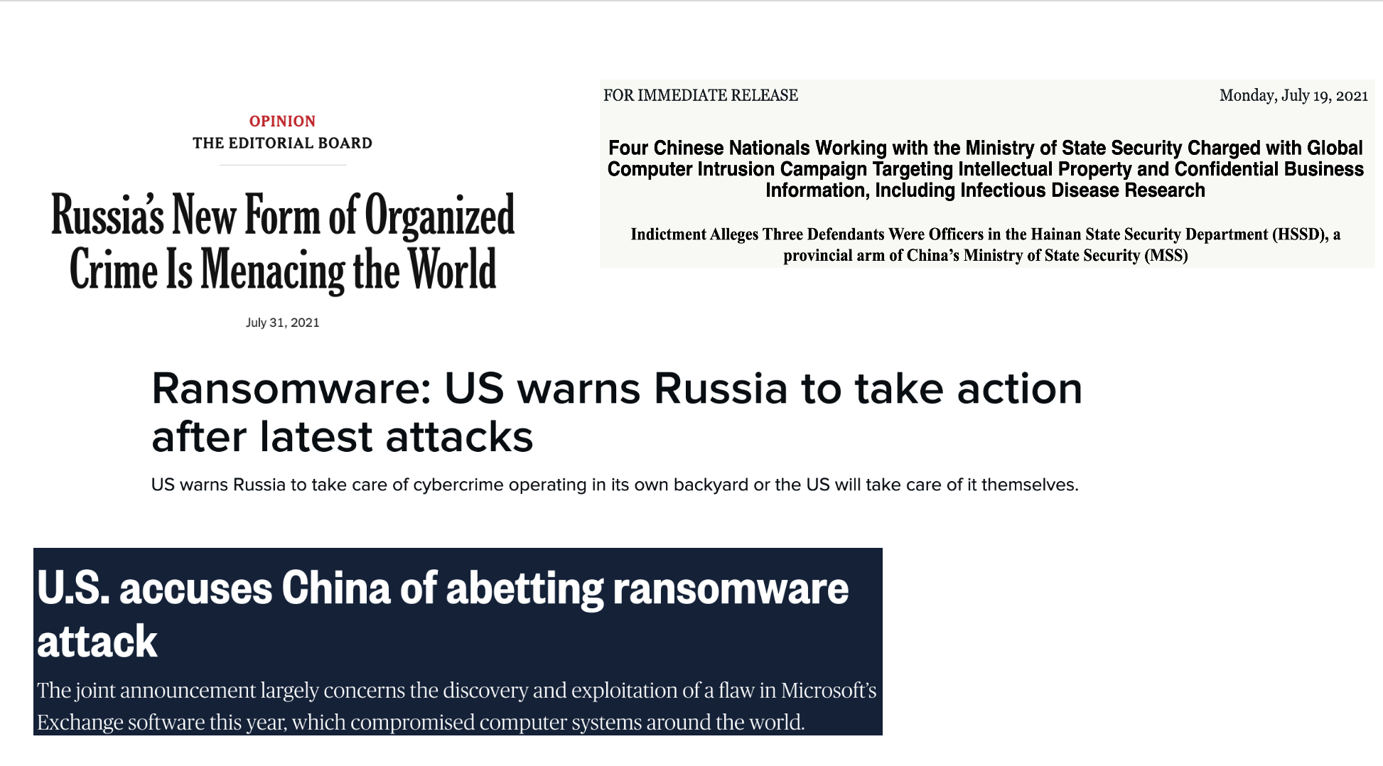
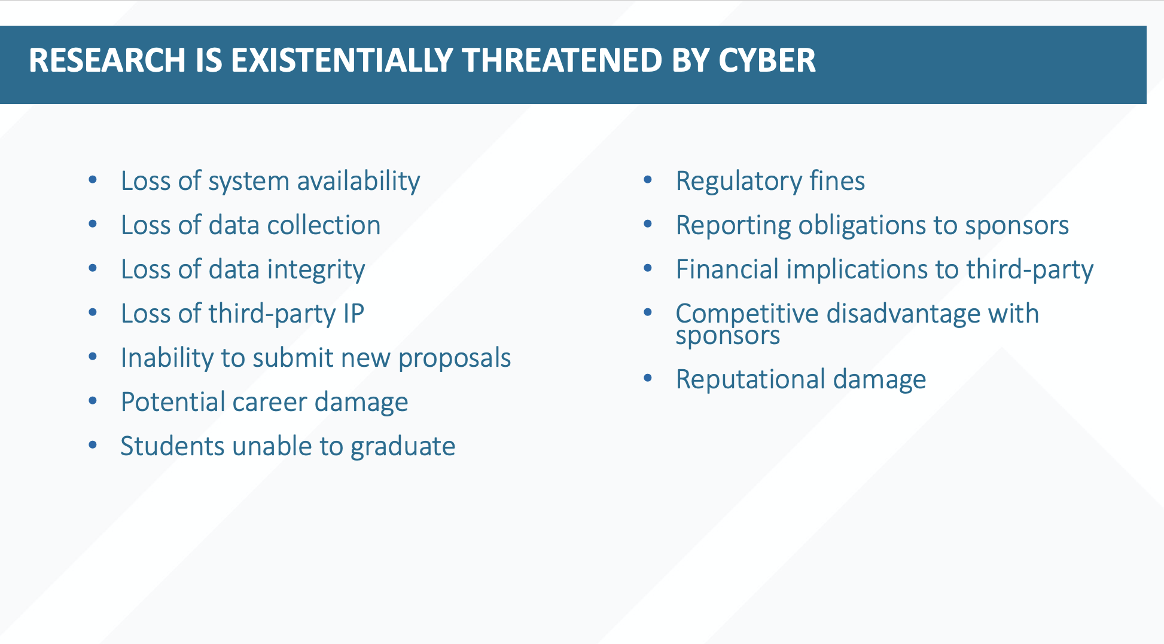
It’s not 1984 anymore – we need to treat research cyberinfrastructure through the contemporary cybersecurity lens

Slide 8
Yada, Yada, Yada
Federal Funding
Federal agencies have been ordered to enhance cybersecurity with explicit mandates
NDAA: https://blink.ucsd.edu/technology/security/ndaa/index.html
EO: https://www.whitehouse.gov/briefing-room/presidential-actions/2021/05/12/executive-order-on-improving-the-nations-cybersecurity/
NSPM-33: https://www.whitehouse.gov/wp-content/uploads/2022/01/010422-NSPM-33-Implementation-Guidance.pdf
No equipment manufactured by certain Chinese companies
Zero Trust security model writ large
Certification of compliance with security requirements
DoD: Cybersecurity Maturity Model Certification (CMMC)
Very closely monitored by NASA, NSF, NIH, DoE

Slide 9

Implications For Researchers And Research Programs
Cybersecurity regulations in grants and contracts: has little or nothing to do with PII
Tremendous pressure on campuses to embrace cybersecurity practices broadly
Governing boards will issue top-down mandates
Institutional officers will need to sign-off on security practices
Personal, i.e., non-institutional accounts will be expressly forbidden
External certifications of practice will be required
Documented security plans will be required
Background checks for all participants
Attempted imposition of ‘enterprise’ security controls
Larger programs will require dedicated security engineers

Slide 10

Resources
Center for Applied Research(CaCR) https://cacr.iu.edu/
TrustedCI https://www.trustedci.org/
Research Security Operations Center(RSoC) https://researchsoc.iu.edu/
Regulated Research Community of Practice (RRCoP) https://www.regulatedresearch.org/home
Ask CI (discord channel) https://ask.cyberinfrastructure.org/
Cybersecurity Certification for Research (CCR) https://assure.ucsd.edu
CMMC and Higher Ed: https://bit.ly/cmmc-2

