Slide 1





Stage 1 Status Report 29 October 2026 Beijing Institute of Technology Team: team
What happens between a sensor reading and a robot's action?
Sensor
Hardware
Network
Agent
Action
reads the world
executes the instructions
links devices when needed
chooses an action
changes the world
Three beginner modules, one traceable system: Hardware · Networks · Behaviorist AI
Notes:
0:00–0:15
What happens between a sensor reading and a robot's action? Our beginner materials connect Hardware, Networks and Behaviorist AI. The robot is a teaching connection. Reinforcement learning remains a proposed extension of the historical case.
Sources
https://github.com/nsdmlk/bit-ai-and-cs/blob/9e82ae9e29bd72842bbb15615cd4ef2954495709/CONTENT-OUTLINE.md
https://github.com/nsdmlk/bit-ai-and-cs/blob/9e82ae9e29bd72842bbb15615cd4ef2954495709/content/Behaviorist%20AI/ROBOT.md

Slide 2

Who we teach and what beginners will learn
Hardware
Networks
Behaviorist AI
CPU and memory
Instruction execution
IP and transport
DNS, DHCP, HTTPS, SSH
Agents and rewards
Q-learning and DQN
Intended learners
First-year BIT students
No prior course assumed
Enough to start
Everyday computer use
School arithmetic
A module map guides
each reading route.
Learning goal
Learning goal
Learning goal
Trace an instruction.
Explain which register changes and why.
Trace a fresh HTTPS request.
Explain the role of each protocol.
Calculate a Q-learning update.
Explain how reward affects an estimate.
Source: CONTENT-OUTLINE.md (outcomes 1-6) and the three module OUTLINE.md maps
Notes:
0:15–0:32
We write for first-year BIT students. The goals are practical: trace an instruction, explain an HTTPS request, and calculate a Q-learning update. Each module supplies a reading map and defines its prerequisites.
Sources
https://github.com/nsdmlk/bit-ai-and-cs/blob/9e82ae9e29bd72842bbb15615cd4ef2954495709/CONTENT-OUTLINE.md

Slide 3
Current progress
Hardware
Networks
Behaviorist AI
34
9
6
intro + 33 lessons
in 9 sections
chapters, overview to SSH
chapters, agents to robotics
179 explained answers
35 local SVG figures
ADD / LOAD traces
30 explained answers
2 local SVG figures
HTTPS request trace
20 explained answers
2 local SVG figures
Q-learning episode
Drafted & revised · review pending
Drafted & revised · review pending
Drafted & revised · review pending
Completed in source
Drafts, worked examples, answer keys, 39 SVG figures, module maps and project records.
Still to finish
Independent content review (A11), syllabus check, rehearsal and offline playback test.
Planned for Stage 2
Study Guide integration and tutorial videos. Stage 2 is due 7 November.
49 learner texts. Source: module maps and TASKS.md. Snapshot: main 9e82ae9, checked 29 October.
Notes:
0:32–0:56
The repository contains 49 learner texts across the three modules, with answer keys and 39 local SVG figures. These are drafted and revised materials. Independent content review, syllabus confirmation and classroom preparation still remain. Study Guide integration is planned for Stage 2.
Sources
https://github.com/nsdmlk/bit-ai-and-cs/blob/9e82ae9e29bd72842bbb15615cd4ef2954495709/README.md
https://github.com/nsdmlk/bit-ai-and-cs/blob/9e82ae9e29bd72842bbb15615cd4ef2954495709/project-management/TASKS.md

Slide 4
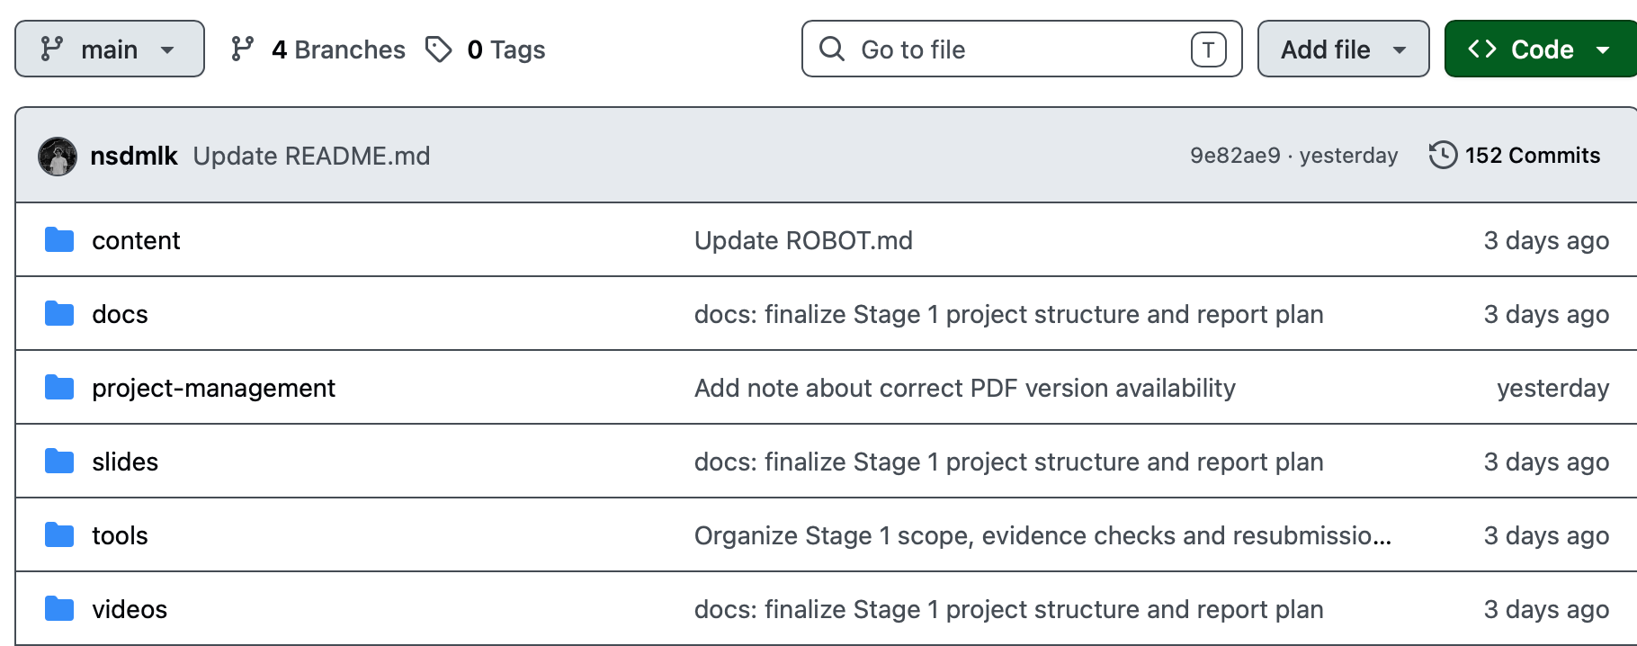
Repository organisation
github.com/nsdmlk/bit-ai-and-cs
GitHub main, 9e82ae9. Team screenshot from 29 October. Files are embedded for offline presentation.
Notes:
0:56–1:15
This is the actual main branch. Content, project-management, slides and video plans have separate places. The screenshot identifies the snapshot, so the audience can connect our claims to a specific version. We embedded it for offline use.
Sources
https://github.com/nsdmlk/bit-ai-and-cs/tree/9e82ae9e29bd72842bbb15615cd4ef2954495709

Slide 5
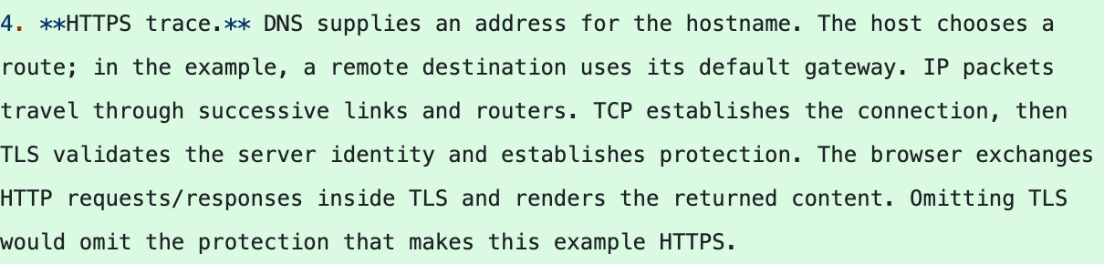
A meaningful change: explained answers
26 October 2026 Commit ac5dd0a content/Networks/ANSWER-KEY.md
Earlier draft: questions referred to an answer resource that was still to come.
Revision: 30 explained answers, including the missing TLS step.
A learner can now check the reasoning after trying the question.
Green lines show a real addition in ac5dd0a. INTRODUCTION.md links its questions to this answer key.
Notes:
1:15–1:42
Here is a meaningful change from 26 October. The earlier introduction referred learners to answers that were still to come. This commit adds 30 explained answers. The green excerpt traces HTTPS through routing, TCP and TLS, including server identity validation. Learners can now check why an answer is correct.
Sources
https://github.com/nsdmlk/bit-ai-and-cs/commit/ac5dd0a35cf7dd8aeb5ad47a04935fea01d3a55d
https://github.com/nsdmlk/bit-ai-and-cs/blob/65f8cc79eecc34c5e675eb7749e7600ab4b2d7ce/content/Networks/INTRODUCTION.md

Slide 6
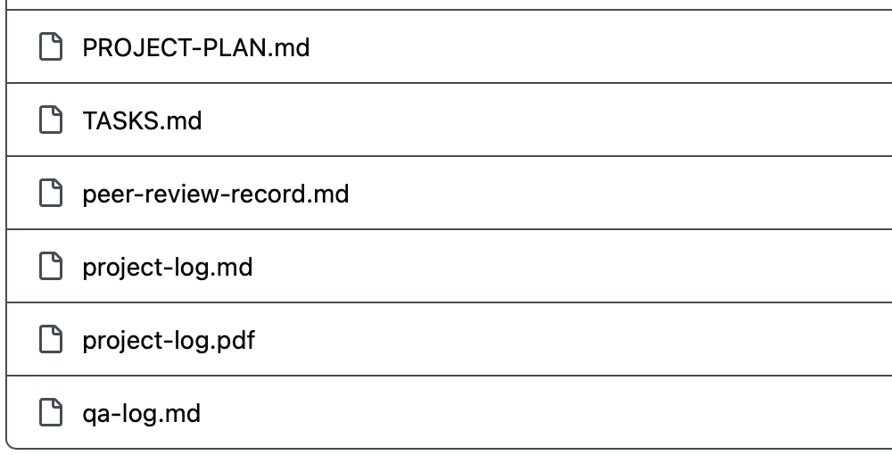
What the team review changed
25 October: team architecture review
We had chapters, but the shared plan and evidence trail were unclear.
The revision added module maps, tasks and a review record.
One important item remains open: independent content review
Sources: peer-review-record.md and TASKS.md, main 9e82ae9. AI checks support the revision; team content review remains pending.
Notes:
1:42–2:05
Our team review identified a weakness: chapters alone did not make the shared plan and evidence trail clear. The revision added maps, tasks and review records. The actual task row also shows what remains unfinished. Alimzhan's independent check is pending. AI checks do not replace it.
Sources
https://github.com/nsdmlk/bit-ai-and-cs/blob/9e82ae9e29bd72842bbb15615cd4ef2954495709/project-management/peer-review-record.md
https://github.com/nsdmlk/bit-ai-and-cs/blob/9e82ae9e29bd72842bbb15615cd4ef2954495709/project-management/TASKS.md

Slide 7

Stage 2 priorities, due 7 November
1
Independent human review
2
Scope and Study Guide
3
Tutorial videos
Alimzhan checks the three teaching anchors and records real findings in qa-log.md.
Confirm syllabus coverage. Integrate the checked chapters into one Study Guide.
Develop the module storyboards into tutorials that match the reviewed Markdown.
A11: pending review
Task A16 · planned
Stage 2 media: planned
Before class: rehearse under 4:00, test the extracted USB folder, then submit the version used in class. These checks remain to be done.
Notes:
2:05–2:26
For Stage 2, due November seventh, we will complete that review, confirm syllabus coverage and integrate a Study Guide. Tutorial videos will follow the checked material. Before this classroom report, we still need a complete rehearsal and a USB playback test.
Sources
https://github.com/nsdmlk/bit-ai-and-cs/blob/9e82ae9e29bd72842bbb15615cd4ef2954495709/project-management/TASKS.md

Slide 8
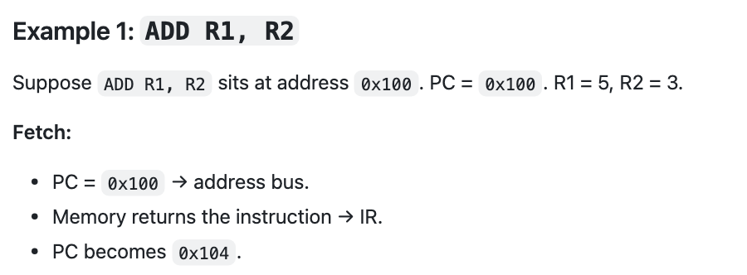
The actual Markdown example
content/Hardware/03 Fetch Decode Execute/05-worked-examples.md
State | Before | After
PC | 0x100 | 0x104
IR | — | ADD R1, R2
R1 | 5 | 8
R2 | 3 | 3
Decode reads ADD and its operands.
Execute adds 5 + 3 and writes 8 into R1.
Teaching model: 4-byte instructions, straight-line execution. The result table shows the full instruction.
Notes:
2:26–3:00
This is a screenshot of our actual Markdown chapter. ADD starts at address hexadecimal one hundred, with register values five and three. Fetch puts the instruction in the instruction register and advances the program counter by four bytes. Decode identifies the operation and operands. Execute writes eight into R1. R2 stays three. Our teaching model states its assumptions explicitly.
Sources
https://github.com/nsdmlk/bit-ai-and-cs/blob/9e82ae9e29bd72842bbb15615cd4ef2954495709/content/Hardware/03%20Fetch%20Decode%20Execute/05-worked-examples.md

Slide 9

Your turn: predict the result
Check yourself, question 1
ADD R5, R6 sits at address 0x300. R5 = 7, R6 = 2.
What are R5, R6 and the PC after the instruction executes?
R5 = ?
R6 = ?
PC = ?
Teaching model: 4-byte instruction, PC initially 0x300, straight-line execution. Predict before checking the answer.
Notes:
3:00–3:13
Now try the chapter's own question. R5 starts at seven and R6 at two. What changes after ADD, and where does the program counter point?
Pause for 3 seconds before showing the answer.
Sources
https://github.com/nsdmlk/bit-ai-and-cs/blob/9e82ae9e29bd72842bbb15615cd4ef2954495709/content/Hardware/03%20Fetch%20Decode%20Execute/05-worked-examples.md#5-check-yourself

Slide 10

The explained answer
Check yourself, question 1
ADD R5, R6 sits at address 0x300. R5 = 7, R6 = 2.
Fetch moves the PC on by one 4-byte instruction; execute writes the sum into the destination R5; the source R6 is only read.
R5 = 9
R6 = 2
PC = 0x304
7 + 2, written back
unchanged, read only
0x300 + 4
Source: Hardware/ANSWER-KEY.md, h03-05, Q1. The key explains the result for every register and the PC.
Notes:
3:13–3:29
R5 becomes nine. R6 stays two because the instruction only reads it. The program counter becomes hexadecimal three hundred and four. The answer key explains each result.
Sources
https://github.com/nsdmlk/bit-ai-and-cs/blob/9e82ae9e29bd72842bbb15615cd4ef2954495709/content/Hardware/ANSWER-KEY.md#h03-05

Slide 11
The same approach across three modules
Hardware
Networks
Behaviorist AI
State
State
State
ADD R1, R2
PC 0x100, R1 = 5, R2 = 3
Fresh HTTPS over TCP
Configured host, no cached answer
Q(A,X) = 20, reward = 10
B nonterminal, max Q(B,·) = 50
Transition
Transition
Transition
Fetch → Decode → Execute
DNS, routing, TCP, then TLS
HTTP inside TLS
α = 1, γ = 0.9
target = 10 + 0.9 × 50 = 55
Result
Result
Result
R1 = 8, R2 = 3
PC = 0x104
Validated server identity
Protected HTTP content in transit
Qnew = 20 + 1 × (55 − 20) = 55
One table entry updates
Predict first. Check the explanation.
github.com/nsdmlk/bit-ai-and-cs Stage 2 due 7 November 2026
Notes:
3:29–3:47
This same approach connects the modules: trace a state change, predict its result and check the explanation. It works for a CPU instruction, a protected web request and an action-value update.
Sources
https://github.com/nsdmlk/bit-ai-and-cs/blob/9e82ae9e29bd72842bbb15615cd4ef2954495709/content/Networks/INTRODUCTION.md
https://github.com/nsdmlk/bit-ai-and-cs/blob/9e82ae9e29bd72842bbb15615cd4ef2954495709/content/Behaviorist%20AI/Q-LEARNING.md#5-worked-episode-retaining-the-result-55

