Slide 1


Home Loans AutoML vs Bespoke ML (EDA, modelling, & evaluation)
23rd December, 2022

Slide 2
TEXT LAYOUT 1
Agenda
Data Science Lifecycle​
Project Overview​
Data
Analysis
Modeling
Model Evaluation
Recommendations

Slide 3
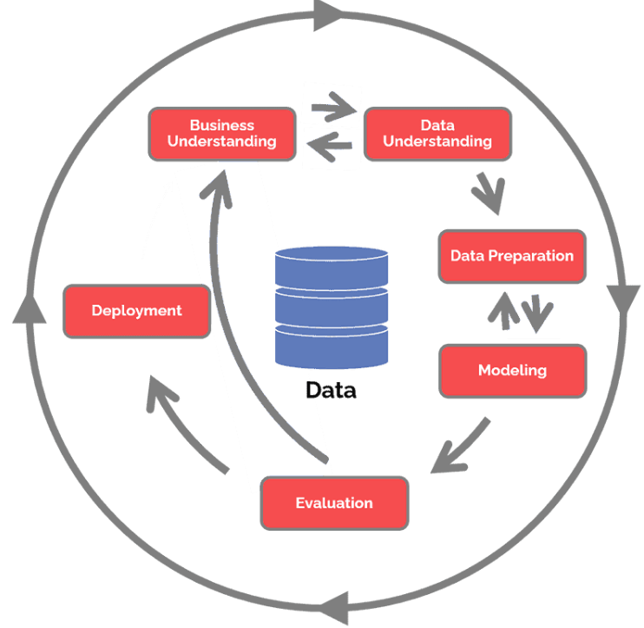
Data Science Lifecycle
Examine historical data for trends/characteristics. Evaluate model with unseen data
Identify business problem & determine model
Clean data for analysis/modelling
Deploy selected model to streamline & speedup process
Use AutoML & bespoke ML to train models, comparing performances.
Evaluate all trained models using accuracy & confusion matrix

Slide 4
TEXT LAYOUT 1
Project Overview
Business Problem: Home loan officers manually process home loans.
Business Objective: To streamline the loan application process
Hypothesis: We can use ML to train a classification model that can predict the outcome of a home loan application with an accuracy of up to 82%.

Slide 5
Project Overview
Business Problem: 2-3 days are required to determine the outcome of a mortgage application.
Business Objective: To allow the loan applicant to receive a decision quickly after applying.
Hypothesis: With ML, we can apply a model to new/unseen client data and make a judgement on a loan application within nanoseconds.

Slide 6








TEXT LAYOUT 1
Process Overview / Solution
Exploratory Data Analysis
Data passes into trained model
Data transformation
Data Cleaning
Model determines if applicant will default or not
Data Loading
Loan application
Decision to grant loan is reached

Slide 7
Data
Test.csv (Unseen data)
Serve as potential loan applicant data
Data is labelled using trained model
Comma-separated values Excel format
22 Kb in size
Consists of 367 instances
Each instance consists of 12 features
Data types are object(categorical), & float64(integer)
Train.csv (historical dataset)
Used to train/validate the model
Comma-separated values Excel format
38 Kb in size
Consists of 614 instances
Each instance consists of 13 features
Data types are object(categorical), & float64(integer)

Slide 8
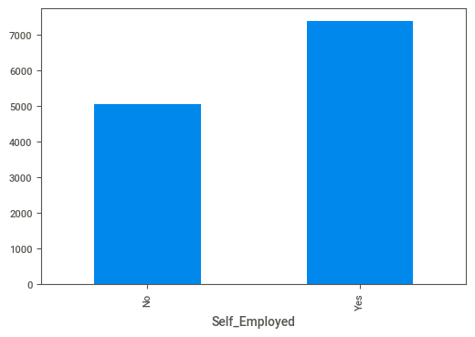
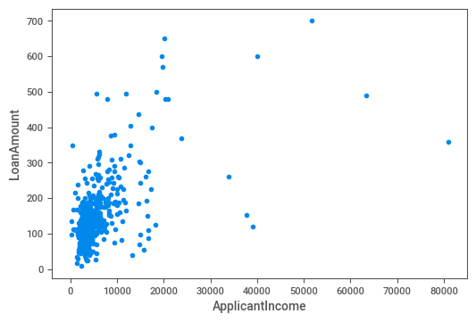
TEXT LAYOUT 1
Analysis
Average incomes of Employed vs Self-Employed
The self-employed earn more on average than the employed
Self-employed average income is ~7300
Average income of employed is ~5000
Correlation between applicant income & loan amount applied for.
There is a fairly good correlation between income and loan amount applied for.
The insights from these results indicate that the self-employed tend to apply for higher loans than the employed

Slide 9
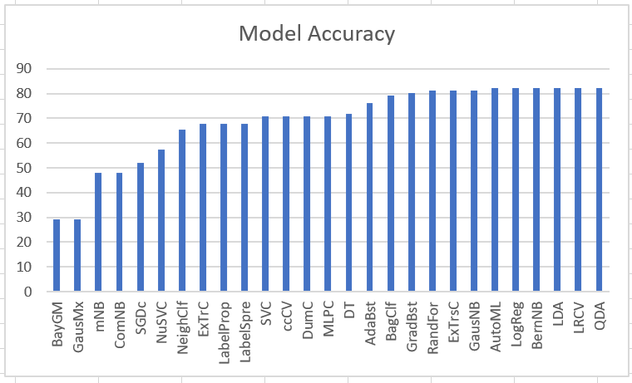
Modeling
A comparison of the 27 models trained shows that in terms of accuracy, LogisticRegression, BernoulliNB, LDA, LRCV,QuadDA performed best ~82% alongside the AutoML

Slide 10
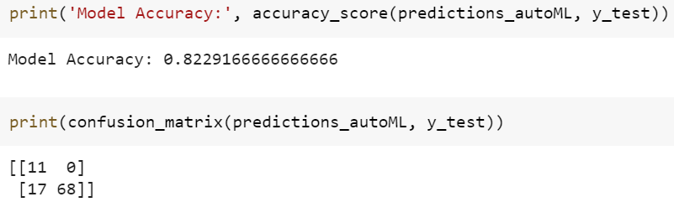
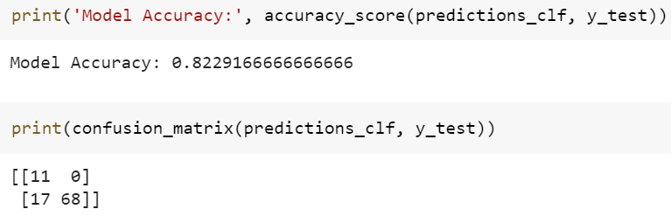
Model Evaluation
AutoML results
Accuracy = 82.29%
Logistic ML results
Accuracy = 82.29%
Here we show the accuracy & confusion matrix results of the Logistic Regression Model, one of our best performing models

Slide 11
TEXT LAYOUT 1
Recommendations
The Logistic Regression Model is a simple model
It had the same accuracy with the AutoML
It had the same confusion matrix with the AutoML
However, it trained faster than the autoML
Based on these, Logistic Regression is the recommended model to use

