Slide 1
British Airways: Web scraping to gain company insights
Scrape and analyze customer review data to uncover findings for British Airways
https://colab.research.google.com/drive/1Ev6hhfKp7L4ml9gQEFsQf_hgJ1bWy9qI#scrollTo=cVaLHLIWpRE9

Slide 2
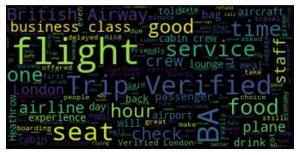
Avg sentiment & Word Cloud
Average sentiment: 0.08
Sentiment from -1 (very negative) to 1 (very positive)
Overall sentiment of the reviews is slightly positive.
Positive words are present but not necessarily dominating reviews.
Context is important in interpreting sentiment values
Neutral words dominate the word cloud
Some positive words like “good”, “nice”
Negative words like “delayed”

