Slide 1
Sentiment Analysis of Nigeria’s Economic News (2021–Present)
Analyzing Media Tone & Economic Narratives
Presented by: InternPulse Data Analyst Track
Group 6
Date: April 2025

Slide 2
Project Objective
• Understand sentiment trends in Nigeria's economic media coverage.
• Analyze emotional tone over time and its influence on public and investor perception.
• Key Questions:
- What general sentiment dominates economic reporting?
- Has sentiment shifted over time?
- How does media tone align with economic realities or investor confidence?

Slide 3
Research Summary
• Articles Analyzed: 7,760 (2021–2025)
• Source: BusinessDay Nigeria
• Scraping Method: Selenium
• Features Extracted: Title, Author, Publication Date, Article Excerpt
• Time Frame: 2021 to Present

Slide 4
Sentiment Distribution
• Positive – 39.1% (3,038 articles)
• Neutral – 38.8% (3,007 articles)
• Negative – 22.1% (1,715 articles)
Interpretation:
• 78% of articles are non-negative.
• Positive sentiment reflects growth narratives.
• Negative sentiment still relevant – inflation, debt, etc.

Slide 5
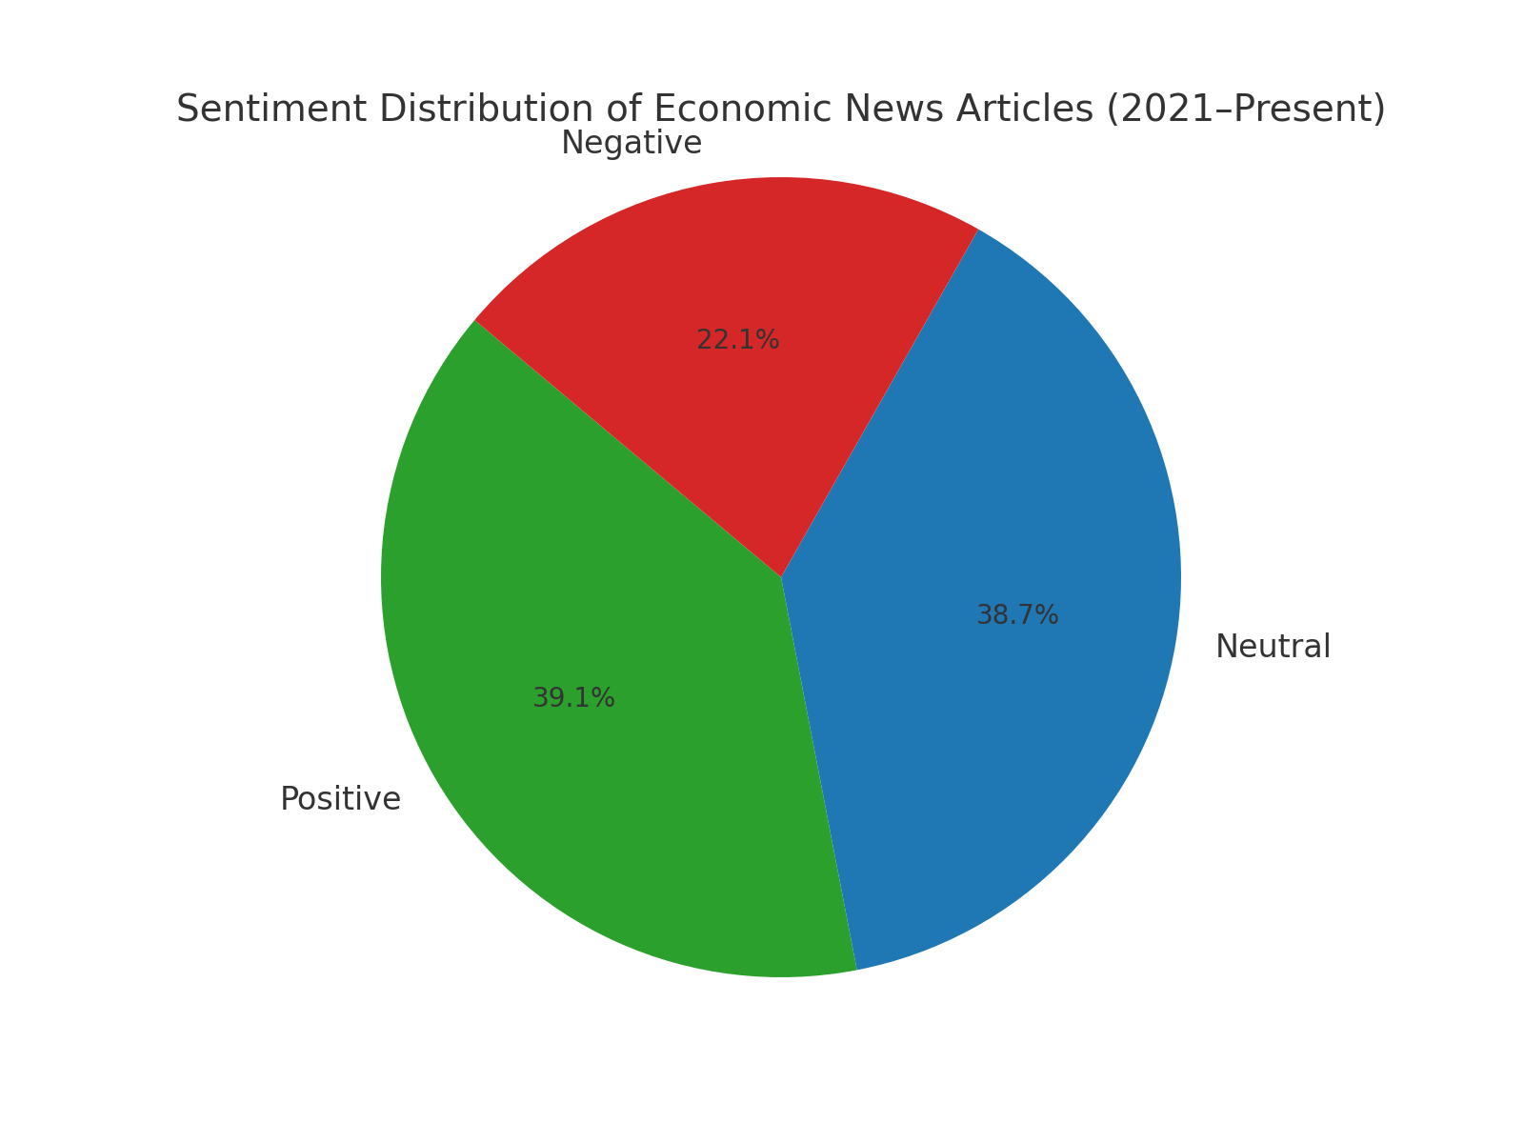

Slide 6
Interpretation of Results
• Positive Sentiment Drivers: Reforms, investments, GDP growth
• Neutral Articles: Informative tone, factual reporting
• Negative Highlights: Economic downturns, insecurity, debt crisis
• Media’s Role: Media tone as a proxy for public & investor sentiment

Slide 7
Methodology Overview
1. Data Collection using Selenium
2. Preprocessing: lowercasing, lemmatization, stopword removal
3. Sentiment Classification: TextBlob polarity scoring
Tools & Libraries: Python, Pandas, NLTK, TextBlob, Matplotlib, Seaborn

Slide 8
Challenges & Solutions
• Cloudflare bot detection: Rotating user agents, randomized delays
• JavaScript rendering: Used Selenium
• Timeout/Failures: Implemented retry logic and error handling

Slide 9

Key Findings Summary
• Predominantly Positive/Neutral sentiment
• Media shows resilience & optimism
• Negative tone reflects key economic concerns
• Sentiment analysis is useful for economic forecasting

Slide 10
Recommendations & Future Work
• Year-over-Year sentiment trend analysis
• Add Named Entity Recognition (NER)
• Perform Topic Modeling (LDA/BERTopic)
• Develop an Interactive Dashboard (Streamlit/Dash)

