Slide 1
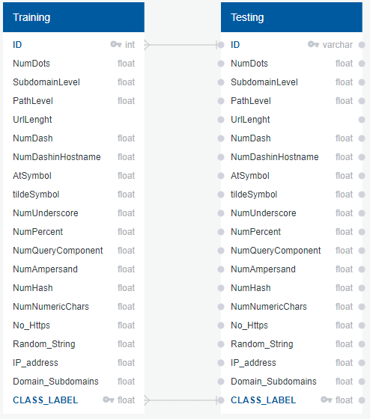
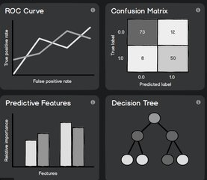
Dataset
Original database 50 futures, we will use 20
The original data gets split in two tables: Training 70% and Testing 30%
With our machine learning model, we will identify which sites are phishing sites and which ones are safe

