Slide 1
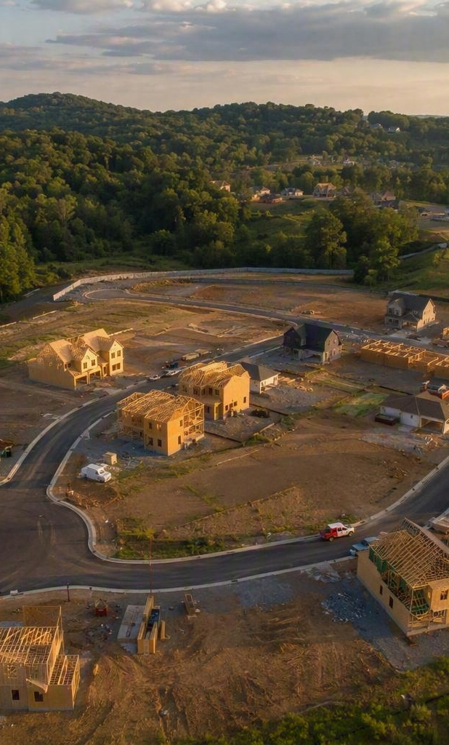
Residential Construction in Middle Tennessee
CAPSTONE ANALYSIS | 2020–2025
Growth drivers, price appreciation, permit supply, and where to build next across Davidson, Williamson, Rutherford, Sumner, and Maury counties.
by Nick Segui

Slide 2
Core Drivers of Growth
01
02
03
In-Migration & Job Growth
Constrained Supply
Exurban Migration Pattern
High net migration from out-of-state buyers and sustained regional employment growth drove primary housing demand across Middle Tennessee.
Supply deficits from a decade of post-2008 underbuilding exacerbated price increases during the initial 2020–2022 surge.
High land prices and tight inventory in Davidson County pushed demand outward into outer-ring counties: Rutherford, Williamson, Sumner, and Maury.
Middle Tennessee Residential Market Analysis | 2

Slide 3
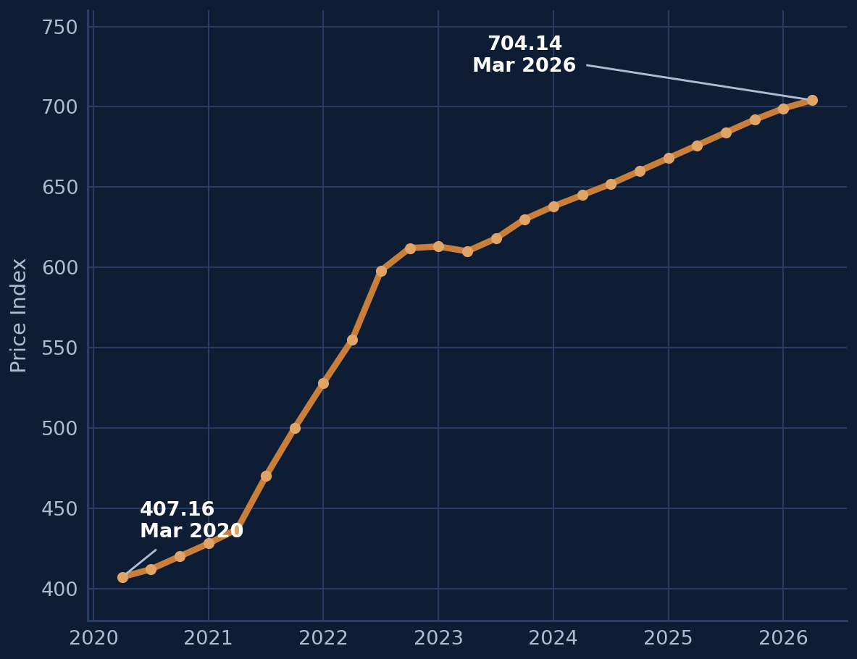
Home Price Appreciation, 2020–2025
Maury & Rutherford
LEADING OUTER MARKETS
Strongest percentage price appreciation. Entry-level price points allowed rapid percentage gains as spillover buyers sought affordability outside Davidson.
Williamson
CORE PREMIUM MARKET
Highest overall dollar prices ($900k+ median), maintaining high appreciation totals on an absolute dollar basis.
Davidson
CORE URBAN MARKET
Slower relative appreciation rates due to higher initial price baselines and rising inventory levels.
Housing Price Index, Mar 2020 – Mar 2026: 407.16 → 704.14
Middle Tennessee Residential Market Analysis | 3

Slide 4
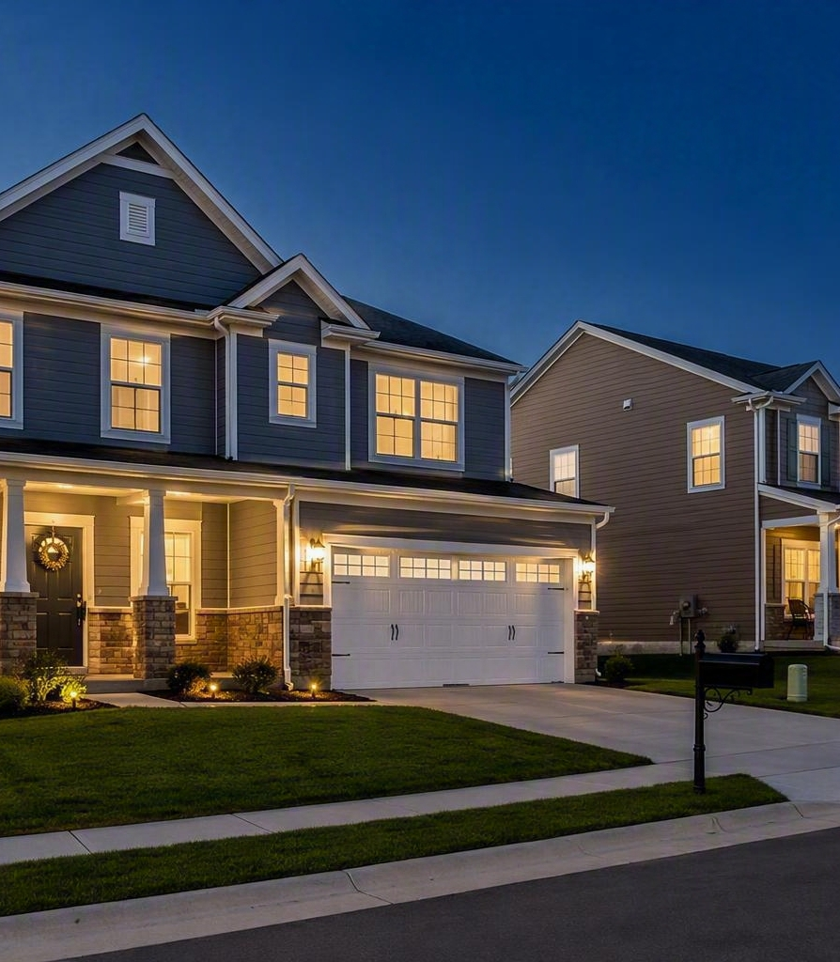
Population Growth vs. Price Appreciation
Direct correlation
High percentage population growth in outer-ring counties directly drove steep home price increases.
In-migration affordability effect
Out-of-state buyers relocating with higher household incomes pushed price limits upward faster than local wage growth alone could support.
Demand spillover
As Davidson hit inventory ceilings, growth spilled south along the I-65 and I-24 corridors, accelerating appreciation in Maury and Rutherford.
Middle Tennessee Residential Market Analysis | 4

Slide 5
Building Permits vs. Demand
Permits issued per 1,000 residents, 2020–2021
SUPPLY VS. DEMAND DYNAMICS
Davidson — High baseline with a modest dip — permits lagged rapidly growing multi-family and single-family demand.
Maury — Aggressive permitting attempted to catch rapid population inflows.
Rutherford — High permitting activity, yet the market remained the tightest in core submarkets.
Sumner — Moderate permitting matched suburban expansion; balanced inventory.
Williamson — Zoning and land constraints kept permits below surging buyer demand.
Middle Tennessee Residential Market Analysis | 5

Slide 6
Opportunities for Future Development
TIER 1
TIER 2
TIER 3
High-Yield Development
High-Margin Luxury
Infill & Multi-Family
Maury & Rutherford
Williamson
Davidson & Sumner
Strengths
Strengths
Strengths
Rapid population expansion, lower entry costs, strong job corridors, sustained absorption rates.
Lowest unemployment, highest median household incomes, strong equity cushion.
Large population baselines, consistent employment, steady suburban demand.
Middle Tennessee Residential Market Analysis | 6

Slide 7
Recommended Product Strategy by Tier
Tier | Target Market | Product Opportunity
Tier 1 | Maury & Rutherford | Entry-to-mid-level single-family homes and build-to-rent developments to capture spillover workforce demand.
Tier 2 | Williamson | Custom luxury, high-end infill, and master-planned upscale developments.
Tier 3 | Davidson & Sumner | Middle-density infill — townhomes and condos — plus redevelopment projects.
Middle Tennessee Residential Market Analysis | 7

Slide 8
Key Takeaways
01
Demand outruns supply
02
Growth moved outward
Migration and job growth met a decade of underbuilding — the deficit still anchors pricing power across the region.
Davidson's price and inventory ceilings pushed buyers down the I-65 and I-24 corridors into Maury and Rutherford.
03
Permits tell the tightness story
04
Build where the spillover lands
Maury permitted most aggressively; Williamson's zoning and land constraints kept supply well below demand.
Attainable single-family and build-to-rent in Tier 1, luxury in Williamson, and middle-density infill in Davidson and Sumner.
Middle Tennessee Residential Market Analysis | 8

