Slide 1
Absolute Real Time system:
event
valid response
invalid response
invalid response
Time
Hard Real Time system:
event
valid response
invalid response
Time
Soft Real Time system:
tolerance
event
valid response
invalid response
Time

Slide 2
RT Task
RT Task
Non RT Task
Non RT Task
RT Task
Operating System
Preemption soft
“NORMAL” KERNEL
RT KERNEL
Priority
HARDWARE

Slide 3
thread #
priority
# of cycles
last measured jitter (µs)
T: 0 ( 557) P:99 I:1000 C:32482 Min: 6 Act: 23 Avg: 14 Max: 36
T: 1 ( 558) P:99 I:1500 C:21654 Min: 6 Act: 22 Avg: 14 Max: 36
T: 2 ( 559) P:99 I:2000 C:16241 Min: 7 Act: 21 Avg: 14 Max: 45
T: 3 ( 560) P:99 I:2500 C:12993 Min: 7 Act: 27 Avg: 14 Max: 36
T: 4 ( 561) P:99 I:3000 C:10827 Min: 6 Act: 25 Avg: 14 Max: 42
pid of the thread
interval between 2 scheduled tasks (µs)
minimal jitter
(µs)
average jitter
(µs)
maximal jitter
(µs)

Slide 4
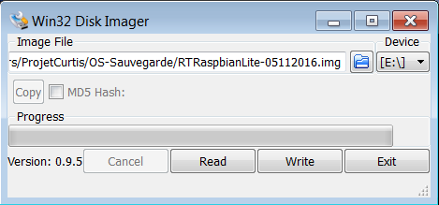
Chosen peripheral
File path
Read card and save it in file
Write on card selected file

