Slide 1


Slide 2
Sabre
Ansible

Slide 3
Ansible
Introduction to Ansible
Installation of Ansible Ansible Basics
Ansible Demonstration

Slide 4
Introduction to Ansible
Ansible is a simple IT Automation platform that makes applications and systems easier to deploy
It supports configuration management with examples as below
Configuration of Servers
Application Deployment
Continuous testing of already installed application
Provisioning
Orchestration
Automation of tasks

Slide 5
Why Config Management/Ansible Tool?
Why Automation
Because of Tasks in code
Collaboration/Eliminate configuration inconsistency
Error elimination
Write once, use multiple times

Slide 6
Why Ansible Tool?
Why Ansible?
Ansible is a free open source application
Agent-less functionality
Based on Python/YAML. There is no need to understand Python to use Ansible
Highly flexible & Scalable

Slide 7
Why Ansible Tool?
Why Ansible?
Large number of ready to use modules for systems management
Custom modules could be added if needed
Configuration roll-back in case of error
Simple and human readable, easy installation & configuration
Self documenting

Slide 8
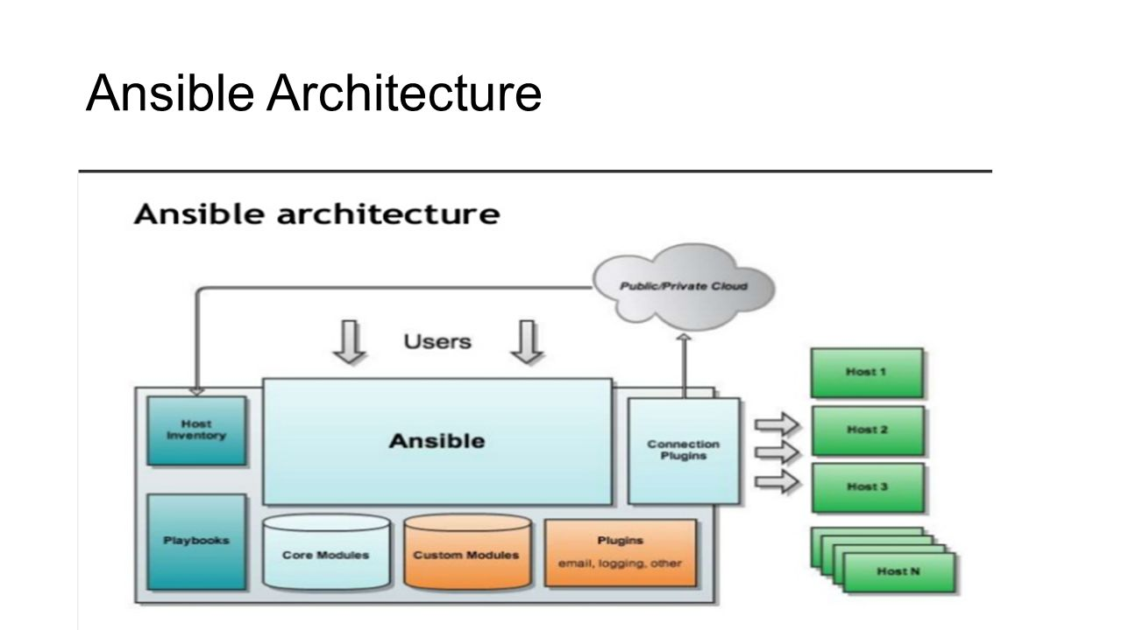
Ansible Architecture

Slide 9
Why Ansible Tool?
Requirements of Ansible
SSh Client (OpenSSH)
Password Less Authentication for non root user from Control System to Client Systems
Sudo Previlliage: To execute all or selective commands without password prompt on client systems
Python

Slide 10
Components of Ansible
Requirements of Ansible
Program
Ansible
Ansible doc
Ansible playbook
ansible pull
Modules
perform configuration and system management examples Modules Copy, Service, File, Yum, user, Group

Slide 11
Ansible Installation/Setup
Requirements of Ansible
Lab Setup Detail:
1. ansible-control Server
2. environment server (webserver/dbserver/appserever)
Ansible Softeware:
Avaibale on EPEL Repository
Ansible control Acount: As ansible administrator
User: ansible, Group: ansible

Slide 12
Ansible Configuration File
Ansible looks for a file named ansible.cfg in the current directory. If no file with the name exists, it defaults to /etc/ansible/ansible.cfg. This allows multiple administrators to keep their own configuration or Inventory depending on their roles and responsibility or interest

Slide 13
Ansible Configuration File/Inventory
Inventory is a method to store a list of clients with grouping. Both static and dynamic inventories are supported. (Static inventory can be considered analogous to /etc/hosts file and dynamic inventory can be thought similar to DNS in the context of simple name resolution in a broader way)

Slide 14
Ansible Adhoc Commands
Adhoc commands in Ansible are executed using the command “ansible”
#ansible-doc –l |more
#ansible-doc –s yum
#ansible appgroup –m ping
#ansible all –m ping
#ansible all –m shell –a “uname –a;df –h”

Slide 15
Ansible Adhoc Commands
Adhoc commands in Ansible are executed using the command “ansible”
#ansible appgroup –m yum –a “name=httpd state =present” -s
#ansible appgroup –m service –a “name=httpd state=started” –s
#ansible webgroup -m service -a "name=httpd enabled=yes" -s
#ansible appgroup –m copy –a “src=/tmp/file dest=/tmp/file” -s

Slide 16
Ansible Playbook
In Ansible terms, play is like a task/command. A set of commands grouped together to serve a defined purpose can be termed as a playbook. A playbook written in YAML is very sensitive to “space” and “indentation”.
YAML stands for Yet Another Markup Language. Ansible uses YAML to instruct the Automation Framework to perform tasks. YAML is very space sensitive. Hence, it will be better to setup indentation in text editors. Failing to do so will fail the syntax
A sample playbook (httpd.yml)

Slide 17
Ansible Playbook
---
- hosts: webgroup
user: ansible
become: yes
become_method: sudo
tasks:
- name: 1. Deploy web server
yum: name=httpd state=present
- name: 2. Start httpd service
service: name=httpd state=started enabled=yes
- name: 3. Copy the index.html file
copy: src=/tmp/index.html dest=/var/www/html/index.html mode=0664

Slide 18
Patching Linux Server Via Ansible Playbook
Servers can be patched in Rolling fashion
Diff Linux OS Distributions/Releases can be patched using a playbook
Servers can be Patched in a Group
Group can be of 2,3,4 …. Or all Servers in inventory
Duration to get Server patched depends upon the network accessibility to the Patch Repository
For Servers to be patched in Group must have Repository on internal Network
Precheck & Post validation can be achieved by Ansible

Slide 19
Patching Linux Server Via Ansible Playbook
In Rolling fashion Servers can be patched one by one or in Group .
Servers will be picked from inventory serial wise.
While Server being patched as a whole inventory will perform all the tasks in parallel and failed one will be skipped.
During parallel patching amount of time taken to patch Group of Servers will be same as time taken by 1 Server, provided enough network bandwidth.

Slide 20
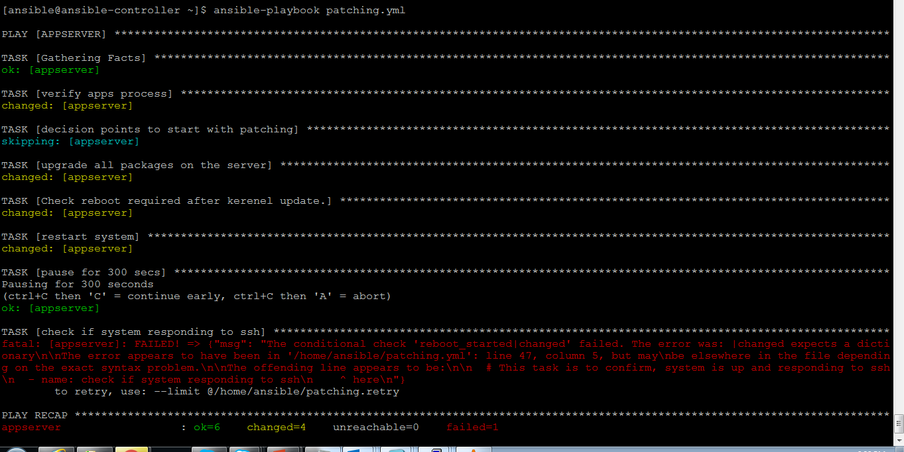
Patching Playbook

Slide 21
Ansible Roles & Galaxy
Ansible Roles and Galaxy
Roles in Ansibe are next level of abstraction of Ansible playbook
Benefits of using Roles:
It include files and combine them to form clean . Reusable abstractions.
Easy way to maintain/troubleshoot playbooks
A role is a defined group of tasks, handlers, variables, files, templates and meta which can serve a specific purpose. Every role
consists of above mentioned subdirectories with main.yml file defining specific actions.
Structure of Roles
Tasks: :Playbook tasks
Handlers: :Event handlers
Vars/group_vars/variables: :Variable definition
Files: :contains regular files those need to be copied to the target hosts
Templates: :Similar to files , but it takes dynamic data
Meta: :Role dependencies
Roles could be called via playbooks any number of times

