Slide 1
GO NUCLEAR
Team Members - Nirupama Sensharma, Devarshi Patel

Slide 2

PROBLEM
The USA is the world's largest producer of nuclear power, accounting for more than 30% of worldwide nuclear generation of electricity. The country's nuclear reactors produced 807 billion kWh in 2018, about 20% of total electrical output.
Despite these fascinating facts, Nuclear energy faces lag in growth and nuclear-powered electricity in America has stayed at that level for the last 30 years, while nastier sources of energy like coal and natural gas take turns dominating the electricity market. A question in mind...
WHY?
Let’s try to find a solution.

Slide 3
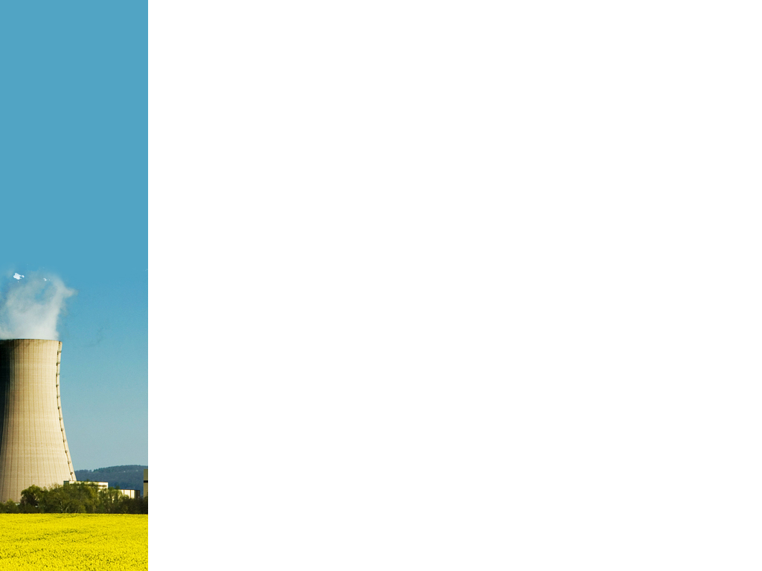
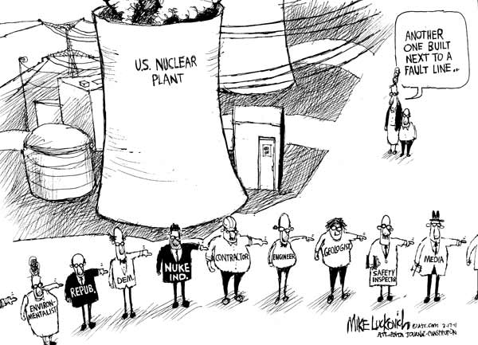
Stop Spreading Myths About Nuclear Power!!
The word ‘nuclear’ has a negative connotation and lead to most people imagining mushroom clouds, black and white photographs of Hiroshima, radioactive poisoning and uninhabited towns in Ukraine. But we must be reminded that these mental images are the result of what our minds keep adding on— “bomb”
Myths about Nuclear Waste:
There is no solution for huge amounts of nuclear waste being generated.
Used nuclear fuel is deadly for 10,000 years.
While we are saying nothing is impossible when we decide to do it!!!
All of the used nuclear fuel generated in every nuclear plant in the past 50 years would fill a football field to a depth of less than 10 yards, and 96% of this “waste” can be recycled.
Used fuel is currently being safely stored. The U.S. National Academy of Sciences and the equivalent scientific advisory panels in every major country support geological disposal of such wastes as the preferred safe method for their ultimate disposal.

Slide 4

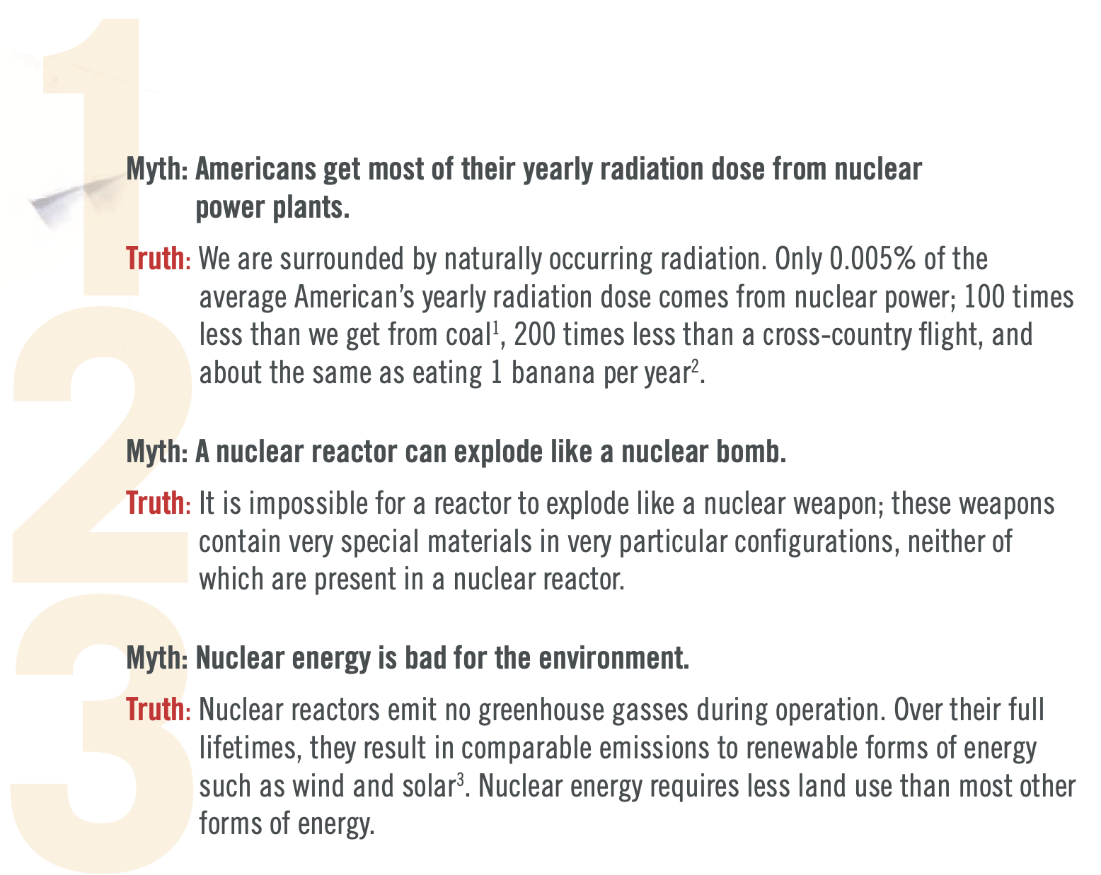
VALIDATION
FUN FACT...
The radioactivity from a truck full of bananas can cause false alarms when passing through a radiation detection device setup to check on the smuggling of radioactive elements!!
Bananas are radioactive! A typical banana contains 0.5g of Potassium of which 0.012% is radioactive Potassium-40.The total amount of radiation that we receive by eating at most 100 bananas is equivalent to the dose received from living near a Nuclear power plant for a year.

Slide 5

SOLUTION
Provide reliable information about the benefits of Nuclear Energy
Provide an easily accessible and interactive platform to help society make well-informed decisions about the use of Nuclear Energy
Engender a better support system for the Nuclear Energy sector which has the potential to significantly reduce carbon emissions
How are we solving the problem?
A comprehensive website aiming to inform people about the importance and benefits of using nuclear power developed
The website is designed to introduce the general public to nuclear science, starting from its basic applications to nuclear power production being the need of the day.
The website comprises of interactive features such as fun-facts, quizzes and articles written by credible authors who are educated in the subject.

Slide 6
WHY NOW?
Our planet is currently experiencing a climate crisis. In order to meet the politically agreed-upon goal of keeping the average global temperature rise below 2⁰C, we need to reduce our emissions and adopt cleaner sources of energy. Out of all the available 'clean' sources of energy, nuclear power is the most promising and produces completely green and carbon-free energy.
Adopting nuclear energy will allow our society to produce enough power to meet our increasing energy demands (which other available renewable sources cannot).
There is a lack of knowledge and awareness in society regarding the safe use of nuclear power.
Misinformation and media-driven hysteria have led to irrational fears within the general public.
This negative attitude towards nuclear power is a roadblock to the expansion of the nuclear energy sector and to the smooth operation of nuclear power plants, increasing their capital costs and forcing society to depend on other carbon-emitting energy sources. This vicious circle leads to burning more and more coal and increased rates of global warming.
Now is the time to break this circle, adopt nuclear energy and act to save our planet!

Slide 7

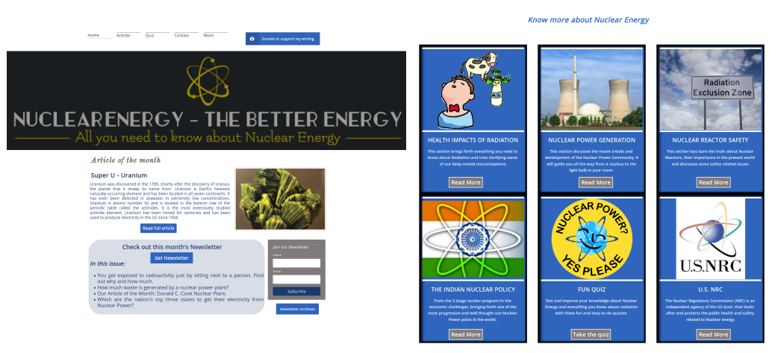
PRODUCT
Screenshot of the homepage of our website: thebetterenergy.net

Slide 8
COMPETITIVE ANALYSIS
OUR COMPETITORS
The U.S. Nuclear Regulatory Commission (www.nrc.gov)
The U.S. Energy Information Administration (www.eia.gov)
The Office of Nuclear Energy (www.energy.gov/ne/)
The Nuclear Energy Institute (www.nei.org)
Personal blogs on the subject
A lot of information is available on these portals but is either too technical or unreliable (blogs) and/or are biased.
Moreover, the Governmental regulatory bodies are not very popular among the general public
OUR COMPETITIVE ADVANTAGE
Our product will deliver much-needed trustworthy information about nuclear energy, tailored specifically to a general audience. The creators of and contributors to our website come from a broad range of backgrounds and have a well-rounded host of experiences with nuclear energy that qualify us to provide fact-informed, comprehensive, yet accessible information about nuclear science. Below are our specific advantages:
Relevant information compiled together in one easily accessible website
Interactive features to facilitate understanding of complex topics
Monthly newsletters, easy to read and understand articles
Connects well with the general public through fun facts and quizzes

Slide 9
MARKET ANALYSIS
Our Market Strategy:
Selling merchandise (stickers, shirts, hats, magnets) to our customers.
Working on starting a magazine that we would be selling to our customers who subscribe to it.
Working to register our venture as a non-profit, we would start accepting donations, grants and gifts.
Social Media Promotions.
Organize interactive competitions (quiz, debates) for our customers.
Make YouTube videos and connect with the youth.
Short-term Market
STEM graduate students (attending academic conferences all over the country)
STEM students in general (at universities in and outside of the state of Indiana)
Students from related disciplines (for ex., sustainability and environmental science)
Medium-term Market
Students across a wide range of disciplines (with and without a science background) and teachers.
Would be extended to the general public
Long-term Market
Personnel working in nuclear power plants
General public that lives around nuclear power plants
Private companies that supply nuclear reactor components

Slide 10








THE TEAM
Nirupama Sensharma (Founder)
PhD Candidate in Nuclear Physics
University of Notre Dame
Devarshi Patel
Graduate Student in Electrical & Computer Engineering,
Rutgers University
Our Content Writers
Max Nguyen
Masters in Global Affairs
Hrafn Traustason
PhD Candidate Chemistry
Sara Gilson
PhD Candidate Chemistry
Lydia Schaecher
Undergraduate Student
Prince Rautiyal
PhD Candidate Nuclear waste
Vaishnvi Tiwari
PhD Nuclear Reactor Physics

