Slide 1

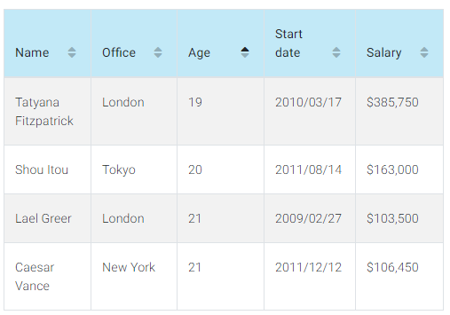
Component:
Datasheet
Child Component:
SearchBox
Child Component:
SearchResults

