Slide 1
MANDATE RULE No. 0
Mandate Ledger
An AI agent that can't write itself a blank check.
APPROVED
ONCE
Spending mandates enforced on-chain · Soroban · Stellar testnet

Slide 2
THE PROBLEM
Autonomous agents need to pay for things.
That's exactly the problem.
1
An agent that can move money is useful — paying vendors, topping up services, settling invoices without a human in the loop.
2
But “trust the agent's own code” doesn't scale — a bug, a bad prompt, or a compromised key turns into an unbounded blank check.
3
Enforcement needs to live somewhere the agent can't touch — not in the agent's logic, not in a UI warning, not in a policy nobody checks.
02 / 09

Slide 3
THE SOLUTION
One human approval. Enforced on every decision after.
→
→
Human
Smart Account
Every Payment
Approves a mandate once:
max amount + allowlist
Mandate installed on-chain
on a Soroban context rule
Checked against the mandate
before it can settle
Enforcement lives in the blockchain — not in the agent's own code.
03 / 09

Slide 4
ARCHITECTURE
One rule at the center. Two contracts serve it.
←
THE RULE
smart-account
mandate-policy
The agent's on-chain account (OpenZeppelin stellar-accounts). Every call routes through its authorization check first.
Max amount per transaction + recipient allowlist. Panics — and reverts the transaction — on any violation. This is the contract every payment is actually judged against.
←
ed25519-verifier
100 XLM
2
Confirms the request really came from the agent's own bound key — before the mandate is even checked.
MAX / TX
ALLOWLISTED PAYEES
04 / 09

Slide 5
MANDATE · CONTEXT RULE No. 0
The mandate used in this demo
Filed once, by a human, at deployment. Never touched again.
100 XLM
2
never
MAX PER TRANSACTION
ALLOWLISTED PAYEES
cafe_supplier · cloud_provider
MANDATE EXPIRES
Approved once by a human — enforced by contract code from then on.
05 / 09

Slide 6
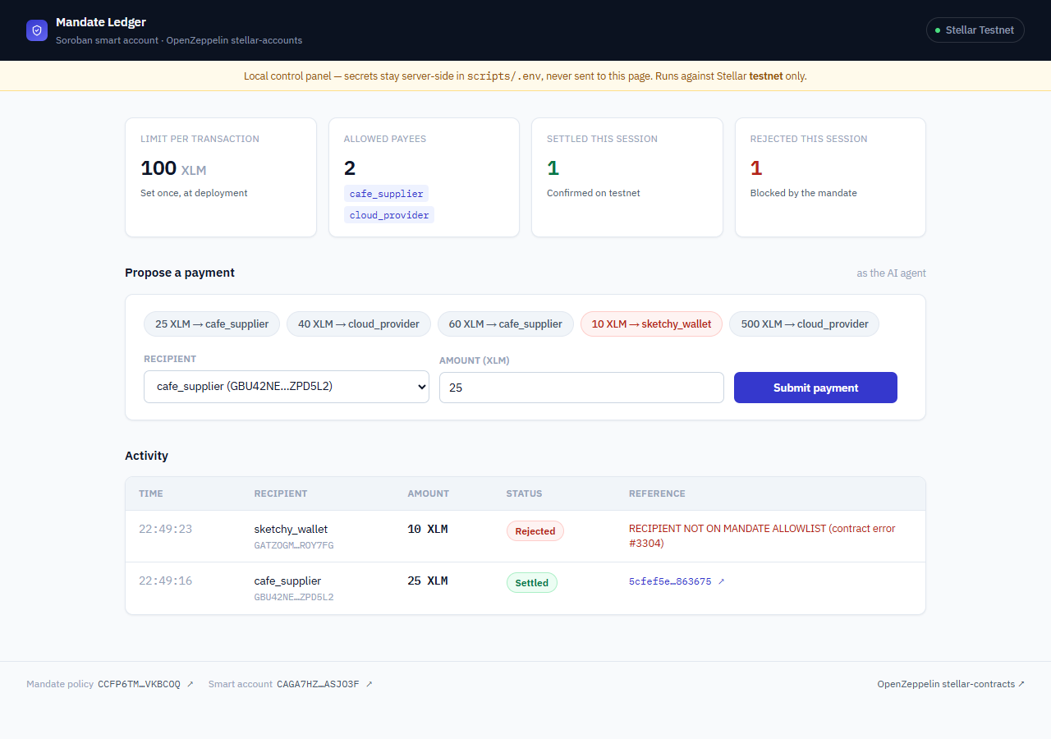
LIVE DEMO — RIGHT NOW
Five autonomous agent decisions, submitted live
OK
OK
OK
NO
NO
3 settled · 2 rejected on-chain · 0 silently skipped
06 / 09

Slide 7
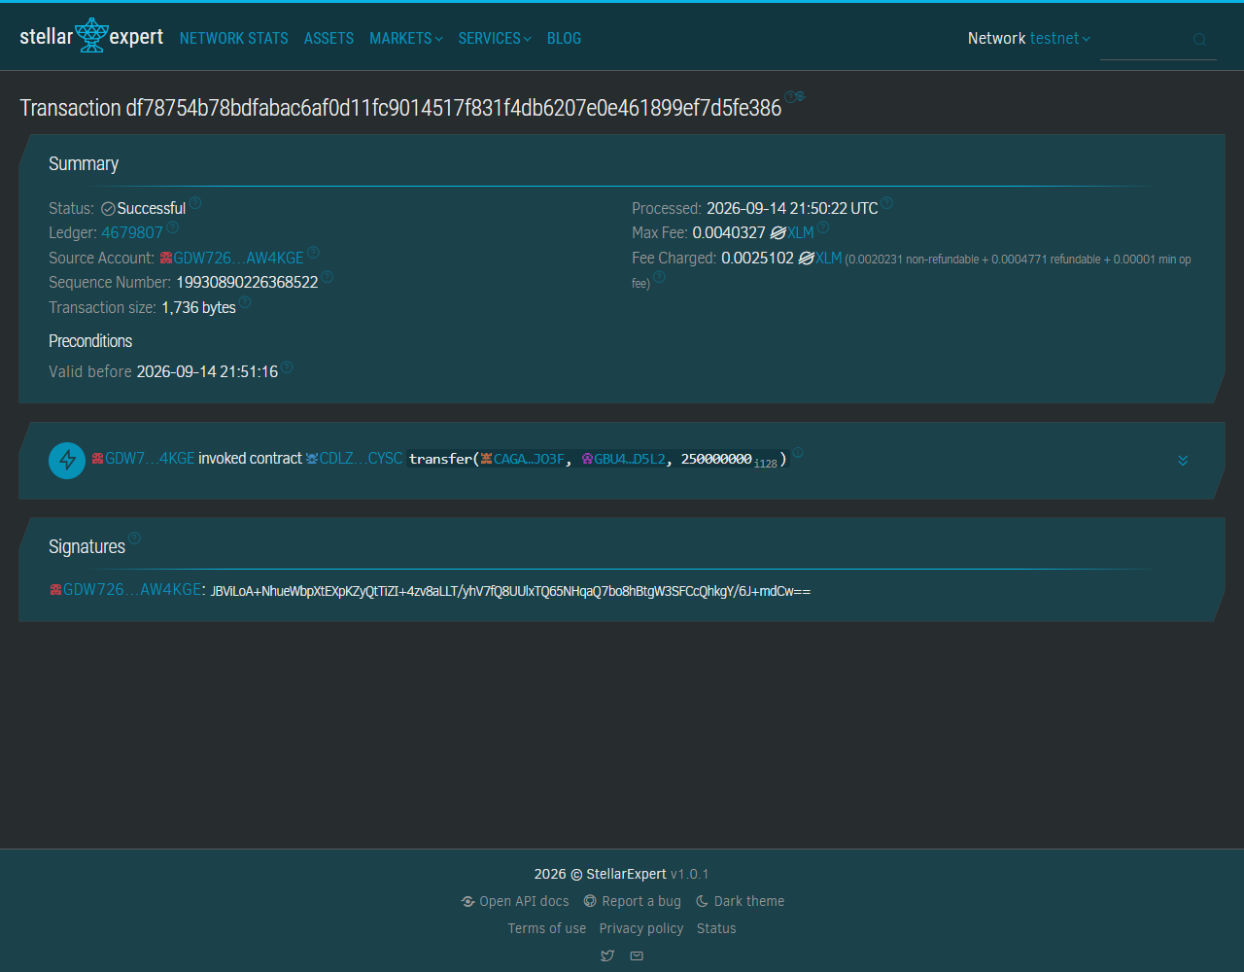
PROOF, NOT A CLAIM
Every settled payment is independently verifiable
Real transaction. Real ledger. Real timestamp.
Anyone can paste the transaction hash into stellar.expert — no need to take our word for it.
Confirmed on Soroban RPC (getTransaction: SUCCESS)
Confirmed independently on Horizon testnet
Ed25519 signature verified on-chain before the mandate ran
07 / 09

Slide 8
WHY THE REJECTIONS MATTER
Two independent gates — both real
→
GATE 1
GATE 2
Identity
Policy
The ed25519-verifier checks the agent's real signature. Both rejected calls passed this — the agent proved exactly who it was.
The mandate-policy then checks amount + allowlist. Both calls were rejected here — for cause, with a specific error code.
Signature valid both times. The agent proved who it was — the mandate still said no.
08 / 09

Slide 9
APPROVED
ONCE
One mandate. Approved once.
Enforced on every decision the agent makes afterward.
No way for the agent — or a bug in its own code — to bypass it.
mandate-policy · smart-account · ed25519-verifier — Soroban on Stellar testnet
09 / 09

