Slide 1
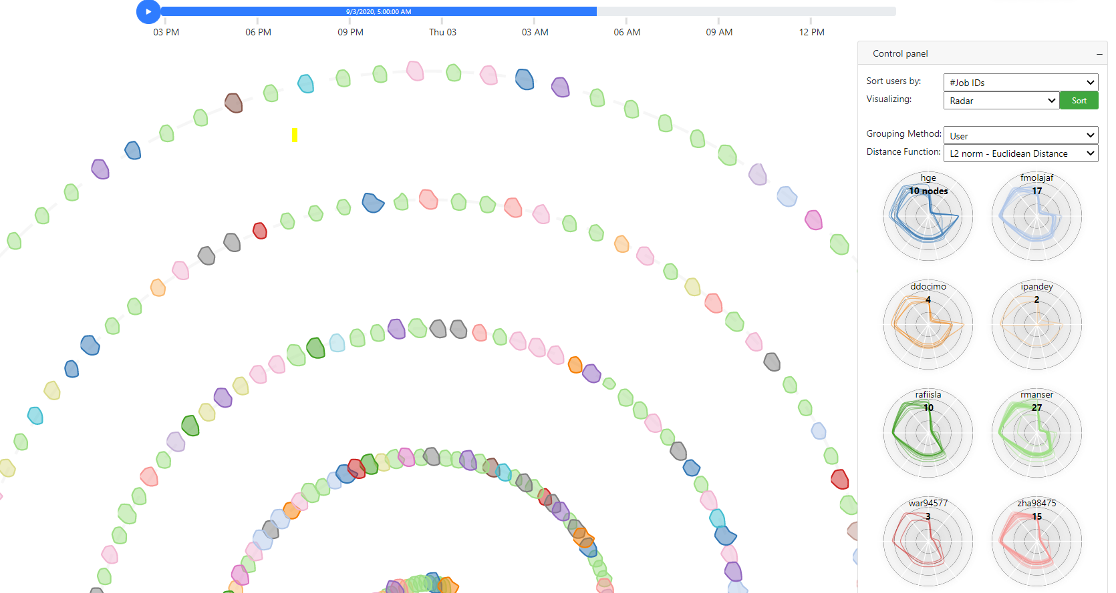
SpiralLayout
Weekly report

Slide 2
SpiralLayout
Compute
Color by metrics value (e.g: Temperature, Fan speed, etc.)

Slide 3
SpiralLayout
Historical data
https://idatavisualizationlab.github.io/HPCC/spiralLayout/index.html
Realtime
https://idatavisualizationlab.github.io/HPCC/spiralLayout/index.html?mode=realTime

Slide 4
SpiralLayout
User’s characteristic
Sep 2, 2020 2:50:00 PM – Sep 3, 2020 2:50:00 PM
Duration: 24 hours
Interval: 5 minutes
#Timesteps: 288
#Users: 57
#Computes: 467
Nodes have high changed value

Slide 5
SpiralLayout
User’s characteristic

Slide 6
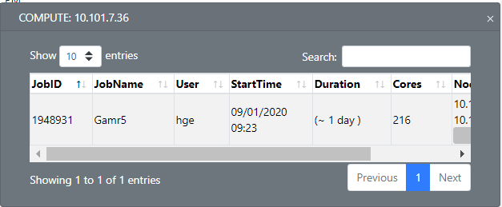
SpiralLayout
User’s characteristic

