Slide 1
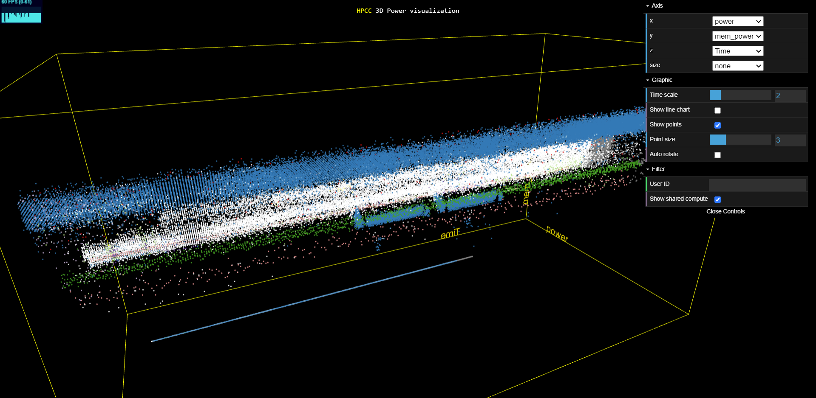
3DPowerViz
Weekly report

Slide 2
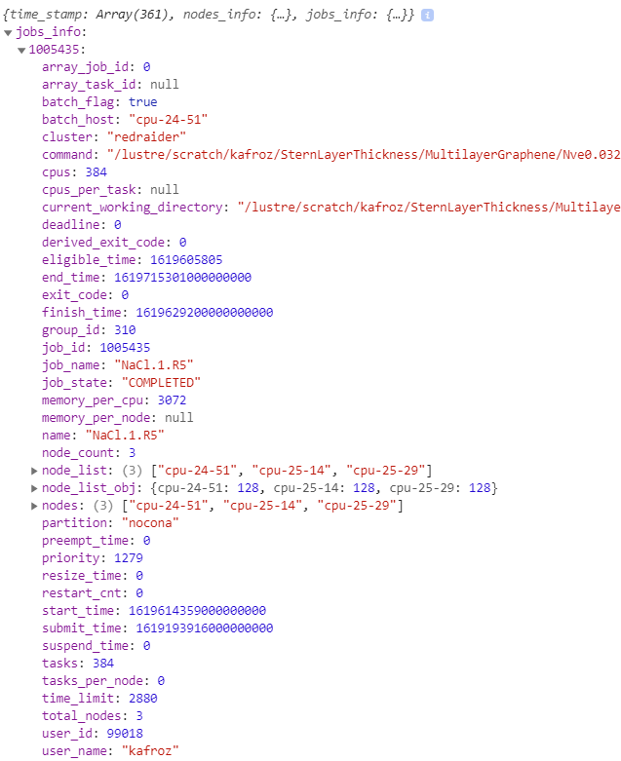
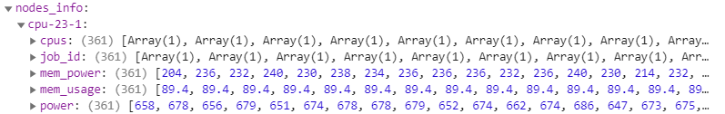
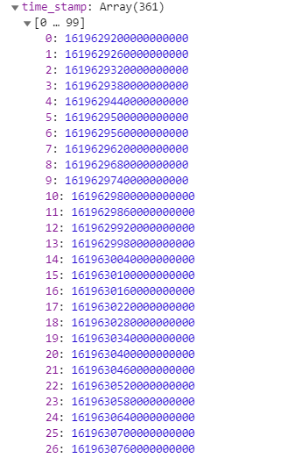
From May 11, 2021 12:00 to 18:00
361 timesteps (1 minutes interval)

Slide 3
https://idatavisualizationlab.github.io/HPCC/3Dcube/index.html
Dot
Each dot is a compute at percific timestep.
Color by user

Slide 4
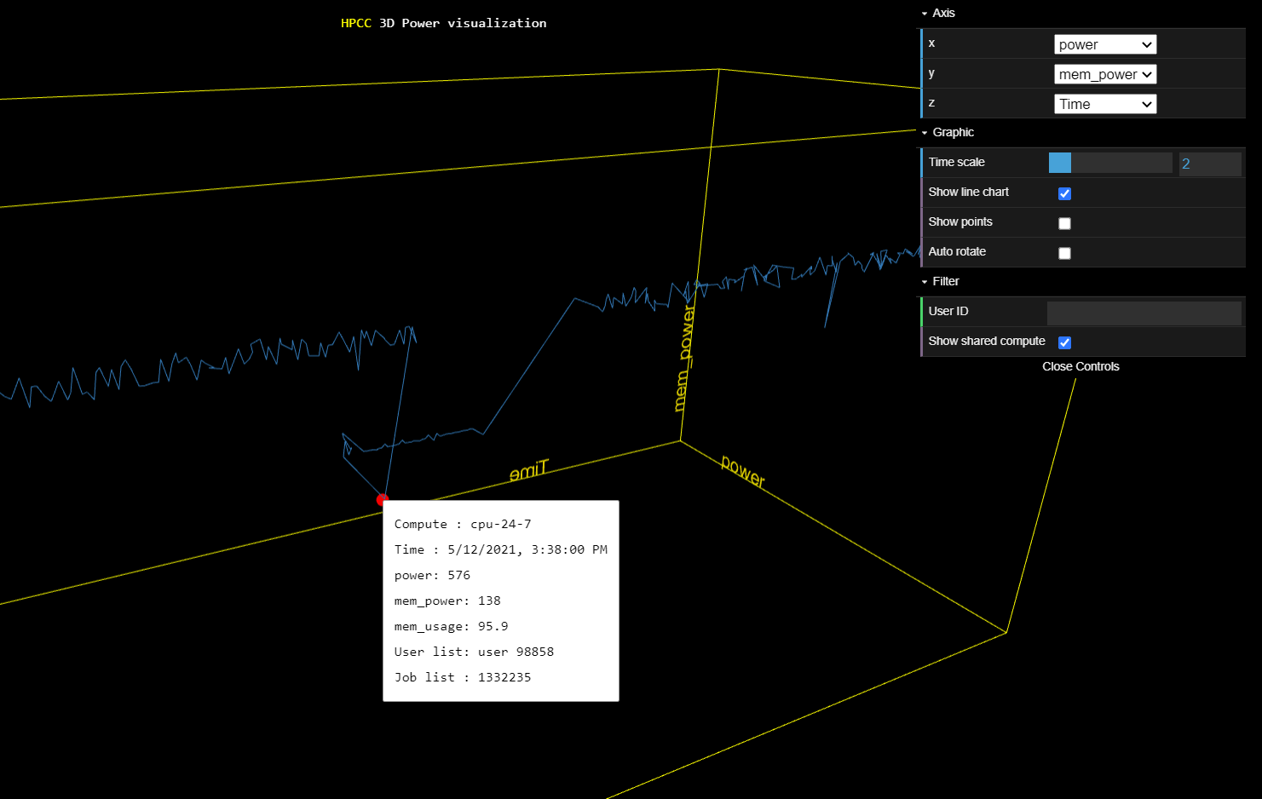
https://idatavisualizationlab.github.io/HPCC/3Dcube/index.html
Line chart
Each line chart is a compute line chart.
Color by user

Slide 5
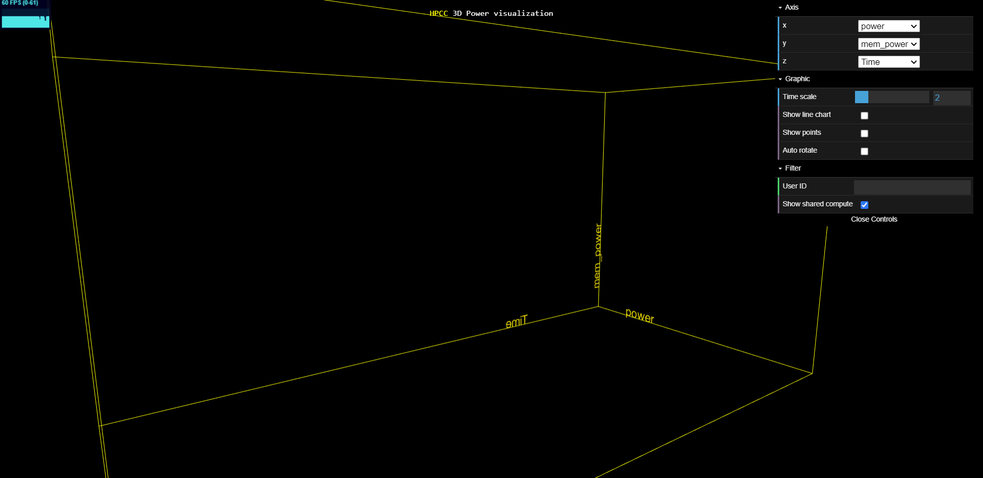
3D PowerViz

Slide 6
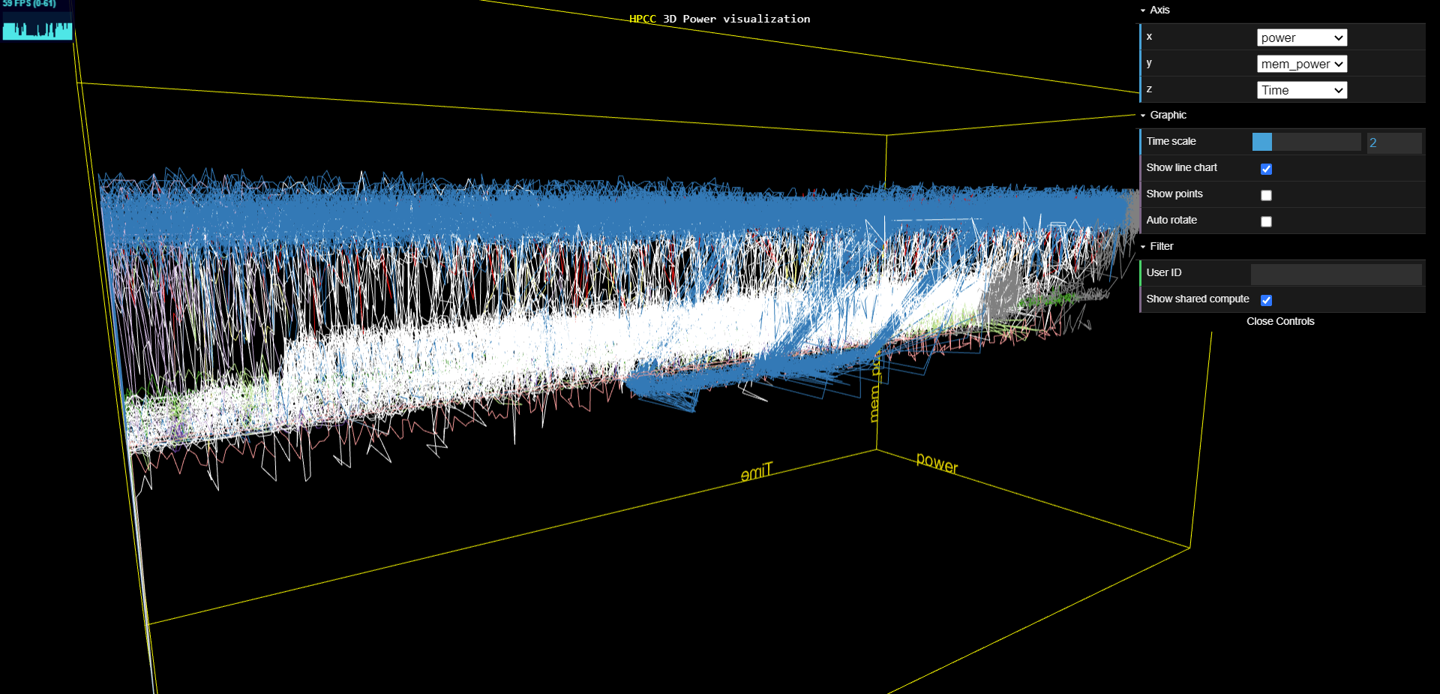
3D PowerViz
High Power and high mem_power

Slide 7
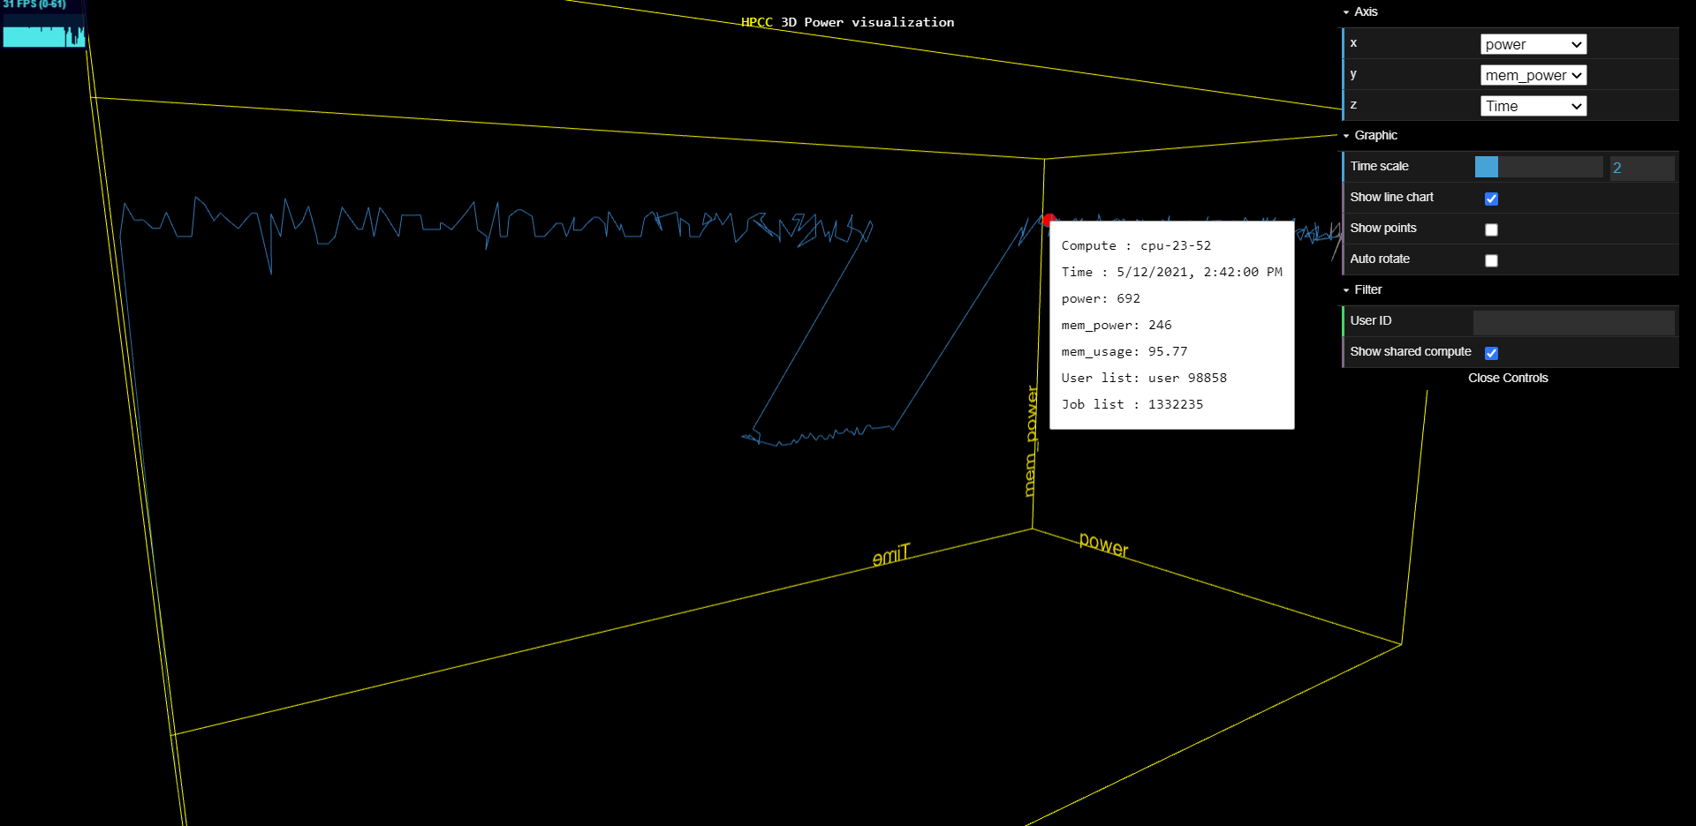
3D PowerViz
High Power and high mem_power

Slide 8
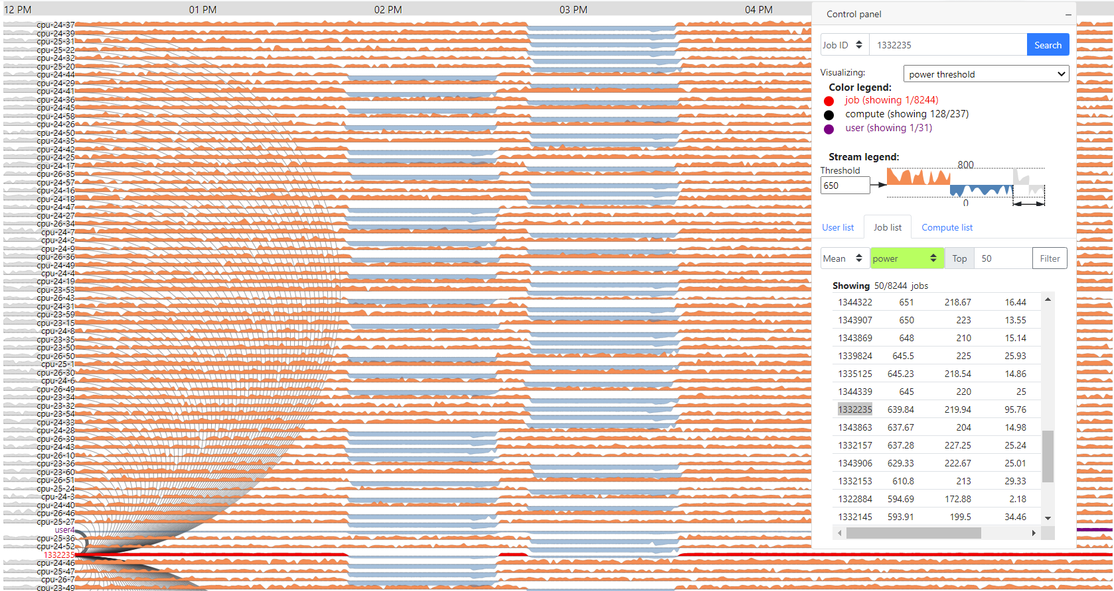
JobPower
1332235

