Slide 1
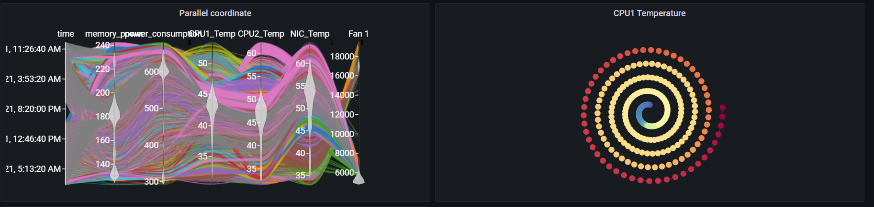
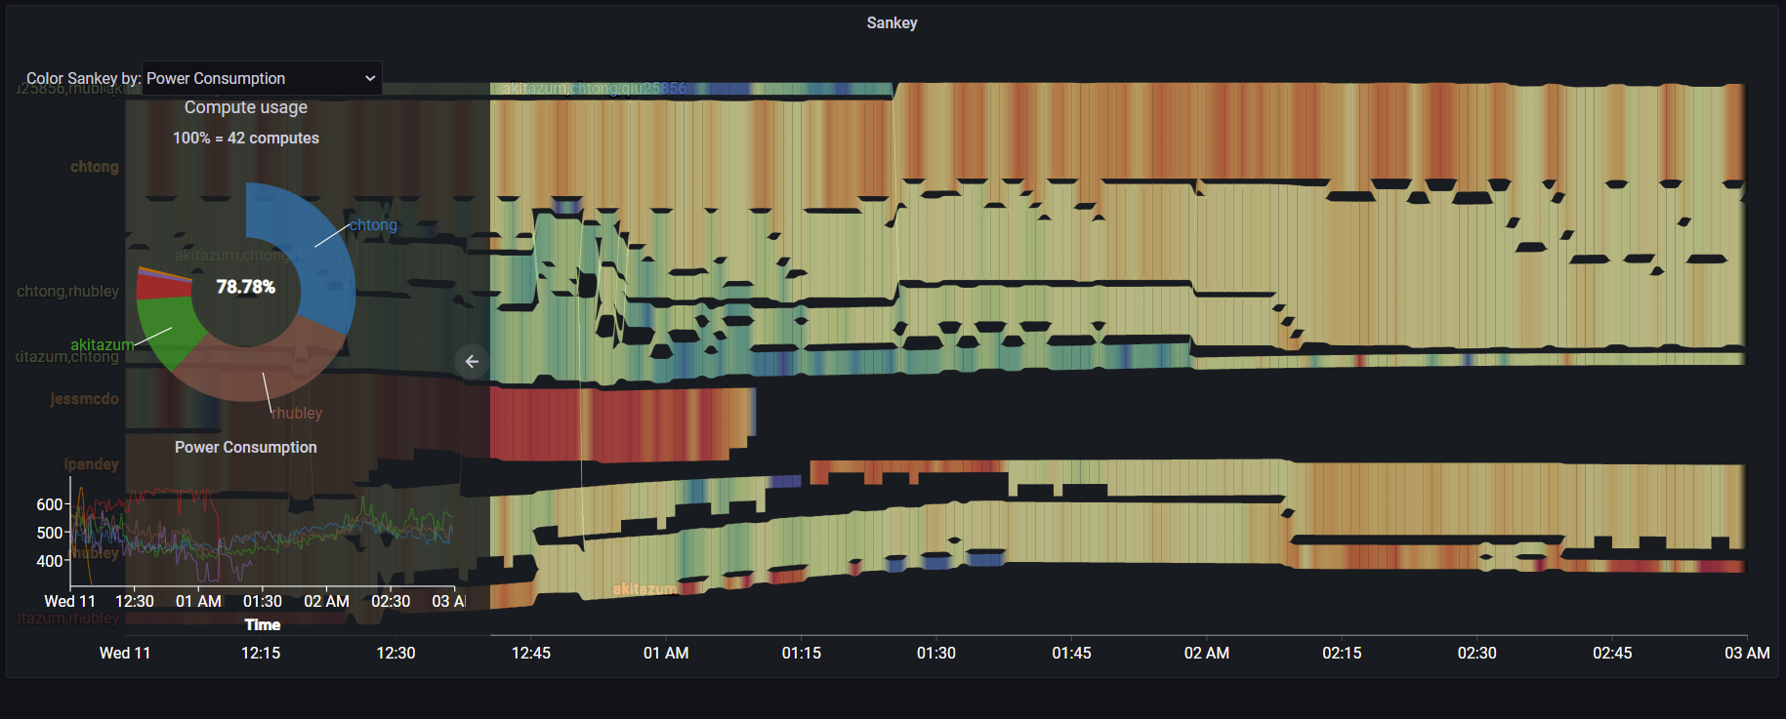
Grafana Plugin
Weekly report

Slide 2
Grafana Monster
Query builder
Monster api payload
Data frame convert

Slide 3
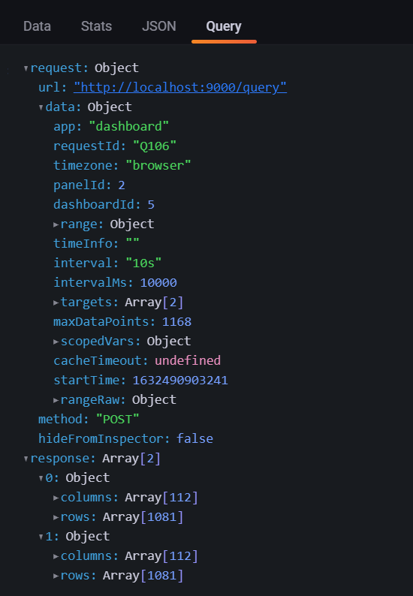
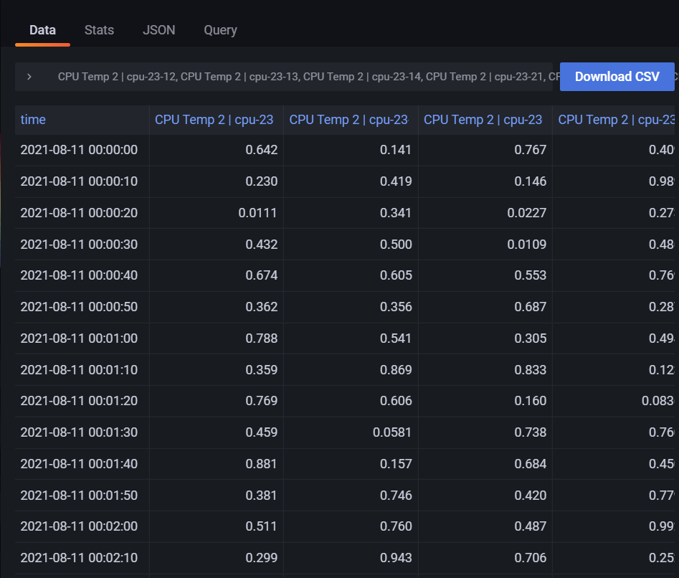
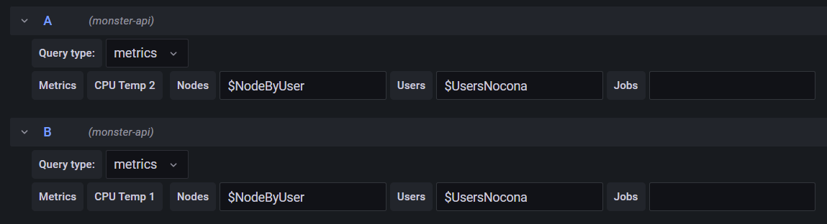
Grafana Monster

Slide 4
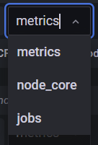
Grafana Monster
Combination query:
Time range
Metric
User names
Job names

Slide 5
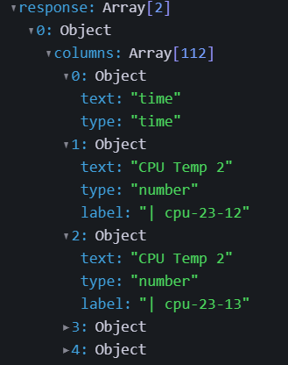
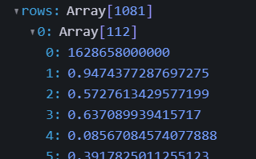
Grafana Monster

Slide 6
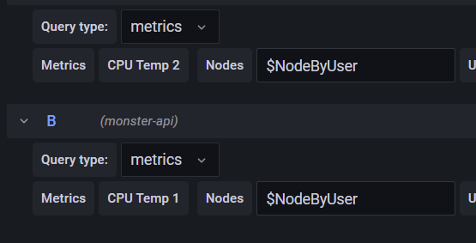
Grafana Monster

Slide 7
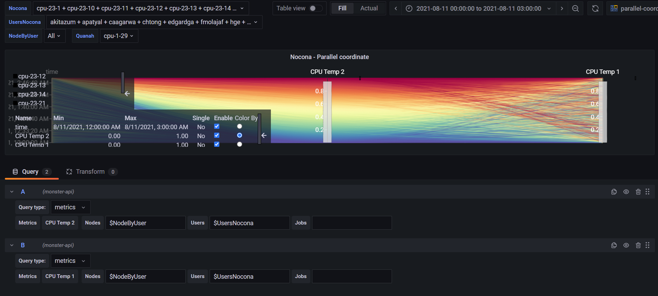
Current result with “simulation” api

Slide 8
Current features
Prototype of Grafana monster data-source
Support query metrics
Support query job info
Alert enable

