Slide 1
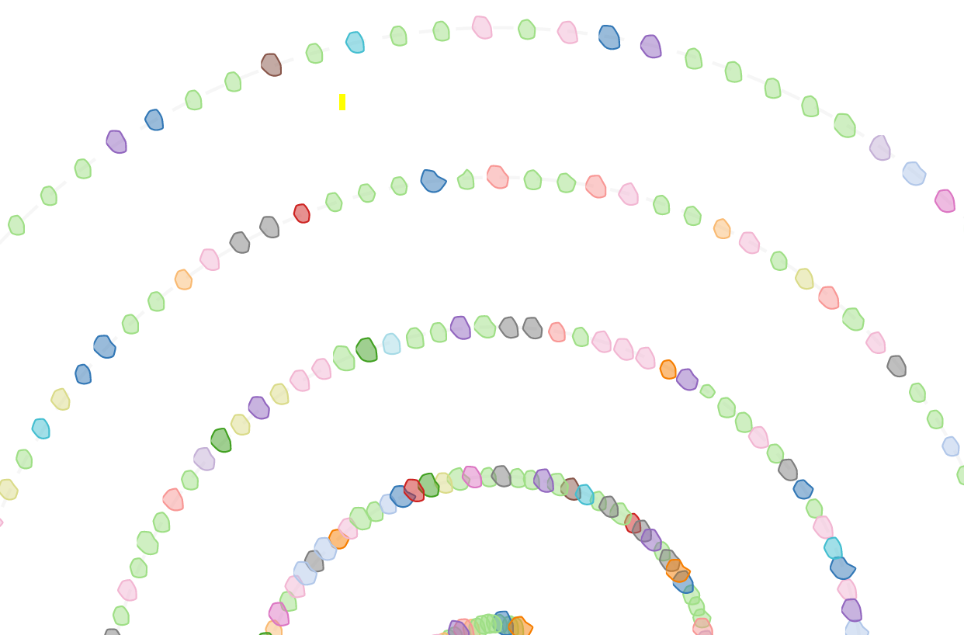
JobSwarm
Weekly report

Slide 2
JobSwarm
Compute
User
Color by metrics value (e.g: Temperature, Fan speed, etc.)

Slide 3

JobSwarm
Compute
User
#running jobs
#compute
Users utilizing timeline with current snapshot highlighted

Slide 4
JobSwarm
Historical data
https://idatavisualizationlab.github.io/HPCC/beeswarm/index.html

Slide 5
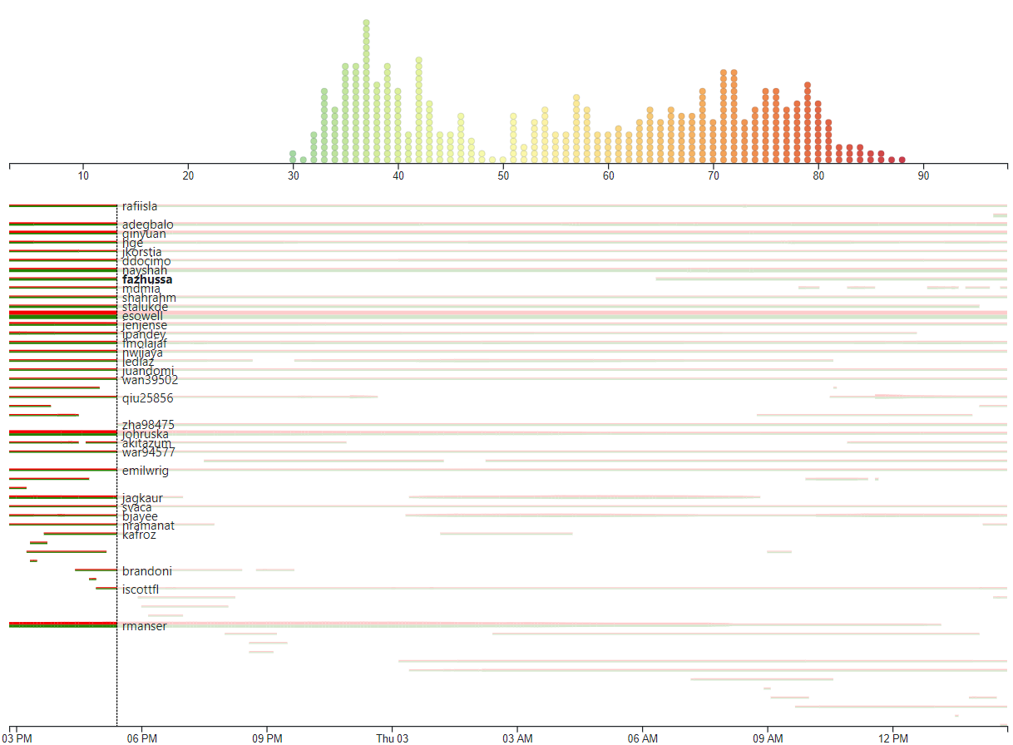
JobSwarm
Sep 2, 2020 2:50:00 PM – Sep 3, 2020 2:50:00 PM
Duration: 24 hours
Interval: 5 minutes
#Timesteps: 288
#Users: 57
#Computes: 467

Slide 6
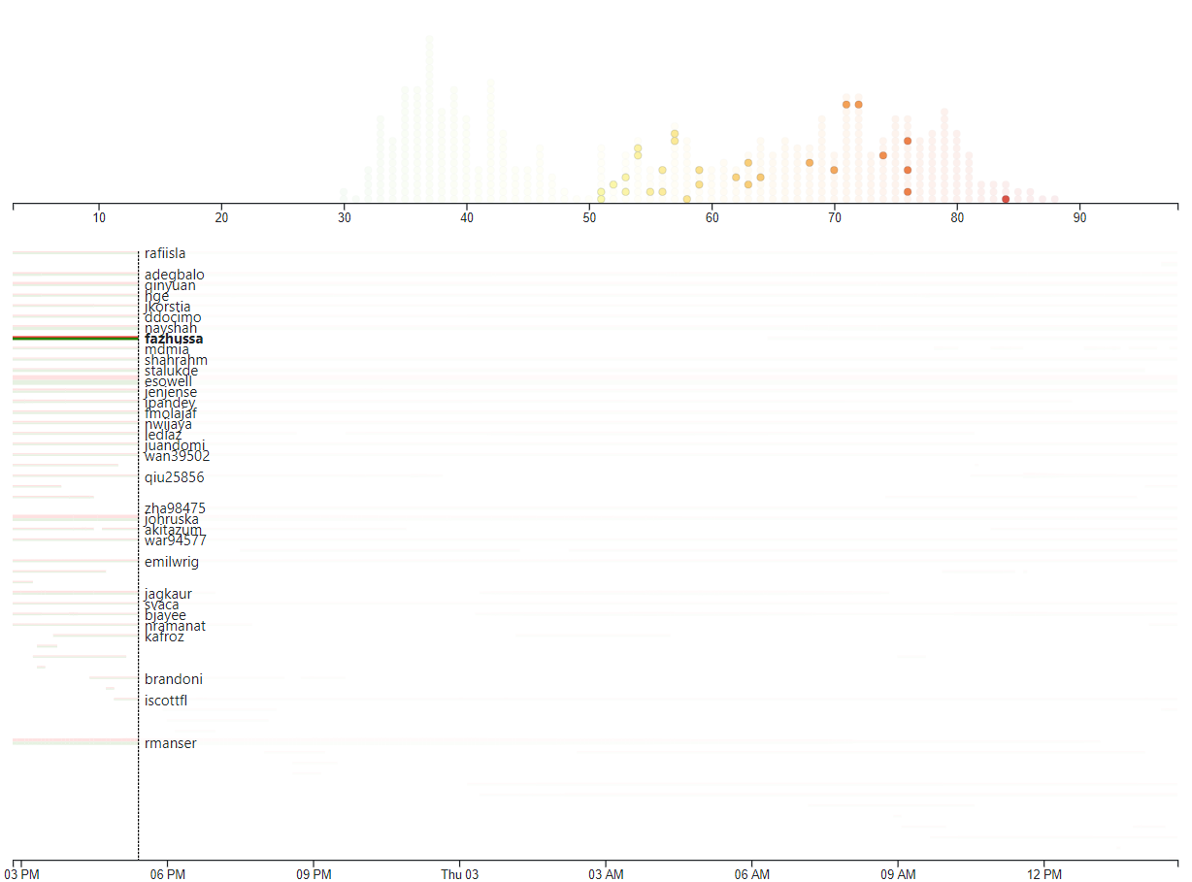
JobSwarm
Sep 2, 2020 2:50:00 PM – Sep 3, 2020 2:50:00 PM
Duration: 24 hours
Interval: 5 minutes
#Timesteps: 288
#Users: 57
#Computes: 467

Slide 7
JobSwarm
Sep 2, 2020 2:50:00 PM – Sep 3, 2020 2:50:00 PM
Duration: 24 hours
Interval: 5 minutes
#Timesteps: 288
#Users: 57
#Computes: 467

Slide 8
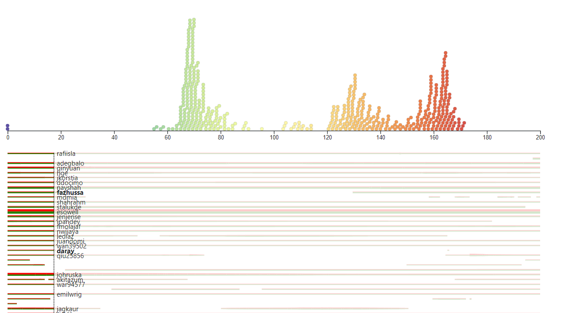
JobSwarm
Power consumption

Slide 9
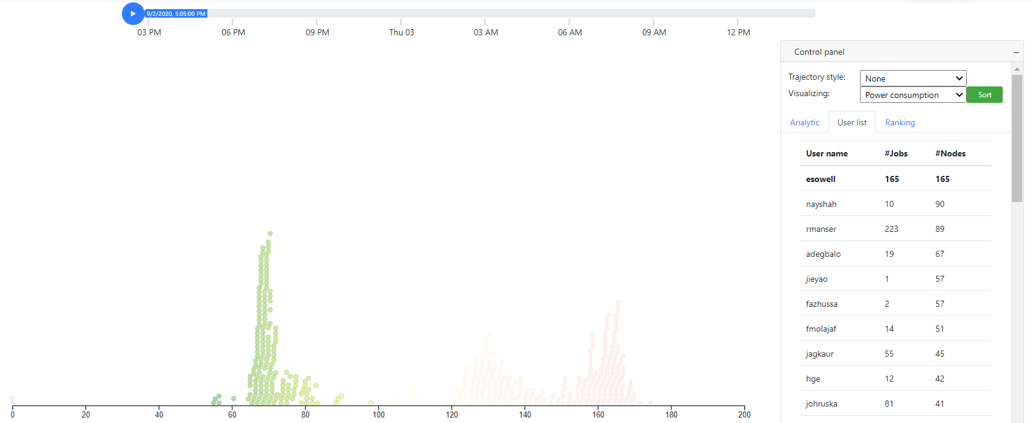
JobSwarm
Power consumption

Slide 10
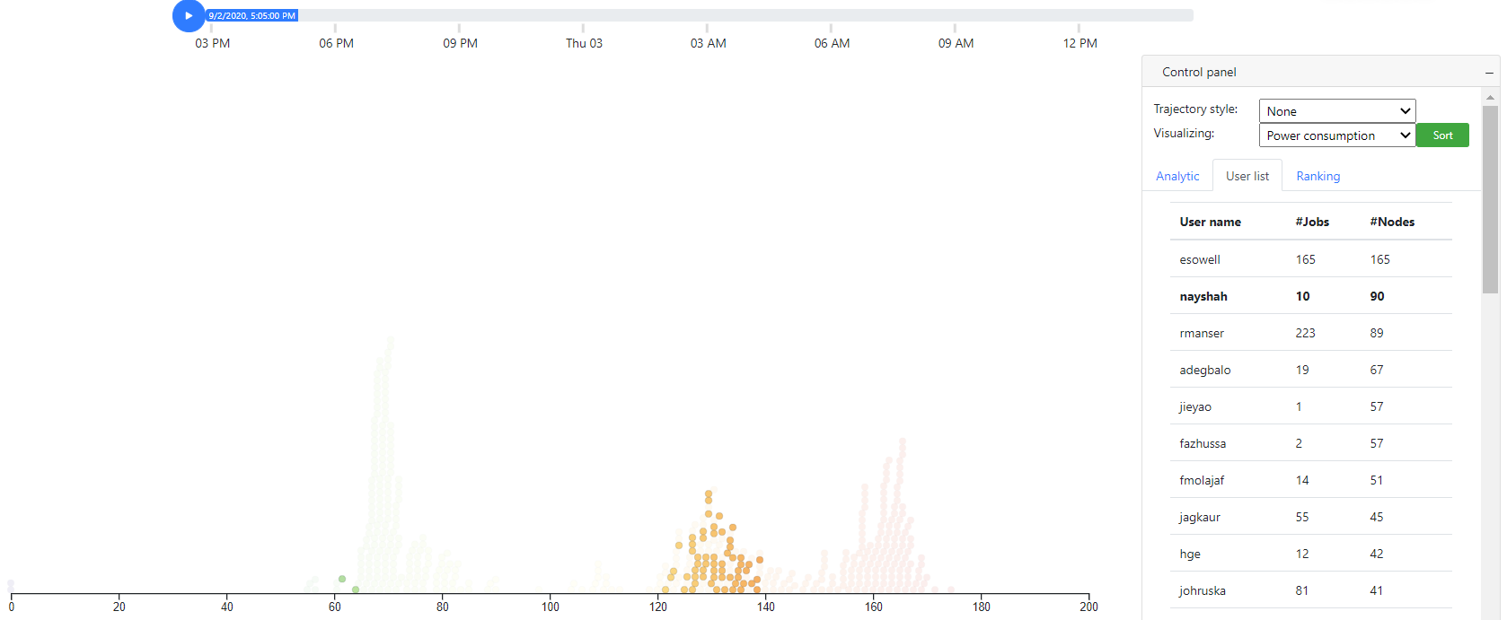
JobSwarm
Power consumption

Slide 11
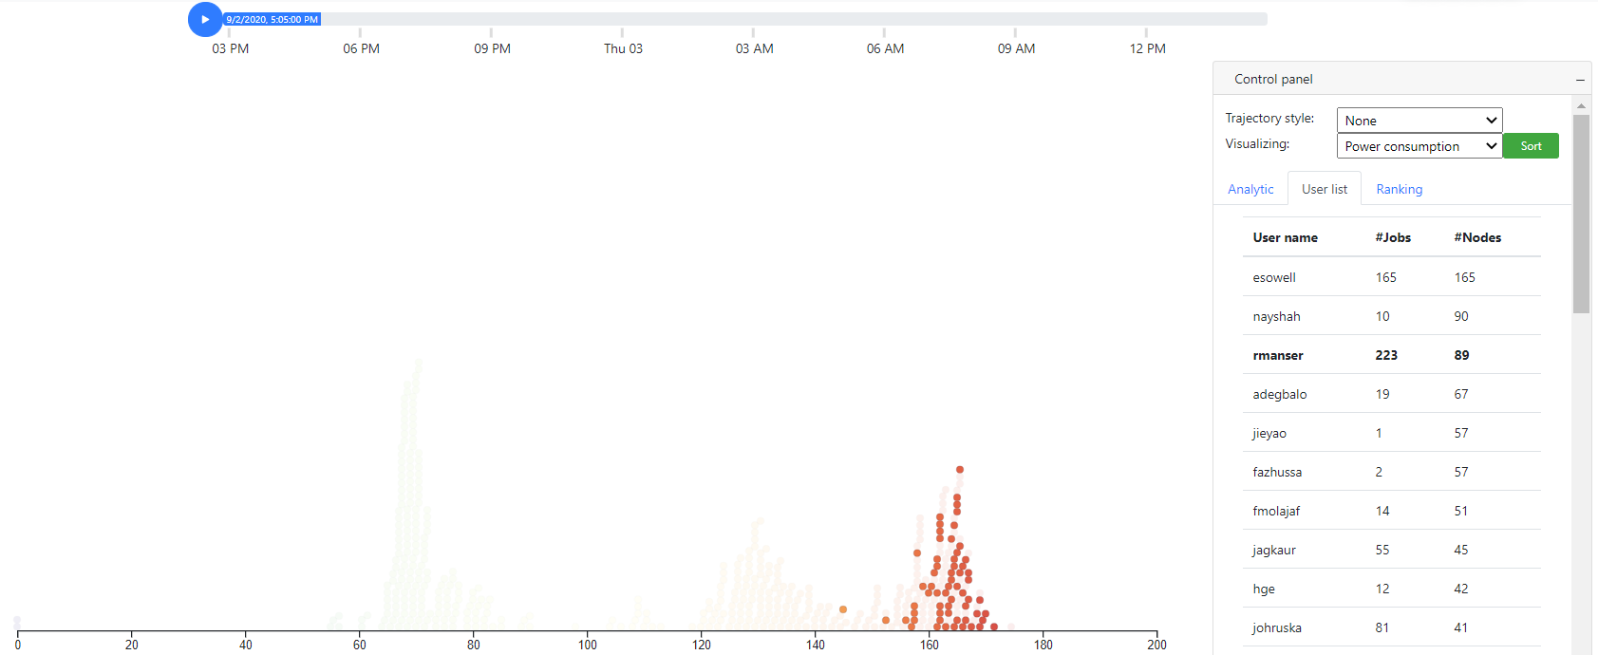
JobSwarm
Power consumption

Slide 12
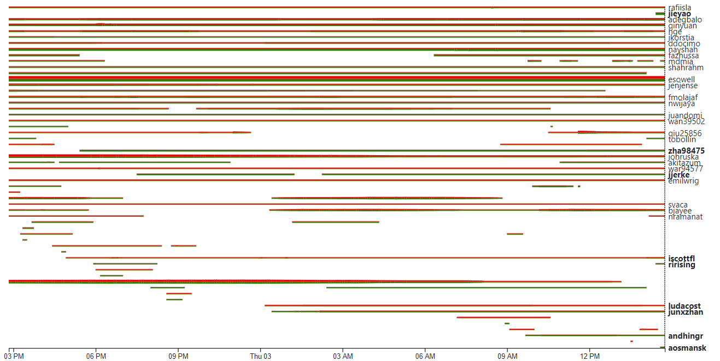
JobSwarm
esowell
rmanser

