Slide 1
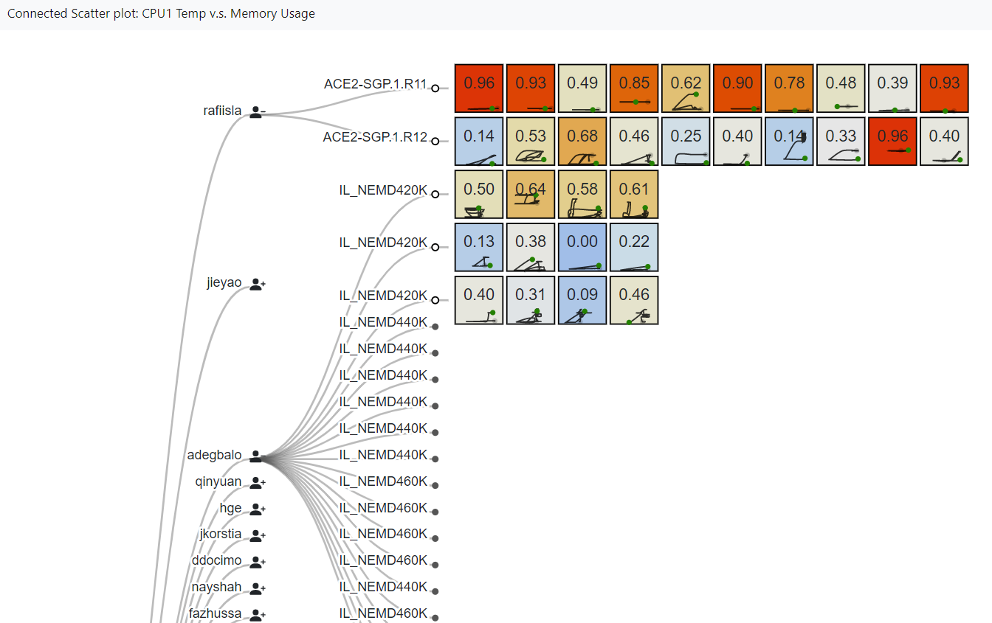
Connected Scatterplot
Weekly report

Slide 2

Connected Scatterplot
User
Job
Nodes
Memory Usage
CPU1 Temp
Color of connected scatter plot by Congnostics*
The green dot in the Scatter plot was the data point when the job finished
*Congnostics: Visual Features for Doubly Time Series Plots, Bao Nguyen, Rattikorm Hewett, Tommy Dang, EuroVA2020 https://diglib.eg.org/handle/10.2312/eurova20201086

Slide 3
Connected Scatterplot
Historical data
https://idatavisualizationlab.github.io/HPCC/connectedScatterPlot/

Slide 4
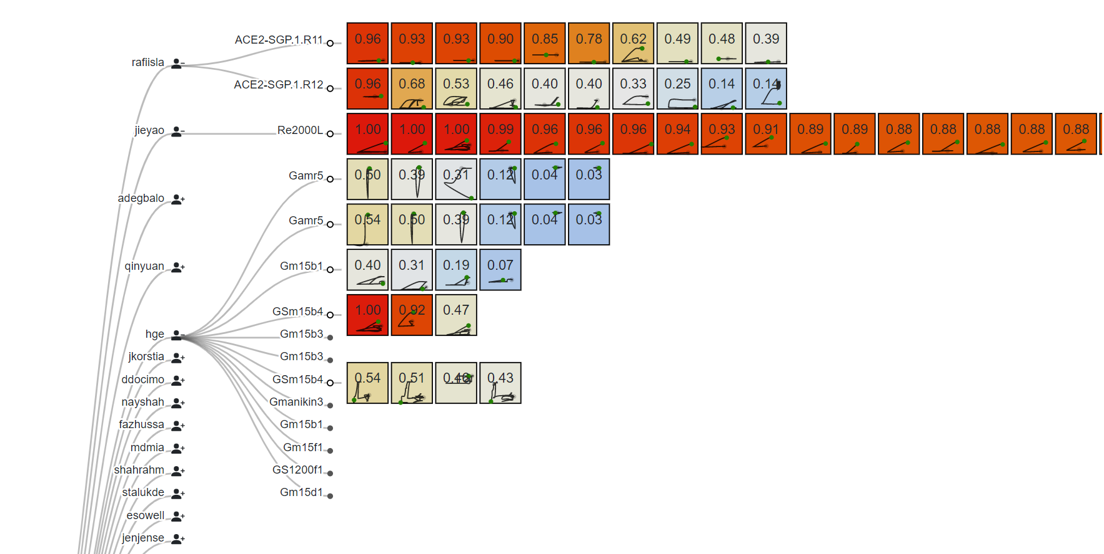
Connected Scatterplot
CPU1 Temp v.s. Memory Usage

Slide 5
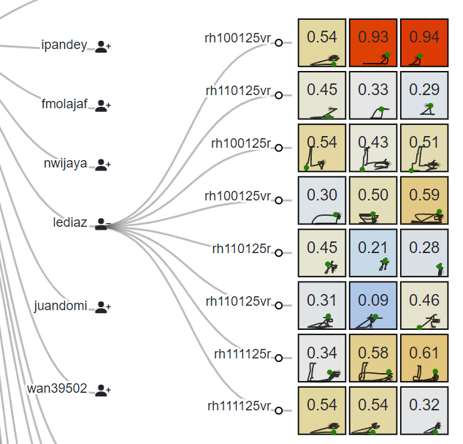

Connected Scatterplot
Consistency of scatterplots within same job

Slide 6
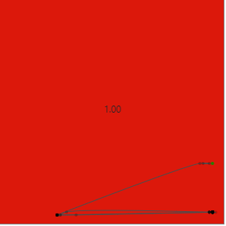
Connected Scatterplot
Job end with High CPU1 Temperature
Memory Usage increase at the end

Slide 7
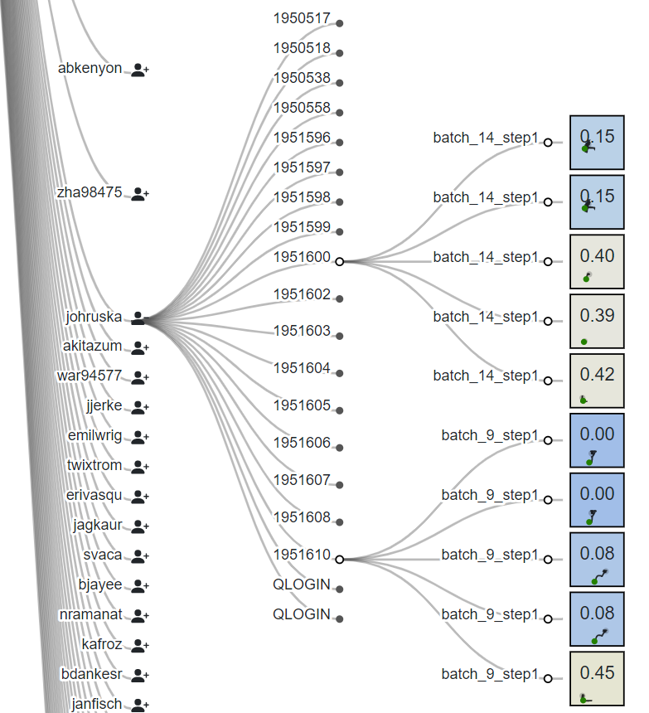
Connected Scatterplot
Different setting, different performance

