Slide 1
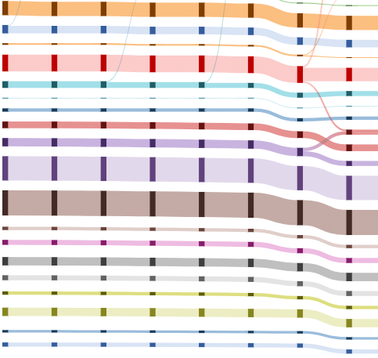
Job Stream
Weekly report

Slide 2
Job Stream
Historical data
https://idatavisualizationlab.github.io/HPCC/sankeyViewer/index.html

Slide 3
Job Stream
Show CPU core more than 36

