Slide 1
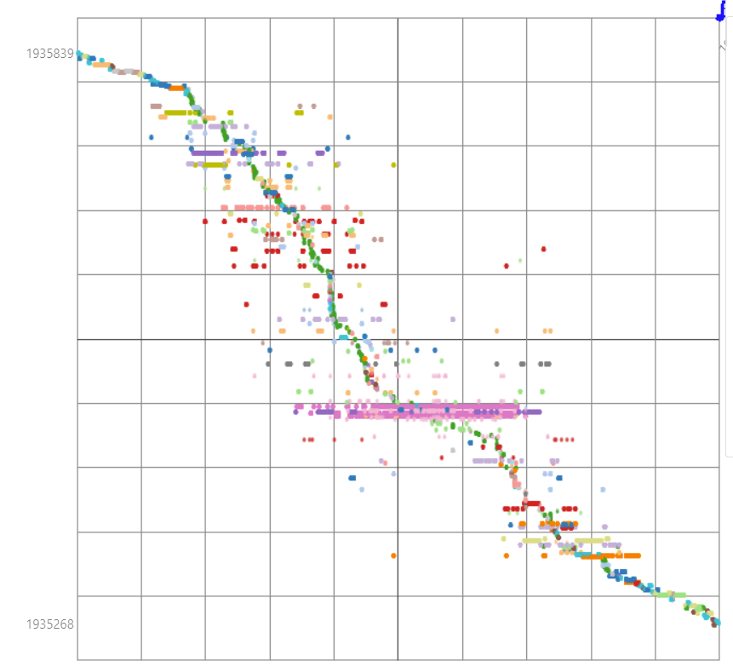
Dymat3D
Weekly report

Slide 2
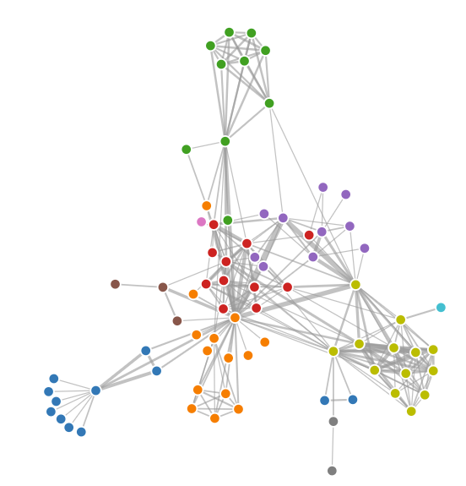
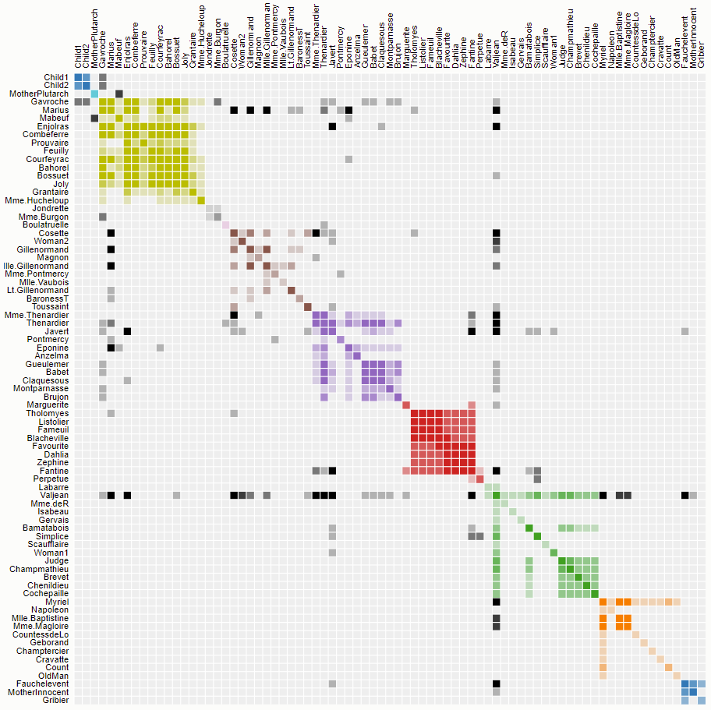
Idea
https://bost.ocks.org/mike/miserables/
A cell represents a link
Network
Adjacency matrix

Slide 3
Idea
https://bost.ocks.org/mike/miserables/
Easy to trace
Avoid link crossing
Network
Adjacency matrix

Slide 4
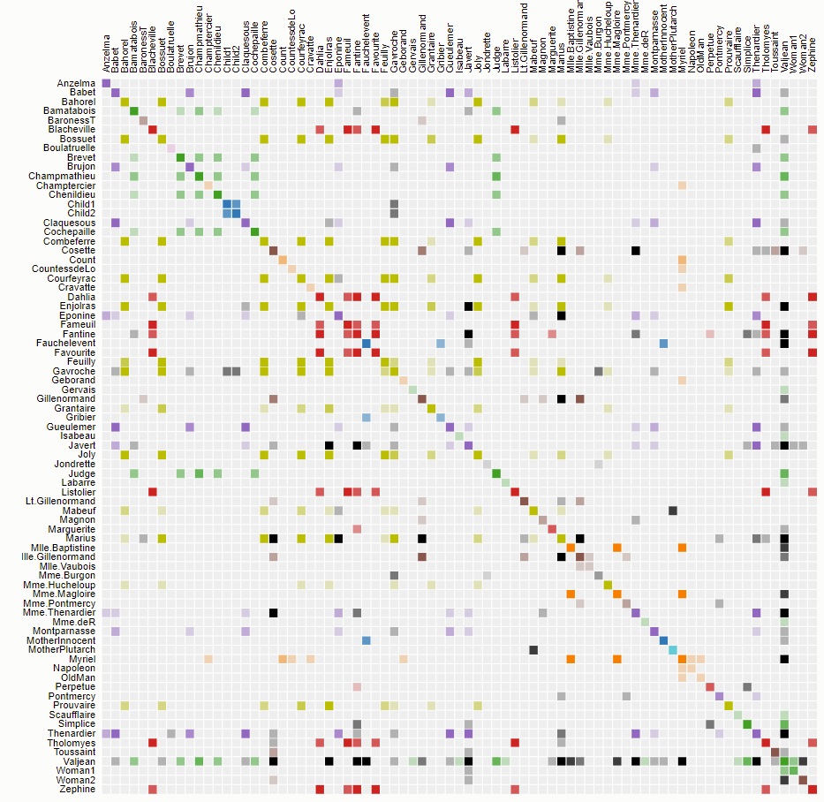
Idea
Depend on order of axes
Order by Cluster
Order by Name

Slide 5
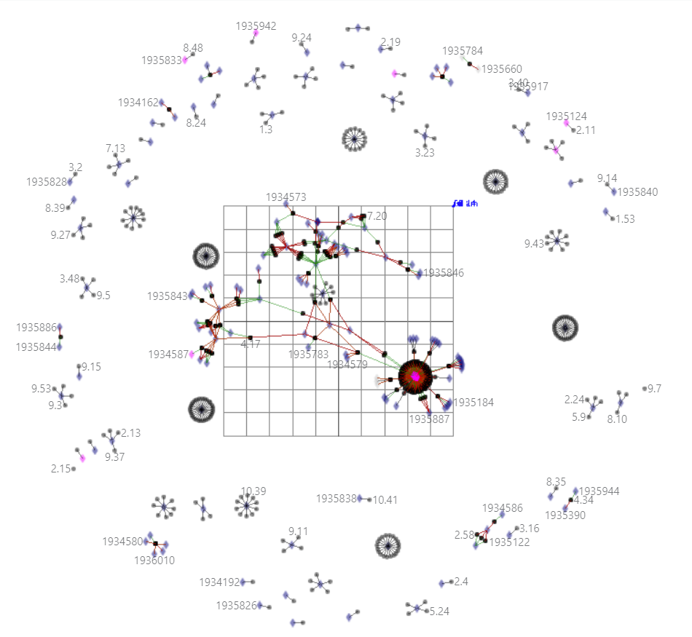
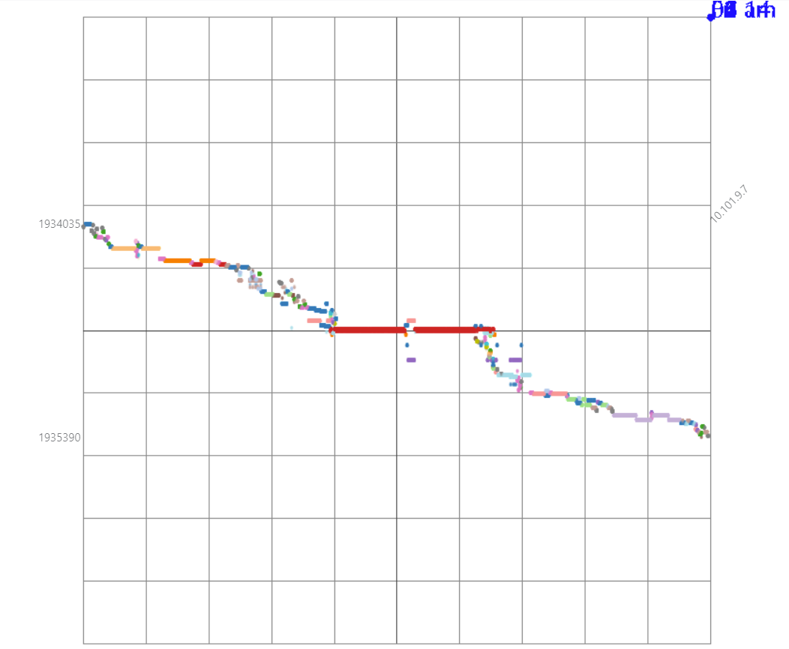
Dymat3D
Quanah Cluster
100 time steps
467 nodes
43 users
159 job IDs
Job v.s. Compute
Dynet3D
Dymat3D

Slide 6
Dymat3D
Job v.s. Compute
Nodes
Job ID
Color by User

Slide 7
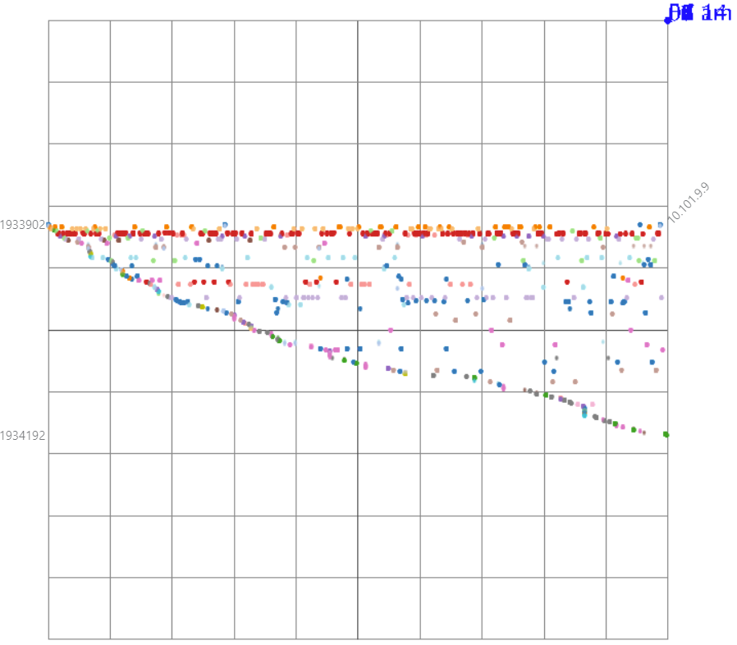
Dymat3D
Job v.s. Compute
Ordering by Node’s name
Ordering by Dynet3D
Jobs order by Node
Ordering by Dynet3D

Slide 8
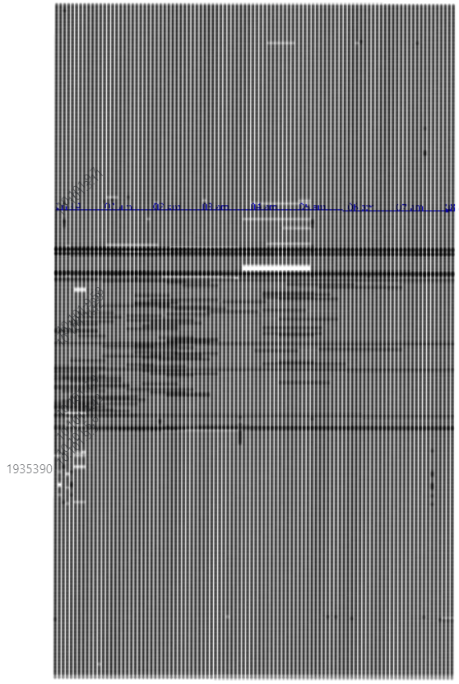
Dymat3D
Top view
Multi-job running
No job running during that time in 2 compute

Slide 9
Dymat3D
Using same set of nodes

Slide 10
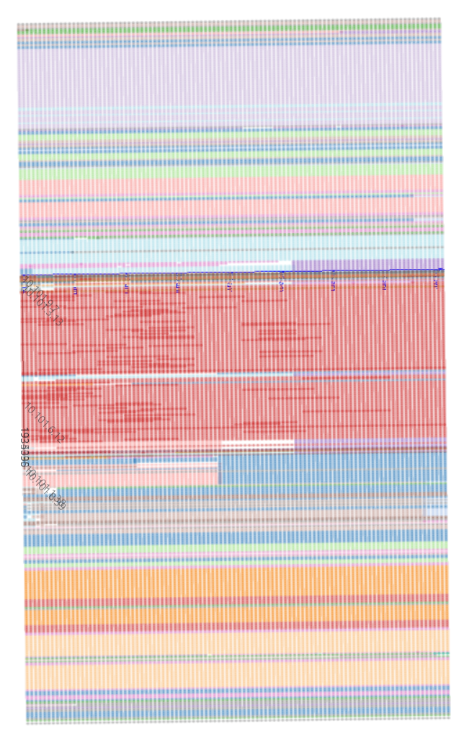
Dymat3D
Top view
No job running during that time in 2 compute

