Slide 1
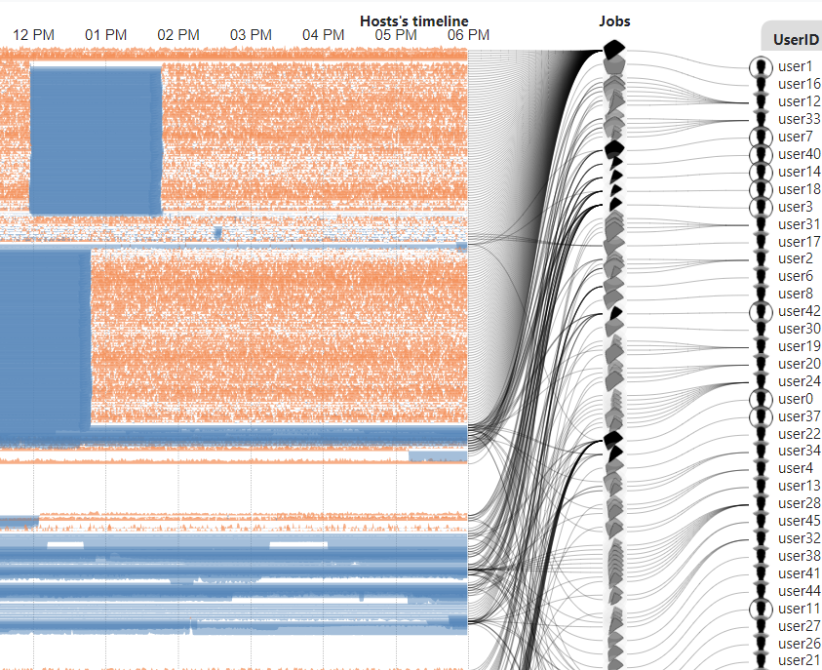
Power Map
Weekly report

Slide 2
From June 17, 2021 6:00 to 12:00
72 timesteps (5 minutes interval)
24 users
968 jobs/job arrays (968 job ids)
computes
5 metrics: power, mem_power, mem_usage, cpu_power, cpu_usage

Slide 3
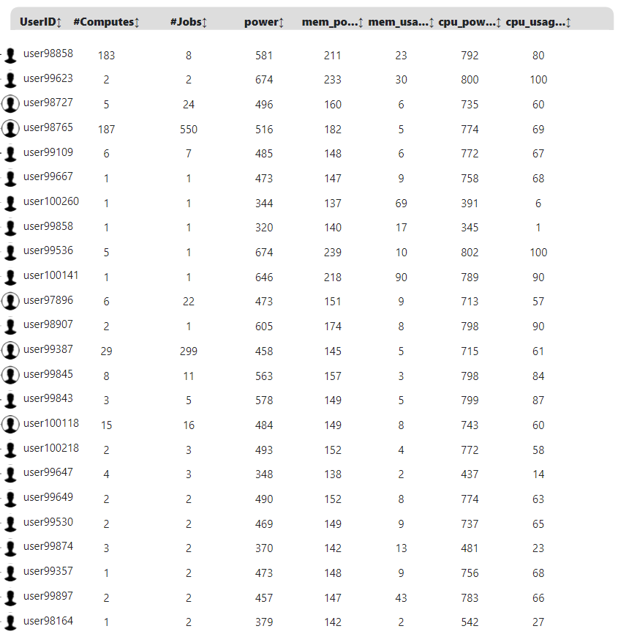

Power Map
https://idatavisualizationlab.github.io/HPCC/PowerMap/index.html
Users
Jobs
Computes
PowerMap auto collapse user with more than 10 jobs
Collapsed user : all jobs will display as 1 summary job only
Normal user: all jobs display

Slide 4
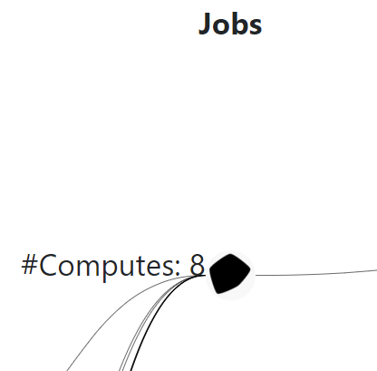

Power Map
https://idatavisualizationlab.github.io/HPCC/PowerMap/index.html
power
Users
Jobs
cpu_usage
mem_power
Computes
cpu_power
mem_usage
jobs: include multi job ids (job array/ summary job)
Single job

Slide 5
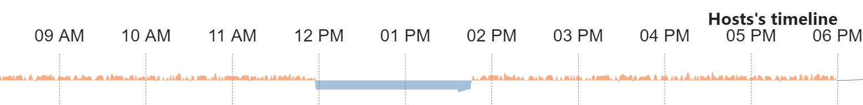
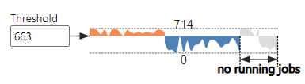
Power Map
https://idatavisualizationlab.github.io/HPCC/PowerMap/index.html
Users
Jobs
Computes
Orange: above Threshold
Blue: below Threshold

Slide 6
Power Map
User list
jieyao
jkorstia
luccorte

Slide 7
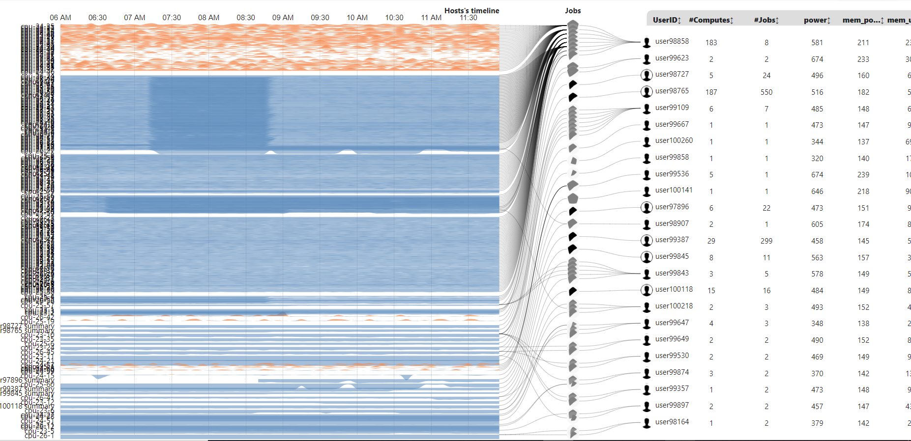
Power Map
Threshold: 675 watt
Power

Slide 8
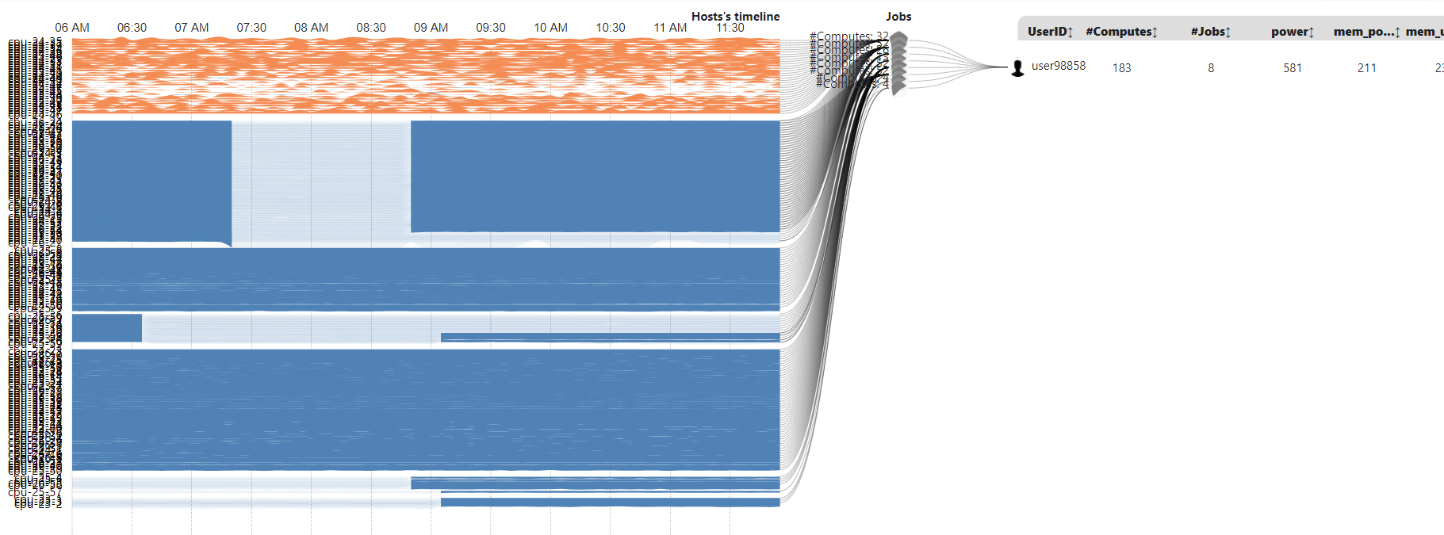
Power Map
Mouseover User/Job | Highlight running duration on compute
Jieyao
2 jobs sequence on same set of computes

Slide 9
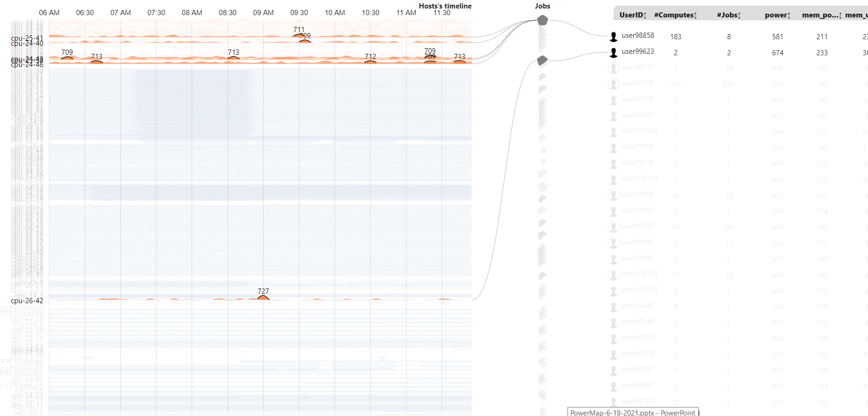
Power Map
Threshold: 675 watt
Power | 10 highest peaks
fmolajaf

Slide 10
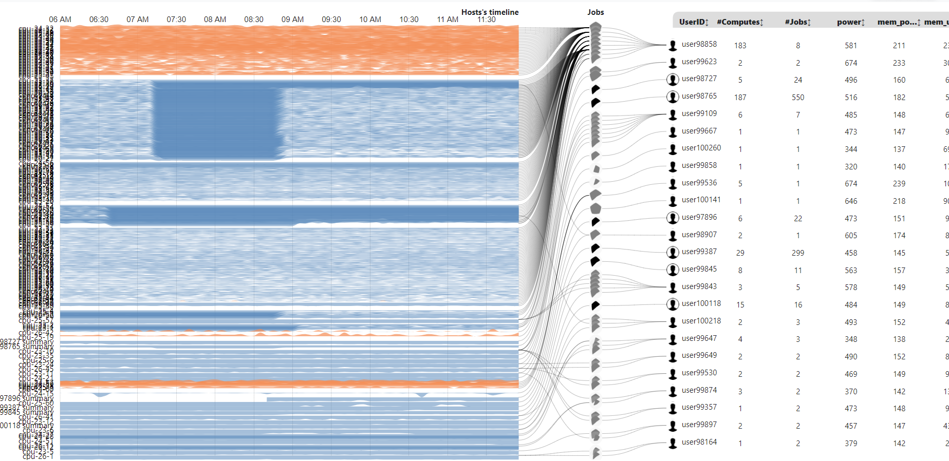
Power Map
Threshold: 230 watt
Mem_power

Slide 11
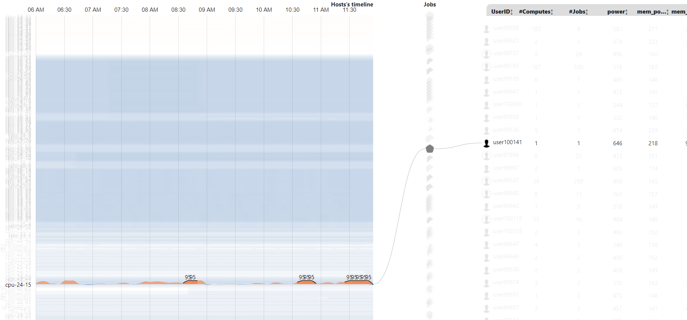
Power Map
Threshold: 88 %
Mem_usage | 10 highest peaks
qying

Slide 12
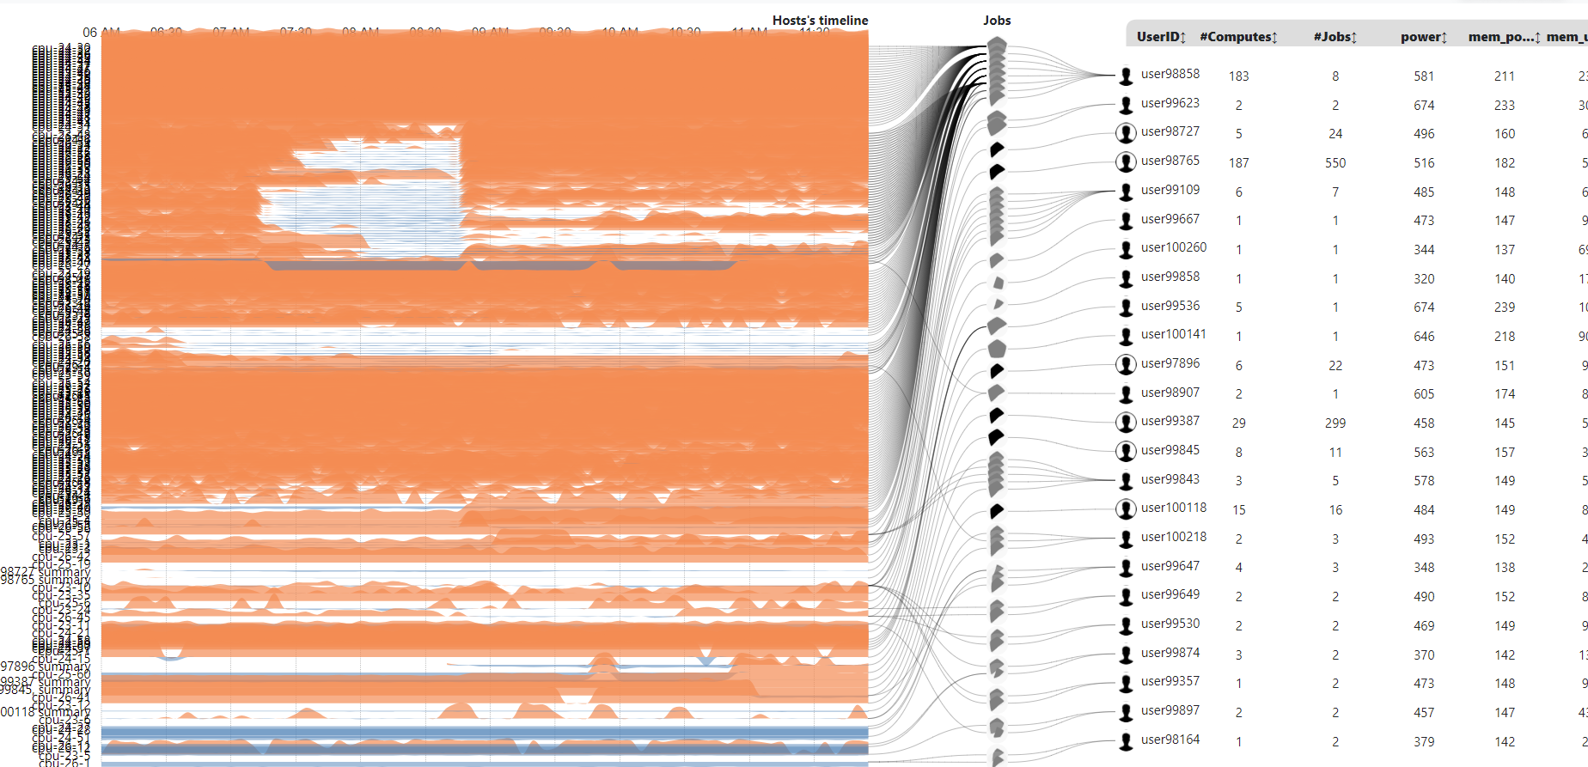
Power Map
Threshold: 790 watt
cpu_power

Slide 13
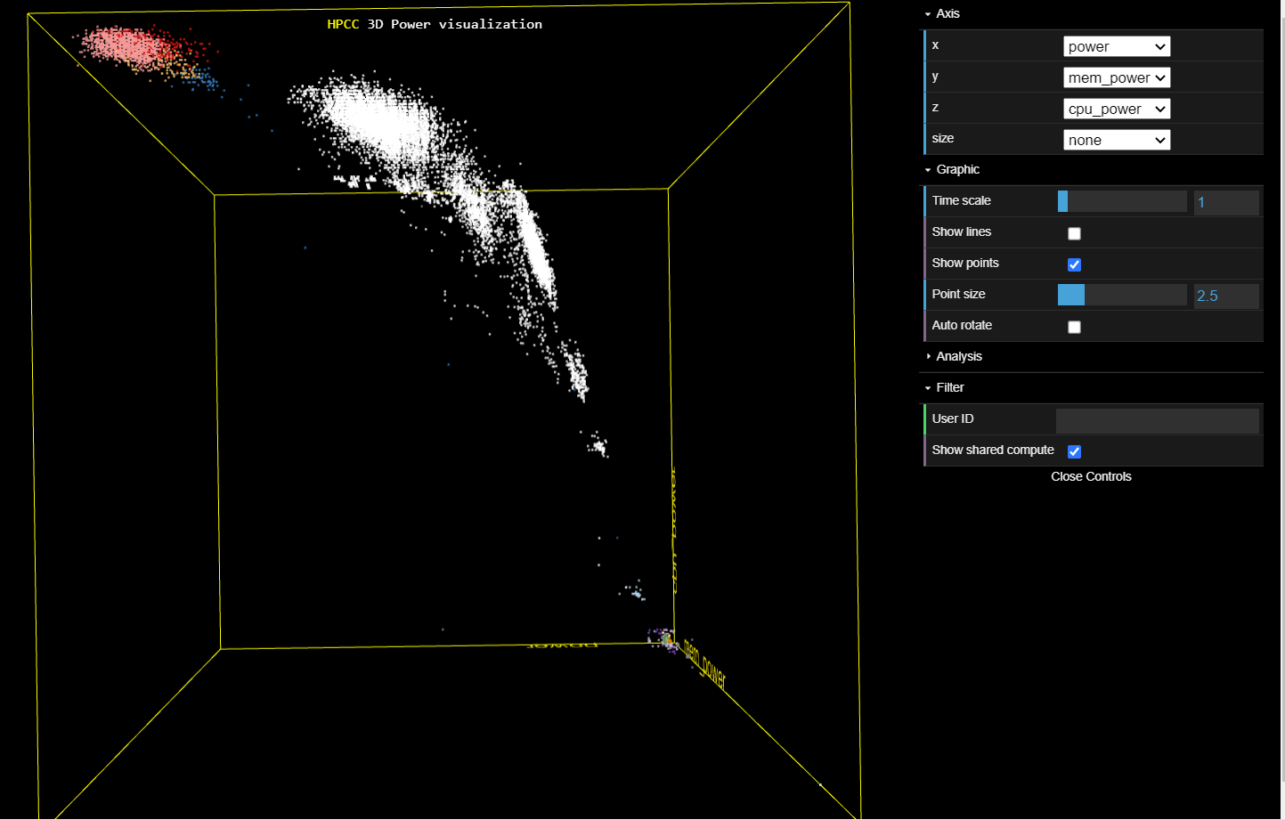
3D Power
https://idatavisualizationlab.github.io/HPCC/3Dcube/index.html

