Slide 1
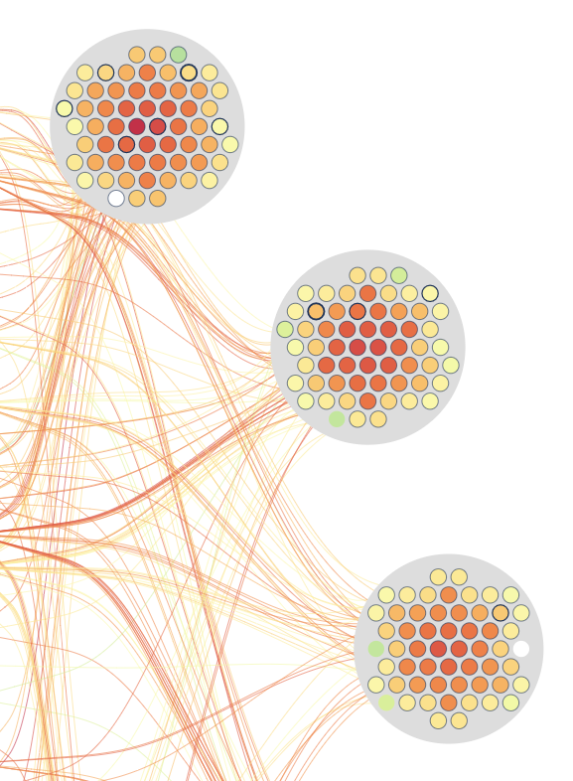
Variable contribution to distinguish User
Weekly report

Slide 2
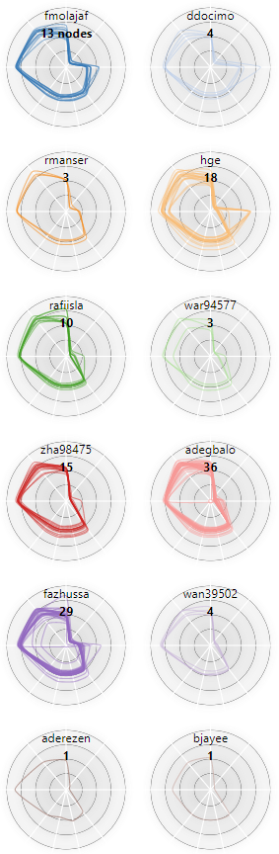
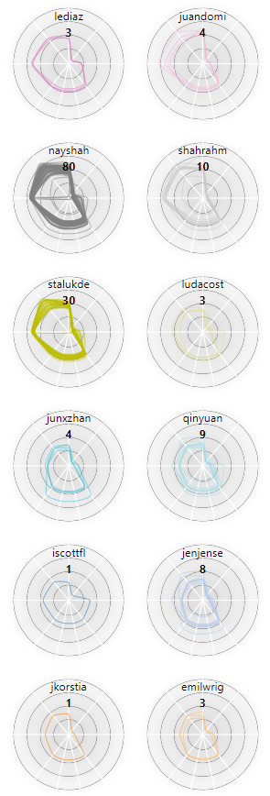
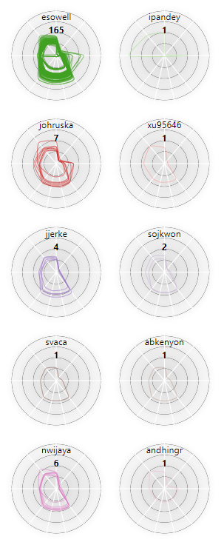
JobViewer
User’s characteristic
Sep 2, 2020 2:50:00 PM – Sep 3, 2020 2:50:00 PM
Duration: 24 hours
Interval: 5 minutes
#Timesteps: 288
#Users: 57
#Computes: 467
Sep 3, 2020 9:45:00 AM
34 Users

Slide 3
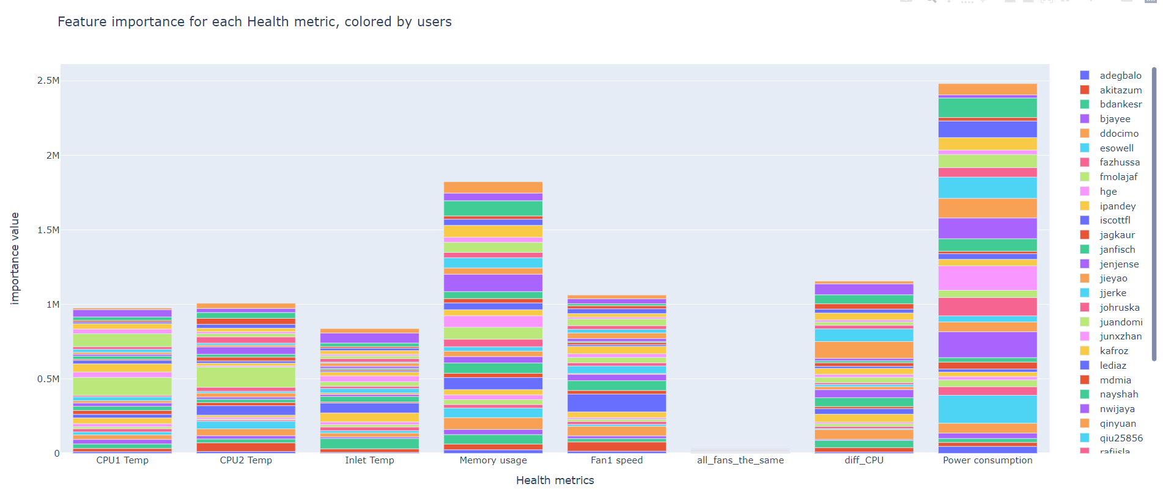
Variable contribution to distinguish User

Slide 4
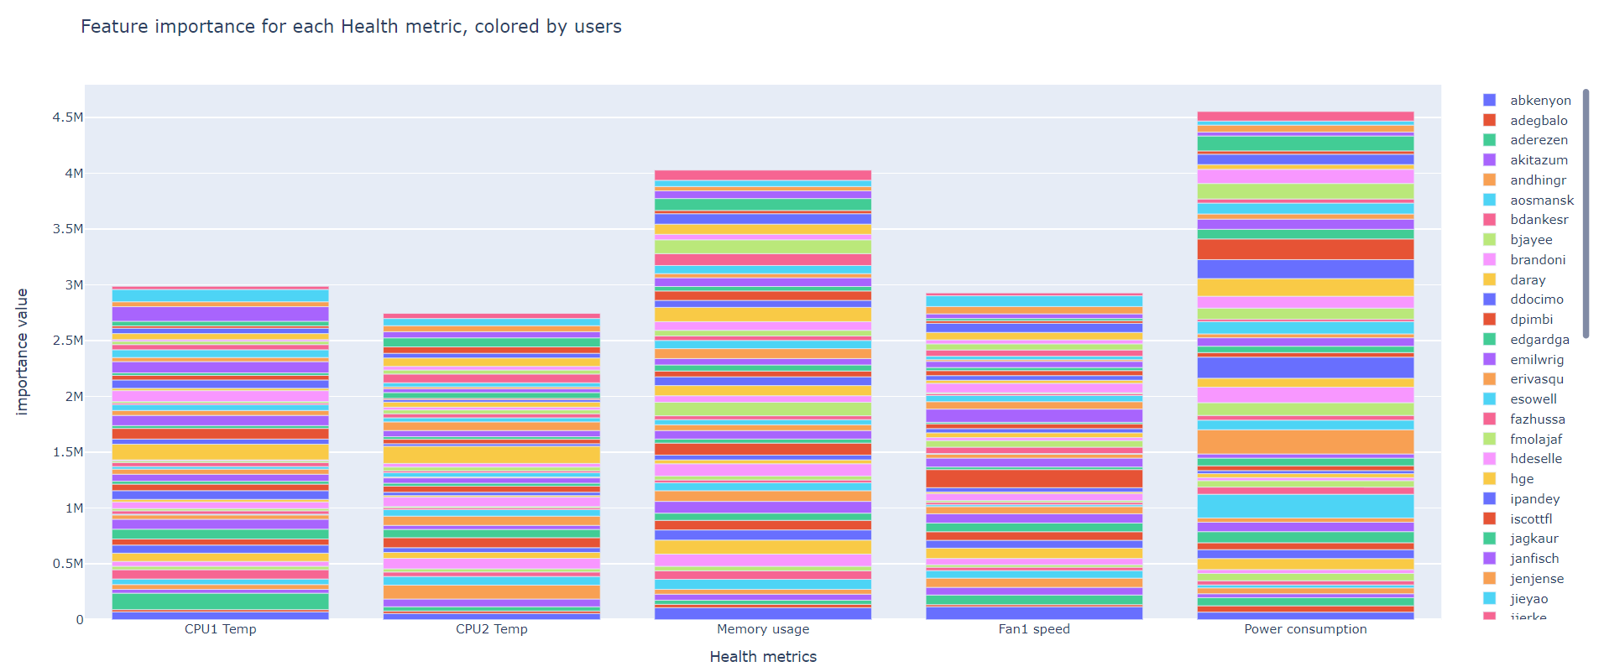
Variable contribution to distinguish User

Slide 5
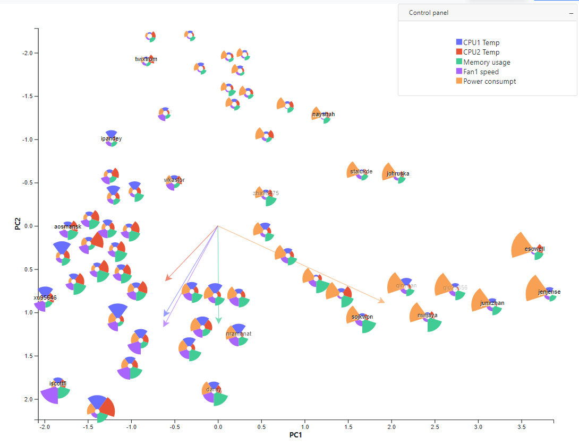
Variable contribution to distinguish User

