Slide 1
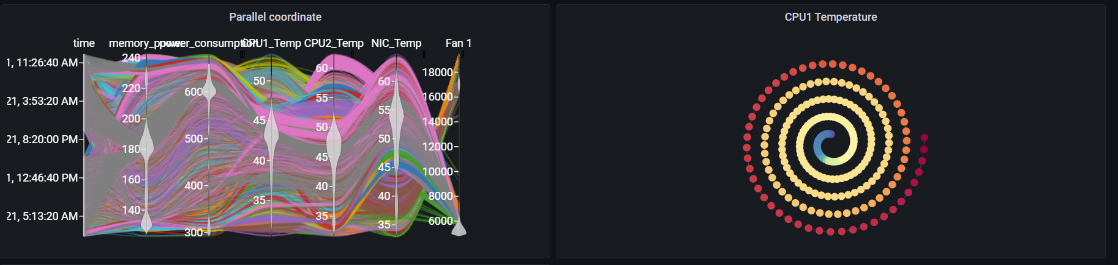
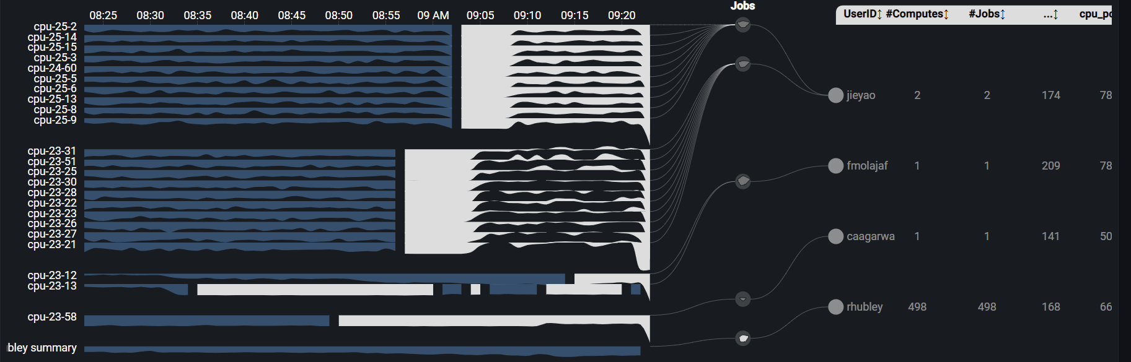
Grafana Plugin
Weekly report

Slide 2
Issue
We have a report from one of our most intense users, Jie Yao, who has trouble running large jobs with many nodes due to intermittent problems on certain nodes. He flags two nodes in particular in the message below. He says: "I feel that several nodes have connection issues (e.g., 23-44, 25-22), and jobs running on these nodes always fail after a few hours."
Partition JobID JobName NNodes State ExitCode End
---------- ------------ ------------------------- -------- --------------- -------- -------------------
nocona 3559319 PIPERe5K 128 FAILED 9:0 2021-10-19T12:37:10
nocona 3559320 PIPERe5K 128 FAILED 9:0 2021-10-19T12:48:46
nocona 3559321 PIPERe5K 128 FAILED 9:0 2021-10-19T21:08:38
nocona 3559322 PIPERe5K 128 FAILED 9:0 2021-10-22T11:42:22
nocona 3625865 OCFKS 32 FAILED 1:0 2021-10-18T22:05:11
nocona 3635228 Re180L 2 FAILED 2:0 2021-10-19T23:21:51
nocona 3635391 OCFKS 32 FAILED 1:0 2021-10-22T02:52:30

Slide 3
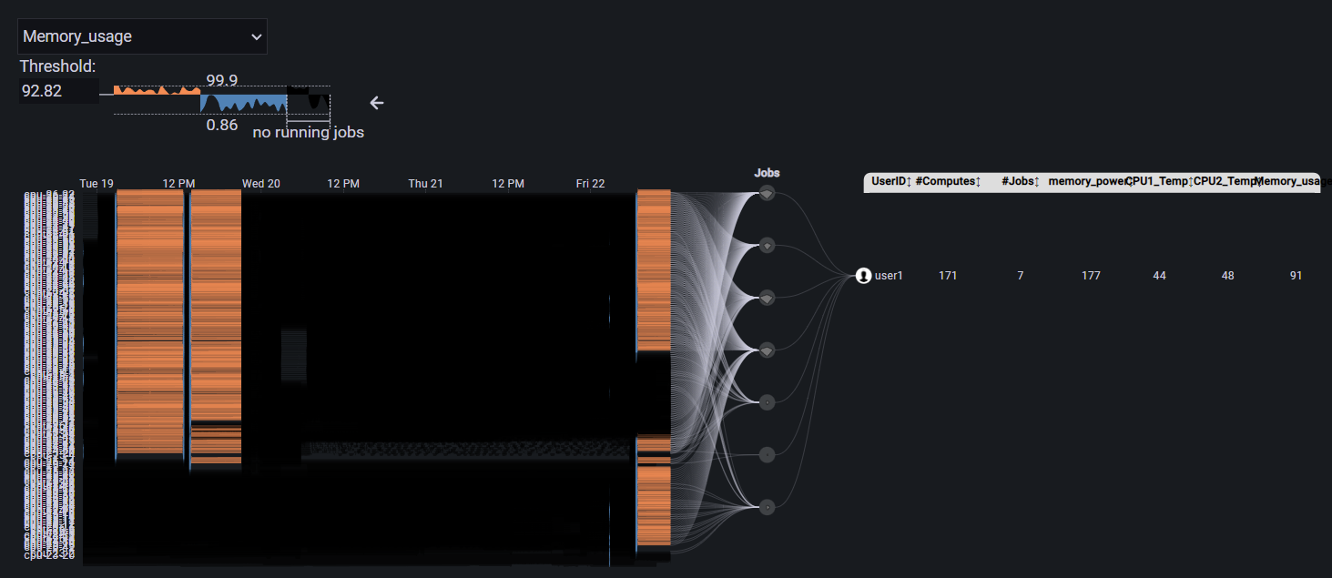
Memory usage
Average memory usage of all job listed is 91%
Memory_power
Memory_usage
CPU1 Temp
CPU2 Temp
3559319
3559321
3559322

Slide 4
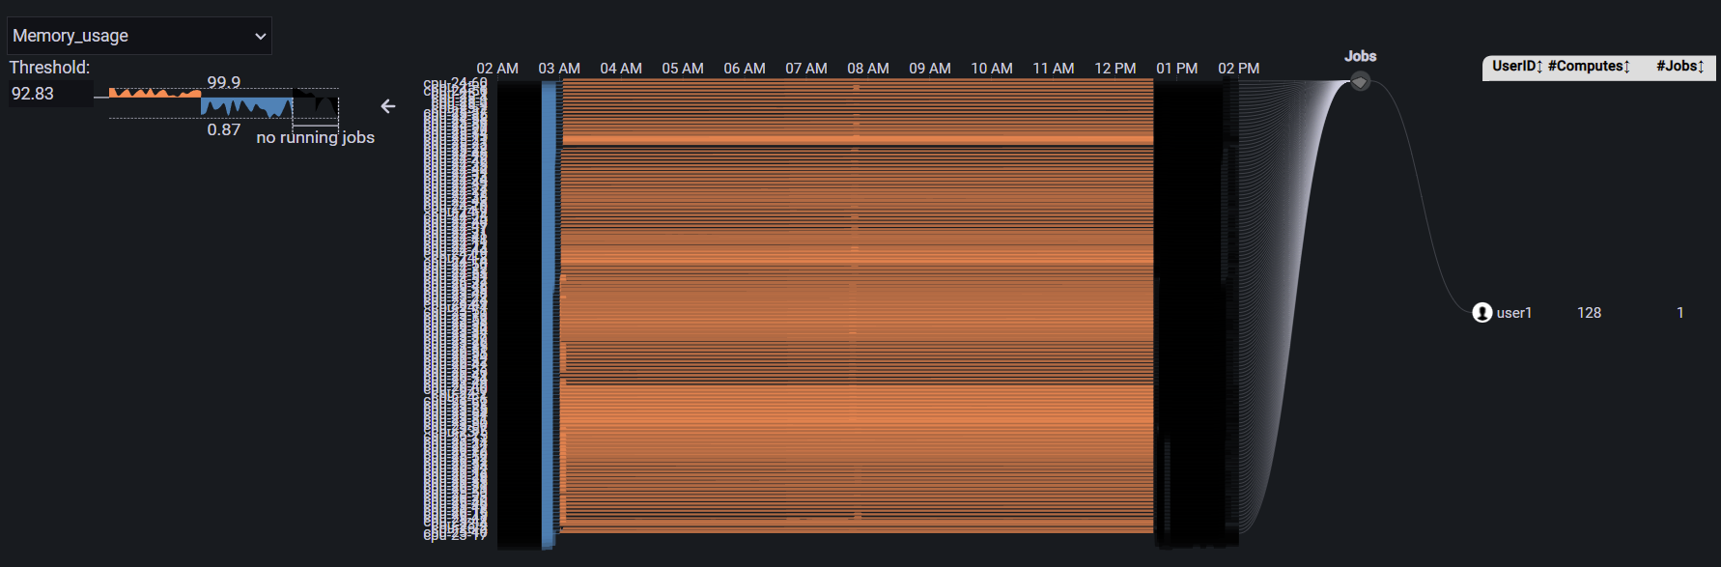
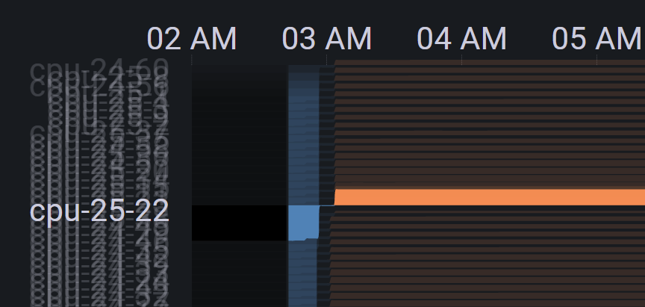
Memory usage
3559319 run on 128 nodes and all of the node have extremely high memory_usage.
After running in about several minute. The memory suddenly increased until job fail

Slide 5
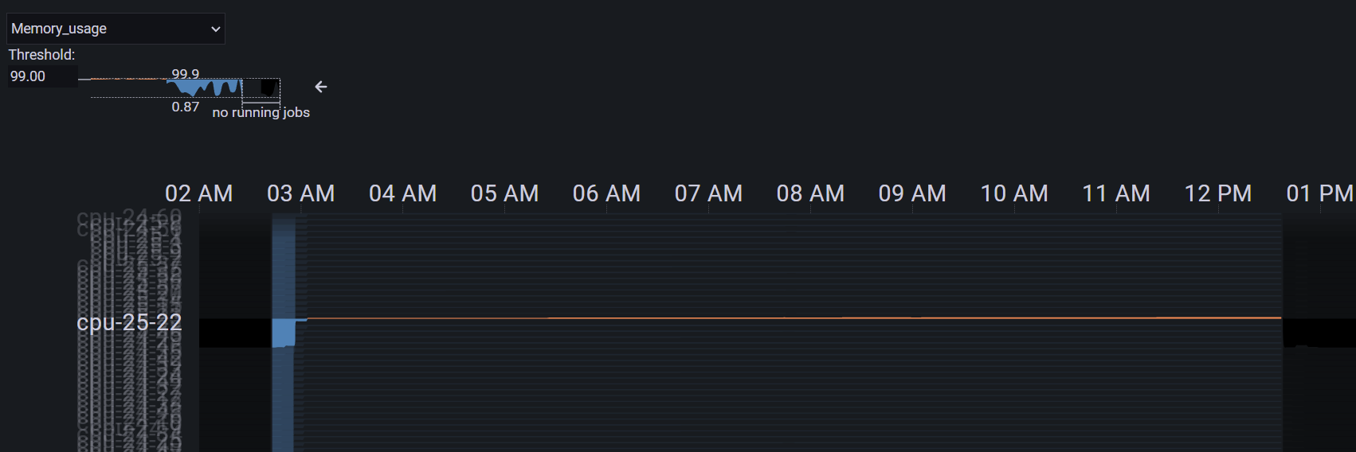
Memory usage
cpu-25-22 go over 99%

